Slide 1

Neural Network Project on Deep Compression
Angelo Catalani 1582230

Slide 2
Introduction
Neural Network are both computationally intensive and memory intensive
Compressing a neural network with pruning and quantization and low loss of accuracy is the aim of this project
Learning both Weights and Connections for Efficient Neural Networks (Song Han, Jeff Pool, John Tran, William J. Dally )
Deep Compression :Compressing Deep Neural Networks With Pruning, Trained Quantization And Huffman Coding (SongHan, HuiziMao, JohnTran, J.Dally )
Deep Compression
Pagina <number>

Slide 3
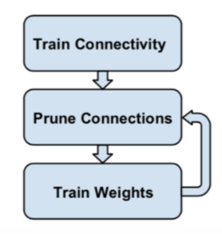
Pruning (1)
Train connectivity :
  learn the connection, not the final weights
Prune connections :
  the hypothesis that the network is over- parametrized
  Reduces memory/complexity requirements and the risk of overfitting
Train weights :
  Otherwise the accuracy will drop (in general)
Deep Compression
Pagina <number>

Slide 4
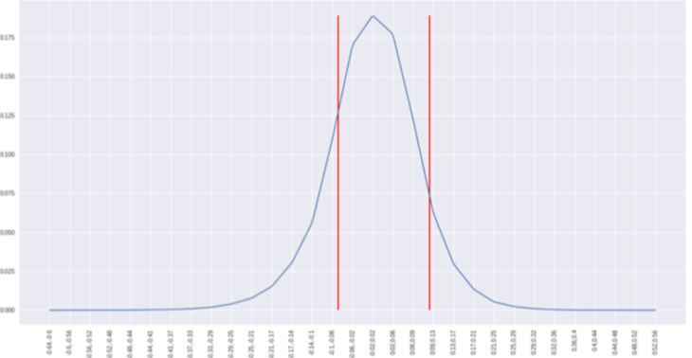
Pruning (2)
Regularization terms in the loss function will make the weights closer to zero :
  L2 has a better accuracy after the pruning than L1 ([1])
Vanishing gradients can not recover from pruning errors:
  Separate the pruning of convolutional and dense layers ([1])
The threshold value is specific for each layer:
  quality parameter x standard deviation
Deep Compression
Pagina <number>

Slide 5
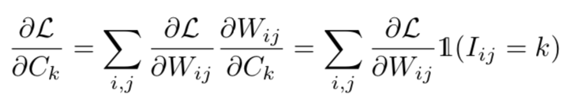
Quantization And Weight Sharing (1)
It is applied to the pruned nerual network
Cluster the weights of each layer :
  Replace the original weights with the centroids they belong to
  Need to store only the centroids
Crucial paramters : bits and centroid initalization
  With n bits, up to 2^n centroids
  More bits, more accuracy, more memory
Fine-tune the centroids
  I have not implemented it
Deep Compression
Pagina <number>

Slide 6
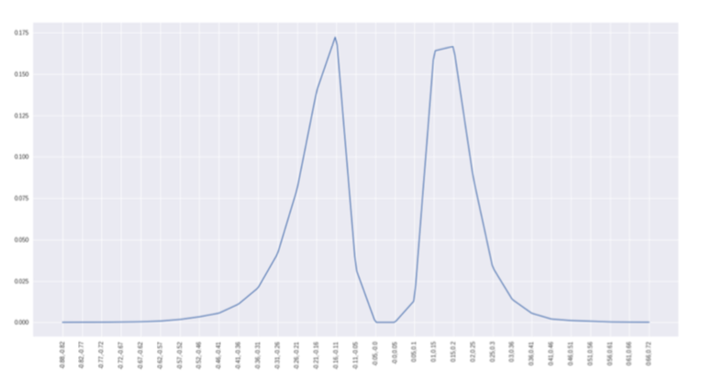
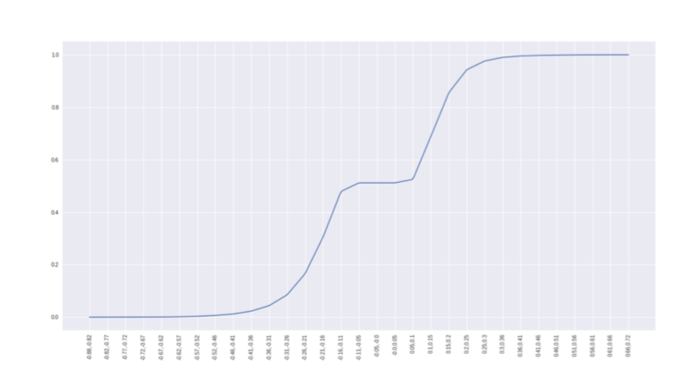
Quantization And Weight Sharing (2) :
Centroid Initialization
Forgy
  Random choice among the weights
  Concentrate around the two peaks
Density
  Span the x-values of the cumulative density function
  Concentrate around the two peaks
Linear
  Span the value from min to max
  High value weights are well represented
Deep Compression
Pagina <number>

Slide 7
Experiment : Test 1 (1)
LeNet300-100
  Fc1 of size 300 with 235200 weights plus 300 bias
  Fc2 of size 100 : 300 · 100 = 30000 weights plus 100 bias
  Fc3 of size 10 : 10·100=1000 weights plus 10 bias
Epochs
  200 for normal train
  30 for pruning
Accuracy
  Before prune 98.24%
  After prune 98.21%
Deep Compression
Pagina <number>

Slide 8
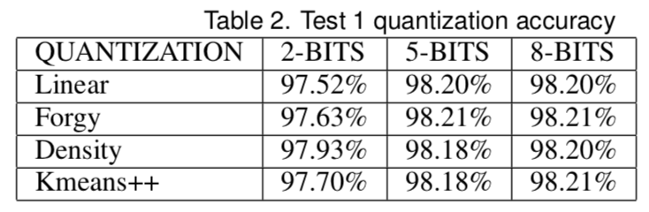
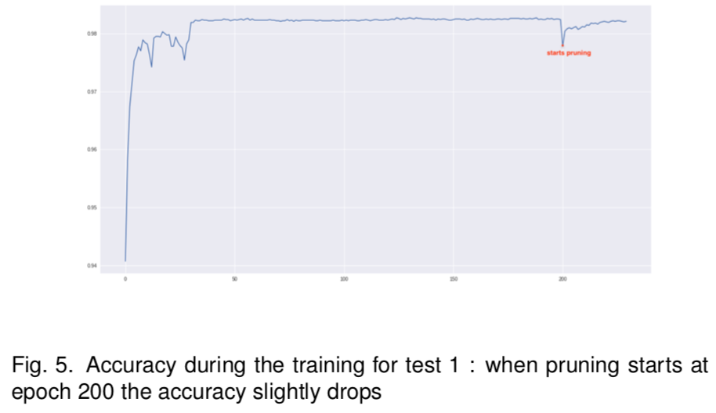
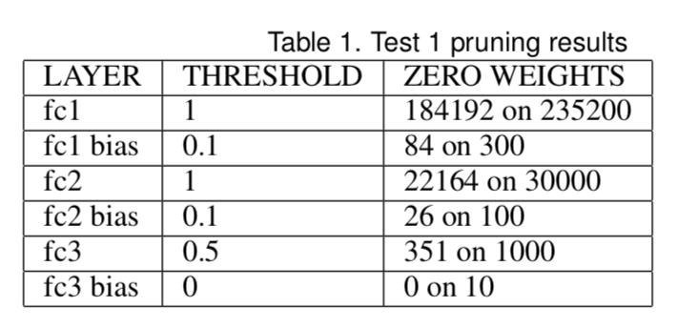
Experiment : Test 1 (2)
Deep Compression
Pagina <number>

Slide 9
Experiment : Test 2 (1)
LeNet300-100
  No regularization term
Epochs
  200 for normal train
  500 for pruning
Accuracy
  Before prune 98.22%
  After prune 96.11%
Deep Compression
Pagina <number>

Slide 10
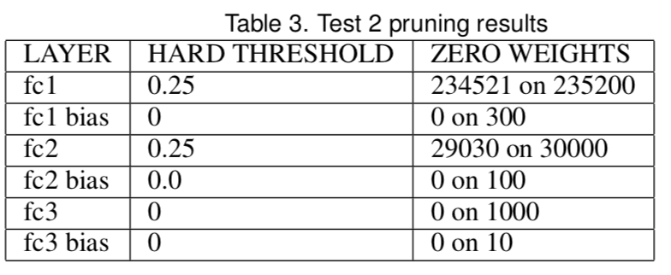
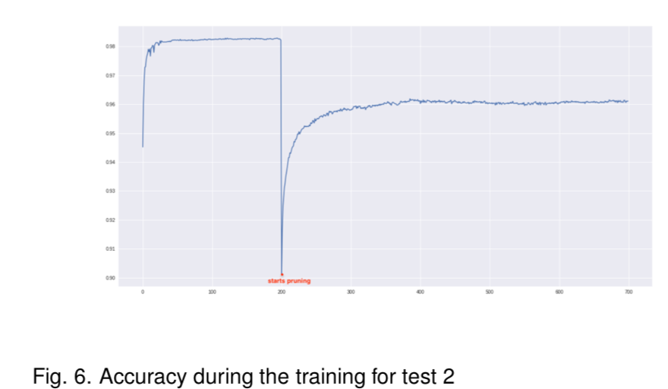
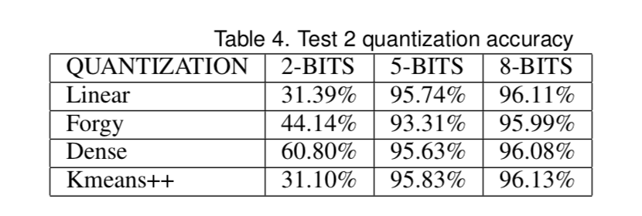
Experiment : Test 2 (2)
Deep Compression
Pagina <number>

Slide 11
Experiment : Test 3 (1)
LeNet5
  Conv1 with 20 filters of shape 5: 20·5·5·1= 500 weights plus 20 bias weights
  Conv2 with 50 filters of shape 5 by 5 : 50·5·5· 20 = 25000 weights plus 50 bias weights
  Fc1 of size 256 : 256·2450 = 627200 weights plus 256 bias weights
  Fc2 of size10 : 10·256 = 2560 weights plus 10 bias weights
Epochs
  70 for normal train
  30 for pruning
Accuracy
  Before prune 99.28%
  After prune 99.34%
Deep Compression
Pagina <number>

Slide 12
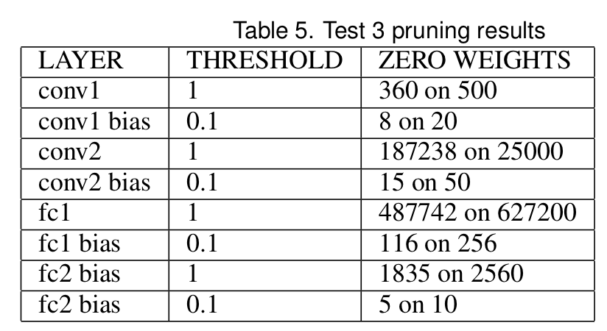
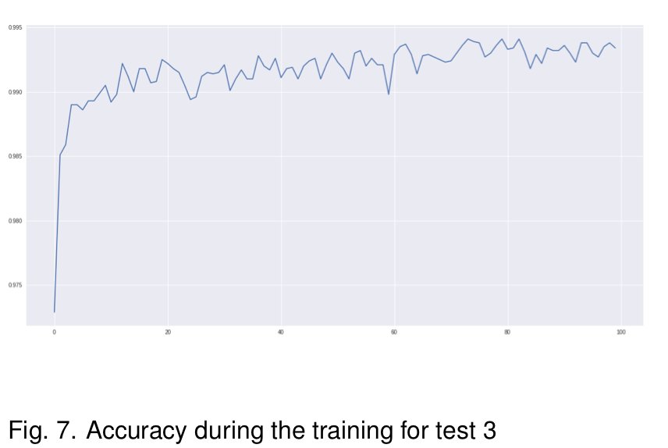
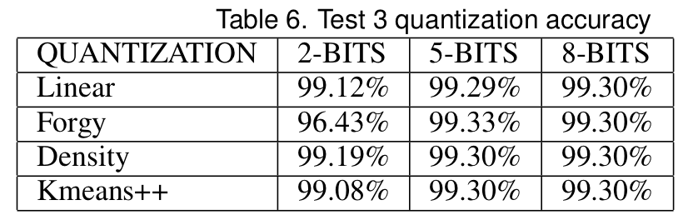
Experiment : Test 3 (2)
Deep Compression
Pagina <number>

Slide 13
Experiment : Test 4 (1)
LeNet5
  No regularization
Epochs
  70 for normal train
  100 for pruning
Accuracy
  Before prune 99.16%
  After prune 99.12%
Deep Compression
Pagina <number>

Slide 14
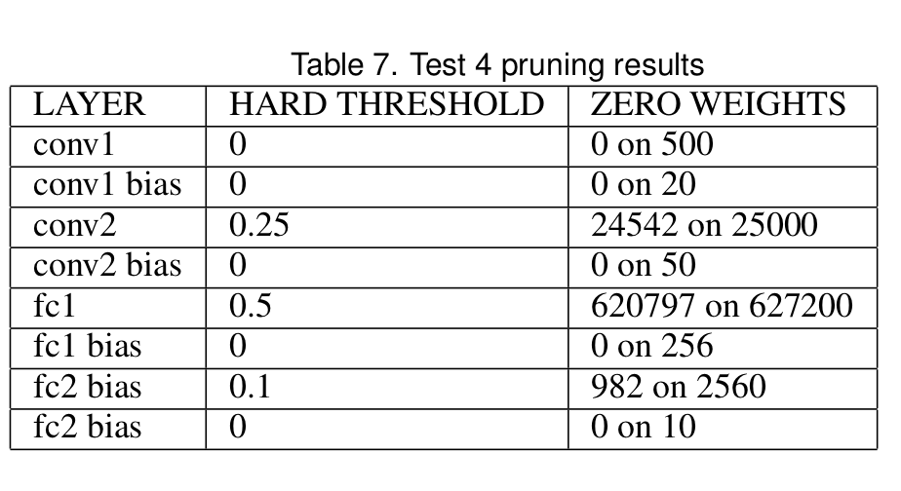
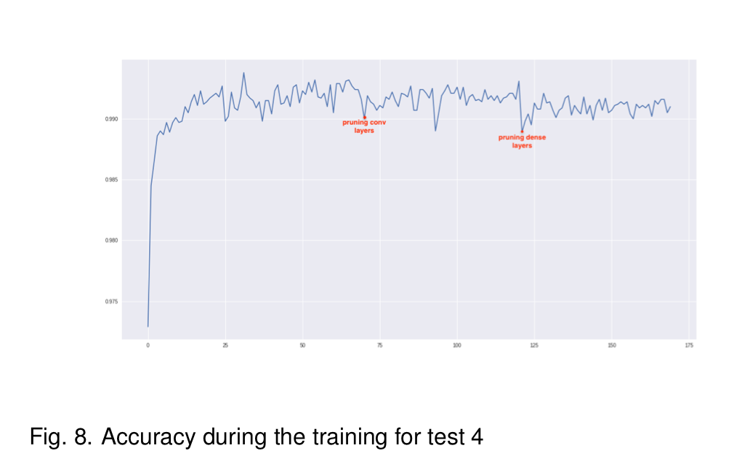
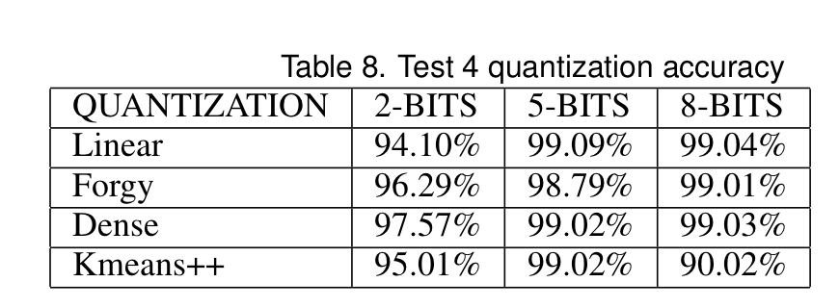
Experiment : Test 4 (2)
Deep Compression
Pagina <number>

