Slide 1

Visual Analytics on World Soccer Statistics
Angelo Catalani
Alessandro Lo Presti

Slide 2
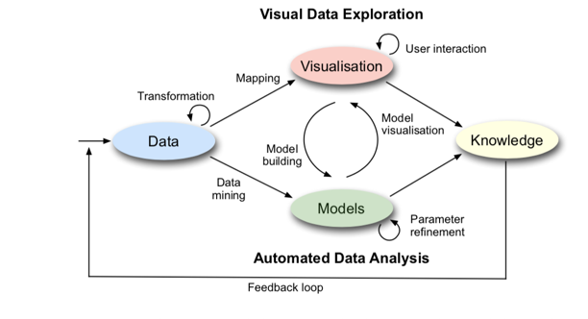
Introduction
Data : International Football Results + Fifa Rank
Visualization : Choropleth Map, Radar Chart, Chord Diagram, Line Graph, Scatter Plot, Time Bar.
Models: Mds, K-means
Knowledge: historical diffusion of soccer and a comparative analysis of soccer teams
Visual Analytics on World Soccer Statistics
Pagina <number>

Slide 3
Data: International Football Results
Original Dataset:
39.669 tuples of 7 features of international football matches from 1872 to 2018
Ex: 1882-02-18, Ireland, United Kingdom, 0, 13, Friendly, Ireland
Transformation:
Integrate the team/country names of the dataset with the GeoJSON map: different names (Eire/Ireland) and missing country(Malta, Tahiti)
Integrate the data with the Time Bar, for a time-based analysis
Final Dataset (a file per year):
played by year.csv : country and games played there (Choropleth Map)
games by year.csv : team, goal-done, goal-done, goal-received, win, lost and draw (Radar Chart)
matrix by year.txt : square matrix of wins (Chord Diagram)
Visual Analytics on World Soccer Statistics
Pagina <number>

Slide 4
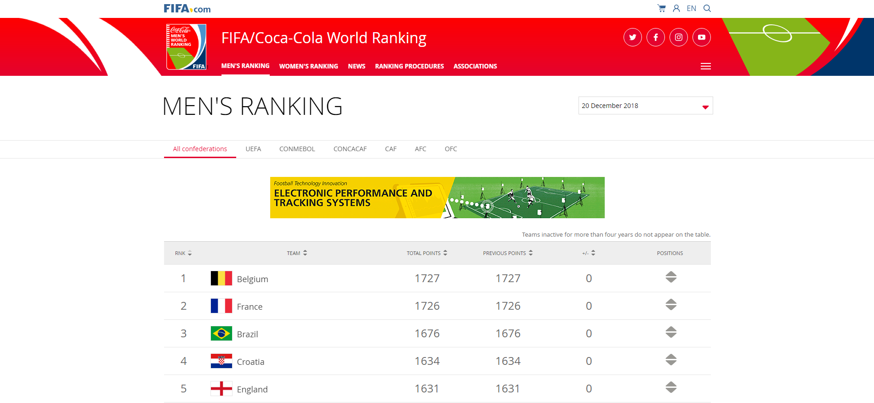
Data: FIFA/Coca-Cola World Ranking (Part 1)
Already available? NO!
Crawling technique needed…
Visual Analytics on World Soccer Statistics
Pagina <number>

Slide 5

Data: FIFA/Coca-Cola World Ranking (Part 2)
A spider analyzed the structure of each target web page referring to each national team and extracted the rank per year.
This kind of web-page scanning was done using the Python library Scrapy.
Original Dataset:
4376 results of 3 features regarding the ranking of 211 teams from 1993 to 2017 (FIFA has not yet computed the final ranking of 2018).
Transformation:
Consistency: number of countries higher than the number of teams
Homogeneity: missing rank-per-year in the considered time-interval (default value = 215)
Final Dataset:
data_rank.json : ranking for each country of the Choropleth Map
Visual Analytics on World Soccer Statistics
Pagina <number>

Slide 6
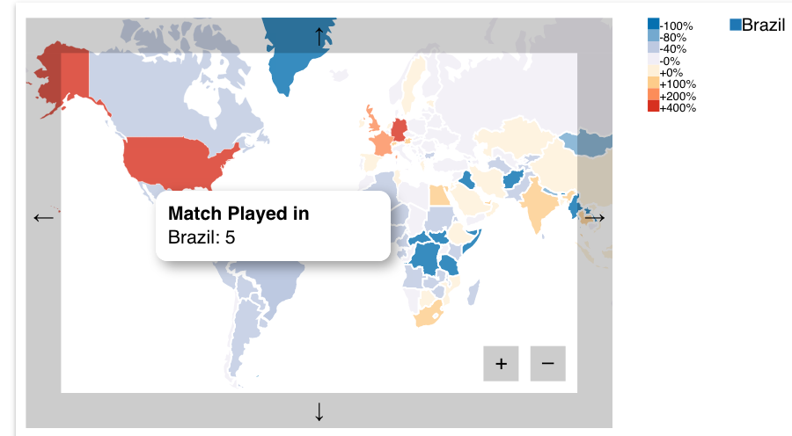
Visualisation: Choropleth Map
Value:
Number of macthes played in a country, normalized with respect the global average
Color scale of 8 values
Interaction:
Zoom/Drag the map to reduce the space occupied
MouseOver a country for the exact value
OnClick to select a country for the other plots
Visual Analytics on World Soccer Statistics
Pagina <number>

Slide 7
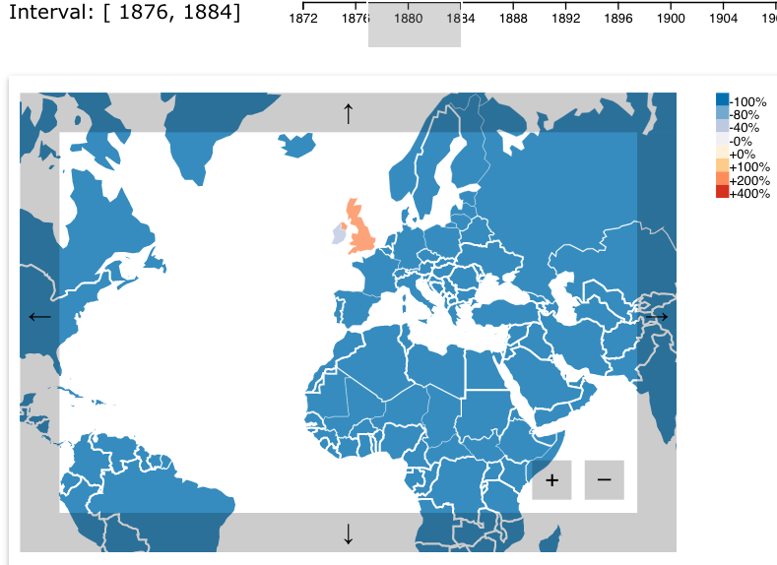
Knowledge: Choropleth Map (Part 1)
Diffusion of Soccer over the time:
from 1871 to 1884, United Kingdom and Ireland were the only countries where soccer was played
Visual Analytics on World Soccer Statistics
Pagina <number>

Slide 8
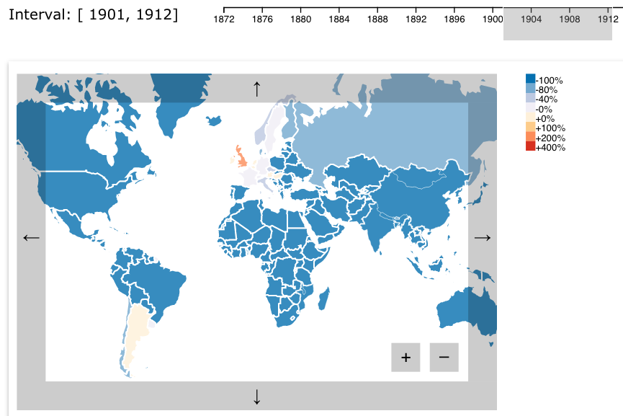
Knowledge: Choropleth Map (Part 2)
Diffusion of Soccer over the time:
from 1901 to 1912 soccer was constantly played in South America, Europe and Russia
Visual Analytics on World Soccer Statistics
Pagina <number>

Slide 9
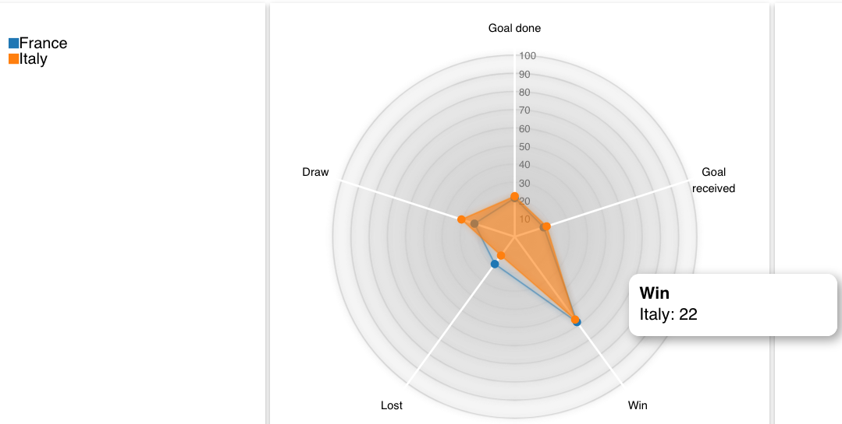
Visualisation: Radar Chart
Value:
Five variables normalized to the total of match played by a country
Color of each polygon is the same of the selected team in the legend
Interaction:
OnMouseOver to get the exact value for that axis and a global comparison
Visual Analytics on World Soccer Statistics
Pagina <number>

Slide 10
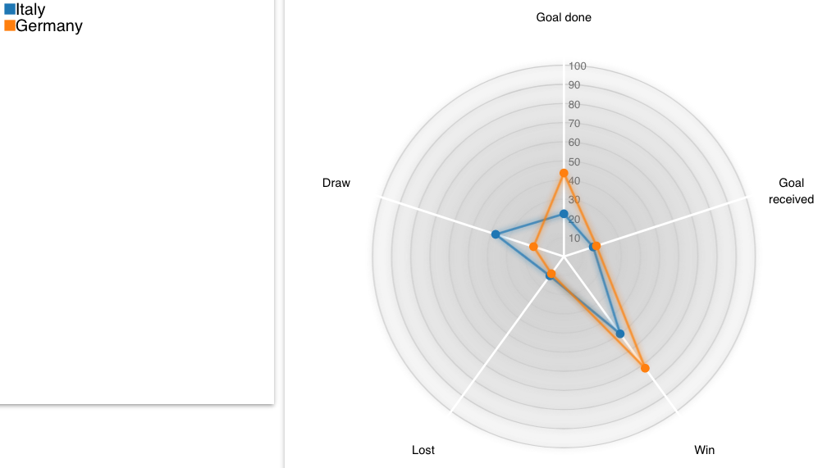
Knowledge: Radar Chart (Part 1)
Was Italy the most prolific (goal and wins) team when it won the World Cup in 2006?
Not really : Germany scored more goal and won more
Visual Analytics on World Soccer Statistics
Pagina <number>

Slide 11
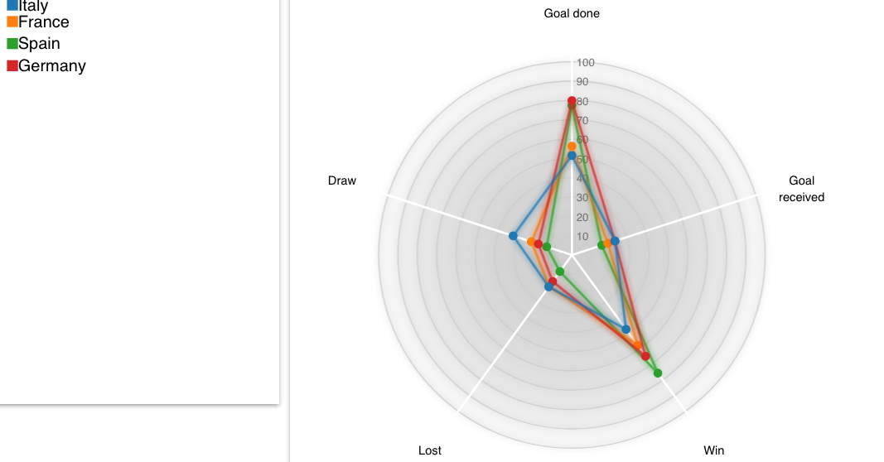
Knowledge: Radar Chart (Part 2)
How did Italy performed after 2006?
Not so good: Italian soccer crisis
Only Germany received more goal, but scored won more
Visual Analytics on World Soccer Statistics
Pagina <number>

Slide 12
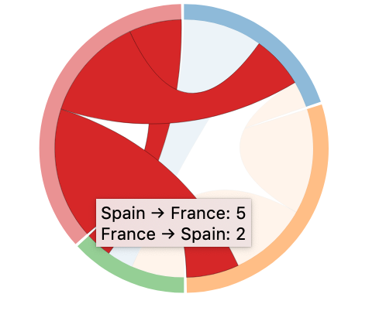
Visualisation: Chord Diagram
Value:
Number of wins of a team against the others in a given time frame
Each arc is proportional to the number of wins
Each chord has the color of the team who won more
Interaction:
OnMouseOver: view the balance of only the selected team
Visual Analytics on World Soccer Statistics
Pagina <number>

Slide 13
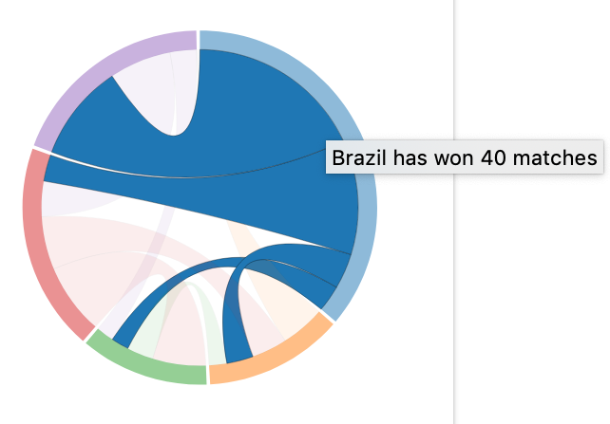
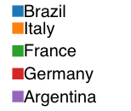
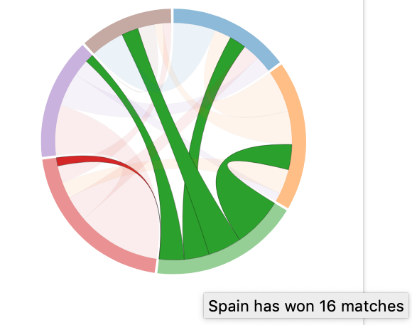
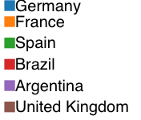
Knowledge: Chord Diagram
Which team has dominated a given period of time:
From 1960 to 1999: Brazil
From 2000 to 2018: Spain
Visual Analytics on World Soccer Statistics
Pagina <number>

Slide 14
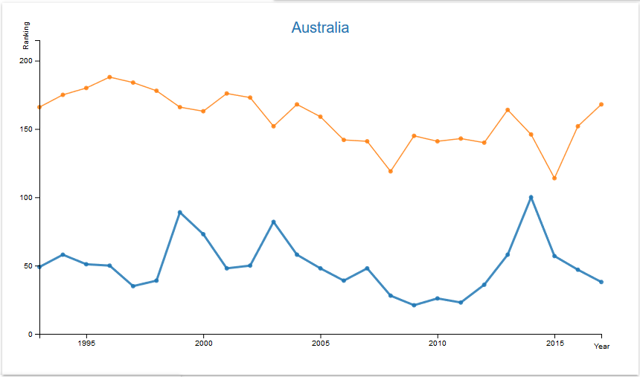
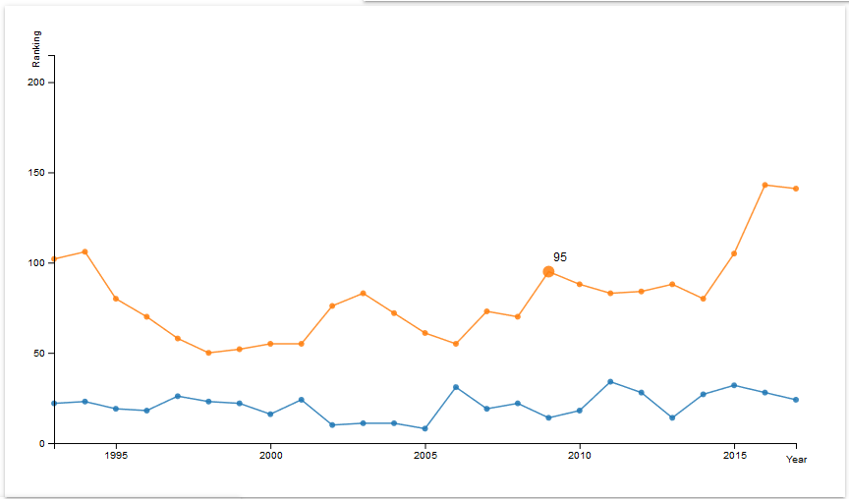

Visualisation: Line Graph
Value:
Rank-per-year of each team from 1993 to 2017
Color of each line is the same of the selected team in the legend
OnMouseOver interaction:
Line: get the name of the team on top of the chart
Circle: get the rank of the team according to the considered year
Visual Analytics on World Soccer Statistics
Pagina <number>

Slide 15

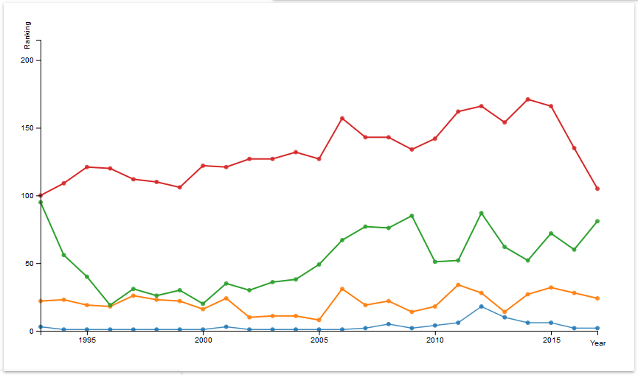

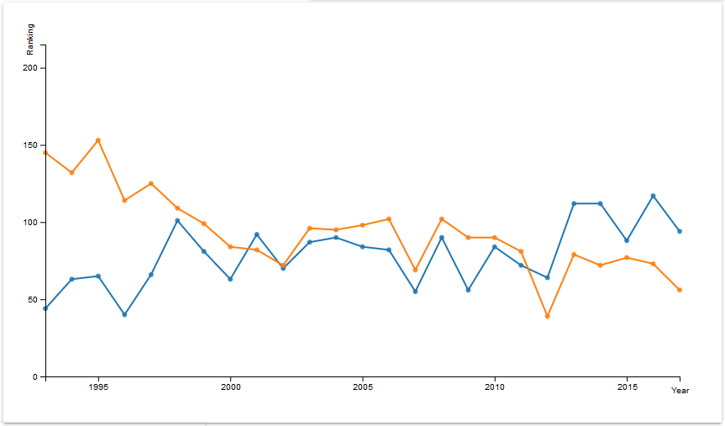
Knowledge: Line Graph
Which of the selected teams has the best ranking score over the last 20 years?
Another useful information…
worst result / best result
Visual Analytics on World Soccer Statistics
Pagina <number>

Slide 16
Scatter Plot
Each point represents a team and the color encodes the cluster it belongs to as we will describe into the k-means section.
Through the mouseover interaction is possible to see what is the selected team and the best rank it got considering all World Cup tournaments.
We decided to show the best FIFA rank to have a quick estimation of the strength of a team and a correlation between FIFA rank and MDS.
(picture in next slides…)
Titolo Presentazione
Pagina <number>

Slide 17
Model: MDS (part 1)
We have considered a dataset where each point that represents a team has 20 features (one for each World Cup), and each of them is as index of how well it performed in that world cup without taking into consideration the qualification phase.
The score is:
+3 for a win
+1 for a draw
The dataset matrix is passed to the MDS algorithm that uses as dissimilarity metric the Euclidean distance and maps the twenty dimensions into two.
Visual Analytics on World Soccer Statistics
Pagina <number>

Slide 18
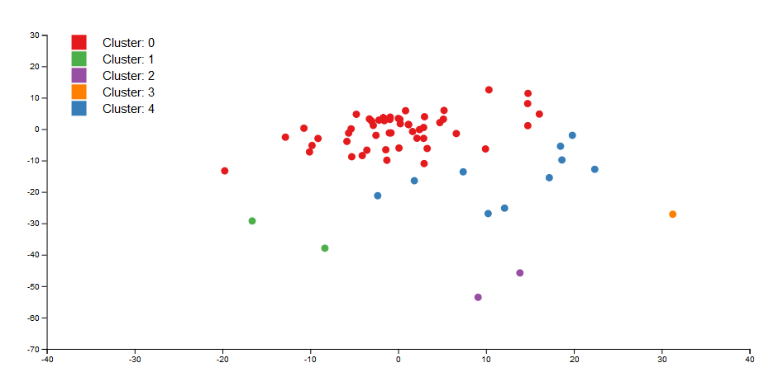
Model: MDS (part 2)
This evaluation represents how similar are teams in terms of constancy over the years in the World Cup competitions, more in detail, how different the corresponding behaviors are according to points gained in each World Cup, thus, how many wins, draws and loses each one had in tournaments.
Examples: Germany – Brazil? Germany – Italy?
Titolo Presentazione
Pagina <number>

Slide 19
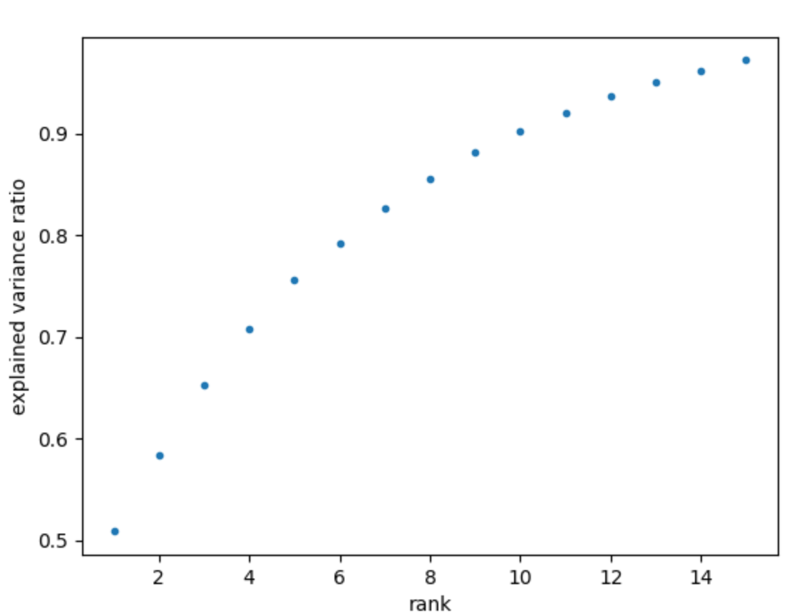
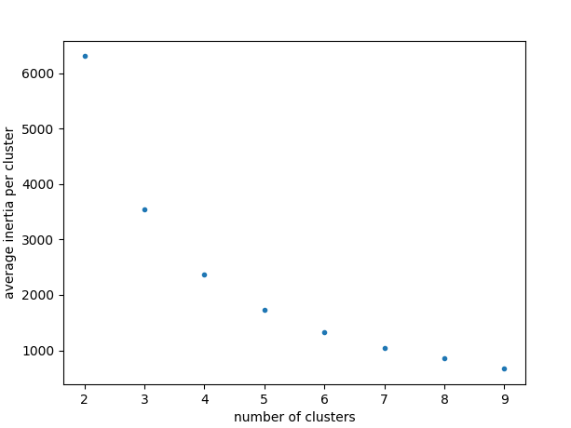
Model: K-means (Part 1)
The data is the same input of Mds
The choice of Truncated-SVD:
15 components: over 90% of variance
The choice of K-means:
K=5: small average inertia
Visual Analytics on World Soccer Statistics
Pagina <number>

Slide 20
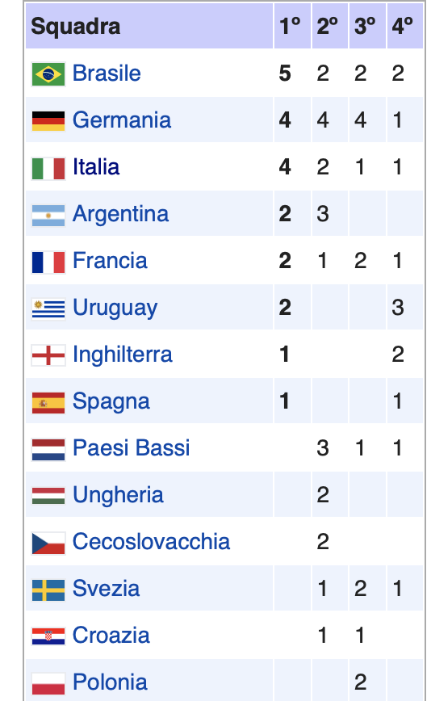
Model: K-means (Part 2)
Meaning of the 4 clusters plotted in the same space of Mds:
Brazil and Germany (yellow)
Italy (blue)
Argentina, Netherlands (orange)
United Kingdom,France, Belgium,Mexico,Spain,Uruguay,Portugal, Russia,Sweden ,Croatia (purple)
Remaining teams (green)
In conclusion: teams who have won a lot, are not always in the same cluster because they have performed differently over the years
Visual Analytics on World Soccer Statistics
Pagina <number>

