Slide 1
Malicious Traffic Classification of Network Intrusion Detection Systems (NIDS)
Skye Jorgensen, Annabelle Crescenzo, Angel Ordonez Retamar

Slide 2
Table of Contents
Background
Problem Statement
Dataset Description
Data Preprocessing
Binary Classification
Logistic Regression
SVM
Multiclass Classification
Decision Trees
ANN
Unsupervised Learning
Conclusion

Slide 3
Background
It is important, more now than ever, that networks are secure. As technology improves, threat actors continue to develop the scale, complexity, and frequency of attacks.
Traditional Signature-based IDS:
Involves comparing active network traffic against a known set of attack signatures and patterns,
Flagging activity that matches.
Challenges:
Struggle to detect new, evolving, or unknown cyberattacks
Requires constant updates to the database of known signatures to remain relevant and effective,
Time-consuming to update
To ensure security, there must be advancements in Network Intrusion Detections Systems (NIDS).

Slide 4
Problem Statement
Our Goal: Create a NIDS that reduces the need for manual intervention in updating the system, adapts to new attack strategies, and effectively identifies malicious activity to protect against cyberattacks
Our Plan:
Utilize supervised ML techniques for Binary Classification
Logistic Regression, SVM
Can consistently and accurately tell if attacks are malicious or benign
Utilize supervised ML techniques for Multiclass Classification
Decision Trees, ANN
Identify the specific attack types (Bot, PortScan, or DDoS)
Implement unsupervised learning
Mimic real-life scenarios where labels are not available
Calculate Information Gain to determine critical attributes of network traffic

Slide 5
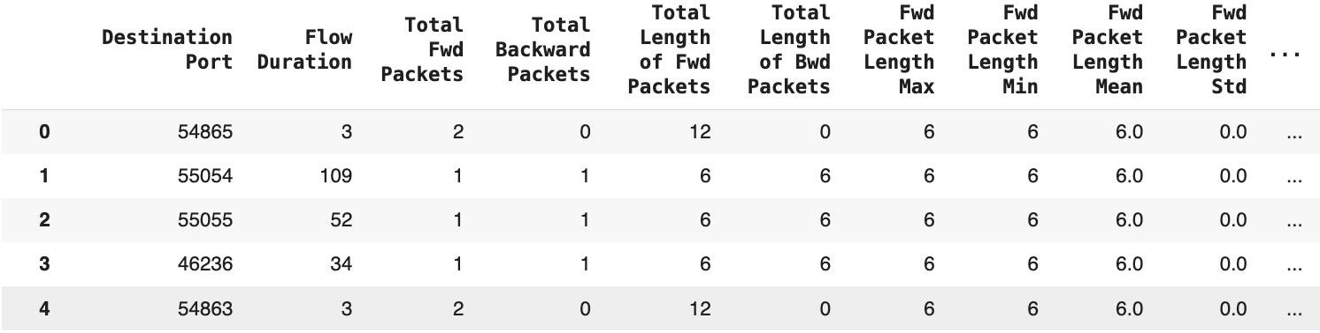
Dataset Description
Source: Canadian Institute for Cybersecurity Intrusion Detection System
Publicly available
Details: 3 files collected on Friday, July 7, 2017 between the hours of 9am and 5pm
Shape:
78 numerical features
703245 observations
Target variable: Traffic Type
Binary: Benign, Anomaly
Multiclass: Benign, PortScan, DDoS, Bot

Slide 6
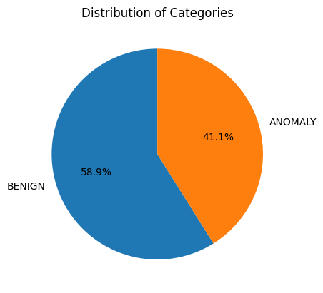
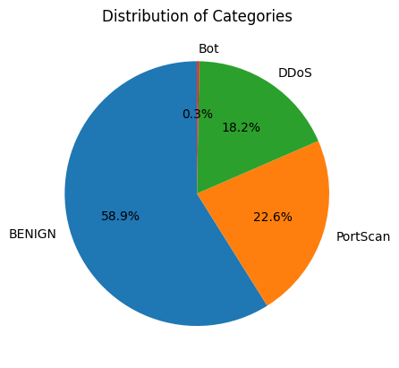
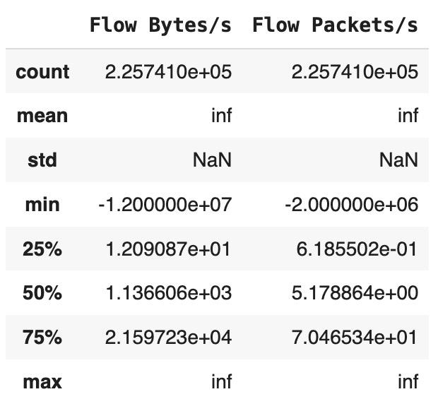
Data Preprocessing
Null and infinite values observed in some features
Removed null observations
Replaced infinite values with medians
Distribution of classes
Imbalanced data
Higher Benign, minimal Bot
Information gain calculated
High dimensional attributes
Chose top 20 features with highest info gain
Used in models to simplify and minimize run time
Split 80% training, 20% testing
Resampling on training dataset
Undersampling to reduce amount of majority class

Slide 7
Binary Classification

Slide 8
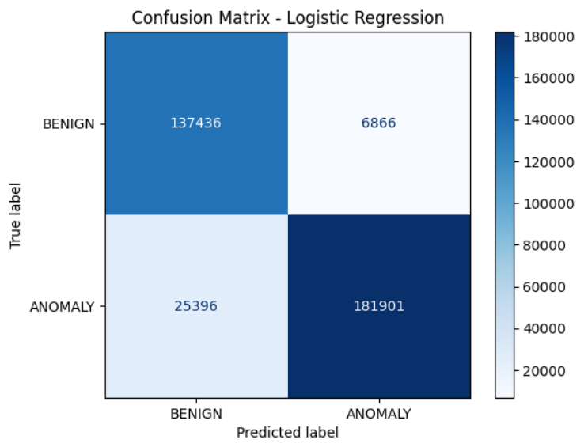
Logistic Regression
Top 20 features, then scaled
GridsearchCV for hyperparameters
3-fold cross-validation
C = 0.01, L1 regularization, saga solver
Accuracy = 91%, precision = 91%, recall = 91%, and F1-score = 91%

Slide 9
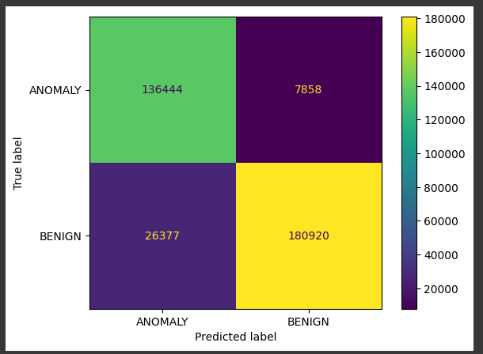
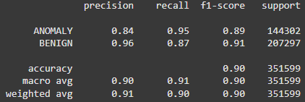
Support Vector Machines (SVM)
Kernel trick was unable to work due to the sheer size of the model
Had to use the Linear SVM
Scaling was required
Performance indicated leaning toward identifying values as anomalies

Slide 10
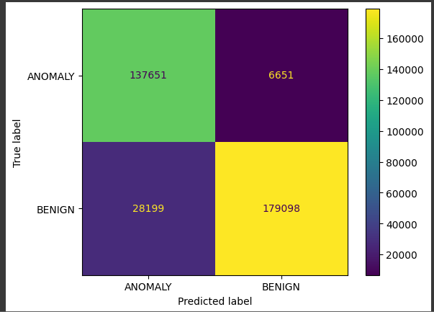
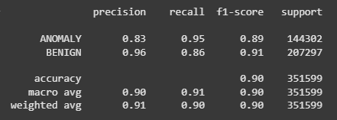
Binary Ensembler Model
Voting methods had to be “hard” because Linear SVM does not support probabilities
Combined both SVM and Logistic Regression
First attempt attempted to use the models previously created
Lower scores and accuracy
Indicates likelihood of our models maybe overfitting
New untrained SVM and Logistic Regression used
More general predictions better

Slide 11
Multiclass Classification

Slide 12
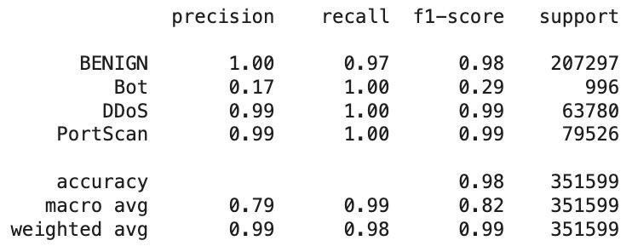
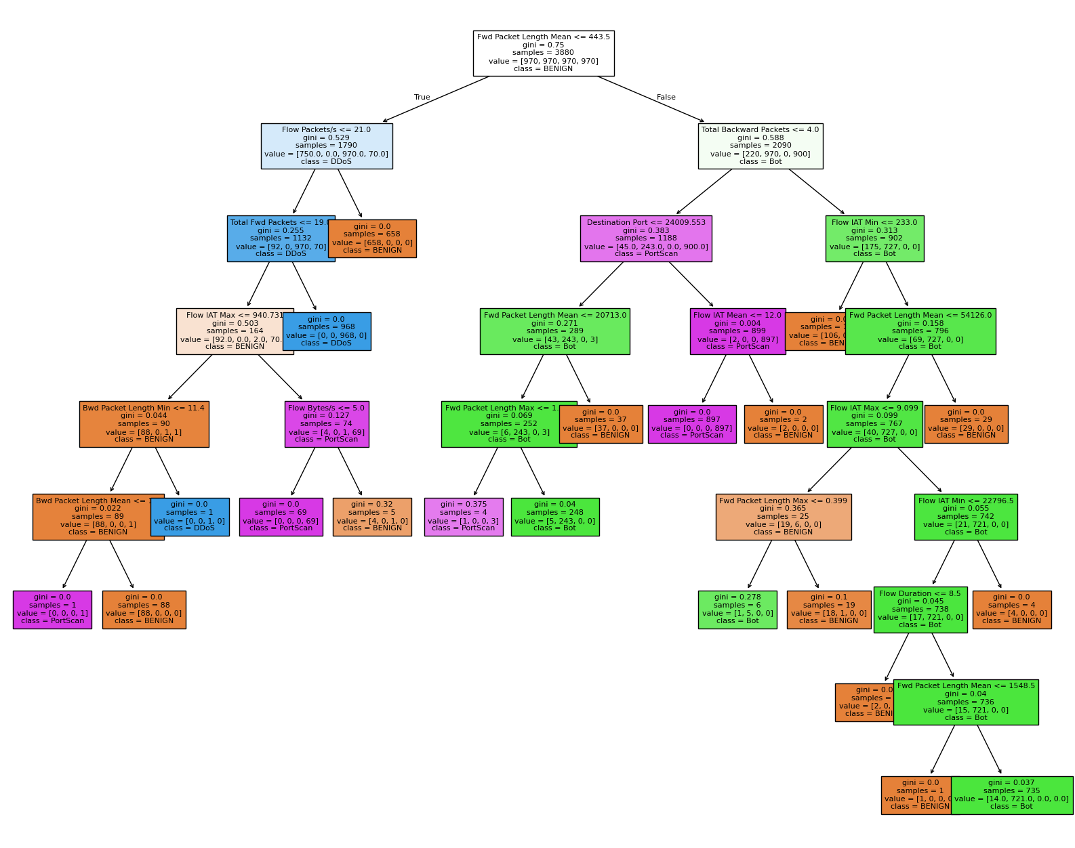
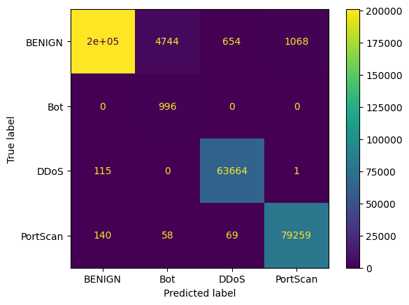
Decision Tree
Initial Model:
Max nodes = 20

Slide 13
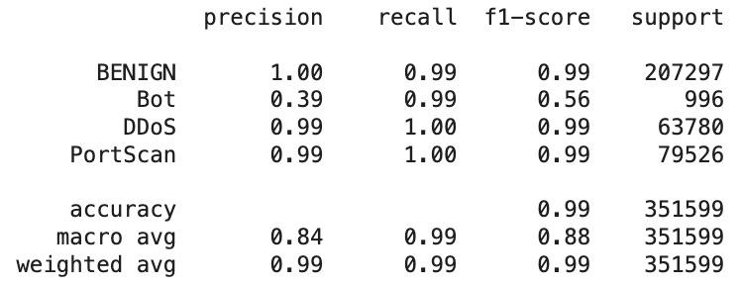
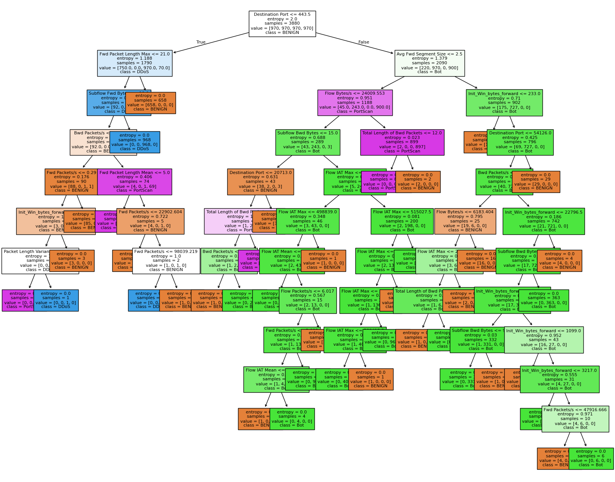
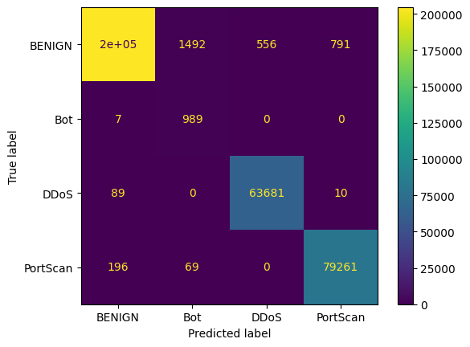
Decision Tree
Initial Hypertuning Model:
Criterion = ['gini', 'entropy', 'log_loss']
Max_depth = [5, 10, 15, 20, 25, 30, None]
Min_samples_split = [2, 5, 10]
Min_samples_leaf = [1, 2, 4]

Slide 14
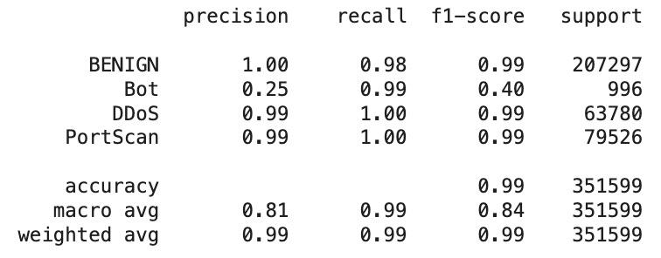
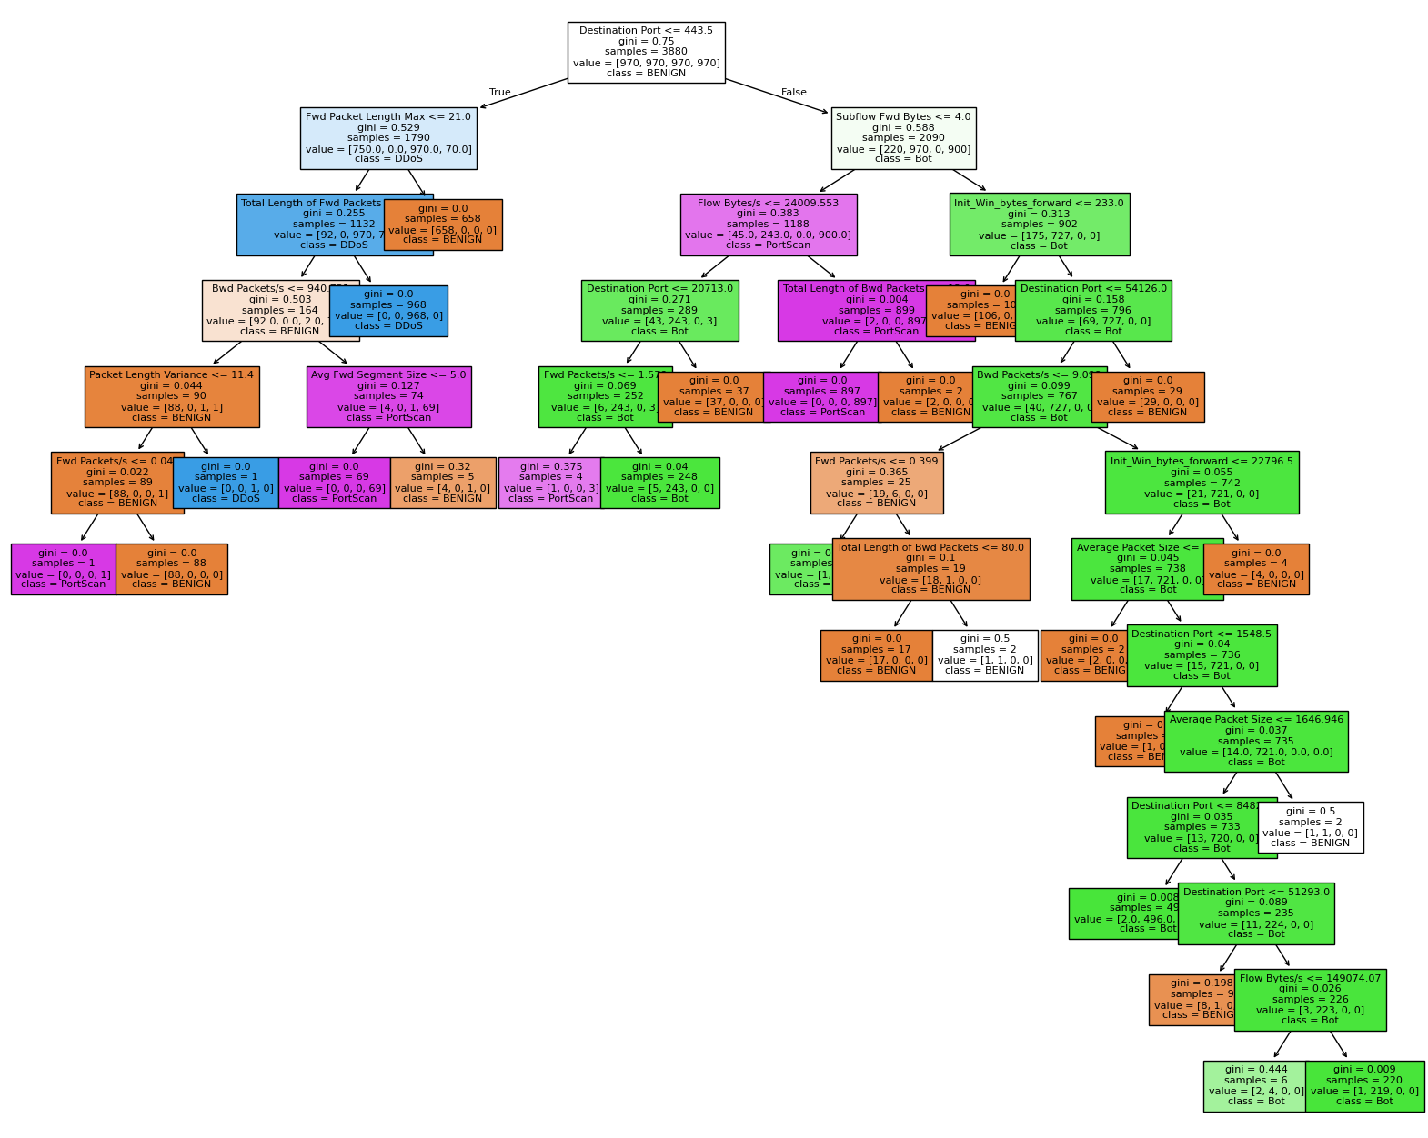
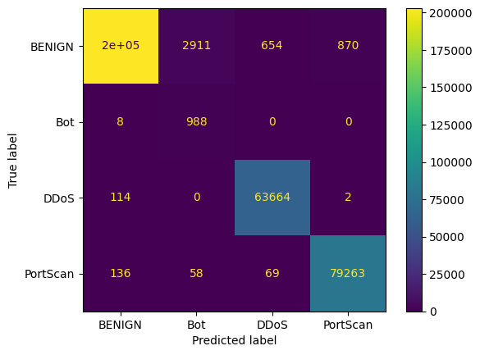
Decision Tree
Final Hypertuning Model:
Criterion = ['gini', 'entropy', 'log_loss']
Max_depth = [5, 10, 15, 20, 25, 30, None]
Min_samples_split = [2, 5, 10]
Min_samples_leaf = [1, 2, 4]
Max_leaf_nodes = [5, 10, 15, 20, 25, 30, 35, 40]

Slide 15
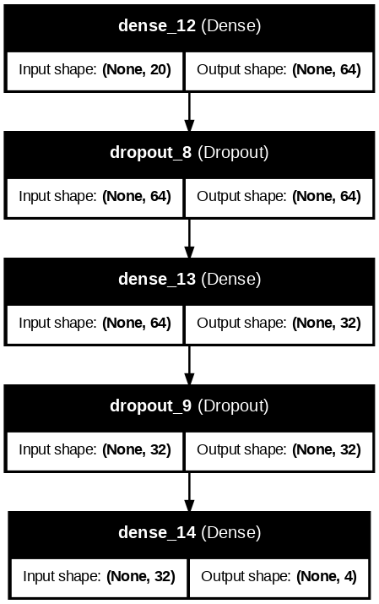

ANN
Structure:
Input layer
2 hidden layers (ReLU)
64 units
32 units
2 dropout layers used for regularization
Output layer (SoftMax)
4 units
Hypertuning: learning_rates = [0.1, 0.01, 0.001, 0.0001]

Slide 16

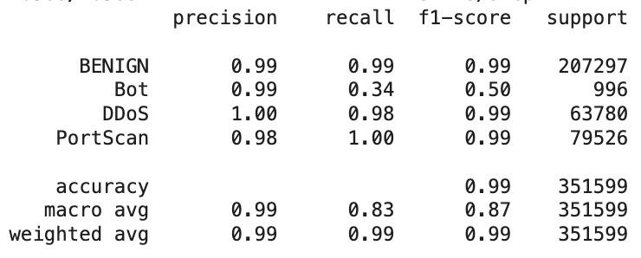
ANN
Model Fitting:
Validation_split = 0.2
Epochs = 25
Batch_size = 32

Slide 17
Unsupervised Learning

Slide 18
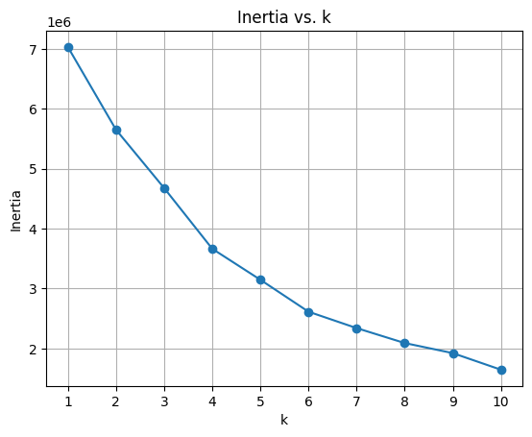
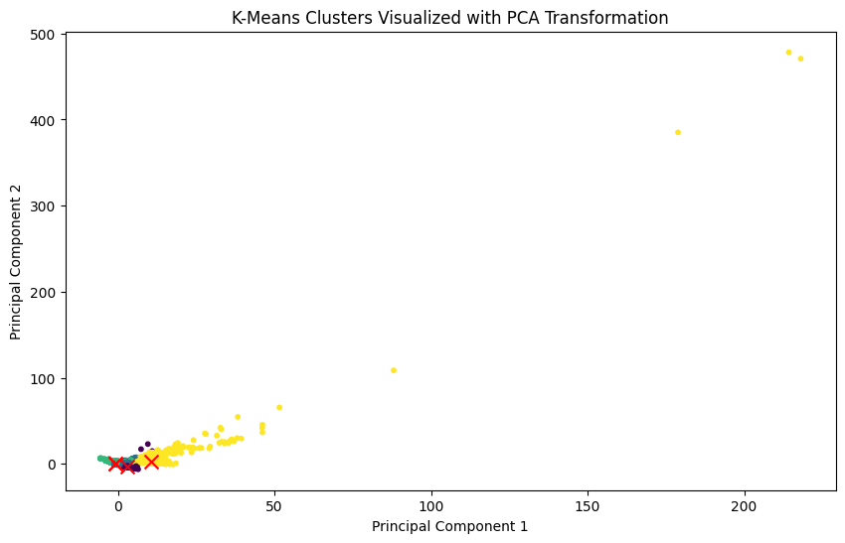
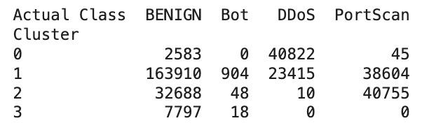
K-Means
Optimal k = 4
Centroids:
[ 2.9681979 , -2.81224712]
[-0.6961512 , 0.28175965]
[-0.75125366, 0.5316841 ]
[10.76757575, 2.45815356]
Cluster to Label Mapping:
0 = DDoS
1 = BENIGN
2 = PortScan
3 = BENIGN

Slide 19
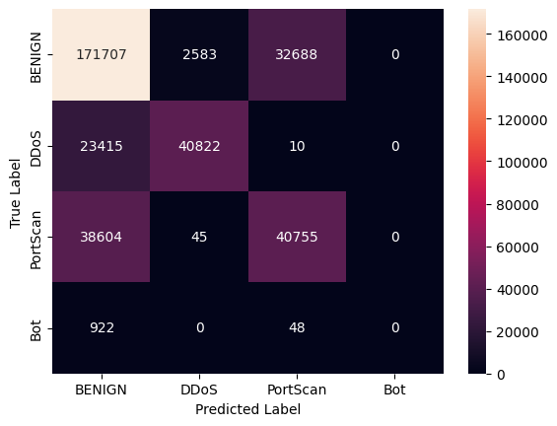
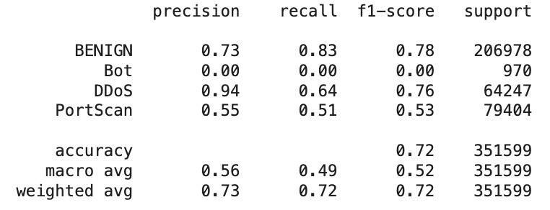
K-Means

Slide 20
Conclusion
High overall accuracy on all models
Model performance varies by class
Poor detection of minority class (Bot)
Hyperparameter tuning can greatly affect model performance
No single model excelled across all metrics and classes
Unsupervised learning struggles with minority traffic attacks
Future Actions:
Better address class imbalance
Explore real-time intrusion detection

Slide 21
Thank you!

