Slide 1
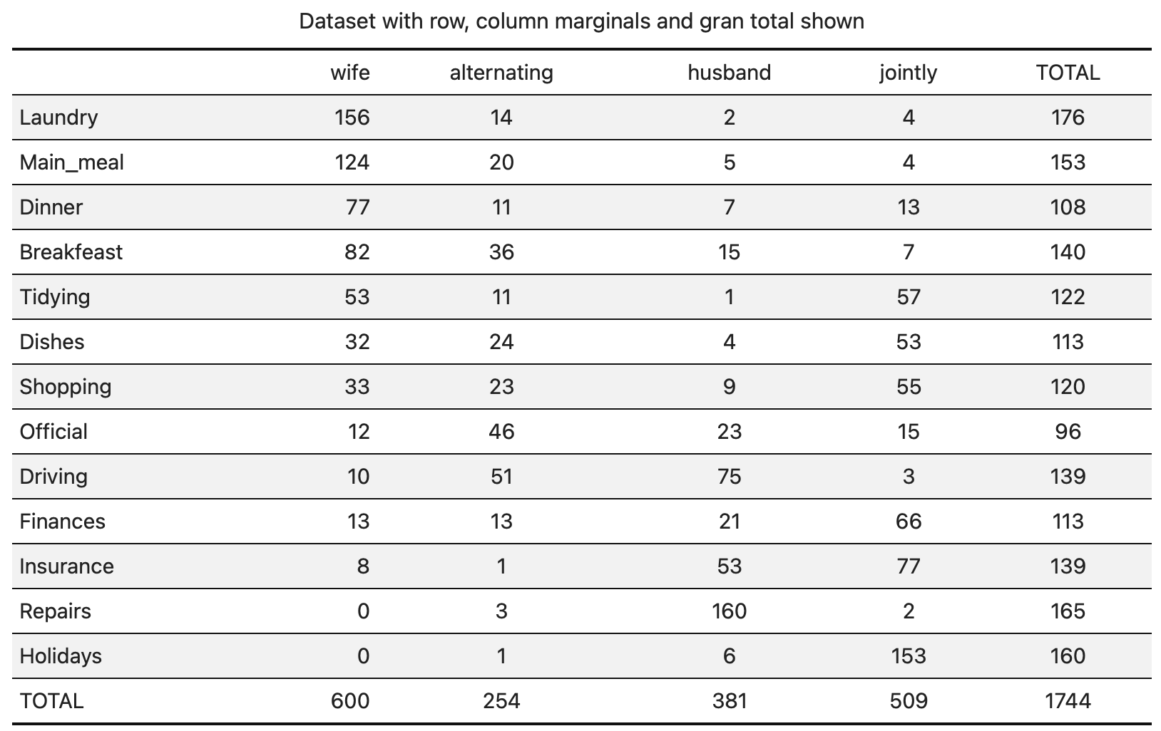

Slide 2
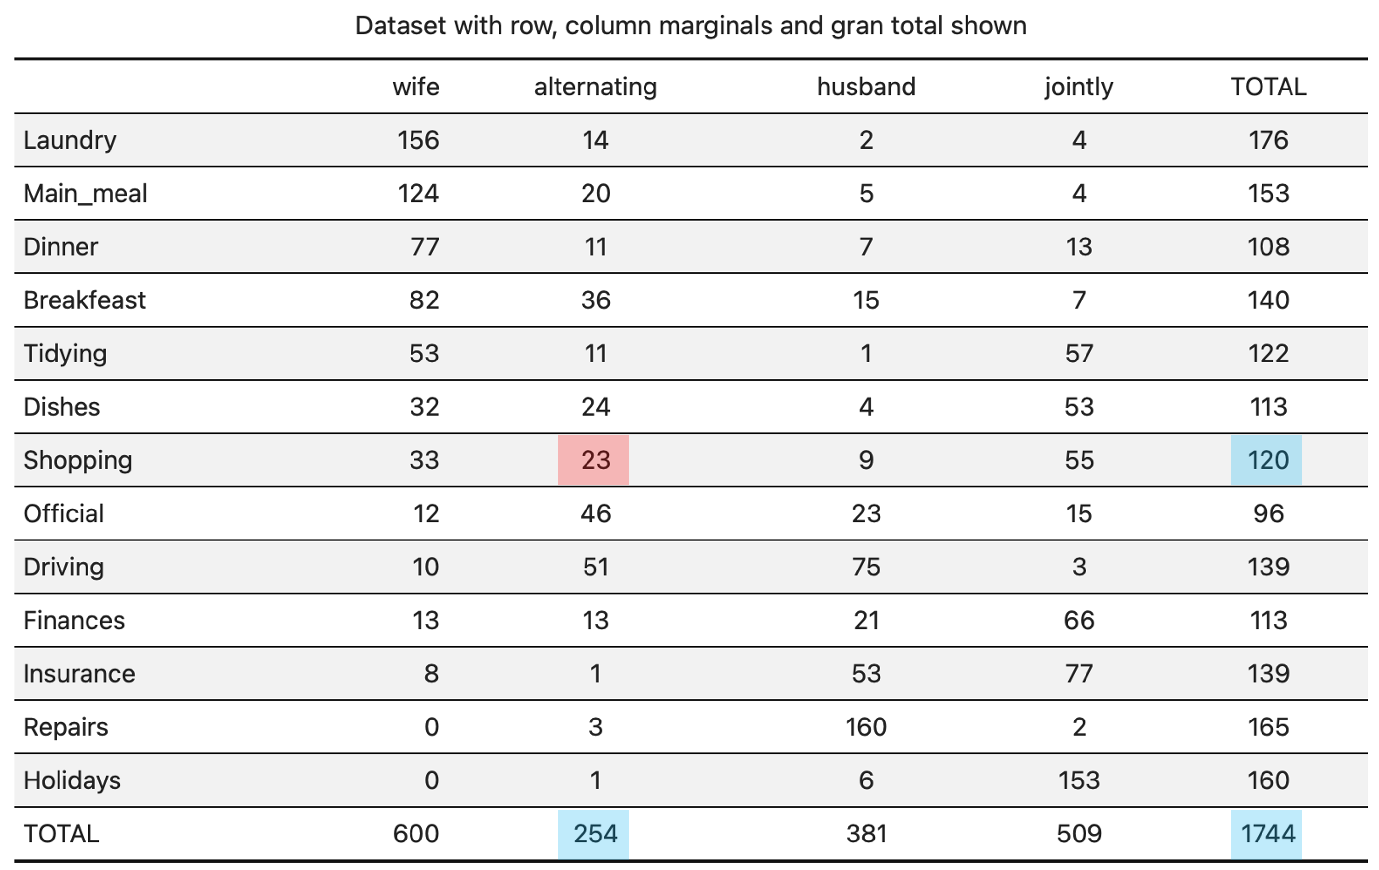


Observed: $23$
Expected:
$$\frac{254∙120}{1744}≈17.48$$

