Slide 1
강물에 놓인 막대기

Slide 2
A stick placed on a river

Slide 3
강물에 놓인 막대기

Slide 4
A stick placed on a river

Slide 5








$$y$$
③
$$Δy$$
②
$$Δx$$
①
$$Δx$$
$$Δy$$
$$(x,y)$$
④
$$0$$
$$x$$

Slide 6

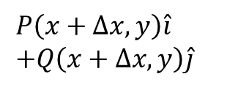



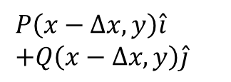


$$y$$
$$P\left(x+Δx,y\right)\hat{i} \\ +Q\left(x+Δx,y\right)\hat{j}$$
$$Q(x+Δx,y)$$
$$P(x−Δx,y)$$
②
$$Δx$$
$$Δx$$
①
$$P(x+Δx,y)$$
$$P\left(x−Δx,y\right)\hat{i} \\ +Q\left(x−Δx,y\right)\hat{j}$$
$$Q(x−Δx,y)$$
$$(x,y)$$
$$0$$
$$x$$

Slide 7
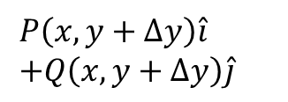





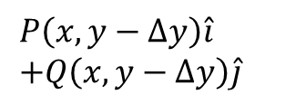


$$y$$
$$P(x,y+Δy)$$
③
$$Δy$$
$$P\left(x,y+Δy\right)\hat{i} \\ +Q\left(x,y+Δy\right)\hat{j}$$
$$Q(x,y+Δy)$$
$$(x,y)$$
$$P\left(x,y−Δy\right)\hat{i} \\ +Q\left(x,y−Δy\right)\hat{j}$$
$$Q(x,y−Δy)$$
$$Δy$$
$$P(x,y−Δy)$$
④
$$0$$
$$x$$

