Slide 1

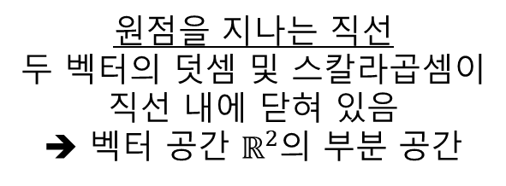
원점을 지나는 직선
두 벡터의 덧셈 및 스칼라곱셈이
직선 내에 닫혀 있음
➔ 벡터 공간 $ℝ^{2}$의 부분 공간
원점을 지나지 않는 직선
두 벡터의 덧셈 및 스칼라 곱셈이
직선 밖에 존재하게 됨
➔ 벡터 공간 $ℝ^{2}$의 부분 공간이 아님

Slide 2
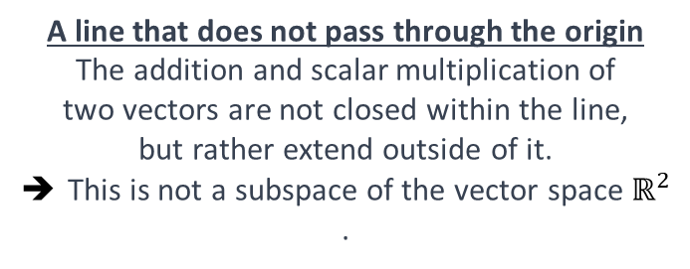
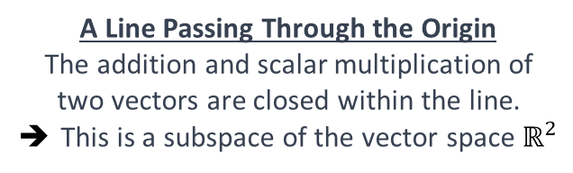
A Line Passing Through the Origin
The addition and scalar multiplication of two vectors are closed within the line.
➔ This is a subspace of the vector space $ℝ^{2}$
A line that does not pass through the origin
The addition and scalar multiplication of two vectors are not closed within the line, but rather extend outside of it.
➔ This is not a subspace of the vector space $ℝ^{2}$.

Slide 3




$$A= \left[\begin{matrix}2 & 1 \\ 4 & 2\end{matrix}\right]$$
$$\left[\begin{matrix}4 & 2\end{matrix}\right]$$
$$\left[\begin{matrix}2 & 1\end{matrix}\right]$$
행렬 $A$의 행공간

Slide 4
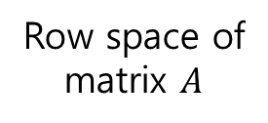
$$A= \left[\begin{matrix}2 & 1 \\ 4 & 2\end{matrix}\right]$$
$$\left[\begin{matrix}4 & 2\end{matrix}\right]$$
$$\left[\begin{matrix}2 & 1\end{matrix}\right]$$
Row space of
matrix $A$

Slide 5



$$\left[\begin{matrix}2 \\ 4\end{matrix}\right]$$
$$A= \left[\begin{matrix}2 & 1 \\ 4 & 2\end{matrix}\right]$$
$$\left[\begin{matrix}1 \\ 2\end{matrix}\right]$$
행렬 $A$의 열공간

Slide 6
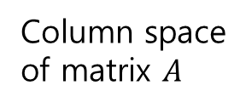
$$\left[\begin{matrix}2 \\ 4\end{matrix}\right]$$
$$A= \left[\begin{matrix}2 & 1 \\ 4 & 2\end{matrix}\right]$$
$$\left[\begin{matrix}1 \\ 2\end{matrix}\right]$$
Column space
of matrix $A$

Slide 7
열공간
$$A= \left[\begin{matrix}2 & 1 \\ 4 & 2\end{matrix}\right]$$
$$\left[\begin{matrix}4 & 2\end{matrix}\right]$$
$$\left[\begin{matrix}2 & 1\end{matrix}\right]$$
영공간
행공간

Slide 8
Column Space
$$A= \left[\begin{matrix}2 & 1 \\ 4 & 2\end{matrix}\right]$$
$$\left[\begin{matrix}4 & 2\end{matrix}\right]$$
$$\left[\begin{matrix}2 & 1\end{matrix}\right]$$
Null Space
Row Space

Slide 9
$$A= \left[\begin{matrix}2 & 1 \\ 4 & 2\end{matrix}\right]$$

Slide 10


$$A= \left[\begin{matrix}2 & 1 \\ 4 & 2\end{matrix}\right]$$
$$\left[\begin{matrix}2 \\ 4\end{matrix}\right]$$
$$\left[\begin{matrix}1 \\ 2\end{matrix}\right]$$
행렬 $A$의 열공간
행렬 $A$의 left nullspace

Slide 11
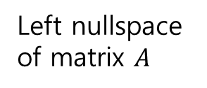
$$A= \left[\begin{matrix}2 & 1 \\ 4 & 2\end{matrix}\right]$$
$$\left[\begin{matrix}2 \\ 4\end{matrix}\right]$$
$$\left[\begin{matrix}1 \\ 2\end{matrix}\right]$$
Column space
of matrix $A$
Left nullspace
of matrix $A$

