Slide 1
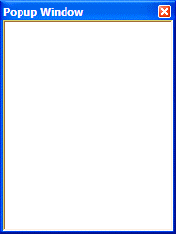
CLICK ME!
action: click
callback command:
create a new popup window

