Slide 1




아날로그
$$s(t)$$
ADC
$$x[n]$$
디지털
시스템
$$y[n]$$
DAC
$$y(t)$$
아날로그

Slide 2
Analog
$$s(t)$$
ADC
$$x[n]$$
Digital
System
$$y[n]$$
DAC
$$y(t)$$
Analog

Slide 3
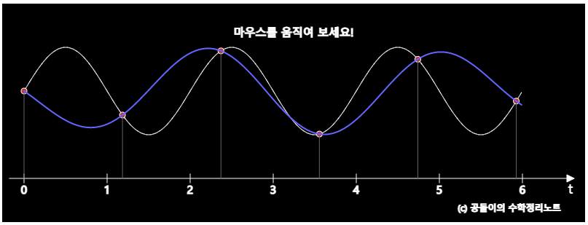
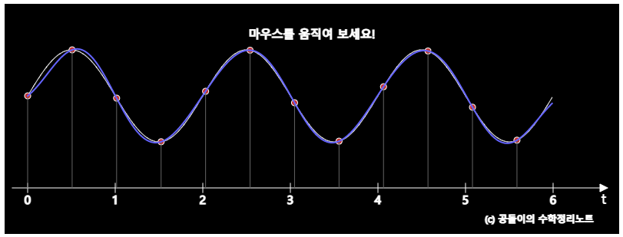
에일리어싱이 일어나는 경우
충분히 높은 주파수로 샘플링해서 에일리어싱을 방지한 경우

Slide 4
When aliased
When aliasing is prevented via sampling with high frequency

Slide 8


$$⋯$$
$$⋯$$

Slide 10


Frequency Spectrum of Continuous Periodic Signal (CTFS)
$$⋯$$
$$⋯$$
angular freq $ω$ [rad/s]
Frequency Spectrum of Discrete Periodic Signal (DTFS)
Digital angular freq $Ω$[rad]

Slide 12
Frequency Spectrum of Continuous Periodic Signal (CTFS)
angular freq $ω$ [rad/s]
Frequency Spectrum of Discrete Periodic Signal (DTFS)
Digital angular freq $Ω$[rad]

