Slide 3










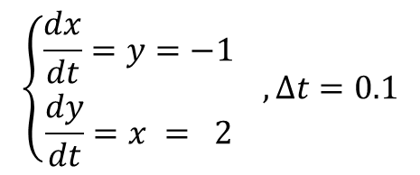

$\left(x,y\right)=\left(2, −1\right)$에서
$$y$$
$$\left\{\begin{aligned}\frac{dx}{dt}=y=−1 \\ \frac{dy}{dt}=x = 2\end{aligned}\right. , Δt=0.1$$
$$0$$
$$1$$
$$2$$
$$x$$
$$−1$$
$$\left(1.9, −0.8\right)$$
$$\frac{dy}{dt}Δt$$
$$\left(2, −1\right)$$
$$\frac{dx}{dt}Δt$$

Slide 4

at $\left(x,y\right)=\left(2, −1\right),$
$$y$$
$$\left\{\begin{aligned}\frac{dx}{dt}=y=−1 \\ \frac{dy}{dt}=x = 2\end{aligned}\right. , Δt=0.1$$
$$0$$
$$1$$
$$2$$
$$x$$
$$−1$$
$$\left(1.9, −0.8\right)$$
$$\frac{dy}{dt}Δt$$
$$\left(2, −1\right)$$
$$\frac{dx}{dt}Δt$$

Slide 7

$$\left[\begin{matrix}0 & 1 \\ 1 & 0\end{matrix}\right]$$
행렬을 통한
선형변환

Slide 8

$$\left[\begin{matrix}0 & 1 \\ 1 & 0\end{matrix}\right]$$
linear
transformation
via matrix

Slide 10
projection to the 1st eig-vector
projection to the 2nd eig-vector

Slide 12
coordinates on 1st eig-vector
coordinates on 1st eig-vector
order

Slide 14
coordinates on 2nd eig-vector
coordinates on 2nd eig-vector
order

Slide 15
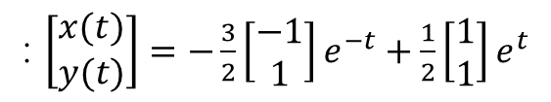




$$t=1.5$$
$$t=1.0$$
$$t=0.5$$
$$t=0$$
: $\left[\begin{matrix}x(t) \\ y(t)\end{matrix}\right]=−\frac{3}{2}\left[\begin{matrix}−1 \\ 1\end{matrix}\right]e^{−t}+\frac{1}{2}\left[\begin{matrix}1 \\ 1\end{matrix}\right]e^{t}$

Slide 17
comparing to the real solution
comparing to the real solution
coordinates on 1st eig-vector
coordinates on 2nd eig-vector

