Slide 5


$$P(x=9|label=1)$$
$$P(x=9|label=0)$$

Slide 8
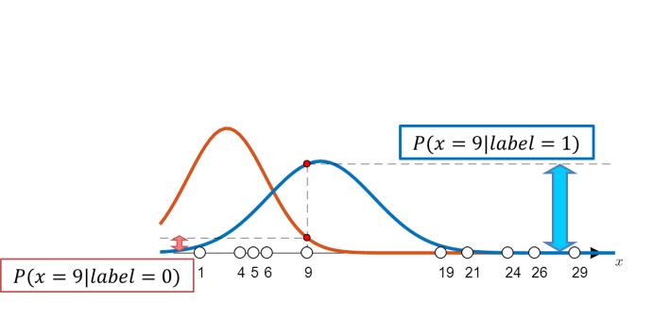

START!
likelihood 비교로
라벨링
랜덤 하게
분포 제안
추정된 모수 이용한
각 그룹별 분포 도시
각 그룹별 모수 추정
$$μ_{1}=…, σ_{1}=⋯$$
$$μ_{2}=⋯, σ_{2}=⋯$$

Slide 9

START!
Randomly
choosing
distributions
Labeling by
comparing likelihood
Get the distributions
of each group
with estimated parameters
Estimating parameters
of each group
$$μ_{1}=…, σ_{1}=⋯$$
$$μ_{2}=⋯, σ_{2}=⋯$$

Slide 10

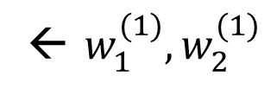

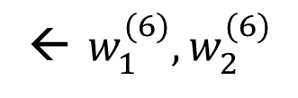
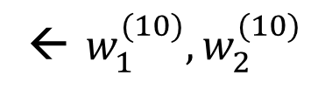
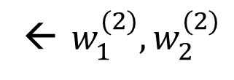
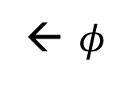
← $w_{1}^{(1)}, w_{2}^{(1)}$
← $w_{1}^{(2)}, w_{2}^{(2)}$
$$⋮$$
← $w_{1}^{(6)}, w_{2}^{(6)}$
$$⋮$$
← $w_{1}^{(10)}, w_{2}^{(10)}$
← $φ$

Slide 11







← $w_{1}^{(1)}, w_{2}^{(1)}$
← $w_{1}^{(2)}, w_{2}^{(2)}$
$$⋮$$
← $w_{1}^{(6)}, w_{2}^{(6)}$
$$⋮$$
← $w_{1}^{(10)}, w_{2}^{(10)}$
← $φ$

