Slide 1
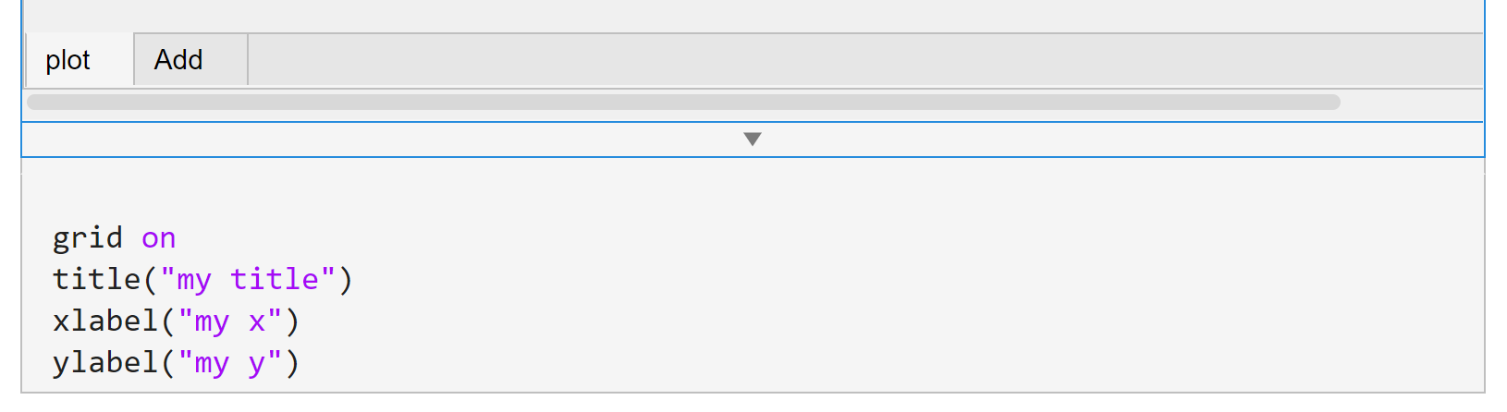
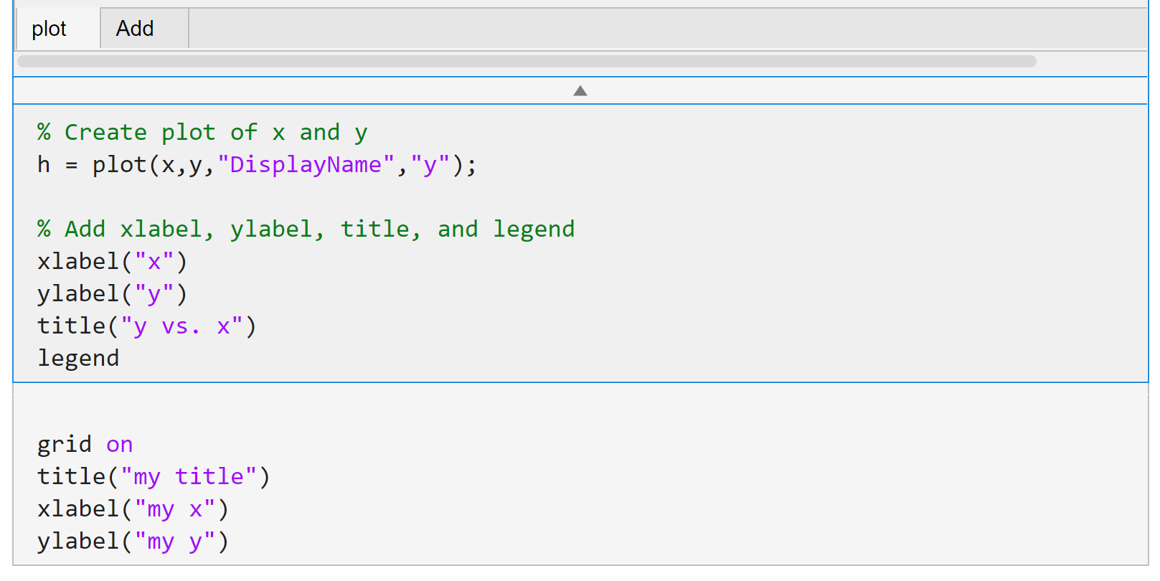
Click

Slide 2
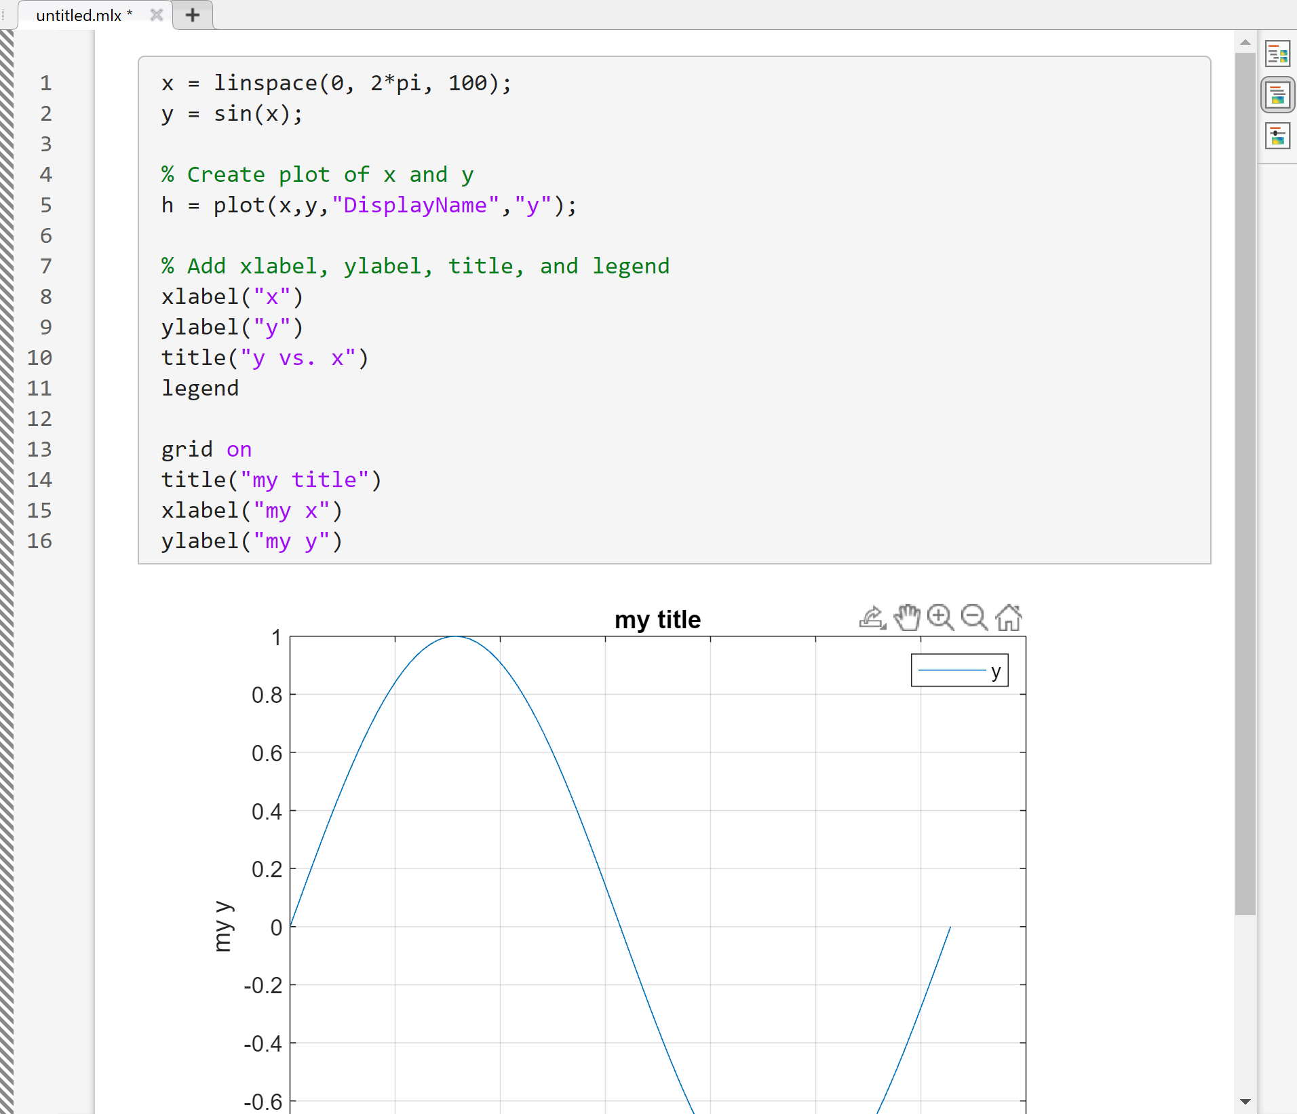
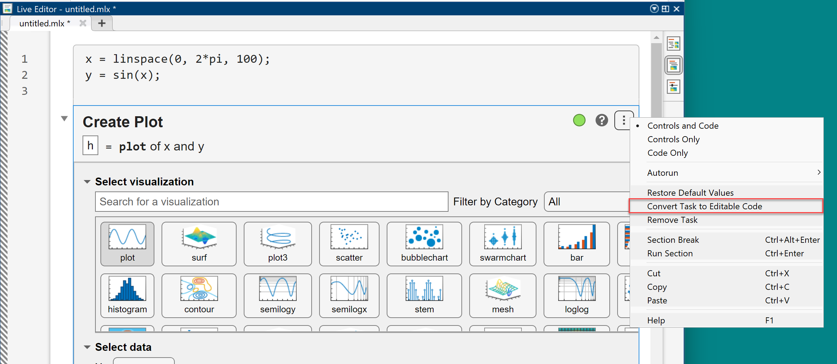

Slide 3



plot([1, 4, 2, 3])
$$y$$
4
3
2
1
$$0$$
1st
2nd
3rd
4th
...
$$x$$

Slide 4

x
y
plot([11, 12, 13, 14], [1, 4, 2, 3])
$$y$$
4
3
2
1
$$0$$
11
12
13
14
...
$$x$$

Slide 5
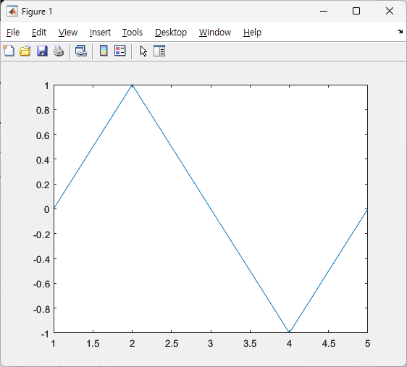







$$x=\left[0,\frac{π}{2}, π,\frac{3π}{2}, 2π\right]$$
y = sin(x)
$$y=[0, 1, 0, −1, 0]$$
plot(y)
$$y\left(2\right)=1$$
$$y\left(1\right)=0$$
$$y\left(3\right)=0$$
$$y(5)=0$$
$$y(4)=0$$

Slide 6
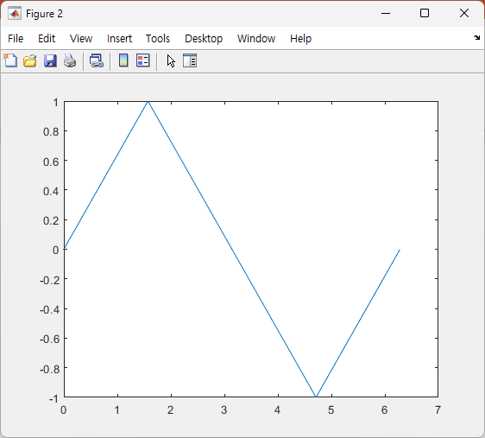










plot(y)
plot(x, y)
$$1$$
$$2$$
$$3$$
$$4$$
$$5$$
$$0$$
$$π/2$$
$$π$$
$$3π/2$$
$$2π$$

Slide 7
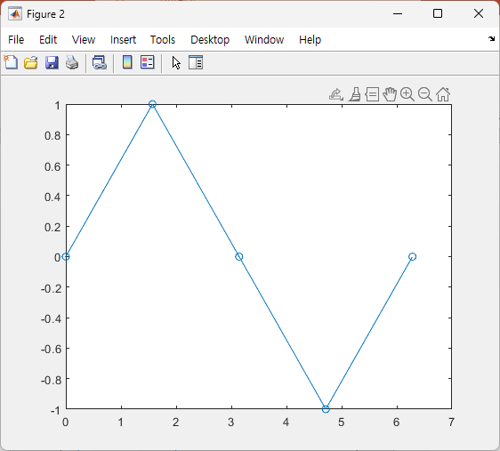










plot(x, y)
plot(x, y, ‘o-’)
$$y\left(2\right)=1$$
$$y\left(2\right)=1$$
$$y(5)=0$$
$$y\left(1\right)=0$$
$$y\left(3\right)=0$$
$$y(5)=0$$
$$y\left(1\right)=0$$
$$y\left(3\right)=0$$
$$y\left(4\right)=−1$$
$$y\left(4\right)=−1$$

Slide 8
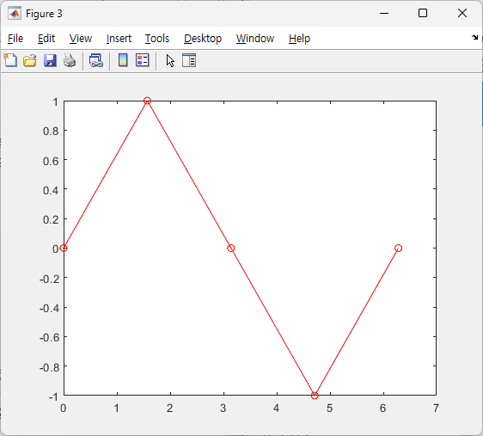
plot(x, y, ‘o-’)
plot(x, y, ‘ro-’)

Slide 9
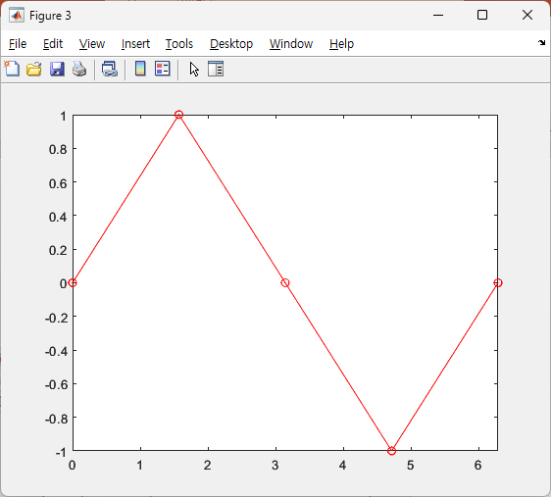
plot(x, y, ‘ro-’);
xlim([0, 2*pi]);
plot(x, y, ‘ro-’)

Slide 10
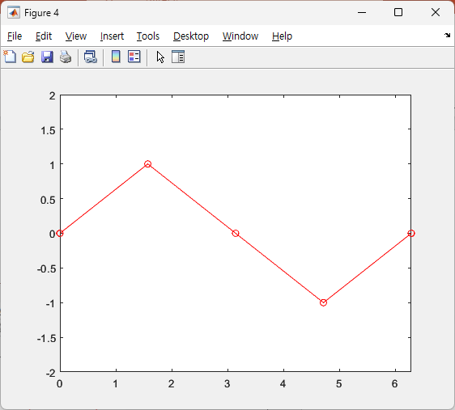
xlim([0, 2*pi]);
ylim([-2, 2]);
xlim([0, 2*pi]);

Slide 11

xticks
xticklabels

Slide 12
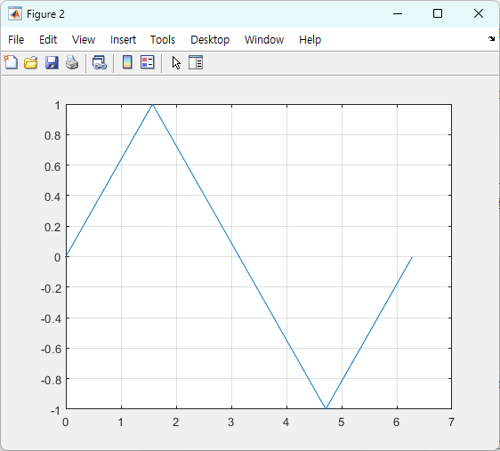
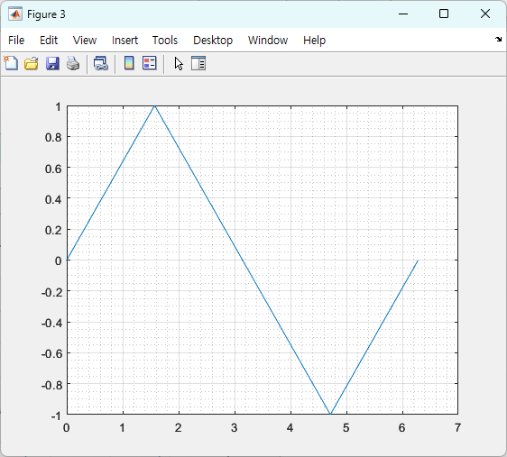
grid on;
grid minor;
grid on;

Slide 13
(2, 1, 1)
(2, 2, 1)
(2, 2, 2)
(1, 2, 1)
(1, 2, 2)
(2, 1, 2)
(2, 2, 3)
(2, 2, 4)
subplot(#row, #col, index)

Slide 14
(2, 2, 1)
(2, 2, 2)
(2, 2, [3, 4])

Slide 16
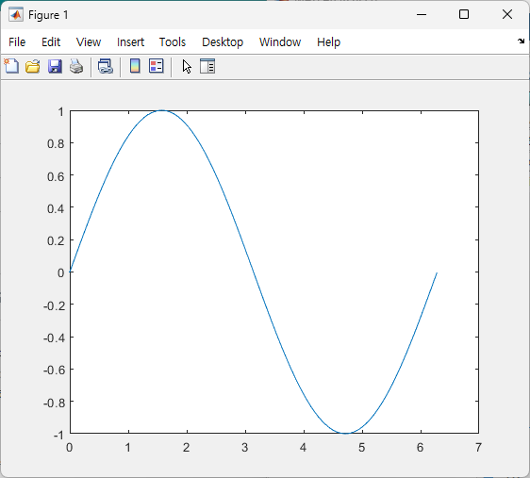
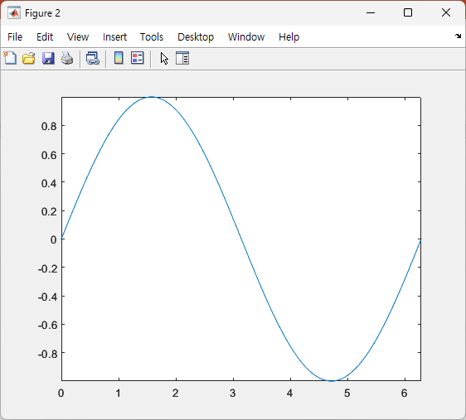
axis tight;

Slide 17
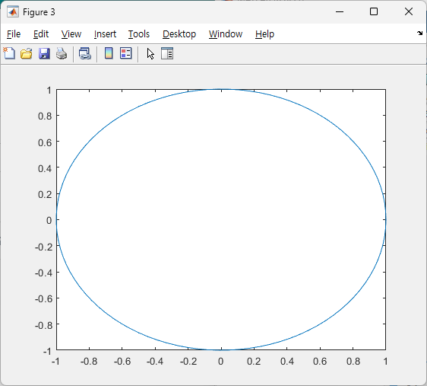
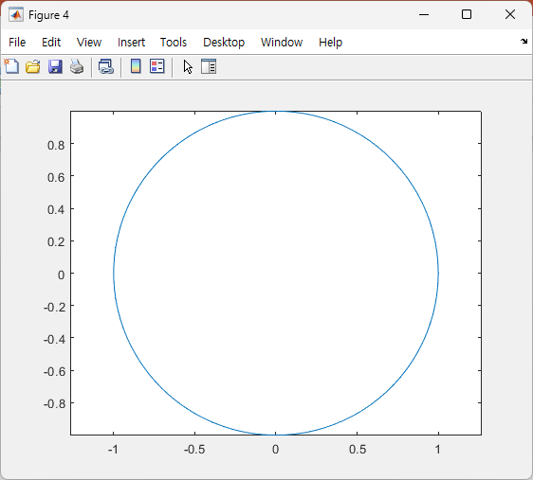
axis equal;

Slide 18
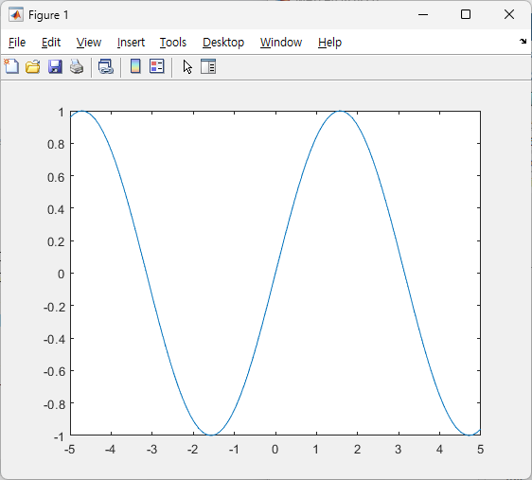
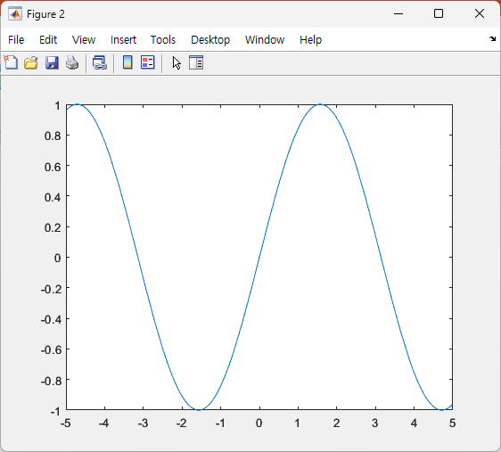
plot
fplot

Slide 19

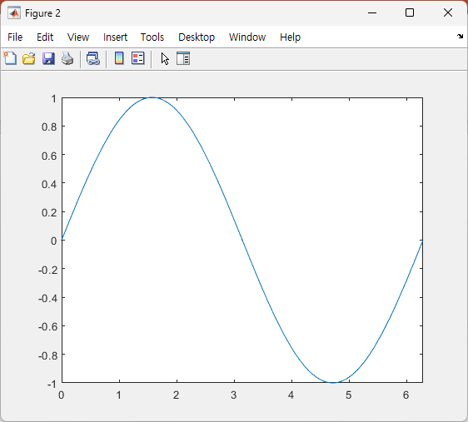
fplot(@(x) sin(x))
fplot(@(x) sin(x), [0, 2*pi])

Slide 22
