Slide 1
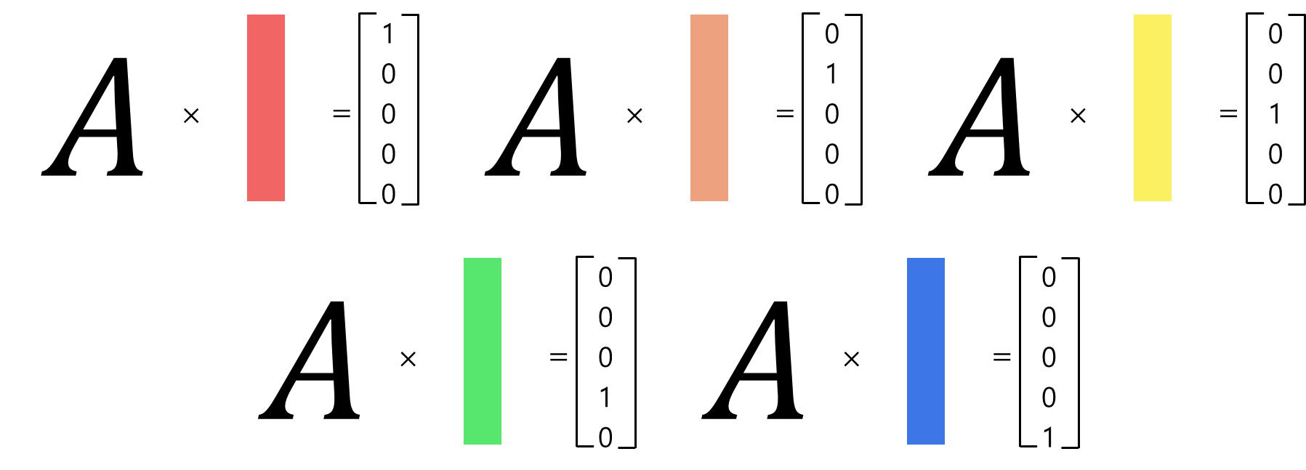



















$$5$$
$$A$$
1
0
0
0
0
0
1
0
0
0
$$×$$
5
$$=$$
0
0
1
0
0
0
0
0
1
0
0
0
0
0
1
$$A$$
1
$$A$$
0
$$A$$
0
0
1
0
$$×$$
$$=$$
0
$$×$$
$$=$$
0
$$×$$
$$=$$
1
0
0
0
0
0
0
$$A$$
0
$$A$$
0
0
0
$$×$$
$$=$$
0
$$×$$
$$=$$
0
1
0
0
1

Slide 2































단위 기저
벡터들의 나열
$$n$$
$$A$$
1
0
0
$$⋯$$
0
0
1
0
$$⋯$$
0
$$×$$
$$n$$
$$=$$
0
0
1
$$⋯$$
0
$$⋮$$
$$⋮$$
$$⋮$$
$$⋱$$
$$⋮$$
0
0
0
$$⋯$$
1
개념의
확장
$$G(x, y)$$
단위 기저
함수들의 나열?
$$y$$
$$y$$
$$L$$
$$b$$
$$b$$
$$×$$
$$=$$
$$a$$
$$x$$
$$a$$
$$x$$
$$a$$
$$b$$
$$a$$
$$b$$

Slide 3
A series of
unit basis vectors
$$n$$
$$A$$
1
0
0
$$⋯$$
0
0
1
0
$$⋯$$
0
$$×$$
$$n$$
$$=$$
0
0
1
$$⋯$$
0
$$⋮$$
$$⋮$$
$$⋮$$
$$⋱$$
$$⋮$$
0
0
0
$$⋯$$
1
Extending
the Concept
$$G(x, y)$$
A series of
unit basis functions?
$$y$$
$$y$$
$$L$$
$$b$$
$$b$$
$$×$$
$$=$$
$$a$$
$$x$$
$$a$$
$$x$$
$$a$$
$$b$$
$$a$$
$$b$$

Slide 4
System as a whole
외부 입력
시스템
출력
피드백

Slide 5












입력
$$[2, 3, 5, 1, 4]$$
전체 미분방정식
시스템
(제차+비제차)
$$[2, 0, 0, 0, 0]$$
$$[8, 0, 0, 0, 0]$$
$$[0, 3, 0, 0, 0]$$
$$[0, 5, 0, 0, 0]$$
$$[0, 0, 5, 0, 0]$$
$$[0, 0, 1, 0, 0]$$
$$[0, 0, 0, 1, 0]$$
$$[0, 0, 0, 2, 0]$$
$$[0, 0, 0, 0, 4]$$
$$[0, 0, 0, 0, 7]$$
$$[8, 5, 1, 2, 7]$$
출력

Slide 6
입력 함수
출력 함수
전체
미분방정식
시스템
(제차+비제차)

Slide 7
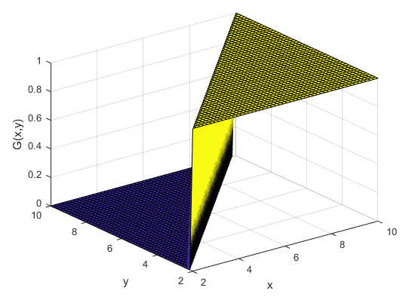

Slide 11
Green’s function G(x, pi/3) when y=pi/3

