Slide 1
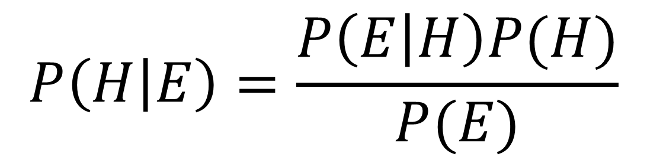
사전 확률
(prior)
$$P\left(H | E\right)=\frac{P\left(E | H\right)P(H)}{P(E)}$$
사후 확률
(posterior)

Slide 2
Prior Probability
$$P\left(H | E\right)=\frac{P\left(E | H\right)P(H)}{P(E)}$$
Posterior
Probability

Slide 3


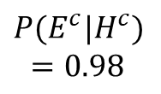
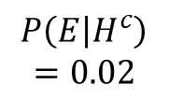

False
Negative
True
Negative
$$P(E^{c}|H^{c})$$
$$=0.98$$
특이도
(specificity)
$$P(E|H)$$
$$=0.99$$
True
Positive
민감도
(sensitivity)
False
Positive
$$P\left(E | H^{c}\right)$$
$$=0.02$$
$$P\left(H\right)$$
$$=0.001$$
$$P\left(H^{c}\right)$$
$$=0.999$$
발병률
(사전 확률)

Slide 4
False
Negative
True
Negative
$$P(E^{c}|H^{c})$$
$$=0.98$$
specificity
$$P(E|H)$$
$$=0.99$$
True
Positive
sensitivity
False
Positive
$$P\left(E | H^{c}\right)$$
$$=0.02$$
$$P\left(H\right)$$
$$=0.001$$
$$P\left(H^{c}\right)$$
$$=0.999$$
disease rate
(prior probability)

Slide 5


False
Negative
True
Negative
$$P(E^{c}|H^{c})$$
$$=0.98$$
특이도
(specificity)
$$P(E|H)$$
$$=0.99$$
True
Positive
민감도
(sensitivity)
False
Positive
$$P\left(E | H^{c}\right)$$
$$=0.02$$
$$P\left(H\right)=0.047$$
$$P\left(H^{c}\right)$$
$$=0.953$$
발병률
(수정된 사전 확률)

Slide 6
False
Negative
True
Negative
$$P(E^{c}|H^{c})$$
$$=0.98$$
specificity
$$P(E|H)$$
$$=0.99$$
True
Positive
sensitivity
False
Positive
$$P\left(E | H^{c}\right)$$
$$=0.02$$
$$P\left(H\right)=0.047$$
$$P\left(H^{c}\right)$$
$$=0.953$$
disease rate
(updated prior probability)

