Slide 1



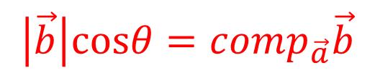

$$\vec{b}$$
$$\vec{a}$$
$$\left|\vec{b}\right|cosθ=comp_{\vec{a}}\vec{b}$$
$$θ$$
벡터 $\vec{b}의$ $\vec{a}$방향 컴포넌트 (스칼라)

Slide 2

$$\vec{b}$$
$$\vec{a}$$
$$\left|\vec{b}\right|cosθ=comp_{\vec{a}}\vec{b}$$
$$θ$$
A component of $\vec{b}$(scalar) in $\vec{a}′$s direction

Slide 3





$$\vec{b}$$
$$\vec{a}$$
$$comp_{\vec{a}}\vec{b}⋅\left(\frac{\vec{a}}{\left|\vec{a}\right|}\right)=proj_{\vec{a}}\vec{b}$$
$$θ$$
벡터 $\vec{b}의$ $\vec{a}$방향으로의 정사영 (벡터)

Slide 4

$$\vec{b}$$
$$\vec{a}$$
$$comp_{\vec{a}}\vec{b}⋅\left(\frac{\vec{a}}{\left|\vec{a}\right|}\right)=proj_{\vec{a}}\vec{b}$$
$$θ$$
projection of $\vec{b}$
onto $\vec{a}′$s direction (vector)

Slide 6
two linearly independent vectors
two orthogonal vectors

Slide 8
two linearly independent vectors
two orthogonal vectors

Slide 9

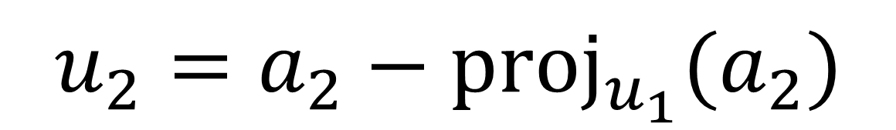
$$u_{2}=a_{2}−{proj}_{u_{1}}(a_{2})$$
$a_{2}$가 갖고 있는 $u_{1}$관련 성분

Slide 10
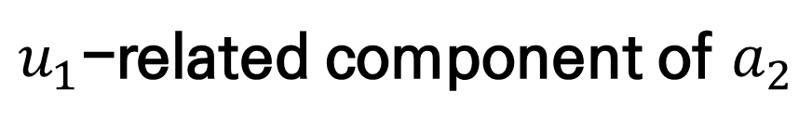
$$u_{2}=a_{2}−{proj}_{u_{1}}(a_{2})$$
$u_{1}$-related component of $a_{2}$

Slide 11
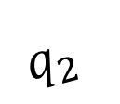
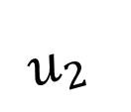
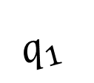
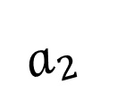
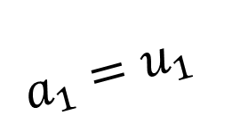

$$a_{2}$$
$$u_{2}$$
$$q_{2}$$
$$q_{1}$$
$${proj}_{u_{1}}a_{2}$$
$$a_{1}=u_{1}$$

