Slide 1
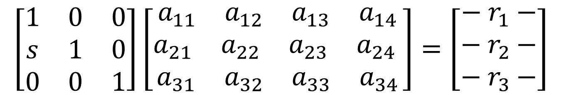
$$\left[\begin{matrix}1 & 0 & 0 \\ s & 1 & 0 \\ 0 & 0 & 1\end{matrix}\right]\left[\begin{matrix}\begin{matrix}\begin{matrix}a_{11} & a_{12}\end{matrix} & \begin{matrix}a_{13} & a_{14}\end{matrix}\end{matrix} \\ \begin{matrix}\begin{matrix}a_{21} & a_{22}\end{matrix} & \begin{matrix}a_{23} & a_{24} \end{matrix}\end{matrix} \\ \begin{matrix}\begin{matrix}a_{31} & a_{32}\end{matrix} & \begin{matrix}a_{33} & a_{34}\end{matrix}\end{matrix}\end{matrix}\right]=\left[\begin{matrix}− r_{1}− \\ − r_{2}− \\ − r_{3}−\end{matrix}\right]$$

Slide 2
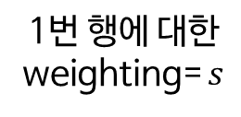
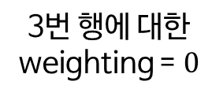
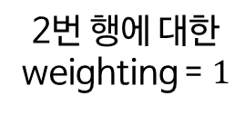
2번 행에 대한
weighting = $1$
$$\left[\begin{matrix}1 & 0 & 0 \\ s & 1 & 0 \\ 0 & 0 & 1\end{matrix}\right]\left[\begin{matrix}\begin{matrix}\begin{matrix}a_{11} & a_{12}\end{matrix} & \begin{matrix}a_{13} & a_{14}\end{matrix}\end{matrix} \\ \begin{matrix}\begin{matrix}a_{21} & a_{22}\end{matrix} & \begin{matrix}a_{23} & a_{24} \end{matrix}\end{matrix} \\ \begin{matrix}\begin{matrix}a_{31} & a_{32}\end{matrix} & \begin{matrix}a_{33} & a_{34}\end{matrix}\end{matrix}\end{matrix}\right]=\left[\begin{matrix}− r_{1}− \\ − r_{2}− \\ − r_{3}−\end{matrix}\right]$$
1번 행에 대한
weighting= $s$
3번 행에 대한
weighting = $0$

Slide 3
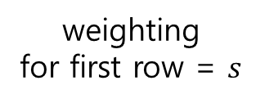
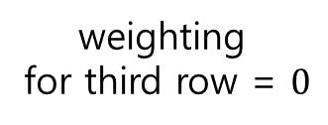
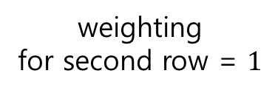
weighting
for second row = $1$
$$\left[\begin{matrix}1 & 0 & 0 \\ s & 1 & 0 \\ 0 & 0 & 1\end{matrix}\right]\left[\begin{matrix}\begin{matrix}\begin{matrix}a_{11} & a_{12}\end{matrix} & \begin{matrix}a_{13} & a_{14}\end{matrix}\end{matrix} \\ \begin{matrix}\begin{matrix}a_{21} & a_{22}\end{matrix} & \begin{matrix}a_{23} & a_{24} \end{matrix}\end{matrix} \\ \begin{matrix}\begin{matrix}a_{31} & a_{32}\end{matrix} & \begin{matrix}a_{33} & a_{34}\end{matrix}\end{matrix}\end{matrix}\right]=\left[\begin{matrix}− r_{1}− \\ − r_{2}− \\ − r_{3}−\end{matrix}\right]$$
weighting
for first row = $s$
weighting
for third row = $0$

Slide 4
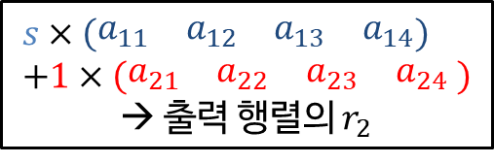
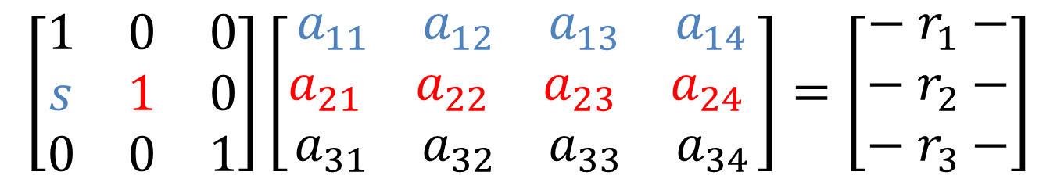
$$s×\left(\begin{matrix}\begin{matrix}a_{11} & a_{12}\end{matrix} & \begin{matrix}a_{13} & a_{14}\end{matrix}\end{matrix}\right) \\ +1×\left(\begin{matrix}\begin{matrix}a_{21} & a_{22}\end{matrix} & \begin{matrix}a_{23} & a_{24} \end{matrix}\end{matrix}\right)$$
→ 출력 행렬의 $r_{2}$
$$\left[\begin{matrix}1 & 0 & 0 \\ s & 1 & 0 \\ 0 & 0 & 1\end{matrix}\right]\left[\begin{matrix}\begin{matrix}\begin{matrix}a_{11} & a_{12}\end{matrix} & \begin{matrix}a_{13} & a_{14}\end{matrix}\end{matrix} \\ \begin{matrix}\begin{matrix}a_{21} & a_{22}\end{matrix} & \begin{matrix}a_{23} & a_{24} \end{matrix}\end{matrix} \\ \begin{matrix}\begin{matrix}a_{31} & a_{32}\end{matrix} & \begin{matrix}a_{33} & a_{34}\end{matrix}\end{matrix}\end{matrix}\right]=\left[\begin{matrix}− r_{1}− \\ − r_{2}− \\ − r_{3}−\end{matrix}\right]$$

Slide 5
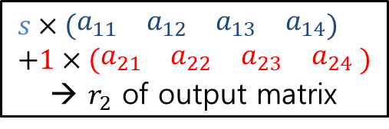
$$s×\left(\begin{matrix}\begin{matrix}a_{11} & a_{12}\end{matrix} & \begin{matrix}a_{13} & a_{14}\end{matrix}\end{matrix}\right) \\ +1×\left(\begin{matrix}\begin{matrix}a_{21} & a_{22}\end{matrix} & \begin{matrix}a_{23} & a_{24} \end{matrix}\end{matrix}\right)$$
→ $r_{2}$ of output matrix
$$\left[\begin{matrix}1 & 0 & 0 \\ s & 1 & 0 \\ 0 & 0 & 1\end{matrix}\right]\left[\begin{matrix}\begin{matrix}\begin{matrix}a_{11} & a_{12}\end{matrix} & \begin{matrix}a_{13} & a_{14}\end{matrix}\end{matrix} \\ \begin{matrix}\begin{matrix}a_{21} & a_{22}\end{matrix} & \begin{matrix}a_{23} & a_{24} \end{matrix}\end{matrix} \\ \begin{matrix}\begin{matrix}a_{31} & a_{32}\end{matrix} & \begin{matrix}a_{33} & a_{34}\end{matrix}\end{matrix}\end{matrix}\right]=\left[\begin{matrix}− r_{1}− \\ − r_{2}− \\ − r_{3}−\end{matrix}\right]$$

