Slide 1
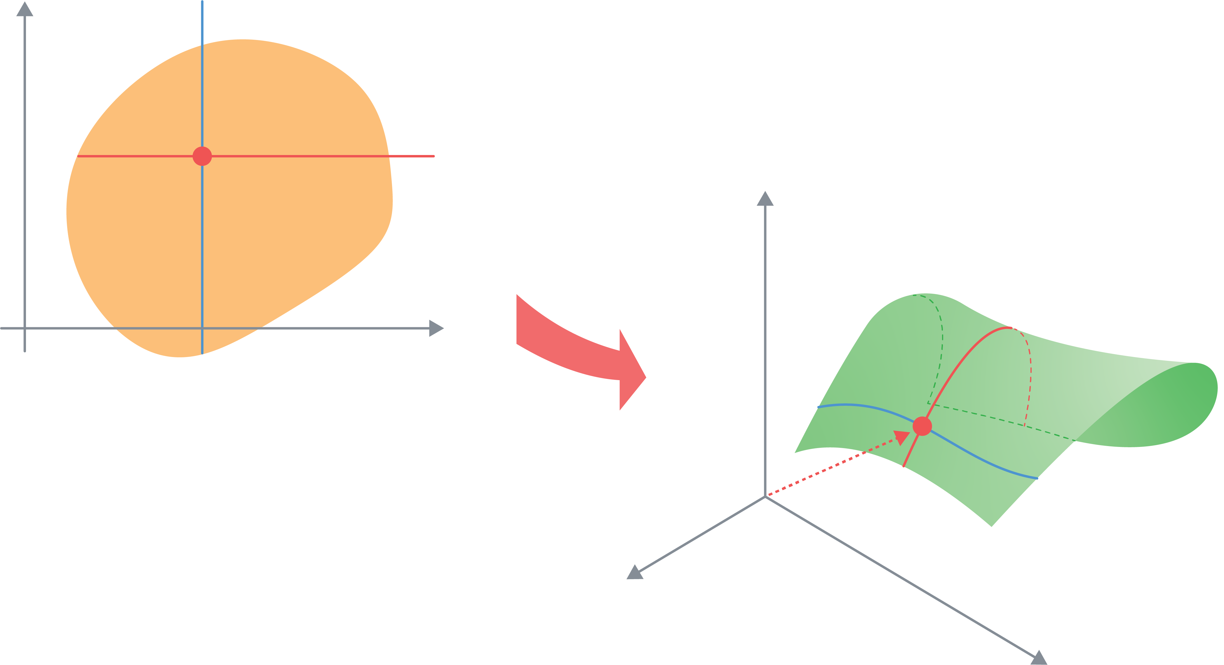








<입력(정의역) 공간>
$$v$$
$$(u_{0}, v_{0})$$
$v_{0}= 상$수
<출력(치역) 공간>
$v=v_{0}$인 지점의 곡선
$$0$$
$$u$$
$u_{0}= 상$수
$u=u_{0}$인 지점의 곡선
$$r\left(u, v\right)=x\left(u,v\right)\hat{i}+y\left(u,v\right)\hat{j}+z\left(u,v\right)\hat{k}$$

Slide 2




<Input(domain) space>
$$v$$
$$(u_{0}, v_{0})$$
$$v_{0}=constant$$
<Output(range) space>
Curve where $v=v_{0}$
$$0$$
$$u$$
$$u_{0}=constant$$
Curve where $u=u_{0}$
$$r\left(u, v\right)=x\left(u,v\right)\hat{i}+y\left(u,v\right)\hat{j}+z\left(u,v\right)\hat{k}$$

Slide 3
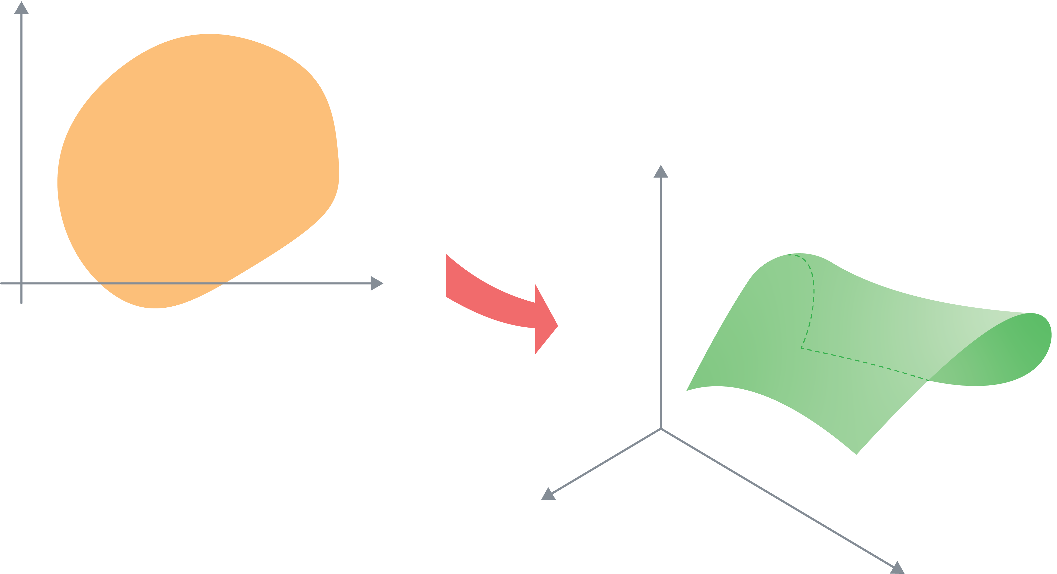




<입력(정의역) 공간>
$$v$$
<출력(치역) 공간>
$$dv$$
접평면
$$du$$
$$r_{v}=\frac{∂r}{∂v}$$
$$0$$
$$u$$
$$r_{u}=\frac{∂r}{∂u}$$

Slide 4
<Input(domain) space>
$$v$$
<Output(range) space>
$$dv$$
tangential plane
$$du$$
$$r_{v}=\frac{∂r}{∂v}$$
$$0$$
$$u$$
$$r_{u}=\frac{∂r}{∂u}$$

