Slide 1
MATLAB
for
Everybody
The quickest way to learn MATLAB
is to type in what you want to

Slide 2
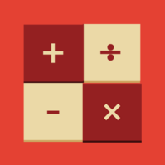
MATLAB
for
Everybody

Slide 3
MATLAB
for
Everybody
Angelo Yeo

Slide 4


Slide 5


Slide 6
MATLAB
&
Simulink
for
Everybody

