Slide 1
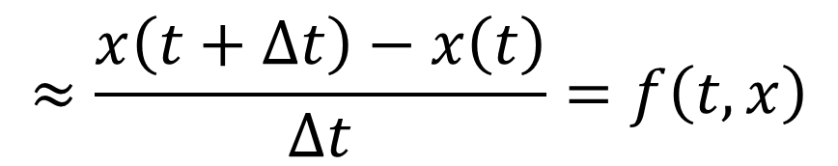
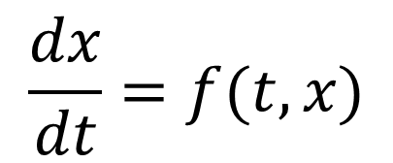
$$\frac{dx}{dt}=f(t, x)$$
$$≈\frac{x\left(t+Δt\right)−x\left(t\right)}{Δt}=f\left(t, x\right)$$
$$⟺x\left(t+Δt\right)=x\left(t\right)+Δtf(t,x)$$
다음 번 step의 값
현재 값
성장량
☆★☆미분방정식은 시간에 따른 성장에 대한 서술☆★☆

Slide 2
$$\frac{dx}{dt}=f(t, x)$$
$$≈\frac{x\left(t+Δt\right)−x\left(t\right)}{Δt}=f\left(t, x\right)$$
$$⟺x\left(t+Δt\right)=x\left(t\right)+Δtf(t,x)$$
The value
of next step
present
value
The amount
of growth
☆★☆Differential equation describes growth along time☆★☆

Slide 3










$$x(t)$$
$$x(t_{0}+Δt)$$
$$f\left(t,x\right)>0$$
$$x(t_{0})$$
$$f\left(t,x\right)=0$$
$$x(t_{0}−Δt)$$
$$f\left(t,x\right)<0$$
$$t_{0}−Δt$$
$$t_{0}$$
$$t_{0}+Δt$$

