Slide 1
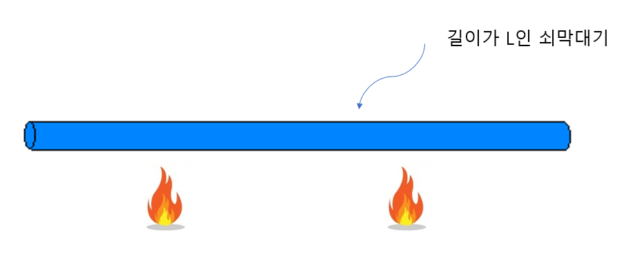
A steel rod with length of “L”

Slide 2
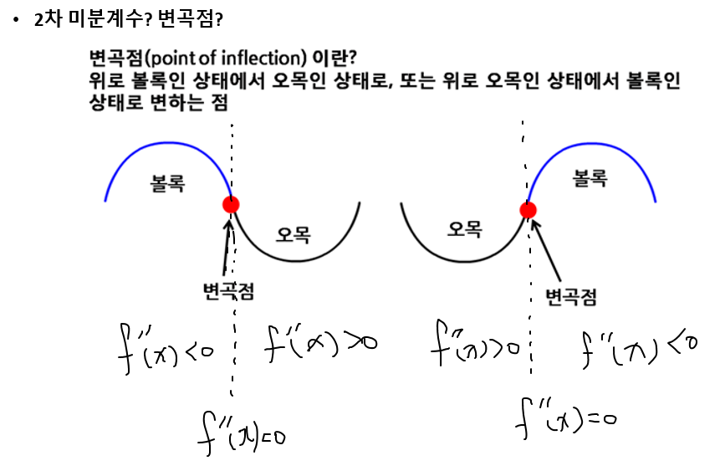
Second derivative? Point of inflection?
What is point of inflection?
The point where the curvature changes from convex to concave,
or from concave to convex.
convex
convex
concave
concave
point of inflection
point of inflection

