Slide 1




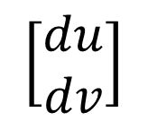







<비선형 변환 후의 결과를
국소적으로 관찰한 것>
<비선형 변환 전의 미소 변위>
$$v$$
$$v$$
$$\left[\begin{matrix}dx \\ dy\end{matrix}\right]$$
$$\left[\begin{matrix}du \\ dv\end{matrix}\right]$$
비선형 변환
$$dv$$
$$dy$$
$$dx$$
$$du$$
$$0$$
$$u$$
$$0$$
$$u$$

Slide 2
<Infinitesimal Displacement
before Nonlinear Transform>
<What is microscopically observed
after nonlinear transform>
$$v$$
$$v$$
$$\left[\begin{matrix}dx \\ dy\end{matrix}\right]$$
$$\left[\begin{matrix}du \\ dv\end{matrix}\right]$$
Nonlinear
Transform
$$dv$$
$$dy$$
$$dx$$
$$du$$
$$0$$
$$u$$
$$0$$
$$u$$

Slide 3







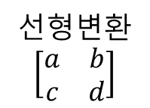








<행렬식의 기하학적 의미>
평행사변형의 넓이: $ad−bc$
$$y$$
$$y$$
선형변환
$$\left[\begin{matrix}a & b \\ c & d\end{matrix}\right]$$
$$A(a+b,c+d)$$
$$V(b,d)$$
$$Q(a,d)$$
$$P(0,d)$$
$$(0, 1)$$
$$U(a,c)$$
$$O$$
$$(1, 0)$$
$$x$$
$$O$$
$$R(a,0)$$
$$x$$

Slide 4

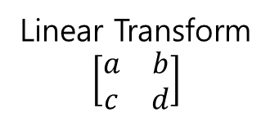
<Geometric Meaning of Determinant>
Area of Parallelogram: $ad−bc$
$$y$$
$$y$$
Linear Transform
$$\left[\begin{matrix}a & b \\ c & d\end{matrix}\right]$$
$$A(a+b,c+d)$$
$$V(b,d)$$
$$Q(a,d)$$
$$P(0,d)$$
$$(0, 1)$$
$$U(a,c)$$
$$O$$
$$(1, 0)$$
$$x$$
$$O$$
$$R(a,0)$$
$$x$$

Slide 5
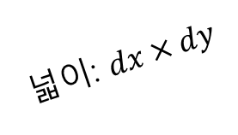

<비선형 변환 후의 결과를
국소적으로 관찰한 것>
<비선형 변환 전의 미소 변위>
$$v$$
$$v$$
넓이: $dx×dy$
넓이: $du×dv$
비선형 변환
$$dv$$
$$dy$$
$$dx$$
$$du$$
$$0$$
$$u$$
$$0$$
$$u$$

Slide 6
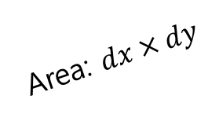

<Infinitesimal Placement
Before Nonlinear Transform>
< What is microscopically observed
after nonlinear transform >
$$v$$
$$v$$
Area: $dx×dy$
Area: $du×dv$
Nonlinear
Transform
$$dv$$
$$dy$$
$$dx$$
$$du$$
$$0$$
$$u$$
$$0$$
$$u$$

