Slide 1
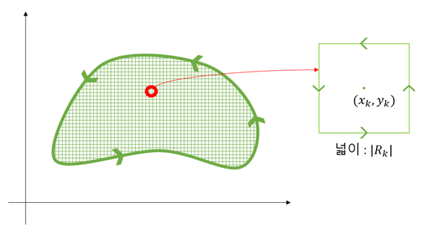

Area: $|R_{k}|$

