Slide 1

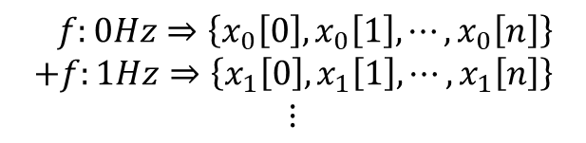
시간 축
$$x\left[k\right]=$$
$$f:0Hz⇒\left\{x_{0}\left[0\right], x_{0}\left[1\right], ⋯,x_{0}\left[n\right]\right\}$$
$$+f:1Hz⇒\left\{x_{1}\left[0\right], x_{1}\left[1\right], ⋯,x_{1}\left[n\right]\right\}$$
$$⋮$$
주파수 축

Slide 2
time axis
$$x\left[k\right]=$$
$$f:0Hz⇒\left\{x_{0}\left[0\right], x_{0}\left[1\right], ⋯,x_{0}\left[n\right]\right\}$$
$$+f:1Hz⇒\left\{x_{1}\left[0\right], x_{1}\left[1\right], ⋯,x_{1}\left[n\right]\right\}$$
$$⋮$$
frequency axis

Slide 3



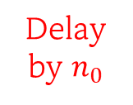

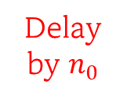
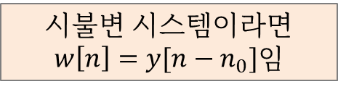


$$x[n]$$
Delay by $n_{0}$
$$x[n−n_{0}]$$
System
$$w[n]$$
시불변 시스템이라면 $w\left[n\right]=y[n−n_{0}]$임
$$x[n]$$
$$y[n]$$
Delay by $n_{0}$
System
$$y[n−n_{0}]$$

Slide 4
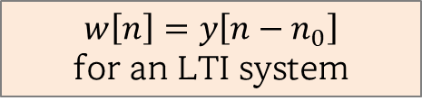
$$x[n]$$
Delay by $n_{0}$
$$x[n−n_{0}]$$
System
$$w[n]$$
$$w\left[n\right]=y\left[n−n_{0}\right]$$
for an LTI system
$$x[n]$$
$$y[n]$$
Delay by $n_{0}$
System
$$y[n−n_{0}]$$

Slide 5









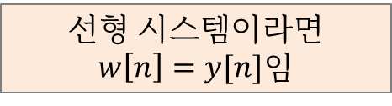




$$α$$
$$x_{1}[n]$$
$$y_{1}[n]$$
system
$$w[n]$$
$$x_{2}[n]$$
$$y_{2}[n]$$
system
$$β$$
$$α$$
선형 시스템이라면 $w\left[n\right]=y[n]$임
$$x_{1}[n]$$
$$x[n]$$
system
$$y[n]$$
$$x_{2}[n]$$
$$β$$

Slide 6
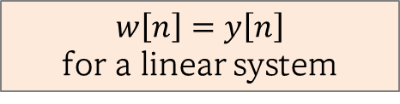
$$α$$
$$x_{1}[n]$$
$$y_{1}[n]$$
system
$$w[n]$$
$$x_{2}[n]$$
$$y_{2}[n]$$
system
$$β$$
$$α$$
$$w\left[n\right]=y\left[n\right]$$
for a linear system
$$x_{1}[n]$$
$$x[n]$$
system
$$y[n]$$
$$x_{2}[n]$$
$$β$$

