Slide 1
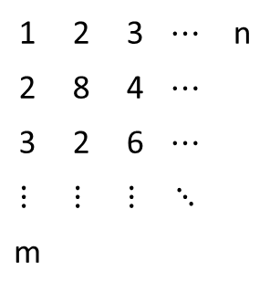
1 | 2 | 3 | $$⋯$$ | n
2 | 8 | 4 | $$⋯$$
3 | 2 | 6 | $$⋯$$
$$⋮$$ | $$⋮$$ | $$⋮$$ | $$⋱$$
m
row
column

Slide 2
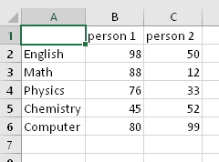
Examples of Matrix
Sets of Exam Scores
Sound Signals from Various Channels
Latitudes and Longitudes
Ch1:
Ch2:

Slide 3






$$size: m×n$$
$$size: m×n$$
$$size: m×n$$
$$size:1×1$$
$$size: m×n$$
$$size: m×n$$

Slide 4






$$size:1×n$$
$$size: m×n$$
$$size: m×n$$
$$size: m×n$$
$$size:m×1$$
$$size: m×n$$

Slide 5

$$size:1×n$$
$$size: m×n$$
$$size:m×1$$

Slide 6




$$size: m×n$$
$$size: m×p$$
$$size:m×1$$
$$size:p×1$$

Slide 7
col 1
col 2
col 3
col 4
A: 4x5 matrix
A(1,1) | A(1,2) | A(1,3) | A(1,4)
A(2,1) | A(2,2) | A(2,3) | A(2,4)
A(3,1) | A(3,2) | A(3,3) | A(3,4)
row 1
row 2
A(2,4)
row 3
number
of row
number
of column

Slide 8


A(1,1) | A(1,2) | A(1,3) | A(1,4)
A(2,1) | A(2,2) | A(2,3) | A(2,4)
A(3,1) | A(3,2) | A(3,3) | A(3,4)
$$A(:, 1)$$
A(1,1)
A(2,1)
$$A(3, :)$$
A(3,1)
A(3,1)
A(3,2)
A(3,3)
A(3,4)

Slide 9

1 | 2
3 | 4
plot(A)
$$A:$$

Slide 10

1 | 2
3 | 4
imagesc(A)
$$A:$$

Slide 11
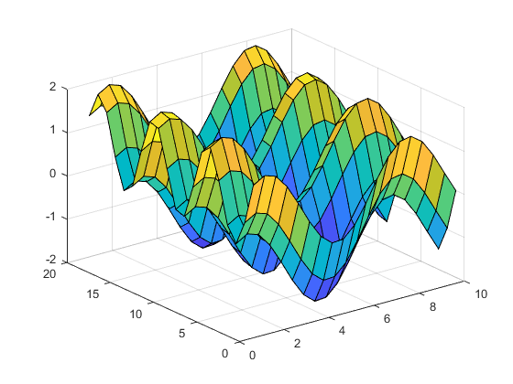
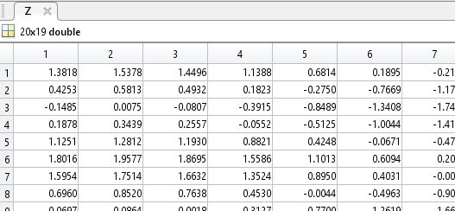





surf(X, Y, Z)
$$Each of element as "height"$$
$$y$$
$$y$$
$$x$$
$$x$$

Slide 12

1 | 2
3 | 4
$$A:$$
sum(A)
4 | 6

