Slide 1

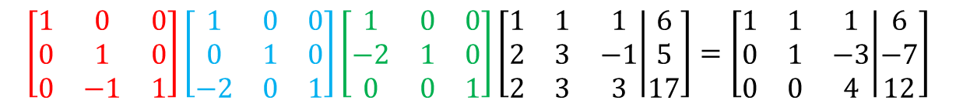



$$r_{3}→(r_{3}−r_{2})$$
$$r_{2}→\left(r_{2}−2r_{1}\right)$$
$$\left[\begin{matrix}1 & 0 & 0 \\ 0 & 1 & 0 \\ 0 & −1 & 1\end{matrix}\right]\left[\begin{matrix}1 & 0 & 0 \\ 0 & 1 & 0 \\ −2 & 0 & 1\end{matrix}\right]\left[\begin{matrix}1 & 0 & 0 \\ −2 & 1 & 0 \\ 0 & 0 & 1\end{matrix}\right]\left[\begin{matrix}1 & 1 & 1 \\ 2 & 3 & −1 \\ 2 & 3 & 3\end{matrix} | \begin{matrix}6 \\ 5 \\ 17\end{matrix}\right]=\left[\begin{matrix}1 & 1 & 1 \\ 0 & 1 & −3 \\ 0 & 0 & 4\end{matrix} | \begin{matrix}6 \\ −7 \\ 12\end{matrix}\right]$$
$$r_{3}→(r_{3}−2r_{1})$$
$$[A|b]$$

Slide 2

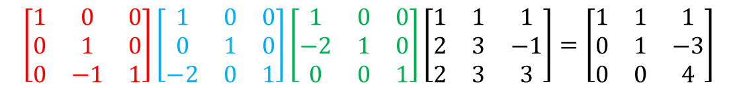



$$r_{3}→(r_{3}−r_{2})$$
$$r_{2}→\left(r_{2}−2r_{1}\right)$$
$$\left[\begin{matrix}1 & 0 & 0 \\ 0 & 1 & 0 \\ 0 & −1 & 1\end{matrix}\right]\left[\begin{matrix}1 & 0 & 0 \\ 0 & 1 & 0 \\ −2 & 0 & 1\end{matrix}\right]\left[\begin{matrix}1 & 0 & 0 \\ −2 & 1 & 0 \\ 0 & 0 & 1\end{matrix}\right]\left[\begin{matrix}1 & 1 & 1 \\ 2 & 3 & −1 \\ 2 & 3 & 3\end{matrix}\right]=\left[\begin{matrix}1 & 1 & 1 \\ 0 & 1 & −3 \\ 0 & 0 & 4\end{matrix}\right]$$
$$r_{3}→(r_{3}−2r_{1})$$
$$A$$

Slide 3


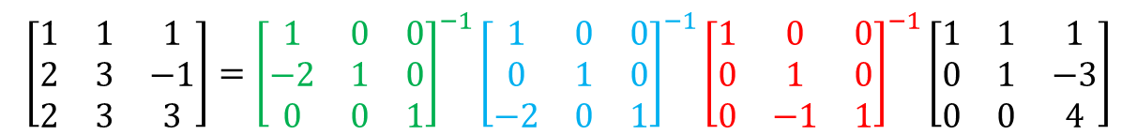
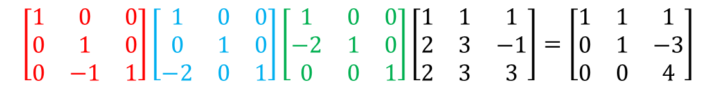



$$r_{3}→(r_{3}−r_{2})$$
$$r_{2}→\left(r_{2}−2r_{1}\right)$$
$$\left[\begin{matrix}1 & 0 & 0 \\ 0 & 1 & 0 \\ 0 & −1 & 1\end{matrix}\right]\left[\begin{matrix}1 & 0 & 0 \\ 0 & 1 & 0 \\ −2 & 0 & 1\end{matrix}\right]\left[\begin{matrix}1 & 0 & 0 \\ −2 & 1 & 0 \\ 0 & 0 & 1\end{matrix}\right]\left[\begin{matrix}1 & 1 & 1 \\ 2 & 3 & −1 \\ 2 & 3 & 3\end{matrix}\right]=\left[\begin{matrix}1 & 1 & 1 \\ 0 & 1 & −3 \\ 0 & 0 & 4\end{matrix}\right]$$
$$r_{3}→(r_{3}−2r_{1})$$
$$A$$
기본 행렬의
역행렬 곱해주기
$$\left[\begin{matrix}1 & 1 & 1 \\ 2 & 3 & −1 \\ 2 & 3 & 3\end{matrix}\right]={\left[\begin{matrix}1 & 0 & 0 \\ −2 & 1 & 0 \\ 0 & 0 & 1\end{matrix}\right]}^{−1}{\left[\begin{matrix}1 & 0 & 0 \\ 0 & 1 & 0 \\ −2 & 0 & 1\end{matrix}\right]}^{−1}{\left[\begin{matrix}1 & 0 & 0 \\ 0 & 1 & 0 \\ 0 & −1 & 1\end{matrix}\right]}^{−1}\left[\begin{matrix}1 & 1 & 1 \\ 0 & 1 & −3 \\ 0 & 0 & 4\end{matrix}\right]$$
$$A$$

Slide 4
$$r_{3}→(r_{3}−r_{2})$$
$$r_{2}→\left(r_{2}−2r_{1}\right)$$
$$\left[\begin{matrix}1 & 0 & 0 \\ 0 & 1 & 0 \\ 0 & −1 & 1\end{matrix}\right]\left[\begin{matrix}1 & 0 & 0 \\ 0 & 1 & 0 \\ −2 & 0 & 1\end{matrix}\right]\left[\begin{matrix}1 & 0 & 0 \\ −2 & 1 & 0 \\ 0 & 0 & 1\end{matrix}\right]\left[\begin{matrix}1 & 1 & 1 \\ 2 & 3 & −1 \\ 2 & 3 & 3\end{matrix}\right]=\left[\begin{matrix}1 & 1 & 1 \\ 0 & 1 & −3 \\ 0 & 0 & 4\end{matrix}\right]$$
$$r_{3}→(r_{3}−2r_{1})$$
$$A$$
multiplying inverses
of elementary matrices
$$\left[\begin{matrix}1 & 1 & 1 \\ 2 & 3 & −1 \\ 2 & 3 & 3\end{matrix}\right]={\left[\begin{matrix}1 & 0 & 0 \\ −2 & 1 & 0 \\ 0 & 0 & 1\end{matrix}\right]}^{−1}{\left[\begin{matrix}1 & 0 & 0 \\ 0 & 1 & 0 \\ −2 & 0 & 1\end{matrix}\right]}^{−1}{\left[\begin{matrix}1 & 0 & 0 \\ 0 & 1 & 0 \\ 0 & −1 & 1\end{matrix}\right]}^{−1}\left[\begin{matrix}1 & 1 & 1 \\ 0 & 1 & −3 \\ 0 & 0 & 4\end{matrix}\right]$$
$$A$$

Slide 5
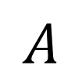

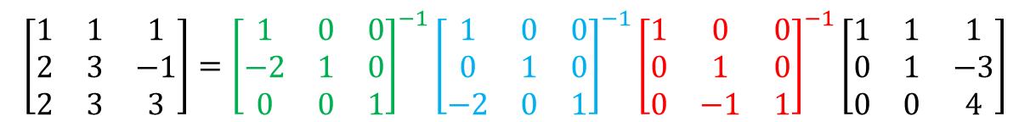

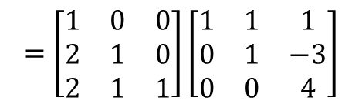
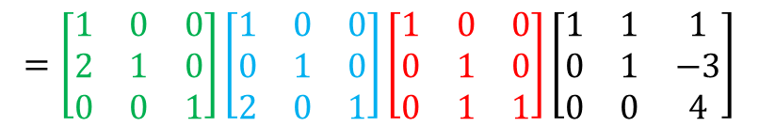
$$A$$
$$\left[\begin{matrix}1 & 1 & 1 \\ 2 & 3 & −1 \\ 2 & 3 & 3\end{matrix}\right]={\left[\begin{matrix}1 & 0 & 0 \\ −2 & 1 & 0 \\ 0 & 0 & 1\end{matrix}\right]}^{−1}{\left[\begin{matrix}1 & 0 & 0 \\ 0 & 1 & 0 \\ −2 & 0 & 1\end{matrix}\right]}^{−1}{\left[\begin{matrix}1 & 0 & 0 \\ 0 & 1 & 0 \\ 0 & −1 & 1\end{matrix}\right]}^{−1}\left[\begin{matrix}1 & 1 & 1 \\ 0 & 1 & −3 \\ 0 & 0 & 4\end{matrix}\right]$$
$$=\left[\begin{matrix}1 & 0 & 0 \\ 2 & 1 & 0 \\ 0 & 0 & 1\end{matrix}\right]\left[\begin{matrix}1 & 0 & 0 \\ 0 & 1 & 0 \\ 2 & 0 & 1\end{matrix}\right]\left[\begin{matrix}1 & 0 & 0 \\ 0 & 1 & 0 \\ 0 & 1 & 1\end{matrix}\right]\left[\begin{matrix}1 & 1 & 1 \\ 0 & 1 & −3 \\ 0 & 0 & 4\end{matrix}\right]$$
$$=\left[\begin{matrix}1 & 0 & 0 \\ 2 & 1 & 0 \\ 2 & 1 & 1\end{matrix}\right]\left[\begin{matrix}1 & 1 & 1 \\ 0 & 1 & −3 \\ 0 & 0 & 4\end{matrix}\right]$$
$$L$$
$$U$$

