Slide 1
MATLAB
for
Everybody
The quickest way to learn MATLAB
is to type in what you want to

Slide 2
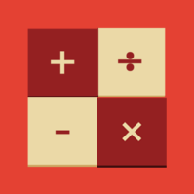
MATLAB
&
Simulink
for
Everybody

