Slide 1
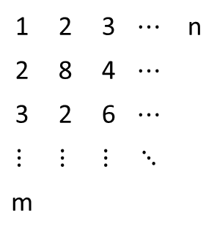
1 | 2 | 3 | $$⋯$$ | n
2 | 8 | 4 | $$⋯$$
3 | 2 | 6 | $$⋯$$
$$⋮$$ | $$⋮$$ | $$⋮$$ | $$⋱$$
m
row
column

Slide 2
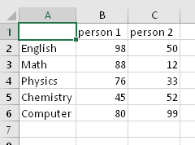
Examples of Matrix
Sets of Exam Scores
Sound Signals from Various Channels
Latitudes and Longitudes
Ch1:
Ch2:

Slide 3
1열
2열
3열
4열
5열
A: 4x5 행렬
A(1,1) | A(1,2) | A(1,3) | A(1,4) | A(1,5)
A(2,1) | A(2,2) | A(2,3) | A(2,4) | A(2,5)
A(3,1) | A(3,2) | A(3,3) | A(3,4) | A(3,5)
A(4,1) | A(4,2) | A(4,3) | A(4,4) | A(4,5)
1행
2행
A(2,5)
3행
행 번호
열 번호
4행

