Slide 1
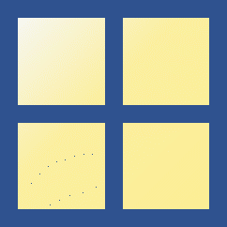




Scope of numeric type variables
multi-dimensional arrays
(e.g., tensor)
$$m×n×l⋯$$
Numeric
matrix
$$m×n$$
vector
$$n×1$$
scalar
$$1×1$$

Slide 2
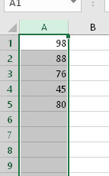
Examples of vector
Exam scores
Sound Signals
Images
7
6
5
5
5
2
1
1
3
4
4
4
3
1
3
2
2
3
2
1
3
2
4
3
2

Slide 3
vector
vector
vector
vector
vector
scalar
+
=
+
=

Slide 4





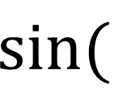









vector
vector
vector
$$0$$
$$0$$
$$0$$
$$\frac{π}{2}$$
scalar
$$1$$
$$1$$
$$\sin{(}$$
$$)$$
=
sum(
)
=
$$6$$
$$π$$
$$0$$
$$2$$
$$\frac{3π}{2}$$
$$−1$$
$$3$$

Slide 5
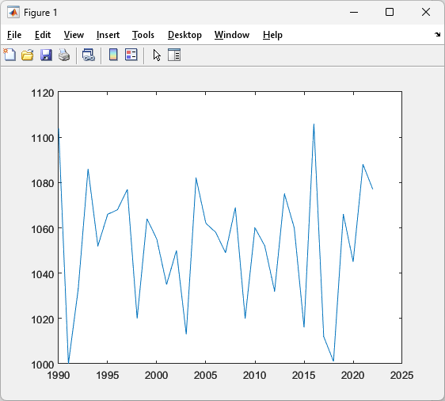

vector
vector
plot(
)
,
$$n×1$$
$$n×1$$
x-axis
y-axis

