Slide 1
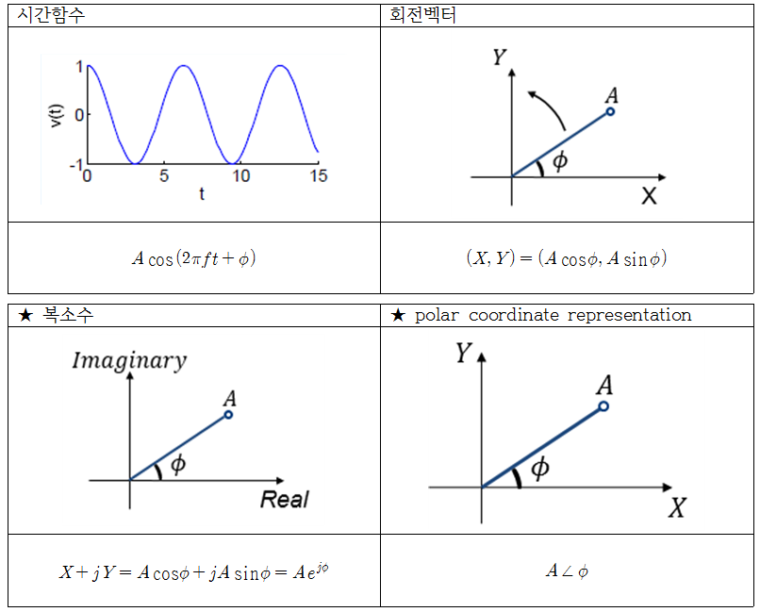
Time Series
Rotating Vector
Complex Number
Polar Coordinate Representation

Slide 2
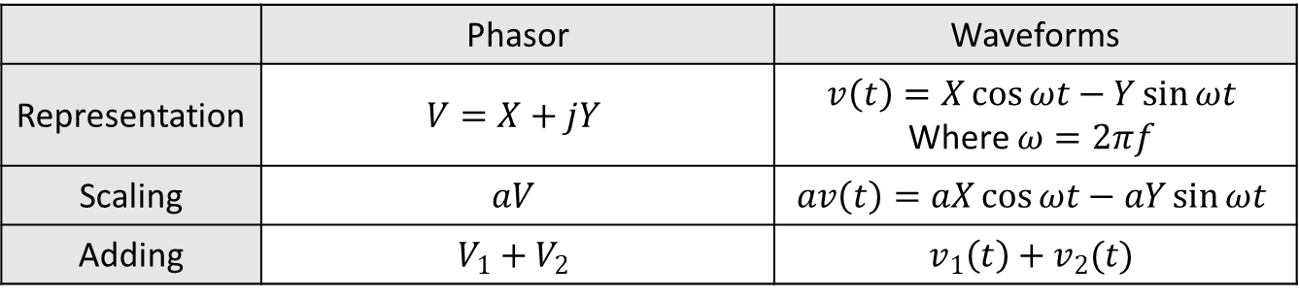
 | Phasor | Waveforms
Representation | $$V=X+jY$$ | $$v\left(t\right)=X\cos{ωt}−Y\sin{ωt}$$ Where $ω=2πf$
Scaling | $$aV$$ | $$av\left(t\right)=aX\cos{ωt}−aY\sin{ωt}$$
Adding | $$V_{1}+V_{2}$$ | $$v_{1}\left(t\right)+v_{2}(t)$$

Slide 3
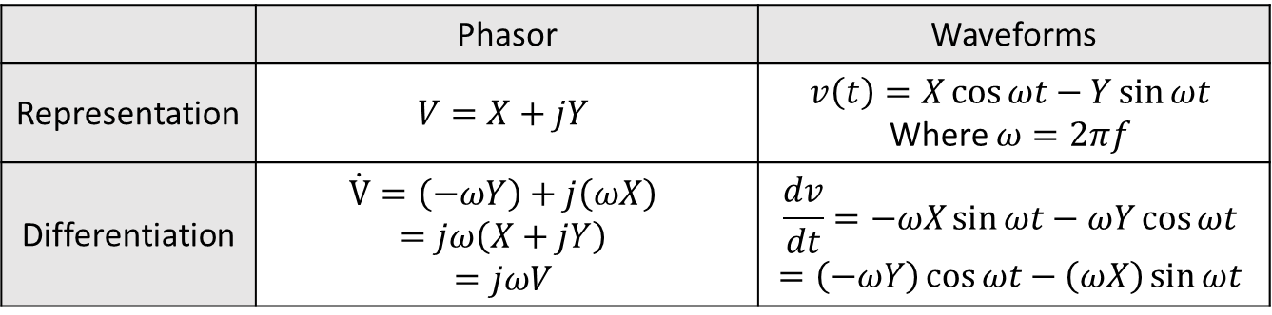
 | Phasor | Waveforms
Representation | $$V=X+jY$$ | $$v\left(t\right)=X\cos{ωt}−Y\sin{ωt}$$ Where $ω=2πf$
Differentiation | $$\dot{V}=\left(−ωY\right)+j\left(ωX\right)$$ $$=jω\left(X+jY\right)$$ $$=jωV$$ | $$\frac{dv}{dt}=−ωX\sin{ωt}−ωY\cos{ωt}$$ $$=\left(−ωY\right)\cos{ωt}−\left(ωX\right)\sin{ωt}$$

