Slide 1

삼각형이 몇 개
들어있을까요?
☆전체와 부분☆

Slide 2
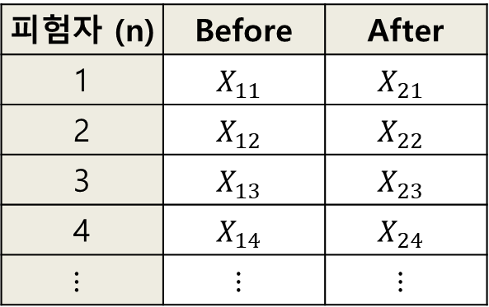
피험자 (n) | Before | After
1 | $$X_{11}$$ | $$X_{21}$$
2 | $$X_{12}$$ | $$X_{22}$$
3 | $$X_{13}$$ | $$X_{23}$$
4 | $$X_{14}$$ | $$X_{24}$$
$$⋮$$ | $$⋮$$ | $$⋮$$

Slide 3
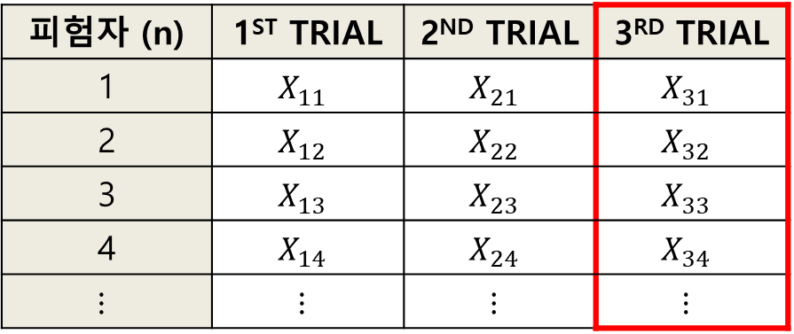
피험자 (n) | 1ST TRIAL | 2ND TRIAL | 3RD TRIAL
1 | $$X_{11}$$ | $$X_{21}$$ | $$X_{31}$$
2 | $$X_{12}$$ | $$X_{22}$$ | $$X_{32}$$
3 | $$X_{13}$$ | $$X_{23}$$ | $$X_{33}$$
4 | $$X_{14}$$ | $$X_{24}$$ | $$X_{34}$$
$$⋮$$ | $$⋮$$ | $$⋮$$ | $$⋮$$

Slide 4
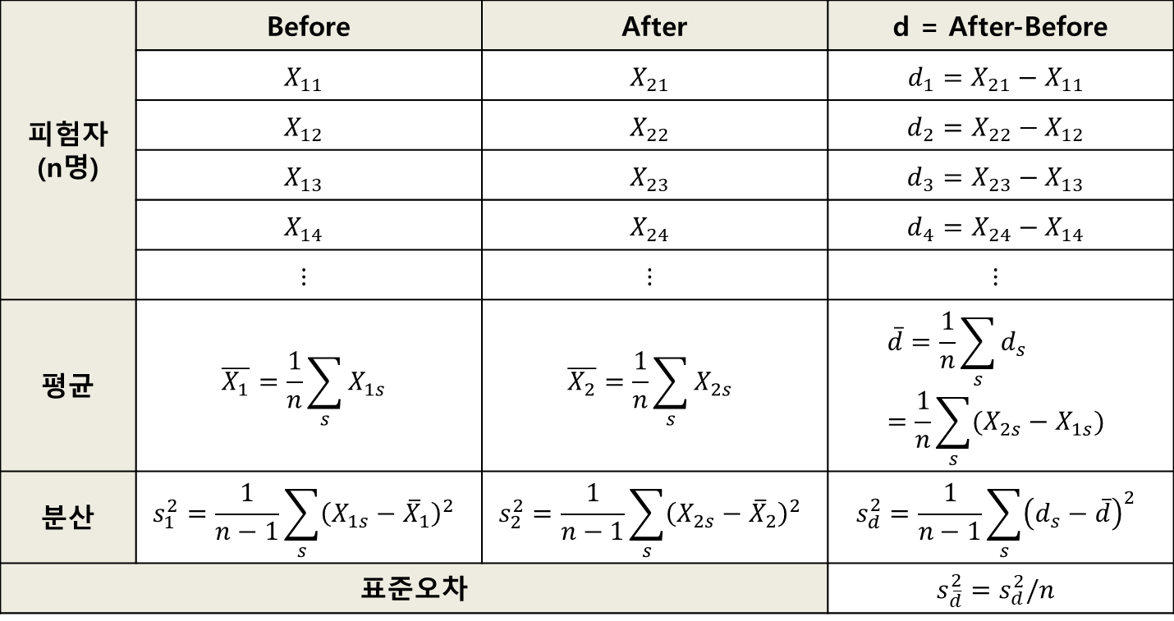
피험자 (n명) | Before | After | d = After-Before
 | $$X_{11}$$ | $$X_{21}$$ | $$d_{1}=X_{21}−X_{11}$$
 | $$X_{12}$$ | $$X_{22}$$ | $$d_{2}=X_{22}−X_{12}$$
 | $$X_{13}$$ | $$X_{23}$$ | $$d_{3}=X_{23}−X_{13}$$
 | $$X_{14}$$ | $$X_{24}$$ | $$d_{4}=X_{24}−X_{14}$$
 | $$⋮$$ | $$⋮$$ | $$⋮$$
평균 | $$\overline{X_{1}}=\frac{1}{n}\sum_{s}{X_{1s}}$$ | $$\overline{X_{2}}=\frac{1}{n}\sum_{s}{X_{2s}}$$ | $$\overline{d}=\frac{1}{n}\sum_{s}{d_{s}}=\frac{1}{n}\sum_{s}{(X_{2s}−X_{1s})}$$
분산 | $$s_{1}^{2}=\frac{1}{n−1}\sum_{s}{{\left(X_{1s}−{\overline{X}}_{1}\right)}^{2}}$$ | $$s_{2}^{2}=\frac{1}{n−1}\sum_{s}{{\left(X_{2s}−{\overline{X}}_{2}\right)}^{2}}$$ | $$s_{d}^{2}=\frac{1}{n−1}\sum_{s}{{\left(d_{s}−\overline{d}\right)}^{2}}$$
표준오차 |  |  | $$s_{\overline{d}}^{2}=s_{d}^{2}/n$$

Slide 5
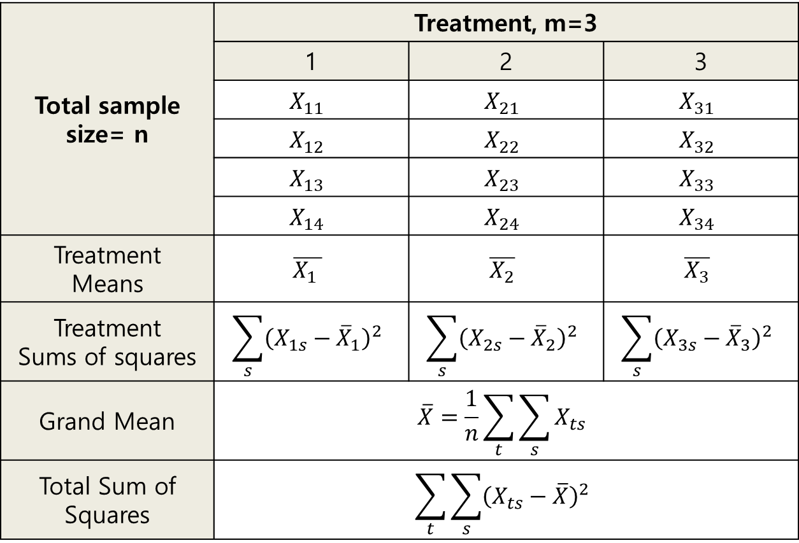
Total sample size= n | Treatment, m=3
 | 1 | 2 | 3
 | $$X_{11}$$ | $$X_{21}$$ | $$X_{31}$$
 | $$X_{12}$$ | $$X_{22}$$ | $$X_{32}$$
 | $$X_{13}$$ | $$X_{23}$$ | $$X_{33}$$
 | $$X_{14}$$ | $$X_{24}$$ | $$X_{34}$$
Treatment Means | $$\overline{X_{1 }}$$ | $$\overline{X_{2}}$$ | $$\overline{X_{3}}$$
Treatment Sums of squares | $$\sum_{s}{{\left(X_{1s}−{\overline{X}}_{1}\right)}^{2}}$$ | $$\sum_{s}{{\left(X_{2s}−{\overline{X}}_{2}\right)}^{2}}$$ | $$\sum_{s}{{\left(X_{3s}−{\overline{X}}_{3}\right)}^{2}}$$
Grand Mean | $$\overline{X}=\frac{1}{n}\sum_{t}{\sum_{s}{X_{ts}}}$$
Total Sum of Squares | $$\sum_{t}{\sum_{s}{{\left(X_{ts}−\overline{X}\right)}^{2}}}$$

Slide 6
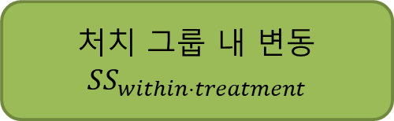
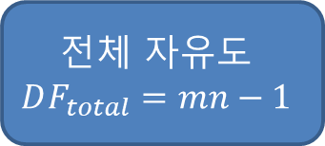
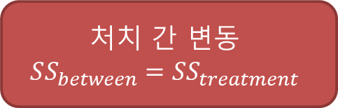
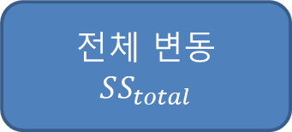
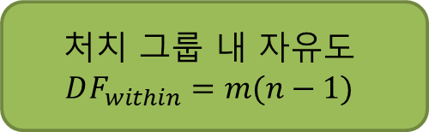
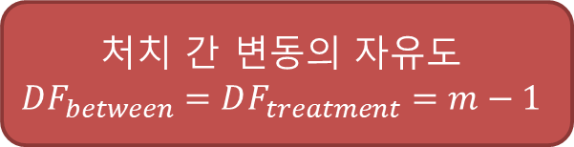
전체 변동
$$SS_{total}$$
처치 간 변동
$$SS_{between}=SS_{treatment}$$
처치 그룹 내 변동
$$SS_{within⋅treatment}$$
전체 자유도
$$DF_{total}=mn−1$$
처치 간 변동의 자유도
$$DF_{between}=DF_{treatment}=m−1$$
처치 그룹 내 자유도
$$DF_{within}=m(n−1)$$

Slide 7
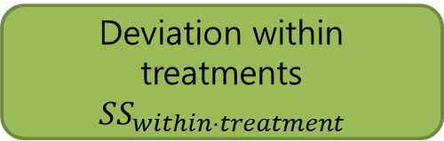
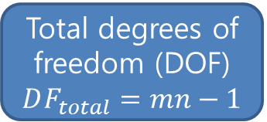
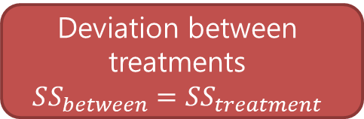
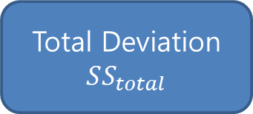
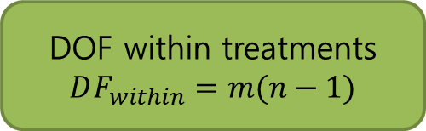
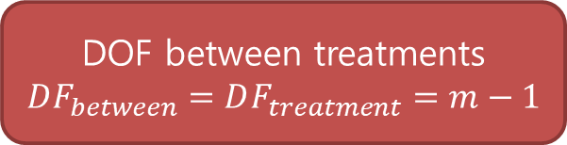
Total Deviation
$$SS_{total}$$
Deviation between treatments
$$SS_{between}=SS_{treatment}$$
Deviation within treatments
$$SS_{within⋅treatment}$$
Total degrees of freedom (DOF)
$$DF_{total}=mn−1$$
DOF between treatments
$$DF_{between}=DF_{treatment}=m−1$$
DOF within treatments
$$DF_{within}=m(n−1)$$

Slide 8

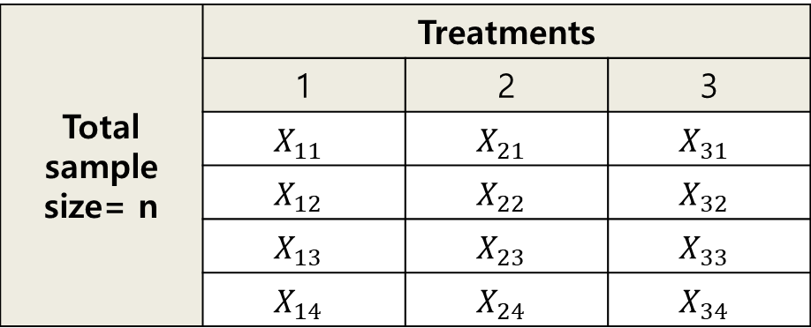

<One-way ANOVA 이용 시 Sum of Squares 분석 방향과 명칭>
Total sample size= n | Treatments
 | 1 | 2 | 3
 | $$X_{11}$$ | $$X_{21}$$ | $$X_{31}$$
 | $$X_{12}$$ | $$X_{22}$$ | $$X_{32}$$
 | $$X_{13}$$ | $$X_{23}$$ | $$X_{33}$$
 | $$X_{14}$$ | $$X_{24}$$ | $$X_{34}$$
$$SS_{\begin{aligned}between \\ treatment\end{aligned}}$$
$$SS_{\begin{aligned}within \\ treatment\end{aligned}}$$

Slide 9
<Analysis direction and naming of Sum of Squares with One-way ANOVA>
Total sample size= n | Treatments
 | 1 | 2 | 3
 | $$X_{11}$$ | $$X_{21}$$ | $$X_{31}$$
 | $$X_{12}$$ | $$X_{22}$$ | $$X_{32}$$
 | $$X_{13}$$ | $$X_{23}$$ | $$X_{33}$$
 | $$X_{14}$$ | $$X_{24}$$ | $$X_{34}$$
$$SS_{\begin{aligned}between \\ treatment\end{aligned}}$$
$$SS_{\begin{aligned}within \\ treatment\end{aligned}}$$

Slide 10
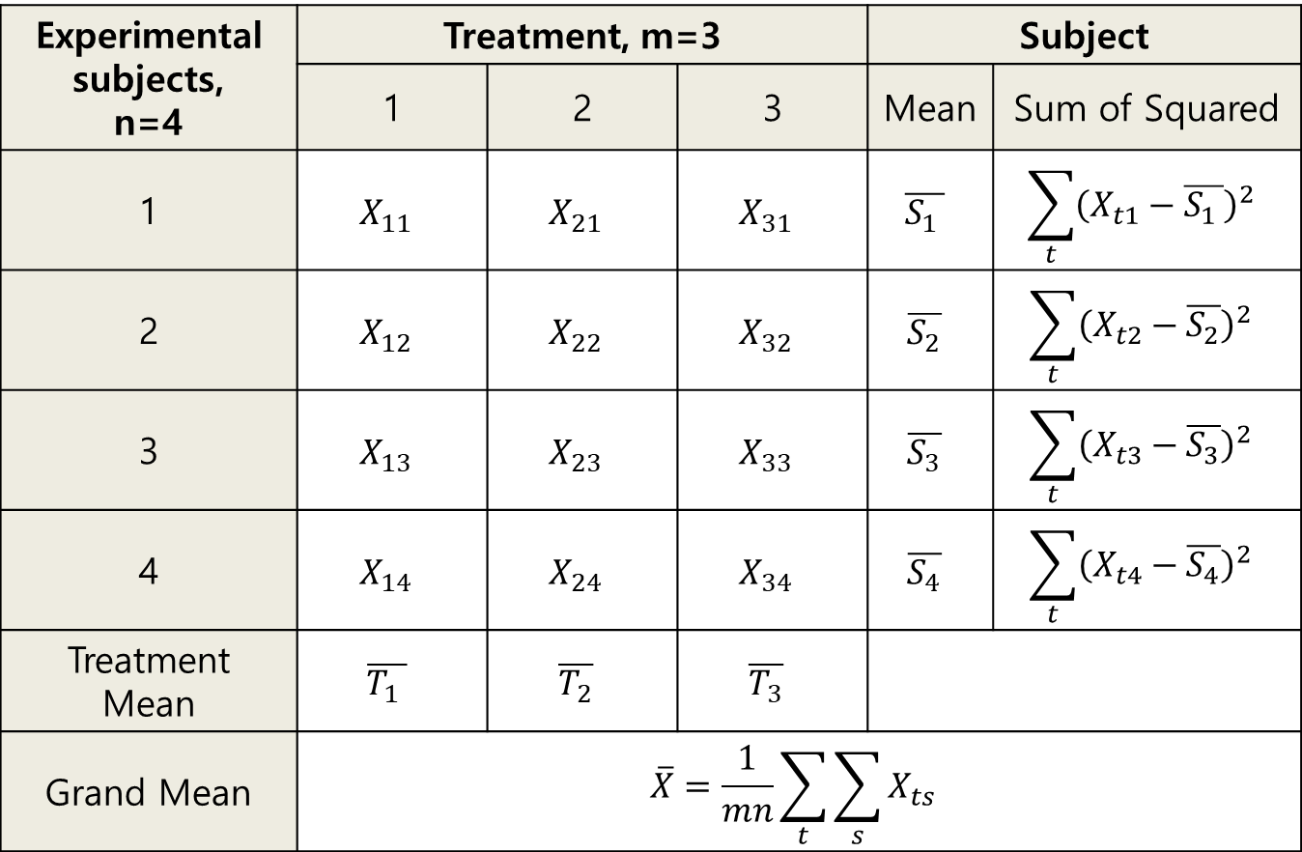
Experimental subjects, n=4 | Treatment, m=3 |  |  | Subject
 | 1 | 2 | 3 | Mean | Sum of Squared
1 | $$X_{11}$$ | $$X_{21}$$ | $$X_{31}$$ | $$\overline{S_{1 }}$$ | $$\sum_{t}{{\left(X_{t1}−\overline{S_{1 }}\right)}^{2}}$$
2 | $$X_{12}$$ | $$X_{22}$$ | $$X_{32}$$ | $$\overline{S_{2}}$$ | $$\sum_{t}{{\left(X_{t2}−\overline{S_{2}}\right)}^{2}}$$
3 | $$X_{13}$$ | $$X_{23}$$ | $$X_{33}$$ | $$\overline{S_{3}}$$ | $$\sum_{t}{{\left(X_{t3}−\overline{S_{3}}\right)}^{2}}$$
4 | $$X_{14}$$ | $$X_{24}$$ | $$X_{34}$$ | $$\overline{S_{4}}$$ | $$\sum_{t}{{\left(X_{t4}−\overline{S_{4}}\right)}^{2}}$$
Treatment Mean | $$\overline{T_{1 }}$$ | $$\overline{T_{2}}$$ | $$\overline{T_{3}}$$
Grand Mean | $$\overline{X}=\frac{1}{mn}\sum_{t}{\sum_{s}{X_{ts}}}$$

Slide 11
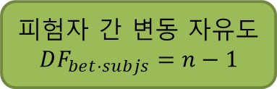
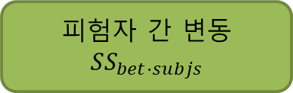
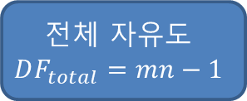
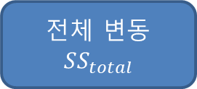

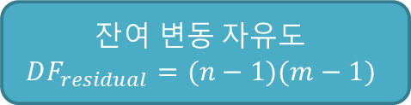
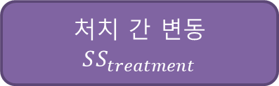
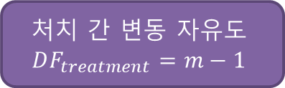
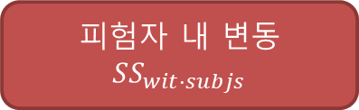
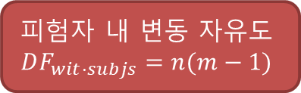
전체 변동
$$SS_{total}$$
피험자 간 변동
$$SS_{bet⋅subjs}$$
피험자 내 변동
$$SS_{wit⋅subjs}$$
처치 간 변동
$$SS_{treatment}$$
$$잔여 변동$$
$$SS_{residual}$$
전체 자유도
$$DF_{total}=mn−1$$
피험자 간 변동 자유도
$$DF_{bet⋅subjs}=n−1$$
피험자 내 변동 자유도
$$DF_{wit⋅subjs}=n(m−1)$$
처치 간 변동 자유도
$$DF_{treatment}=m−1$$
$$잔여 변동 자유도$$
$$DF_{residual}=(n−1)(m−1)$$

Slide 12
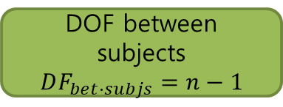
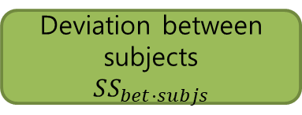
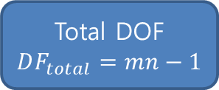
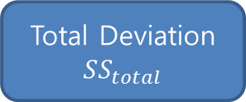
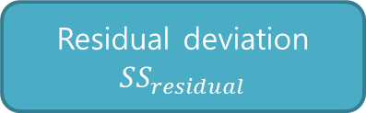
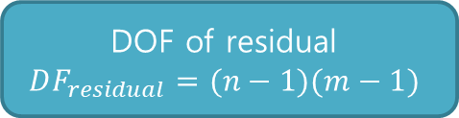
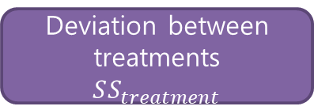
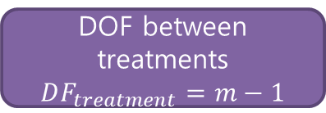
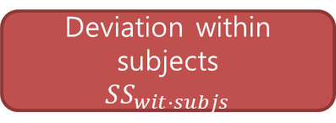
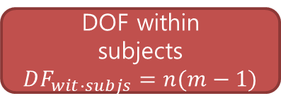
Total Deviation
$$SS_{total}$$
Deviation between subjects
$$SS_{bet⋅subjs}$$
Deviation within subjects
$$SS_{wit⋅subjs}$$
Deviation between treatments
$$SS_{treatment}$$
Residual deviation
$$SS_{residual}$$
Total DOF
$$DF_{total}=mn−1$$
DOF between subjects
$$DF_{bet⋅subjs}=n−1$$
DOF within
subjects
$$DF_{wit⋅subjs}=n(m−1)$$
DOF between treatments
$$DF_{treatment}=m−1$$
DOF of residual
$$DF_{residual}=(n−1)(m−1)$$

Slide 13
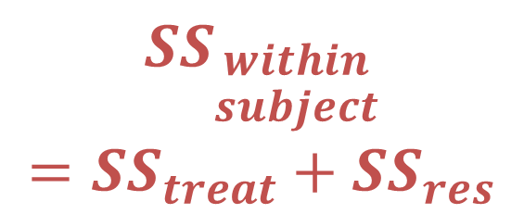
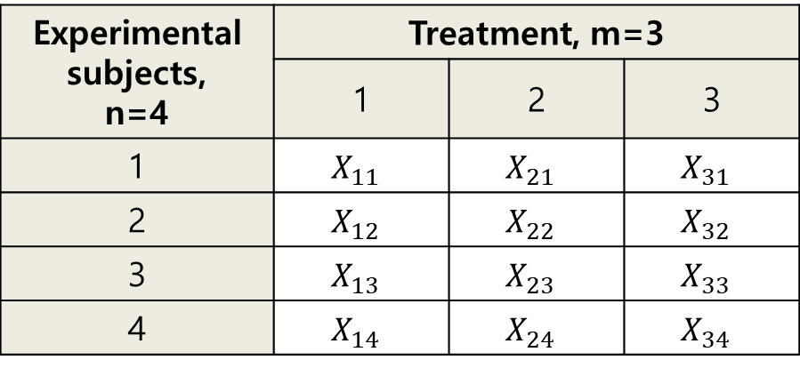

<One-way RM ANOVA 이용 시 Sum of Squares 분석 방향과 명칭>
Experimental subjects, n=4 | Treatment, m=3
 | 1 | 2 | 3
1 | $$X_{11}$$ | $$X_{21}$$ | $$X_{31}$$
2 | $$X_{12}$$ | $$X_{22}$$ | $$X_{32}$$
3 | $$X_{13}$$ | $$X_{23}$$ | $$X_{33}$$
4 | $$X_{14}$$ | $$X_{24}$$ | $$X_{34}$$
$$SS_{\begin{aligned}within \\ subject\end{aligned}}$$
$$=SS_{treat}+SS_{res}$$
$$SS_{\begin{aligned}between \\ subjects\end{aligned}}$$

Slide 14
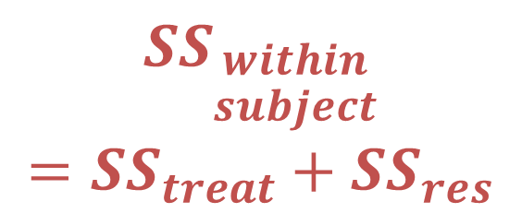
< Analysis direction and naming of Sum of Squares with One-way RM ANOVA >
Experimental subjects, n=4 | Treatment, m=3
 | 1 | 2 | 3
1 | $$X_{11}$$ | $$X_{21}$$ | $$X_{31}$$
2 | $$X_{12}$$ | $$X_{22}$$ | $$X_{32}$$
3 | $$X_{13}$$ | $$X_{23}$$ | $$X_{33}$$
4 | $$X_{14}$$ | $$X_{24}$$ | $$X_{34}$$
$$SS_{\begin{aligned}within \\ subject\end{aligned}}$$
$$=SS_{treat}+SS_{res}$$
$$SS_{\begin{aligned}between \\ subjects\end{aligned}}$$

Slide 15
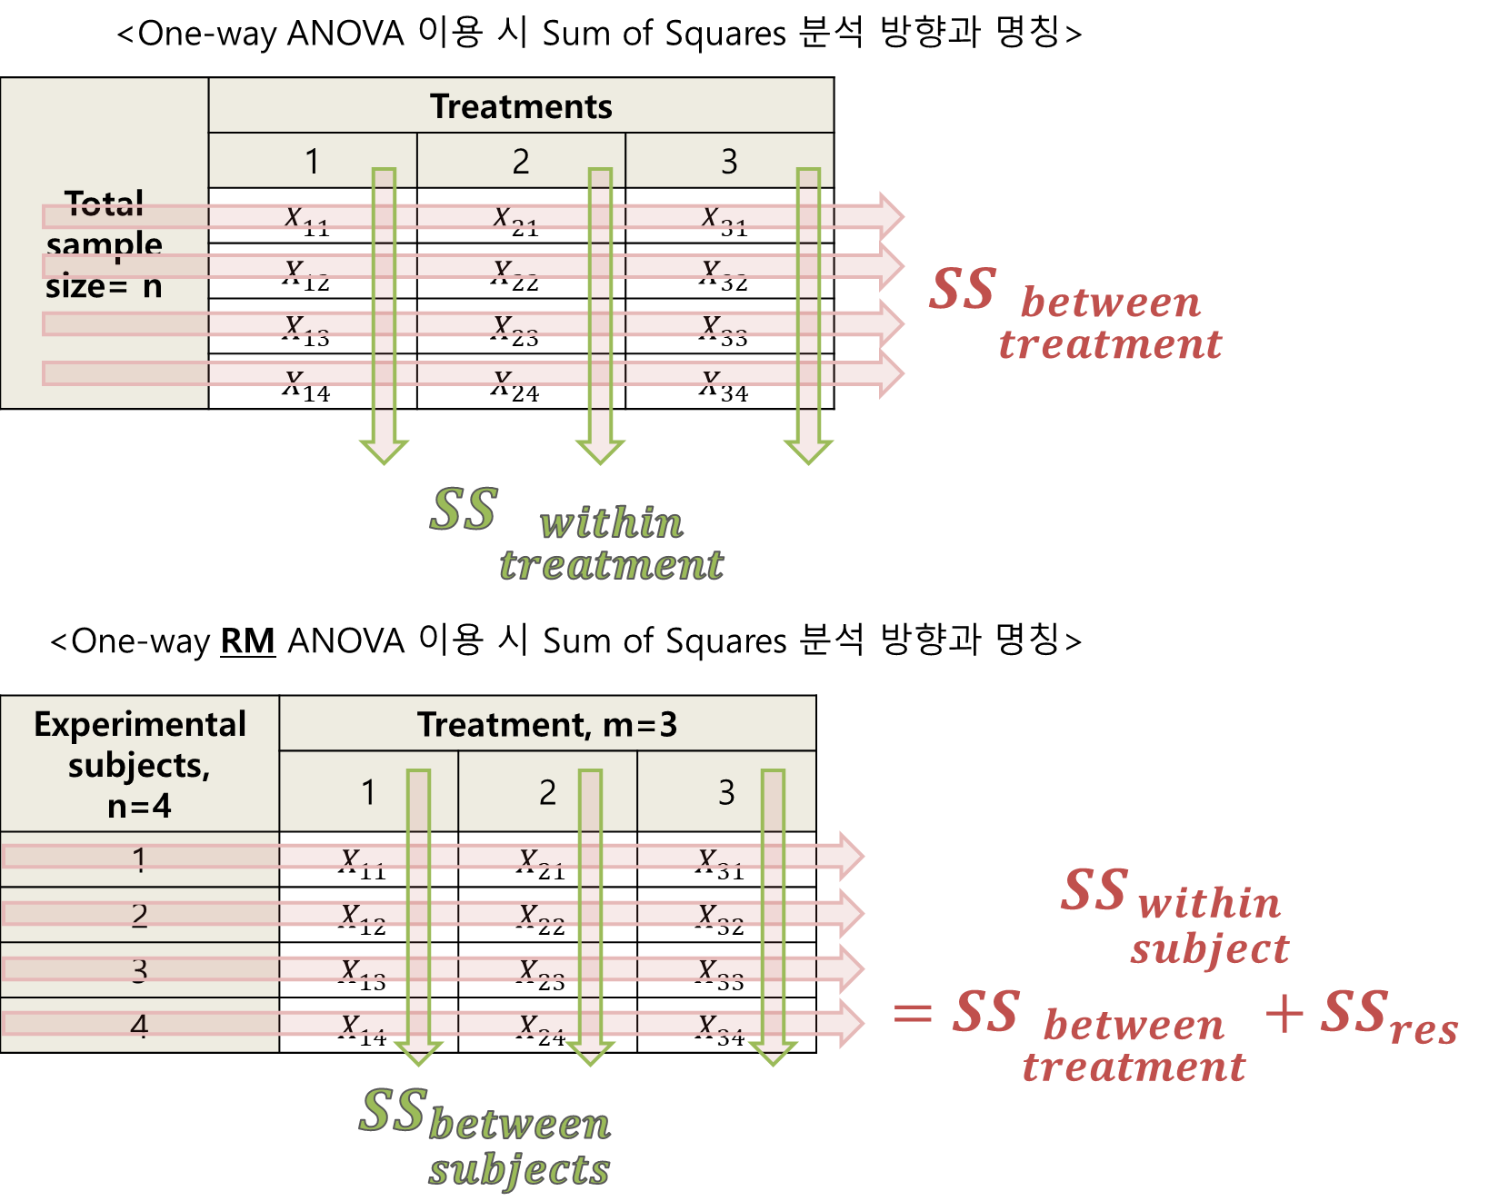
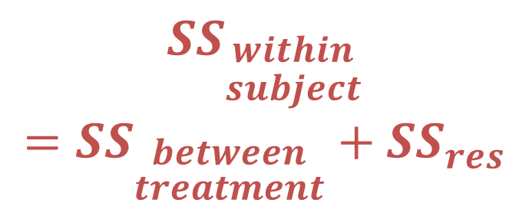



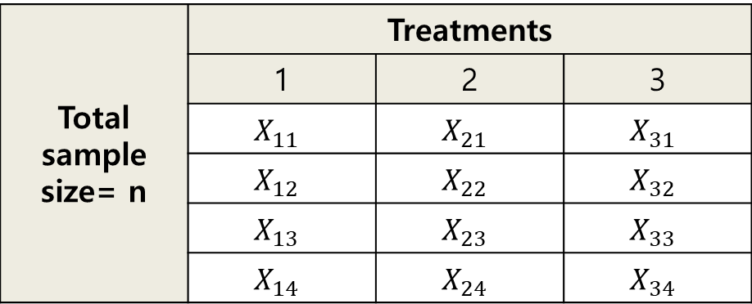

<One-way ANOVA 이용 시 Sum of Squares 분석 방향과 명칭>
Total sample size= n | Treatments
 | 1 | 2 | 3
 | $$X_{11}$$ | $$X_{21}$$ | $$X_{31}$$
 | $$X_{12}$$ | $$X_{22}$$ | $$X_{32}$$
 | $$X_{13}$$ | $$X_{23}$$ | $$X_{33}$$
 | $$X_{14}$$ | $$X_{24}$$ | $$X_{34}$$
$$SS_{\begin{aligned}between \\ treatment\end{aligned}}$$
$$SS_{\begin{aligned}within \\ treatment\end{aligned}}$$
<One-way RM ANOVA 이용 시 Sum of Squares 분석 방향과 명칭>
Experimental subjects, n=4 | Treatment, m=3
 | 1 | 2 | 3
1 | $$X_{11}$$ | $$X_{21}$$ | $$X_{31}$$
2 | $$X_{12}$$ | $$X_{22}$$ | $$X_{32}$$
3 | $$X_{13}$$ | $$X_{23}$$ | $$X_{33}$$
4 | $$X_{14}$$ | $$X_{24}$$ | $$X_{34}$$
$$SS_{\begin{aligned}within \\ subject\end{aligned}}$$
$$=SS_{\begin{aligned}between \\ treatment\end{aligned}}+SS_{res}$$
$$SS_{\begin{aligned}between \\ subjects\end{aligned}}$$

Slide 16

<Analysis direction and naming of Sum of Squares with One-way ANOVA>
Total sample size= n | Treatments
 | 1 | 2 | 3
 | $$X_{11}$$ | $$X_{21}$$ | $$X_{31}$$
 | $$X_{12}$$ | $$X_{22}$$ | $$X_{32}$$
 | $$X_{13}$$ | $$X_{23}$$ | $$X_{33}$$
 | $$X_{14}$$ | $$X_{24}$$ | $$X_{34}$$
$$SS_{\begin{aligned}between \\ treatment\end{aligned}}$$
$$SS_{\begin{aligned}within \\ treatment\end{aligned}}$$
< Analysis direction and naming of Sum of Squares with One-way RM ANOVA >
Experimental subjects, n=4 | Treatment, m=3
 | 1 | 2 | 3
1 | $$X_{11}$$ | $$X_{21}$$ | $$X_{31}$$
2 | $$X_{12}$$ | $$X_{22}$$ | $$X_{32}$$
3 | $$X_{13}$$ | $$X_{23}$$ | $$X_{33}$$
4 | $$X_{14}$$ | $$X_{24}$$ | $$X_{34}$$
$$SS_{\begin{aligned}within \\ subject\end{aligned}}$$
$$=SS_{\begin{aligned}between \\ treatment\end{aligned}}+SS_{res}$$
$$SS_{\begin{aligned}between \\ subjects\end{aligned}}$$

