Slide 1
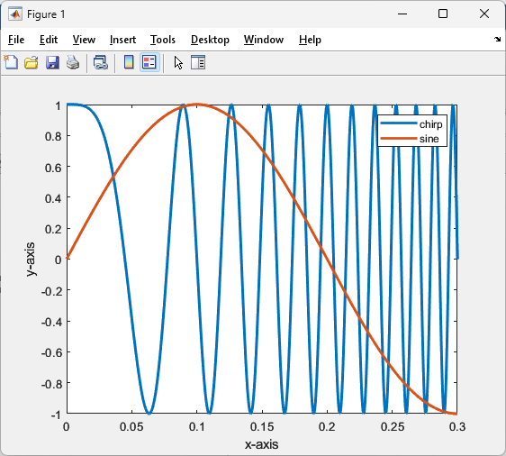

Slide 2
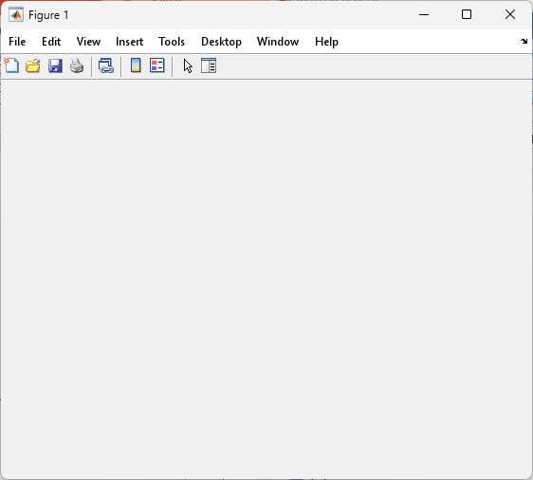
chirp
Legend object
1
sine
0.8
0.6
Line objects
0.4
0.2
s
i
x
a
0
Axes object
-
y
-0.2
-0.4
-0.6
-0.8
Figure object
-1
0
0.05
0.1
0.15
0.2
0.25
0.3
x-axis

Slide 3
1
0.8
0.6
0.4
s
0.2
i
x
a
0
-
y
-0.2
-0.4
-0.6
-0.8
-1
0
0.05
0.1
0.15
0.2
0.25
0.3
x-axis

