Slide 1
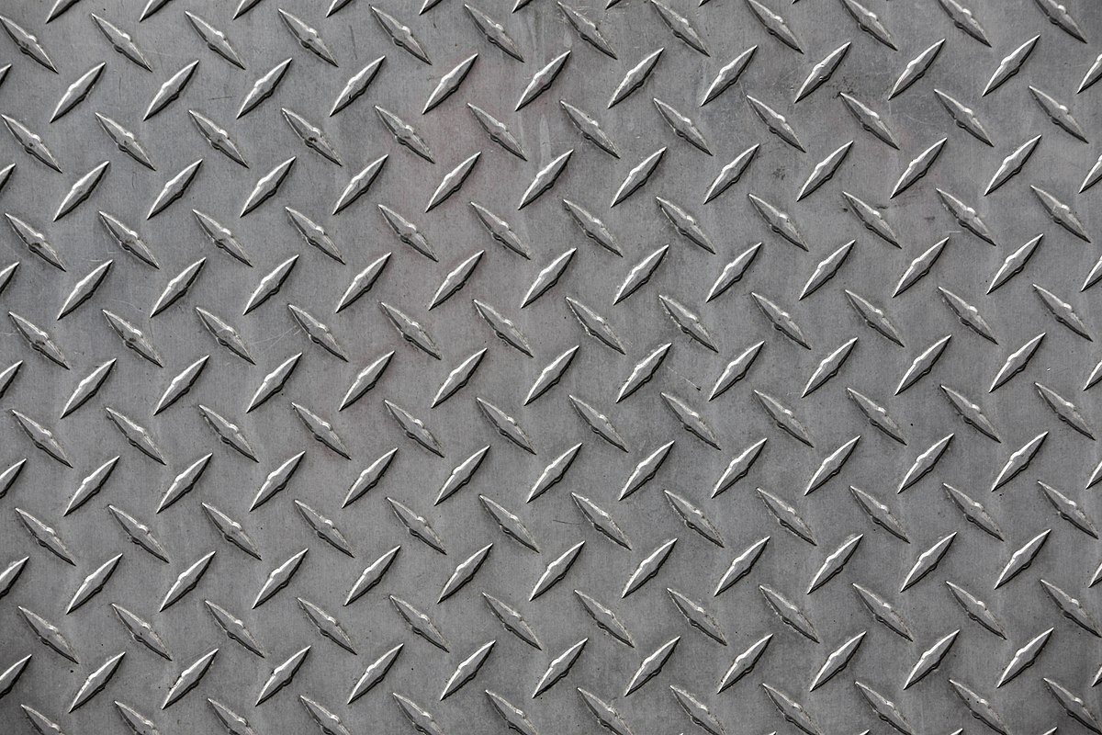





$$\text{Keep} 0°C$$
What would the temperature distribution be like if kept like this forever?
Steel
Plate
Keep$100°C$
$$\text{Keep} 0°C$$
Keep $0°C$

Slide 2
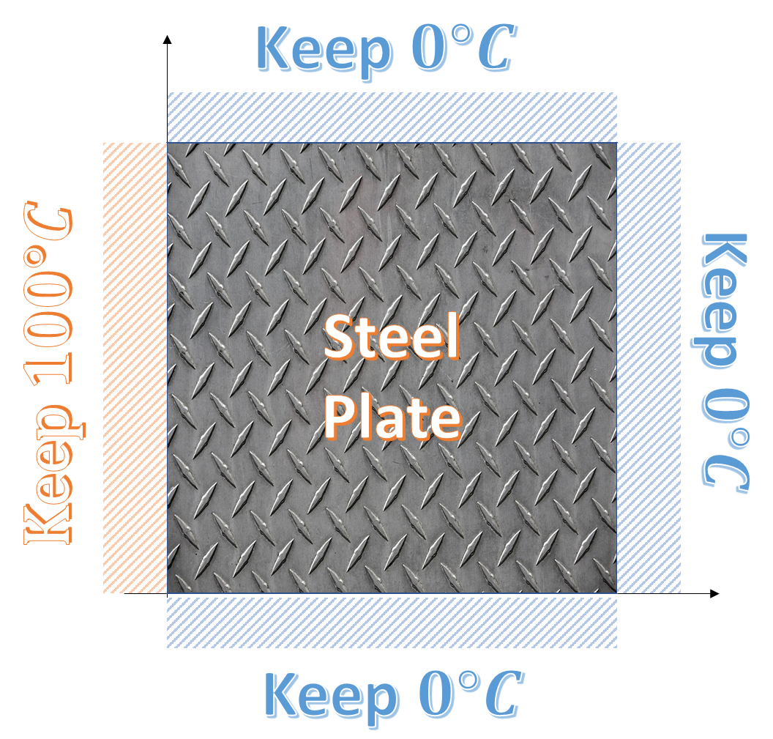









In the POV of molecules,
$$6°C$$
$$7°C$$
$$8°C$$
1
2
3
$$3°C$$
$$x°C$$
$$5°C$$
4
5
6
$$4°C$$
1$°C$
$$2°C$$
7
8
9
⇒ What is the temperature of molecule 5?

Slide 3
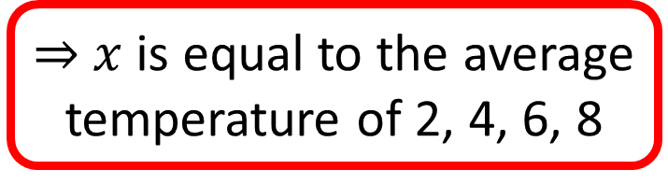
$$6°C$$
$$7°C$$
$$8°C$$
1
2
3
$$3°C$$
$$x°C$$
$$5°C$$
4
5
6
This is what
Laplace’s Equation
is saying!
$$4°C$$
1$°C$
$$2°C$$
7
8
9
⇒ $x$ is equal to the average
temperature of 2, 4, 6, 8

