Slide 1
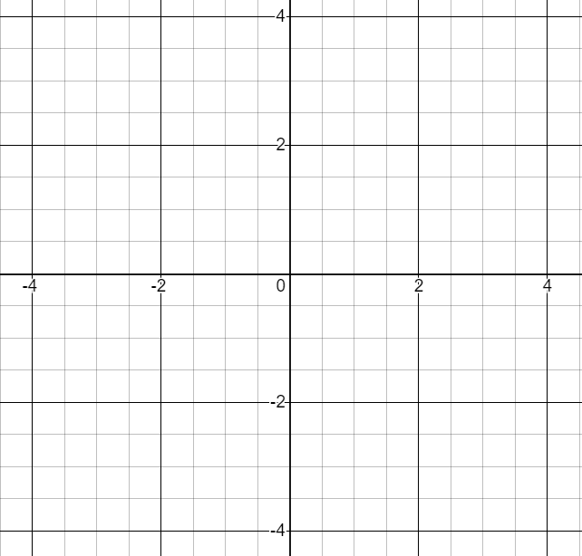
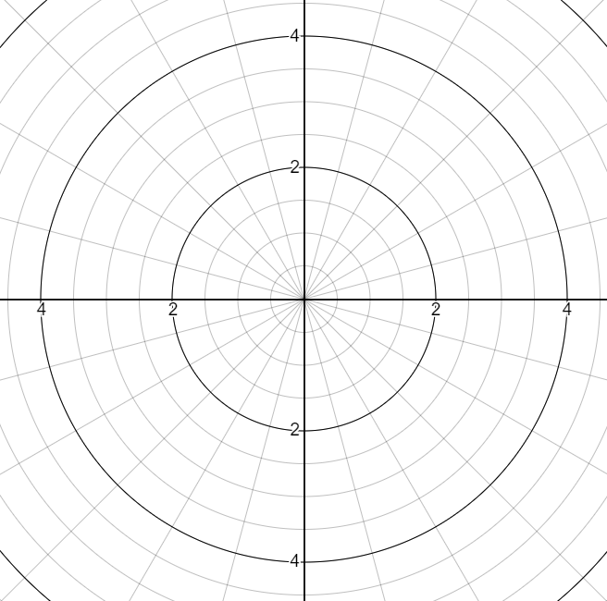










직교좌표계
극좌표계
$$π/2$$
$$y$$
$$3π/4$$
$$π/4$$
$$π$$
$$0$$
$$x$$
$$5π/4$$
$$7π/4$$
$$3π/2$$

Slide 2
Cartesian Coordinate
Polar Coordinate
$$π/2$$
$$y$$
$$3π/4$$
$$π/4$$
$$π$$
$$0$$
$$x$$
$$5π/4$$
$$7π/4$$
$$3π/2$$

Slide 3
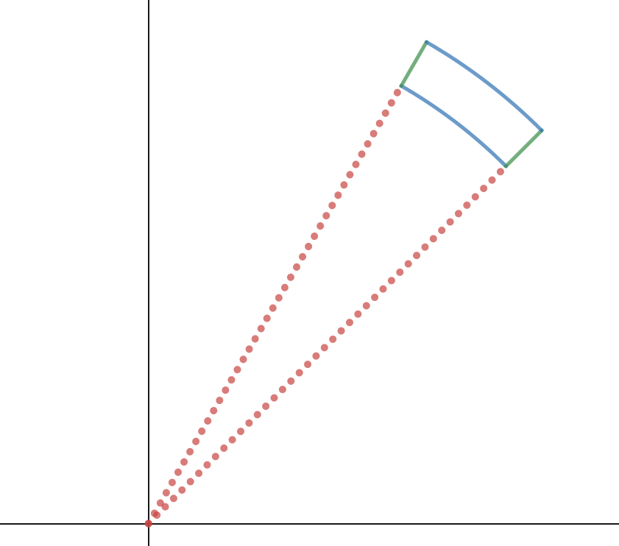




미소 면적
$$rdθ$$
$$dr$$
$$r$$
$$dθ$$

Slide 4
Infinitesimal
Area
$$rdθ$$
$$dr$$
$$r$$
$$dθ$$

