Slide 1
h
W
v

Slide 3
probability distribution of
all kinds of nose shapes in the world
Probability
shapes of nose

Slide 4
Forward
Backward
h
h
v
v
이 두 값이 같아질 때 까지 Forward <--> Backward
반복하면서 weight, bias 조정

Slide 5
Forward
Backward
h
h
v
v
To manipulate weight, bias by repeating forward <--> Backward
until these two values get same

Slide 6
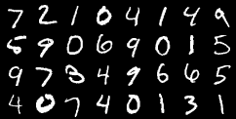
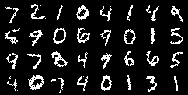
<real data>
<generated data>

