Slide 1





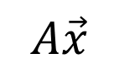
$$A$$
$$\vec{x}$$
$$A\vec{x}$$
Another
vector
vector
matrix
개념의 확장
$$L$$
$$f$$
$$Lf$$
Another
function
function
operator

Slide 2
$$A$$
$$\vec{x}$$
$$A\vec{x}$$
Another
vector
vector
matrix
Extending the Concept
$$L$$
$$f$$
$$Lf$$
Another
function
function
operator

