Slide 1

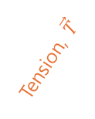

$$T_{y}$$
Tension, $\vec{T}$
$$T_{x}$$
gravity

