Slide 1
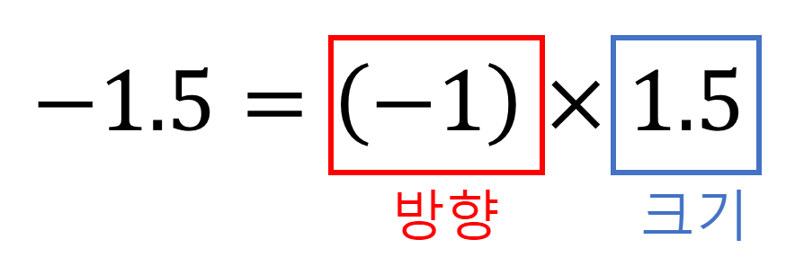
Direction
Magnitude

