Slide 1
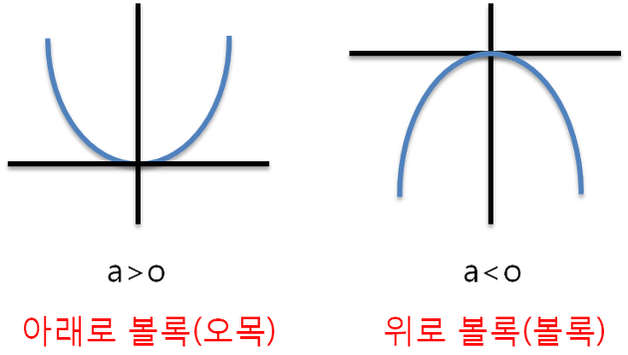
Convex Shape to Downwards
Concave Shape to Upwards

Slide 2
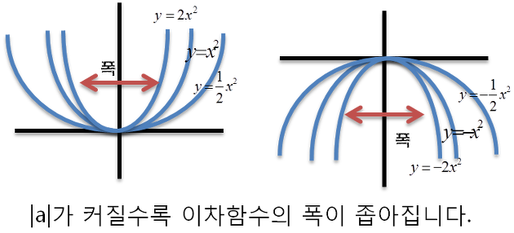
width
width
The width of quadratic functions becomes narrower as |a| gets bigger.

