Slide 1
Eclipse Code Mining
One of a new Eclipse Photon feature

Slide 2
About me…
Working at Sodifrance company
Java EE / RCP developer
Eclipse contribution, creator of:
E4 CSS engine
WTP JSON Editor
CodeMining
TM4e (Syntax color with TextMate grammar)
Other Eclipse plugins, creator of :
AngularJS Eclipse / Tern IDE
Angular Eclipse / TypeScript IDE

Slide 3
Quick Plan
What is inlined annotations?
What is Code Mining?
Demo with JDT CodeMining
Technical points (StyledText, GlyphMetrics)
Issues with Code Mining

Slide 4
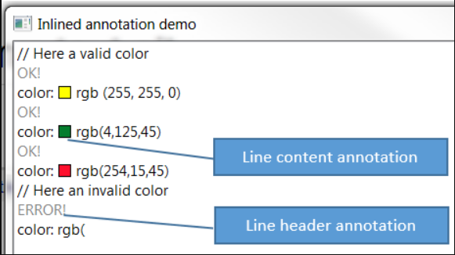
What is inlined annotation?
Definition: annotation which takes care of placing the necessary space vertically or horizontally, in the StyledText widget to draw a content (text, image…).
2 kinds:
Line header annotation
Line content annotation
Draw anything (text, image)
Clickable to bind some action.

Slide 5
Inlined Annotation - API
AbstractInlinedAnnotation is base class:
Several methods like
setText : set the text content of the annotation
draw : by default draw the set text, can be overrided to draw anything
getAction: implement it to bind an action on click of the annotation
2 inlined annotation kinds which extends AbstractInlinedAnnotation:
LineHeaderAnnotation
LineContentAnnotation
Managed with InlinedAnnotationSupport class which works with:
An ISourceViewer
Source viewer configured with AnnotationPainter
doesn’t take care of performance to compute content of annotation(UI freeze)
InlinedAnnotationSupport provides 2 methods:
findExistingAnnotation(Position position)
updateAnnotations(Set<AbstractInlinedAnnotation> annotations)

Slide 6


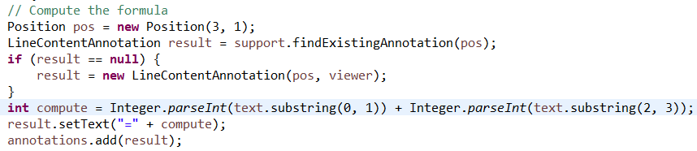
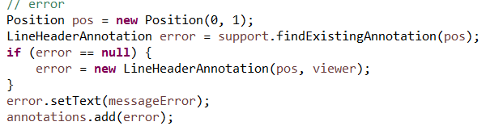
Inlined Annotation - API
Study API with CalculatorInlinedAnnotationDemo

Slide 7
Advanced Inlined Annotation - Demo
The example InlinedAnnotationDemo shows in action:
LineHeaderAnnotation : the result status (OK! / ERROR!) of parse of rgb color declaration in the line header
LineContentAnnotation: the colorized square of the rgb color declaration in the line content:
Custom draw
Clickable to open a color picker

Slide 8
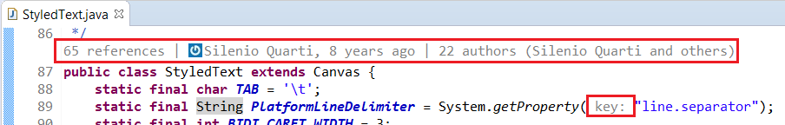
What is Code Mining?
Idea comes from Microsoft CodeLens (2013)
Draw none editable information in the editor to help developer:
Overview of code (show references, implementations class)
Provide actions (run, debug)
Show status (ex: JUnit status of test method)
Challenge: don’t freeze the UI

Slide 9
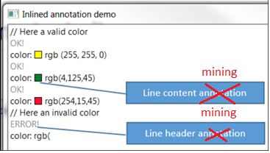
What is Code Mining?
Managed with CodeMiningManager
Works with ICodeMining instances
LineHeaderCodeMining
LineContentCodeMining
Use InlinedAnnotationSupport to draw ICodeMining with internal class:
CodeMiningLineHeaderAnnotation : draw list of line header minings for a given offset
CodeMiningLineContentAnnotation : draw list of line content minings for a given offset
What is difference with InlinedAnnotationSupport?
don’t freeze the UI :
Code mining instances are created in background
Draw of code mining is done only when content is ready.

Slide 10
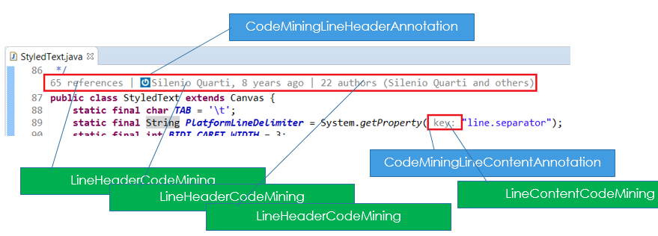
What is Code Mining?

Slide 11
Code Mining - Process
Compute list of code mining for the whole document
with a position
with a label if the compute of this label is fast and null otherwise
then render the computed list
group by mining with position and link it to a CodeMiningLine*Annotation
update annotation support with the new CodeMiningLine*Annotation list
The update of annotations call the AnnotationPainter which draws each annotations:
A given CodeMiningLine*Annotation is drawn only if it is in visible lines
CodeMiningLine*Annotation draws only minings which are ready.
If mining is not ready (not resolved), compute it in background, then redraw the parent CodeMiningLine*Annotation
2 « then »: use of CompletableFuture (thenApply).

Slide 12
Code Mining - API
Draw inlined annotation:
Line header
Line content
Takes care of performance by using CompletableFuture:
Provide list of all minings of the document:
Compute position where mining must be drawn (provider)
Resolve only visible mining:
then draw only the visible lines

Slide 13

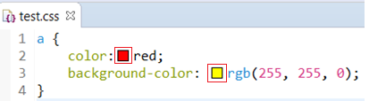
Code Mining – real use case 1 / 2
LSP4e https://projects.eclipse.org/projects/technology.lsp4e:
Code Lens support:
Spring Tools 4
Color support (experimental)
CSS Language Server

Slide 14
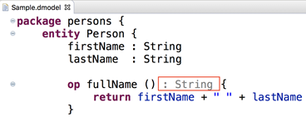
Code Mining – real use case 2 / 2
Xtext https://blogs.itemis.com/en/code-mining-support-in-xtext
JDT Code Mining https://github.com/angelozerr/jdt-codemining

Slide 15
CodeMining demo

Slide 16
CodeMinining - API
ICodeMiningProvider:
Must be fast (don’t freeze the UI)
ICodeMining
doResolve can be slow
Update the label or draw custom square image.

Slide 17
CodeMinining - API
Register mining provider
Update mining support
With a thread a reconciler, or other (don’t freeze the UI)

Slide 18
CodeMining – Extension Point
Work with any editor
codeminingProvider extension point

Slide 19
Demo with generic editor
Eclipse BlueSky

Slide 20
Demo with JDT CodeMining

Slide 21
Issues
Eclipse bugzilla
JDT CodeMining github

Slide 22
Technical points
Inlined annotation used M6 StyledTextLineSpacingProvider
In M7, inlined annotation use GlyphMetrics ascent
Redraw the character
StyledText was improved
Fix bug with cursor
Improve performance with variable line height (word wrap)
Line number / Fold font

Slide 23
What’s next?
Improvements
Don’t redraw character
StyledText should provide a getLineCodeHeight used for JDT refactor, mark occurrences, line highlight
Bugs:
In MacOS: bad renderer

Slide 24
Thanks!
Mickael Istria for her review code
Dani Megert and JDT Team
Lars Vogel for JDT Code Mining feedbacks
Karsten Thoms for CodeMining integration in XText
Martin Lippert for CodeMining integration in Spring Tools 4

