Slide 1
Eclipse Code Mining
One of a new Eclipse Photon feature

Slide 2
About me…
Working at Sodifrance company
Java EE developer
Eclipse contribution, creator of:
E4 CSS engine
WTP JSON Editor
CodeMining
TM4e (Syntax color with TextMate grammar)
Other Eclipse plugins, creator of :
AngularJS Eclipse / Tern IDE
Angular Eclipse / TypeScript IDE

Slide 3
Quick Plan
What is inlined annotations?
What is Code Mining?
Demo with JDT CodeMining
Technical points (StyledText, GlyphMetrics)
Issues with Code Mining

Slide 4
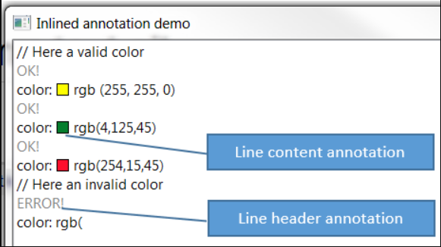
What is inlined annotation?
Definition: annotation which takes care of placing the necessary space vertically or horizontally, in the StyledText widget to draw a content (text, image…).
2 kinds:
Line header annotation
Line content annotation
Draw anything (text, image)
Clickable to bind some action
Managed with InlinedAnnotationSupport class:
doesn’t take care of performance to compute content of annotation(UI freeze)

Slide 5
Inlined Annotation - API
AbstractInlinedAnnotation is base class:
Several methods like
setText : set the text content of the annotation
draw : by default draw the set text, can be overrided to draw anything
getAction: implement it to bind an action on click of the annotation
2 inlined annotation kinds which extends AbstractInlinedAnnotation:
LineHeaderAnnotation
LineContentAnnotation
Managed with InlinedAnnotationSupport class which works with:
An ISourceViewer
Source viewer configurated with AnnotationPainter
InlinedAnnotationSupport provides 2 methods:
findExistingAnnotation(Position position)
updateAnnotations(Set<AbstractInlinedAnnotation> annotations)

Slide 6


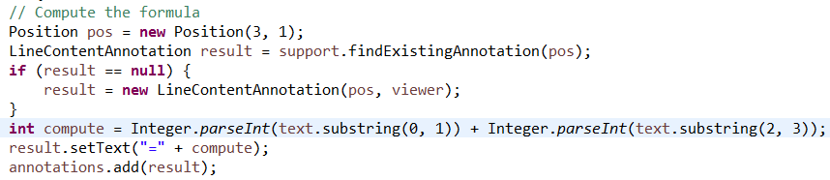
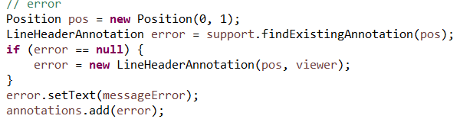
Inlined Annotation - API
Study API with CalculatorInlinedAnnotationDemo

Slide 7
Advanced Inlined Annotation - Demo
The example InlinedAnnotationDemo shows in action:
LineHeaderAnnotation : the result status (OK! / ERROR!) of parse of rgb color declaration in the line header
LineContentAnnotation: the colorized square of the rgb color declaration in the line content:
Custom draw
Clickable top open a color picker

Slide 8
Eclipse Code Mining
Idea comes from Microsoft CodeLens (2013)
Draw none editable information in the editor to help developer:
Overview of code (show references, implementations class)
Provide actions (run, debug)
Show status (ex: Junit status of test method)
Based on inlined annotation support
Challenge: don’t freeze the UI

Slide 9

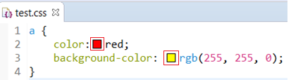
Code Mining – real use case 1 / 2
LSP4e https://projects.eclipse.org/projects/technology.lsp4e:
Code Lens support:
Spring Tools 4
Color support (experimental)
CSS Language Server

Slide 10
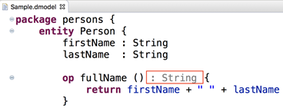
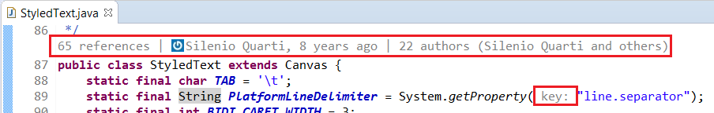
Code Mining – real use case 2 / 2
Xtext https://blogs.itemis.com/en/code-mining-support-in-xtext
JDT CodeMining https://github.com/angelozerr/jdt-codemining

Slide 11
CodeMining support ISourceViewer
Draw inlined annotation:
Line header
Line content
Takes care of performance by using CompletableFuture:
Provide list of all minings of the document:
Compute position where mining must be drawn (provider)
Resolve only visible mining:
then draw only the visible lines

Slide 12
CodeMining demo

Slide 13
CodeMinining - API
ICodeMiningProvider:
Must be fast (don’t freeze the UI)
ICodeMining
doResolve can be slow
Update the label or draw custom square image.

Slide 14
CodeMinining - API
Register mining provider
Update mining support
With a thread a reconciler, or other (don’t freeze the UI)

Slide 15
CodeMining – Extension Point
Work with any editor
codeminingProvider extension point

Slide 16
Demo with generic editor

Slide 17
Demo with JDT CodeMining

Slide 18
Issues
Eclipse bugzilla
JDT CodeMining github

Slide 19
Technical points
Inlined annotation used M6 StyledTextLineSpacingProvider
In M7, inlined annotation use GlyphMetrics ascent
Redraw the character
StyledText was improved
Fix bug with cursor
Improve performance with variable line height (word wrap)
Line number / Fold font

Slide 20
What’s next?
Improvements
Don’t redraw character
StyledText should provide a getLineCodeHeight used for JDT refactor, mark occurrences, line highlight
Bugs:
In MacOS: bad renderer

Slide 21
Thanks!
Mickael Istria for her review code
Dani Megert and JDT Team
Lars Vogel for JDT Code Mining feedbacks
Karsten Thoms for CodeMining integration in XText
Martin Lippert for CodeMining integration in Spring Tools 4

