Slide 1
Eclipse Code Mining
One of a new Eclipse Photon feature

Slide 2
About me…
Angelo ZERR
Working at Sodifrance company
Java EE / RCP developer
Eclipse contribution, creator of:
E4 CSS engine
WTP JSON Editor
Code Mining
TM4e (Syntax color with TextMate grammar)
Minimap (current work…)
Other Eclipse plugins, creator of :
AngularJS Eclipse / Tern IDE
Angular Eclipse / TypeScript IDE

Slide 3
Quick Plan
How can inlined annotations enrich my editor?
definition, API and examples
How can I add CodeMining to my custom editor?
definition, API and examples
Demo with JDT CodeMining

Slide 4
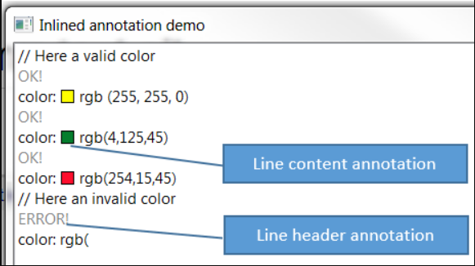
How can inlined annotations enrich my editor?
Annotation which takes care of placing the necessary space vertically or horizontally, in the StyledText widget to draw a content (text, image…).
2 kinds:
Line header annotation
Line content annotation
Draw anything:
text
graphics, …
Clickable to bind a custom action.

Slide 5
Inlined Annotation – API - Overview
2 annotations kind:
LineHeaderAnnotation
LineContentAnnotation
Managed with InlinedAnnotationSupport:
ISourceViewer
AnnotationPainter
doesn’t take care of performance to compute content of annotation(UI freeze)
InlinedAnnotationSupport API:
findExistingAnnotation(Position position)
updateAnnotations(Set<AbstractInlinedAnnotation> annotations)

Slide 6
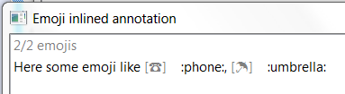
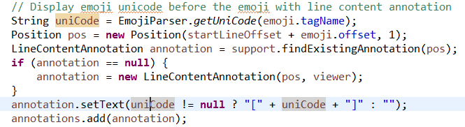
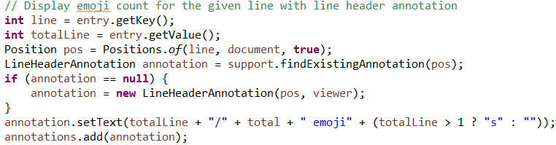
Emoji inlined annotation in a simple main
Study API with EmojiWithInlinedAnnotation

Slide 7
Advanced Inlined Annotation - Demo
The example InlinedAnnotationDemo shows in action:
LineHeaderAnnotation : the result status (OK! / ERROR!) of parse of rgb color declaration in the line header
LineContentAnnotation: the colorized square of the rgb color declaration in the line content:
Custom draw
Clickable to open a color picker

Slide 8
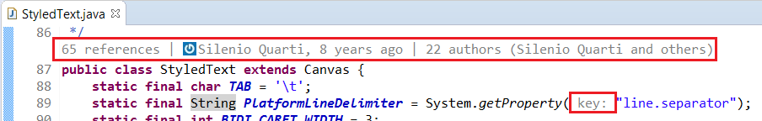
How can I add CodeMining to my custom editor?
Idea comes from Microsoft CodeLens (2013)
Draw none editable information in the editor to help developer:
Overview of code (show references, implementations class)
Provide actions (run, debug)
Show status (ex: JUnit status of test method)
Challenge: don’t freeze the UI

Slide 9
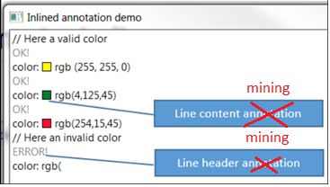
What is difference with InlinedAnnotationSupport?
Manage mining instances instead of annotation instances:
LineHeaderCodeMining
LineContentCodeMining
CodeMining use the support to draw mining
don’t freeze the UI :
Code mining instances are created in background
Draw of code mining is done only when content is ready.

Slide 10
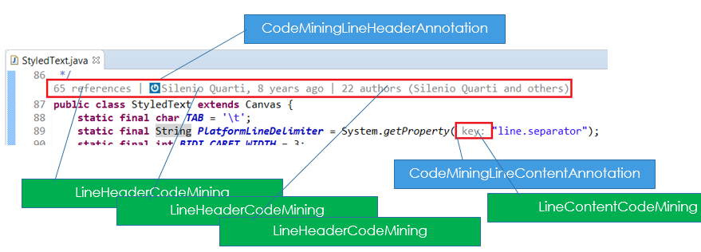
What is Code Mining?

Slide 11
Code Mining – API - Overview
ICodeMining
LineHeaderCodeMining
LineContentCodeMining
ICodeMiningProvider
ISourceViewerExtension5
Use of CompletableFuture:
ICodeMiningProvider#provideCodeMinings to create code minings instances with position
must be fast: to avoid not creating other mining of other code mining provider.
ICodeMining#resolve: to resolve content of mining if it takes time
can be slow

Slide 12
Code Mining – API - ICodeMining
AbstractCodeMining is base class:
Several methods like
setLabel : set the text content of the annotation
draw : by default draw the set text, can be overrided to draw anything
getAction: implement it to bind an action on click of the mining
2 code mining kinds which extends AbstractCodeMining :
LineHeaderCodeMining
LineContentCodeMining

Slide 13
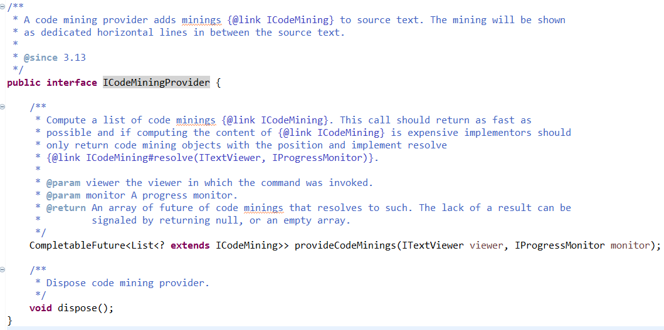
Code Mining – API- ICodeMiningProvider
Factory to create minings (resolved or not)

Slide 14
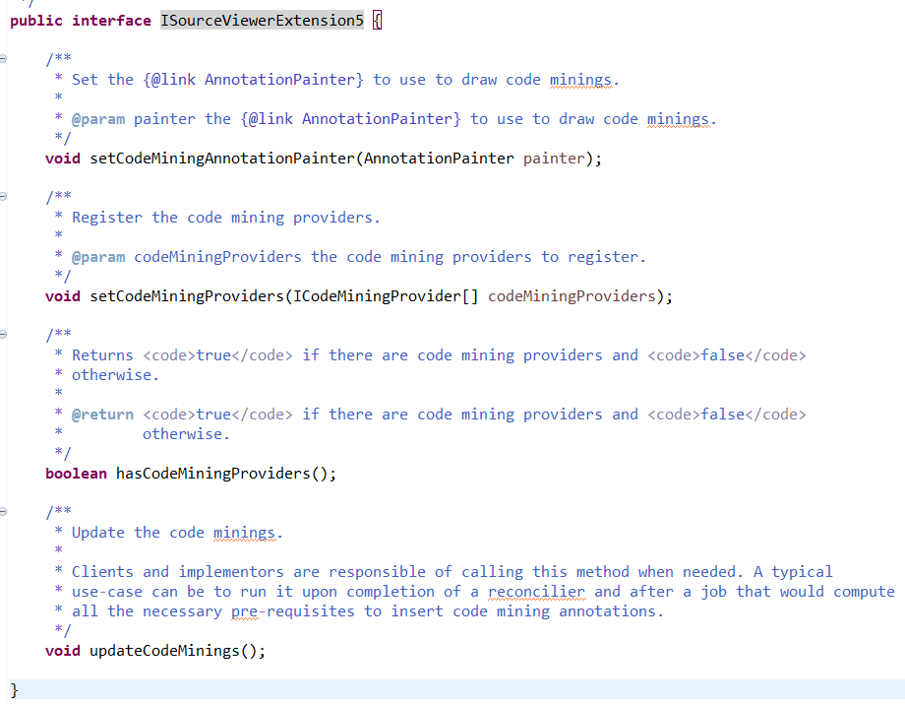
Code Mining – API - ISourceViewerExtension5
Manage code minings
register code mining providers
update code minings

Slide 15
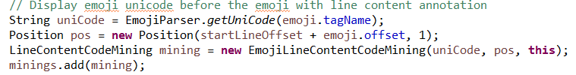
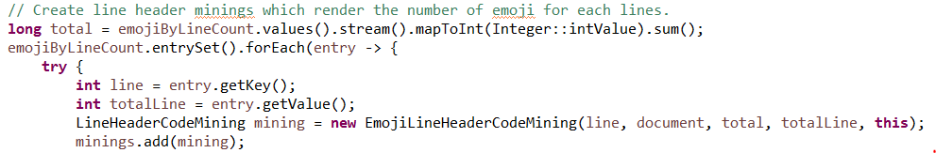
Emoji code mining in a simple main
Study code mining API with EmojiWithCodeMining

Slide 16
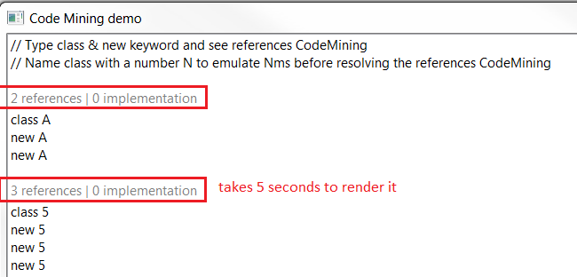
Advanced Code Mining - Demo
The example CodeMiningDemo shows in action:
LineHeaderCodeMining: which can take some time to compute label

Slide 17
How to integrate Code Mining in Editor
3 steps:
step 1: Implement a code mining provider (ICodeMiningProvider)
step 2 : register the code mining provider with org.eclipse.ui.workbench.texteditor.codeminingProviders extension point
step 3 : update code minings when text changed with thread, reconciler, etc
You can use CodeMiningReconciler
with custom editor
With Generic editor: extension point
In JDT, IReconcilingListener is used

Slide 18
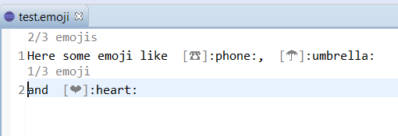
Emoji code mining in a an editor
In GenericEditor
In custom editor

Slide 19
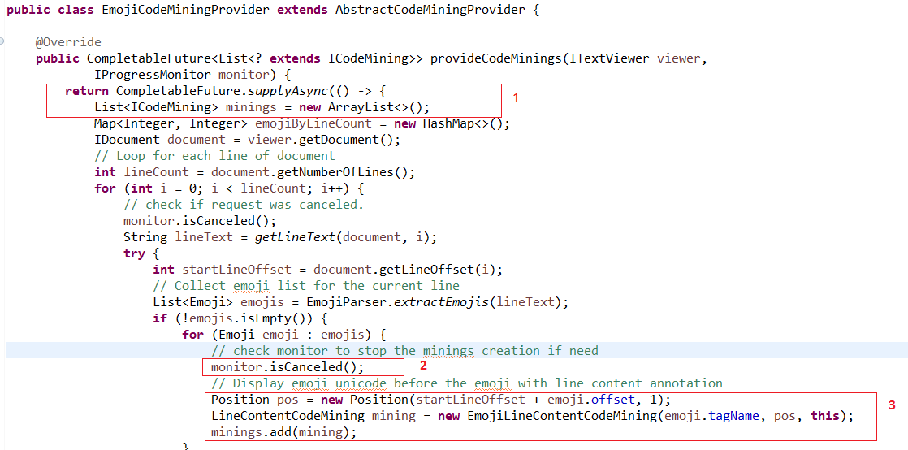
Step 1/1: Implement your code mining provider

Slide 20
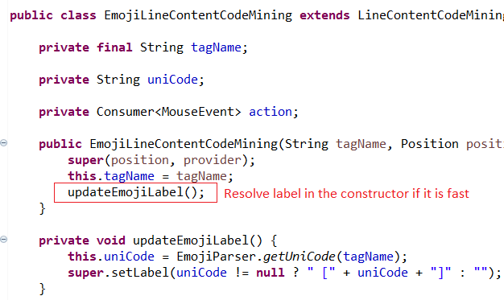
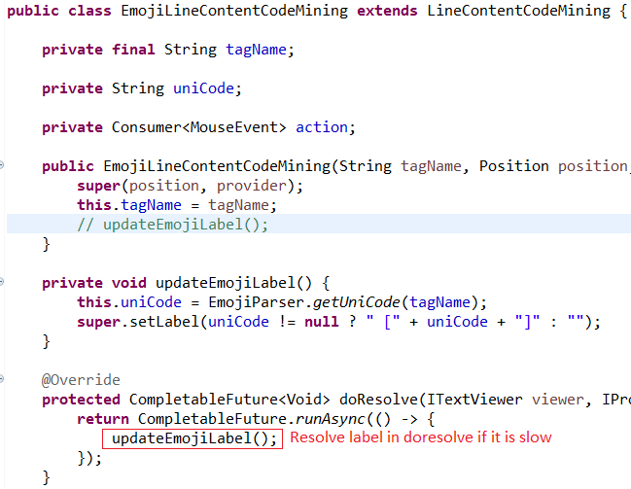
Step 1/2: Implement your code mining provider

Slide 21
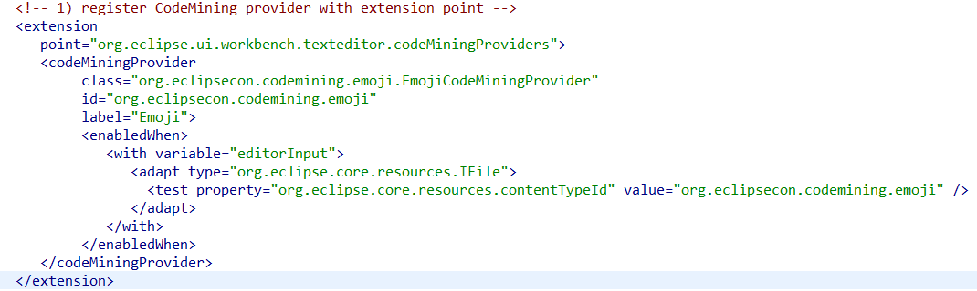
Step 2: code Mining provider – Extension Point
Work with any editor
org.eclipse.ui.workbench.texteditor.codeminingProviders extension point

Slide 22
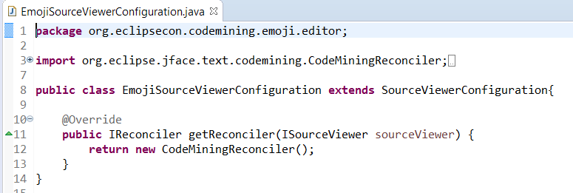
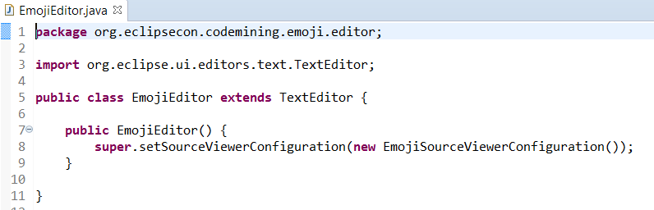
Step 3/1: update code mining in custom editor

Slide 23
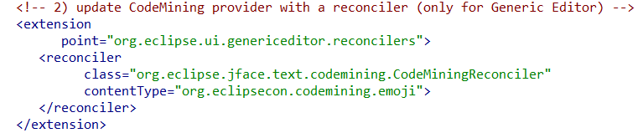
Step 3/2: update code mining in generic editor

Slide 24
Recipe to integrate Code Minining…
Step 1: implements ICodeMiningProvider
create minings instances with a position and label or not
call monitor.canceled() when you can
for minings which have label which takes time, implement AbstractCodeMining#doResolve()
Step 2: register mining providers
with ISourceViewerExtension5#setCodeMiningProviders
Or with codeMiningProvider extension point
Step 3: update mining support
call ISourceViewerExtension5#updateCodeMinings with
a thread a reconciler(ex: CodeMiningReconciler), or other
JDT already provides this update
LSP4e already provides this update

Slide 25

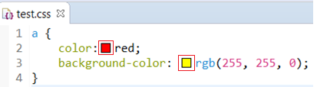
Code Mining – real use case 1 / 2
LSP4e https://projects.eclipse.org/projects/technology.lsp4e:
Code Lens support:
Spring Tools 4
Color support (experimental)
CSS Language Server

Slide 26
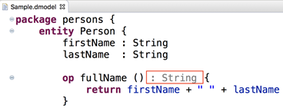
Code Mining – real use case 2 / 2
Xtext https://blogs.itemis.com/en/code-mining-support-in-xtext
JDT Code Mining https://github.com/angelozerr/jdt-codemining

Slide 27
Demo with JDT CodeMining
JDT CodeMining:
https://github.com/angelozerr/jdt-codemining

Slide 28
Issues
Eclipse Bugzilla: tag title with [code mining]
SWT
Text
JDT CodeMining:
https://github.com/angelozerr/jdt-codemining/issues

Slide 29
Thanks!
Mickael Istria for her review code
Dani Megert and JDT Team
Lars Vogel for JDT Code Mining feedbacks
Karsten Thoms for CodeMining integration in XText
Martin Lippert for CodeMining integration in Spring Tools 4

