Slide 1
Eclipse Code Mining
One of a new Eclipse Photon feature

Slide 2
About me…
Working at Sodifrance company
Java EE / RCP developer
Eclipse contribution, creator of:
E4 CSS engine
WTP JSON Editor
Code Mining
TM4e (Syntax color with TextMate grammar)
Minimap (current work…)
Other Eclipse plugins, creator of :
AngularJS Eclipse / Tern IDE
Angular Eclipse / TypeScript IDE

Slide 3
Quick Plan
How can inlined annotations enrich my editor?
definition, API and examples
How can I add CodeMining to my custom editor?
definition, API and examples
Demo with JDT CodeMining
Technical points (StyledText, GlyphMetrics)
Issues with Code Mining

Slide 4
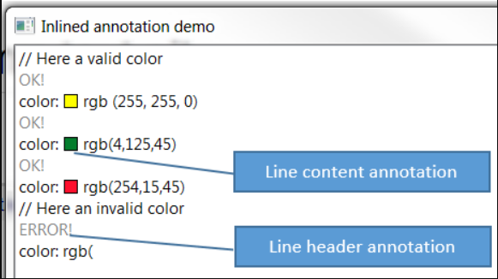
How can inlined annotations enrich my editor?
Annotation which takes care of placing the necessary space vertically or horizontally, in the StyledText widget to draw a content (text, image…).
2 kinds:
Line header annotation
Line content annotation
Draw anything:
text
graphics, …
Clickable to bind a custom action.

Slide 5
Inlined Annotation – API - Overview
2 annotations kind:
LineHeaderAnnotation
LineContentAnnotation
Managed with InlinedAnnotationSupport:
ISourceViewer
AnnotationPainter
doesn’t take care of performance to compute content of annotation(UI freeze)
InlinedAnnotationSupport API:
findExistingAnnotation(Position position)
updateAnnotations(Set<AbstractInlinedAnnotation> annotations)

Slide 6
Inlined Annotation – API (TO REMOVE)
AbstractInlinedAnnotation is base class:
Several methods like
setText : set the text content of the annotation
draw : by default draw the set text, can be overrided to draw anything
getAction: implement it to bind an action on click of the annotation
2 inlined annotation kinds which extends AbstractInlinedAnnotation:
LineHeaderAnnotation
LineContentAnnotation
Managed with InlinedAnnotationSupport class which works with:
An ISourceViewer
Source viewer configured with AnnotationPainter
doesn’t take care of performance to compute content of annotation(UI freeze)
InlinedAnnotationSupport provides 2 methods:
findExistingAnnotation(Position position)
updateAnnotations(Set<AbstractInlinedAnnotation> annotations)

Slide 7
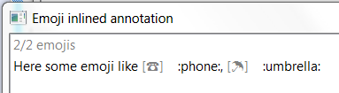
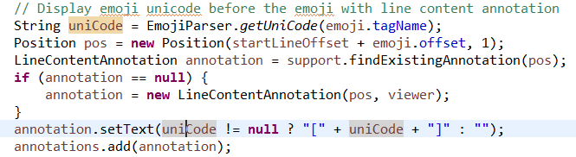
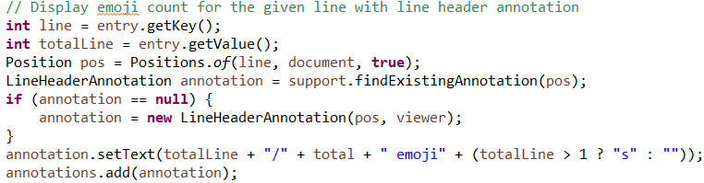
Emoji inlined annotation in a simple main
Study API with EmojiWithInlinedAnnotation

Slide 8
Advanced Inlined Annotation - Demo
The example InlinedAnnotationDemo shows in action:
LineHeaderAnnotation : the result status (OK! / ERROR!) of parse of rgb color declaration in the line header
LineContentAnnotation: the colorized square of the rgb color declaration in the line content:
Custom draw
Clickable to open a color picker

Slide 9
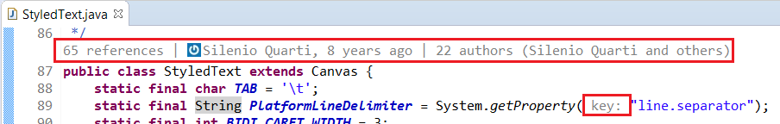
How can I add CodeMining to my custom editor?
Idea comes from Microsoft CodeLens (2013)
Draw none editable information in the editor to help developer:
Overview of code (show references, implementations class)
Provide actions (run, debug)
Show status (ex: JUnit status of test method)
Challenge: don’t freeze the UI

Slide 10
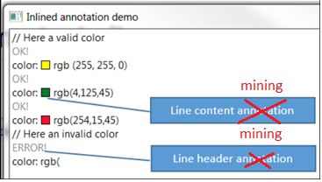
What is difference with InlinedAnnotationSupport?
Manage mining instances instead of annotation instances.
CodeMining use the support to draw mining
don’t freeze the UI :
Code mining instances are created in background
Draw of code mining is done only when content is ready.

Slide 11
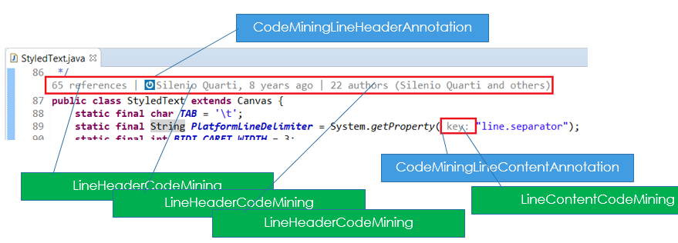
What is Code Mining?

Slide 12
What is Code Mining? – Internal class (TO REMOVE)
Managed with internal class
CodeMiningManager
Works with ICodeMining instances
LineHeaderCodeMining
LineContentCodeMining
Use InlinedAnnotationSupport to draw ICodeMining with internal class:
CodeMiningLineHeaderAnnotation : draw list of line header minings for a given offset
CodeMiningLineContentAnnotation : draw list of line content minings for a given offset
What is difference with InlinedAnnotationSupport?
don’t freeze the UI :
Code mining instances are created in background
Draw of code mining is done only when content is ready.

Slide 13
Code Mining – Process (TO REMOVE)
Compute list of code minings for the whole text editor content
with a position
with a label if the compute of this label is fast and null otherwise
then render the computed list
group by mining with position and link it to a CodeMiningLine*Annotation
update annotation support with the new CodeMiningLine*Annotation list
The update of annotations call the AnnotationPainter which draws each annotations:
A given CodeMiningLine*Annotation is drawn only if it is in visible lines
CodeMiningLine*Annotation draws only minings which are ready.
If mining is not ready (not resolved), compute it in background, then redraw the parent CodeMiningLine*Annotation
2 « then »: use of CompletableFuture (thenApply/thenRun).
This process is done when editor is opened and content changes.

Slide 14
Code Mining – API - Overview
ICodeMining
LineHeaderCodeMining
LineContentCodeMining
ICodeMiningProvider
ISourceViewerExtension5
Use of CompletableFuture:
ICodeMiningProvider#provideCodeMinings to create code minings instances with position
must be fast: to avoid not creating other mining of other code mining provider.
ICodeMining#resolve: to resolve content of mining if it takes time
can be slow

Slide 15
Code Mining – API - ICodeMining
AbstractCodeMining is base class:
Several methods like
setLabel : set the text content of the annotation
draw : by default draw the set text, can be overrided to draw anything
getAction: implement it to bind an action on click of the mining
2 code mining kinds which extends AbstractCodeMining :
LineHeaderCodeMining
LineContentCodeMining

Slide 16
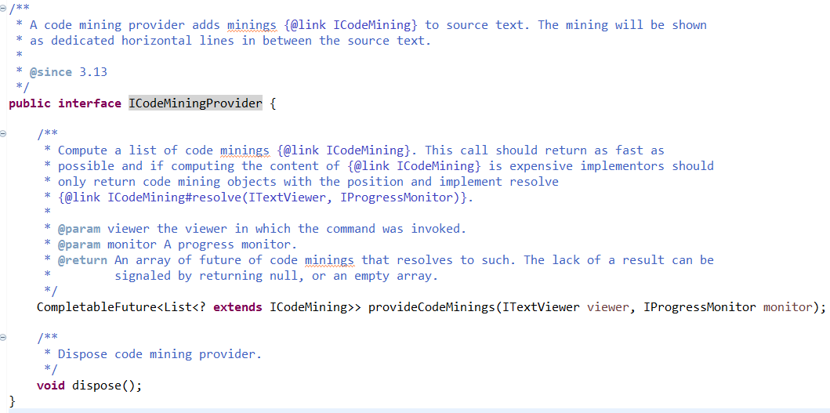
Code Mining – API- ICodeMiningProvider
Factory to create minings (resolved or not)

Slide 17
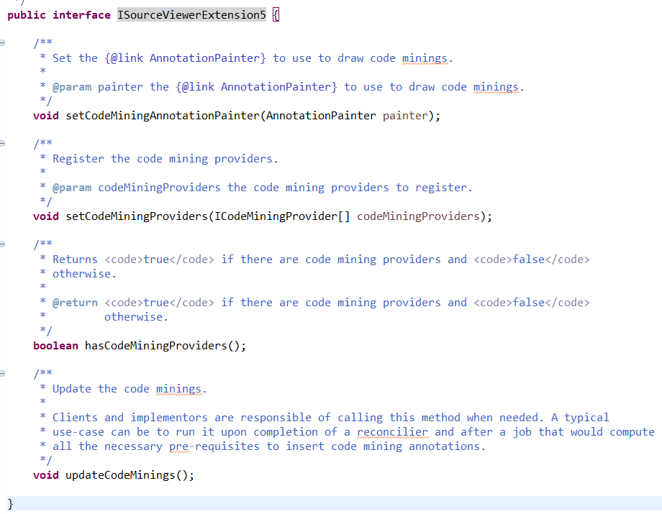
Code Mining – API - ISourceViewerExtension5
Used to manage minings
Register code mining providers
Update code minings

Slide 18
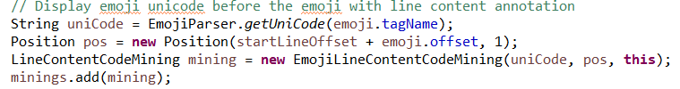
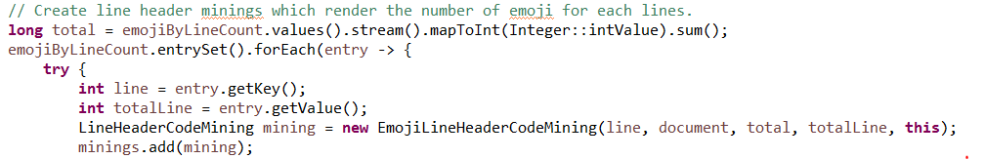
Emoji code mining in a simple main
Study code mining API with EmojiWithCodeMining

Slide 19
Code Mining and resolved (TO REMOVE)
ICodeMining#isResolved()
A code mining is resolved when her content is ready.
A code mining is drawn when it is resolved
Label of code mining is important (even if it is not drawn):
null: means that mining is not resolved
‘’ (empty): means that mining is not visible
filled : means that mining is resolved
In the codeming provider:
Update the label of mining, if it fast with ICodeMining#setLabel
Or implement AbstractCodeMining#doResolve if label compute takes time

Slide 20
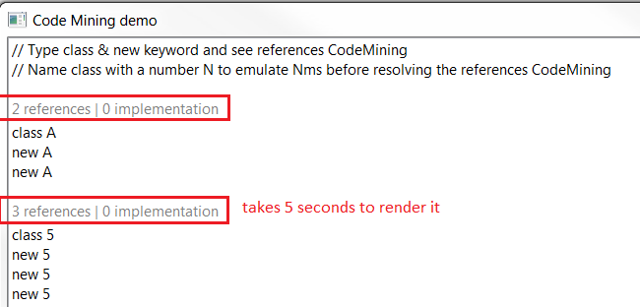
Advanced Code Mining - Demo
The example CodeMiningDemo shows in action:
LineHeaderCodeMining: which can take some time to compute label

Slide 21
How to integrate Code Mining in Editor
3 steps:
step 1: Implement a code mining provider (ICodeMiningProvider)
step 2 : register the code mining provider with org.eclipse.ui.workbench.texteditor.codeminingProviders extension point
step 3 : update code minings when text changed with thread, reconciler, etc
You can use CodeMiningReconciler
with custom editor
With Generic editor: extension point
In JDT, IReconcilingListener is used

Slide 22
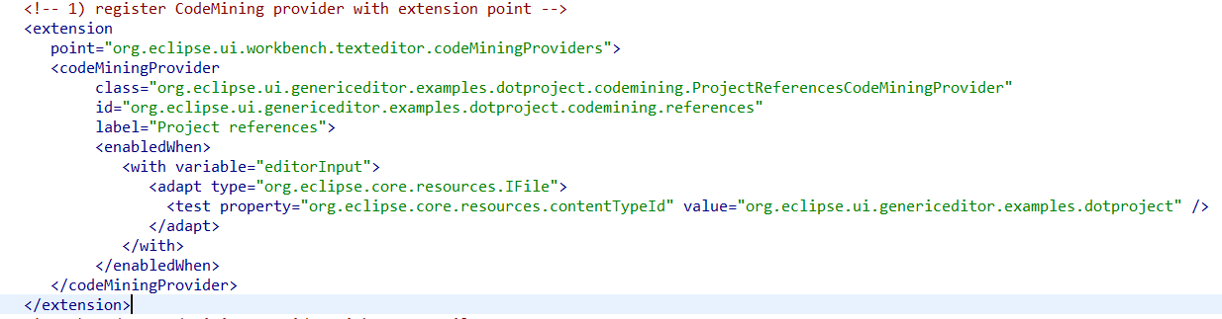
Code Mining – Extension Point
Work with any editor
org.eclipse.ui.workbench.texteditor.codeminingProviders extension point
See generic editor sample dotproject

Slide 23
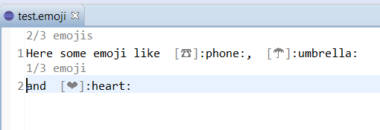
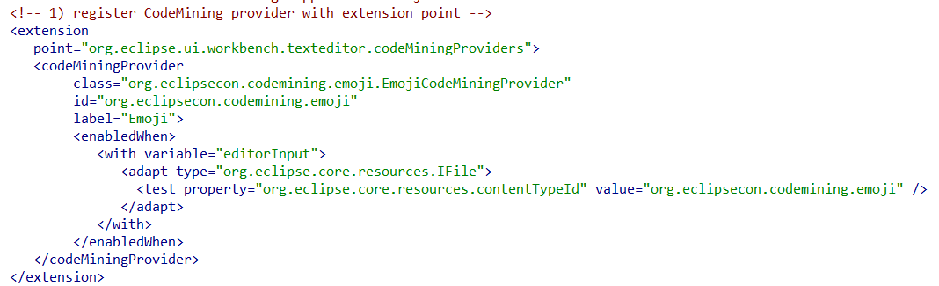
Emoji code mining in a custom/generic editor

Slide 24
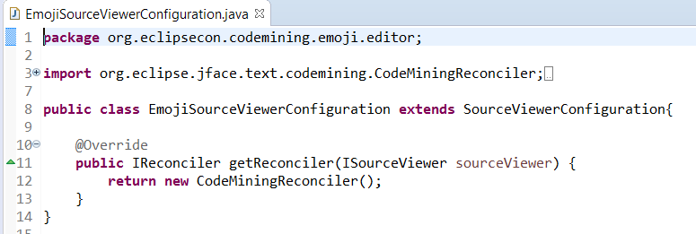
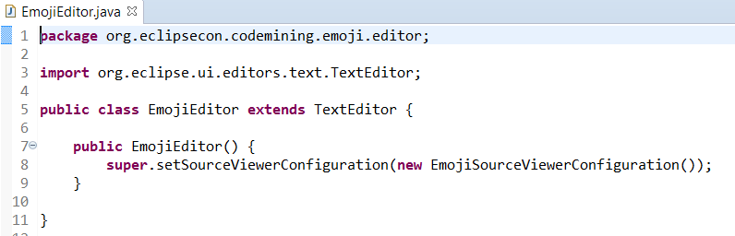
Emoji code mining in a custom editor

Slide 25
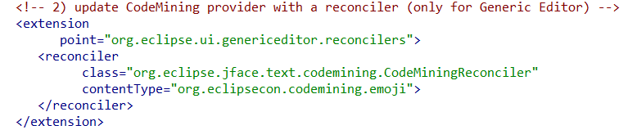
Emoji code mining in the generic editor

Slide 26
Code Minining - Recipe
Implements ICodeMiningProvider
create minings instances with a position and label or not
for minings which have label which takes time, implement AbstractCodeMining#doResolve()
Register mining provider
With ISourceViewerExtension5#setCodeMiningProviders
Or with codeMiningProvider extension point
Update mining support
With a thread a reconciler(ex: CodeMiningReconciler), or other (don’t freeze the UI)
JDT already provides this update
LSP4e already provides this update

Slide 27

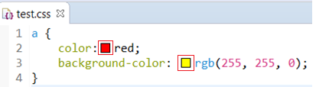
Code Mining – real use case 1 / 2
LSP4e https://projects.eclipse.org/projects/technology.lsp4e:
Code Lens support:
Spring Tools 4
Color support (experimental)
CSS Language Server

Slide 28
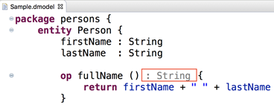
Code Mining – real use case 2 / 2
Xtext https://blogs.itemis.com/en/code-mining-support-in-xtext
JDT Code Mining https://github.com/angelozerr/jdt-codemining

Slide 29
Demo with generic editor
Eclipse BlueSky and CSS Language Server

Slide 30
Demo with JDT CodeMining
TODO

Slide 31
Technical points
Inlined annotation takes place by updating StyledText#setStyleRange / GlyphMetrics:
Line header Inlined annotation : GlyphMetrics ascent is updated
Line content Inlined annotation : GlyphMetrics width is updated
Use of GlyphMetrics for a given offset replace text content
requires the redraw of the character
StyledText was been improved
Height cursor: line header annotation must not have cursor
Improve performance: with variable line height (word wrap)
Line number / Fold icon location

Slide 32
Issues
Eclipse Bugzilla: tag title with [code mining]
SWT
Text
JDT CodeMining github

Slide 33
What’s next?
Improvements
Don’t redraw character: https://bugs.eclipse.org/bugs/show_bug.cgi?id=531769
StyledText should provide a getLineCodeHeight used for JDT refactor, mark occurrences, line highlight bug with dark: TODO describe those issues
Bugs:
In MacOS: bad renderer

Slide 34
Thanks!
Mickael Istria for her review code
Dani Megert and JDT Team
Lars Vogel for JDT Code Mining feedbacks
Karsten Thoms for CodeMining integration in XText
Martin Lippert for CodeMining integration in Spring Tools 4

