Slide 1
MCP Language Tools
Bringing Java tooling to AI assistants without an IDE
Eclipse JDT.LS + vscode-java-debug + MCP
Angelo Zerr

Slide 2
What Already Exists
MCP servers for code intelligence and debugging
Java-specific MCP servers
IDE-based MCP servers
▸ javalens-mcp — 56 tools, Eclipse JDT Core direct
▸ codebase-memory-mcp — tree-sitter + JDT semantic
▸ LSP4J-MCP — JDT.LS wrapper via LSP4J
▸ java-jdtls-mcp-server — JDT.LS bridge + AI skills
▸ JetBrains MCP Server — built-in since 2025.2 (IntelliJ, PyCharm...)
▸ vscode-mcp-server — VS Code editing features via MCP
Powerful, but require a running IDE
MCP + LSP only
MCP + DAP only
▸ lsp-mcp — hover, completion, code actions
▸ mcp-language-server — definition, references, rename
▸ dap-mcp — breakpoints, step, evaluate
▸ mcp-debug-server — DAP integration for Claude
Good tools, but...
▸ LSP or DAP — never both together · No server collaboration · No multi-language platform
▸ No Quarkus/Qute/MicroProfile (no JDT delegate command handler)
▸ IDE-based MCP: powerful but require a running IDE — not usable in CI, containers, or headless agents

Slide 3
Beyond LSP
LSP features alone are not enough for robust Java MCP tools
Approach 1: JDT Core direct (javalens-mcp)
MCP Language Tools: Best of both
▸ 56 advanced Java tools (type hierarchy, refactoring...)
▸ Full JDT API access — robust results
▸ But: no Quarkus/Qute/Liberty, no server collaboration
▸ Single server, no delegate command handler support
Platform that orchestrates LSP & DAP servers and manages their communication (like VS Code + vscode-java for Java, but for any language)
JDT.LS = VS Code extension ecosystem
Using JDT.LS (not JDT Core) means reusing plugins from: → LSP: vscode-quarkus, vscode-microprofile, vscode-liberty → DAP: vscode-java-debug (requires JDT.LS) All these plugins work with MCP LT out-of-the-box
Approach 2: JDT.LS via LSP protocol only (LSP4J-MCP...)
▸ Wraps JDT.LS but only uses LSP protocol (completion, hover...)
▸ Ignores JDT.LS plugins and delegate command handlers
▸ No advanced analysis, no refactoring, no framework support
▸ Cannot reuse vscode-quarkus/liberty/debug plugins
+ Advanced tools via mcp-jdtls plugin
OSGi bundle deployed into JDT.LS: → Full JDT API access for 80 advanced MCP tools (hierarchy, refactoring, code quality, search...) → Best of both: LSP ecosystem + JDT API power

Slide 4
The Solution: MCP as the Bridge
An MCP server that manages LSP and DAP servers together and exposes their capabilities as MCP tools
→ LSP
Eclipse JDT.LS
AI Assistant
MCP Language Tools
80 Java tools + mcp-jdtls
→ MCP →
Claude Code / Bob
110+ MCP Tools
→ LSP
Quarkus / Qute / Liberty LS
Workspace & Lifecycle Mgr
→ DAP
vscode-java-debug
LSP + DAP together
Server collaboration
Open platform
Practical
JDT.LS + Quarkus/Qute/Liberty (LSP) vscode-java-debug (DAP) DAP ↔ LSP coordination
contributes: bundles, classpath, bindRequest/Notification 80 Java tools via mcp-jdtls
47 language extensions 52 LSP + 8 DAP servers Admin console
VSCode settings.json reuse Auto-install servers IDE server reuse (study)

Slide 5
Technology Stack
Built on Quarkus MCP Server
MCP tools are declared via Quarkus MCP Server annotations — zero boilerplate
Declaring an MCP tool (Java)
Quarkus MCP Server
@Tool(name = "java_find_field_writes", description = "Find all write accesses to a field") public CompletableFuture<String> findFieldWrites( @ToolArg(description = "...") String cwd, @ToolArg(description = "...") String fileUri, @ToolArg(description = "...") int line, @ToolArg(description = "...") int character, Cancellation cancellation, Progress progress) { ... }
@Tool, @ToolArg, Progress, Cancellation
Quarkus (runtime)
CDI, native binary, fast startup
LSP4J
LSP and DAP protocol clients
Admin UI
Quarkus web resources + WebSocket

Slide 6
Core Concepts
Adding a language server or debug adapter is simple
Add an LSP server
Add a DAP server
Just provide a server.json: name, command, documentSelector. MCP LT handles lifecycle, workspace isolation, traces, and contribution wiring automatically.
Same simplicity for debug adapters: name, command, debug templates. Link to an LSP server for coordination (e.g., java-debug ↔ JDT.LS). Done.
Workspace isolation
Server collaboration
Each project gets its own server instances. Created on-demand when an AI agent calls a tool with a cwd parameter. No cross-project interference.
Servers communicate automatically: contributes: bundles, classpath, bindRequest/Notification. Declared in server.json — no code needed.

Slide 7
Java: 80 Specialized MCP Tools
Powered by Eclipse JDT.LS + custom mcp-jdtls plugin (OSGi bundle)
Analysis (12)
Navigation (11)
Code Search (11)
Reference Search (6)
Refactoring (18)
▸ Type hierarchy
▸ Go-to-definition
▸ Find references
▸ Method references
▸ Extract method/variable
▸ Call hierarchy
▸ Hover info
▸ Find implementations
▸ Field writes
▸ Inline method
▸ Control flow
▸ Javadoc
▸ Find tests
▸ Casts
▸ Convert to record
▸ Change impact
▸ Symbol info
▸ Find unused code
▸ Catch blocks
▸ Move type
Code Generation (5)
Diagnostics (4)
Code Quality (5)
Framework (3)
Project (4)
▸ Getters/setters
▸ Validate syntax
▸ Large classes
▸ HTTP endpoints
▸ Project structure
▸ Constructors
▸ Quick fixes
▸ Naming violations
▸ JPA model
▸ Classpath info
▸ equals/hashCode
▸ Diagnose & fix
▸ Circular deps
▸ DI registrations
▸ Dependencies
▸ toString
▸ Possible bugs

Slide 8
Quarkus & Qute Tooling
Framework-aware Java development via JDT delegate command handler
Quarkus LS
Qute LS
▸ application.properties completion & validation
▸ REST endpoint discovery (java_get_http_endpoints)
▸ CDI injection analysis (java_get_di_registrations)
▸ Delegates Java resolution to JDT.LS via bind mechanism
▸ Qute template completion & validation
▸ Type-safe template expressions
▸ Java type resolution via JDT delegate commands
▸ Template ↔ Java type binding
How it works: MCP Language Tools manages inter-LSP communication
MCP Language Tools (orchestrator)
Quarkus / Qute LS
← bindRequest/Notification →
Eclipse JDT.LS
needs Java type info
delegate command handler → resolves Java types

Slide 9
Java Debugging via vscode-java-debug
Full debugging experience through MCP tools
24 DAP Tools
Example: AI-driven debugging
▸ start_debugging — launch or attach to JVM
▸ set_breakpoint / remove_breakpoint
▸ step_over, step_in, step_out
▸ get_stack_trace — full call stack
▸ get_variables / get_local_variables
▸ evaluate_expression — runtime evaluation
▸ get_console_output — stdout/stderr
▸ list_threads — multi-thread inspection
▸ get_debug_statistics — session summary
User: "There's a NullPointerException in UserService.createUser, debug it" Claude Code: 1. set_breakpoint("UserService.java", 42) 2. start_debugging("com.app.Main") 3. get_local_variables() → user.email = null ← root cause 4. evaluate_expression("user.toString()") 5. get_stack_trace() → sees the full call chain

Slide 10
Demo: Java Tools in Action
Real examples of Claude Code using MCP Language Tools
Java / MicroProfile validation
Java Debugging session
[ TODO: screenshot ]
[ TODO: screenshot ]

Slide 11
Server Collaboration: Bind Mechanism
Language servers communicate with each other — no custom code needed
Qute LS
contributes → bundles + bindRequest/Notification
Eclipse JDT.LS
Contribution types
template type resolution
delegate command handler
▸ bundles: deploy OSGi plugins into JDT.LS
▸ bindRequest/Notification: route custom LSP requests to delegate handler
▸ classpath: extend another server's classpath with JARs
▸ All declared in server.json
Quarkus LS
contributes → bundles
Eclipse JDT.LS
properties + YAML support
Quarkus JDT extension
Quarkus LS
contributes → classpath
MicroProfile LS
properties + YAML support
Quarkus JAR on classpath
lemminx-liberty
contributes → classpath
LemMinX (XML)
server.xml support
Liberty JAR on classpath

Slide 12
Open Platform: 47 Built-in Extensions
Easy to add your own language — just 2 JSON files, no code required
52 LSP servers (built-in)
Add your own!
Java (JDT.LS) · JavaScript/TS · Angular · Python (Pyright) · Go (gopls) · Rust · C/C++ · C# HTML/CSS/JSON · Vue · Svelte · Bash · Ruby · Scala · Kotlin · Dart · Swift · Zig · Haskell Elixir · Erlang · OCaml · F# · Clojure · PHP · Lua · Perl · R · Julia · Fortran · Ada · Crystal Pascal · Terraform · LaTeX · Markdown · Nix · TOML · Elm · Ansible · XML · YAML · Dockerfile · ...
▸ server.json — defines the server
▸ installer.json — auto-download
▸ No code needed
▸ Drop files in extensions/ folder
▸ SPI for advanced cases (e.g., mcp-jdtls plugin)
8 DAP servers (built-in)
Java (vscode-java-debug) · JavaScript (vscode-js-debug) · Python (debugpy) Go (delve) · C/C++ (codelldb) · Dart · PHP · Dockerfile
These are default extensions — adding a new language is as simple as creating a folder with 2 JSON files

Slide 13
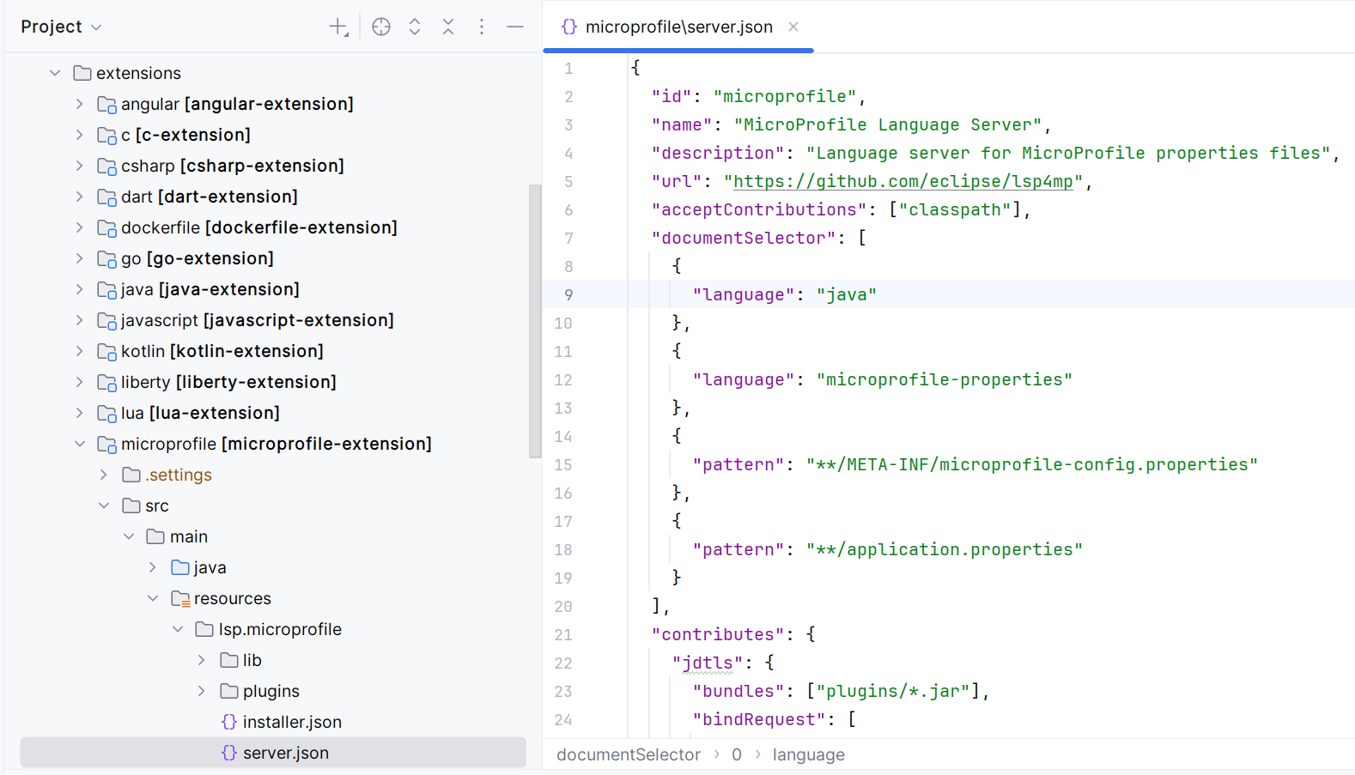
Adding a New Language
server.json + installer.json (auto-install) in the extensions/ folder — zero code

Slide 14
Admin Console
Real-time monitoring at localhost:7654/admin
Workspaces
Servers
Debuggers
MCP
Monitor opened projects, server status (Running/Error), start/stop/restart, contribution diagrams
All 52 LSP servers, enable/disable, install, language filter, configuration
8 debug adapters, installation status, configuration, trace level control
Connected MCP clients, live protocol traces, tool calls & results, real-time search
▸ Real-time WebSocket updates — live LSP/DAP/MCP trace viewing
▸ Server collaboration diagrams (vis.js) — visualize bind relationships

Slide 15
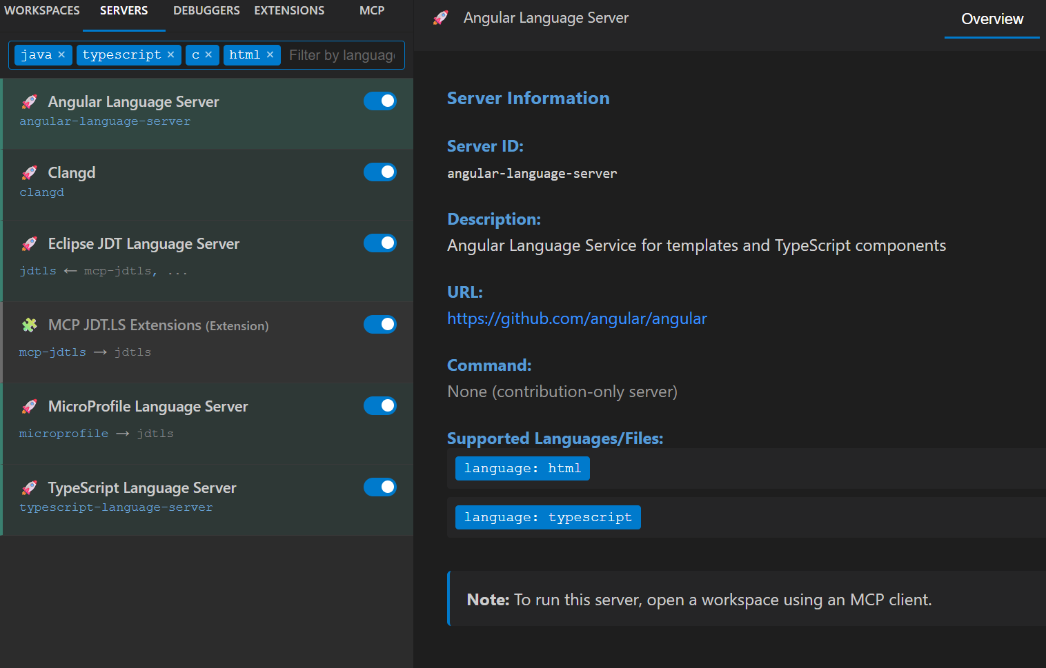
Admin: Servers
52 LSP servers — enable/disable, install, language filter, configuration

Slide 16
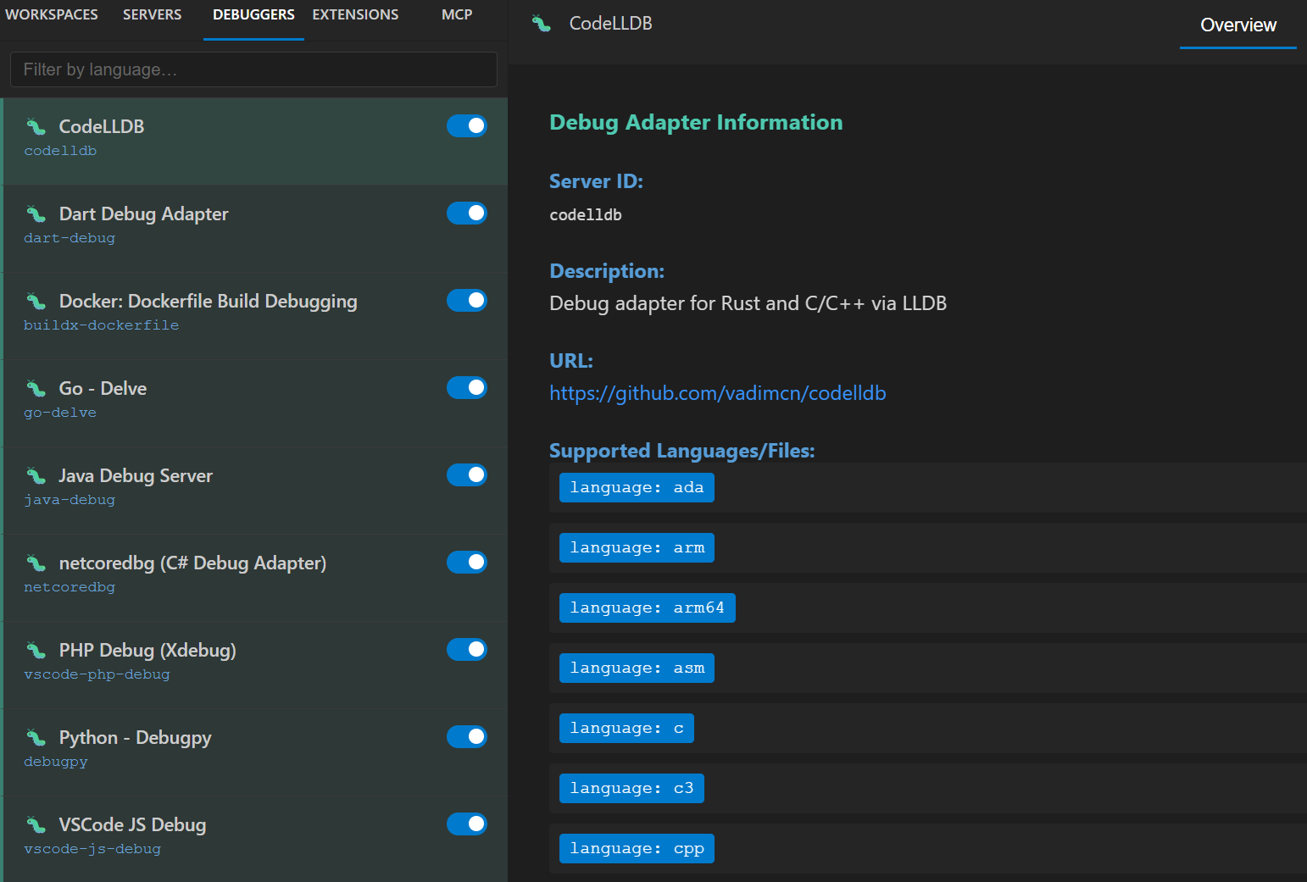
Admin: Debuggers
8 debug adapters — installation status, configuration, trace level

Slide 17
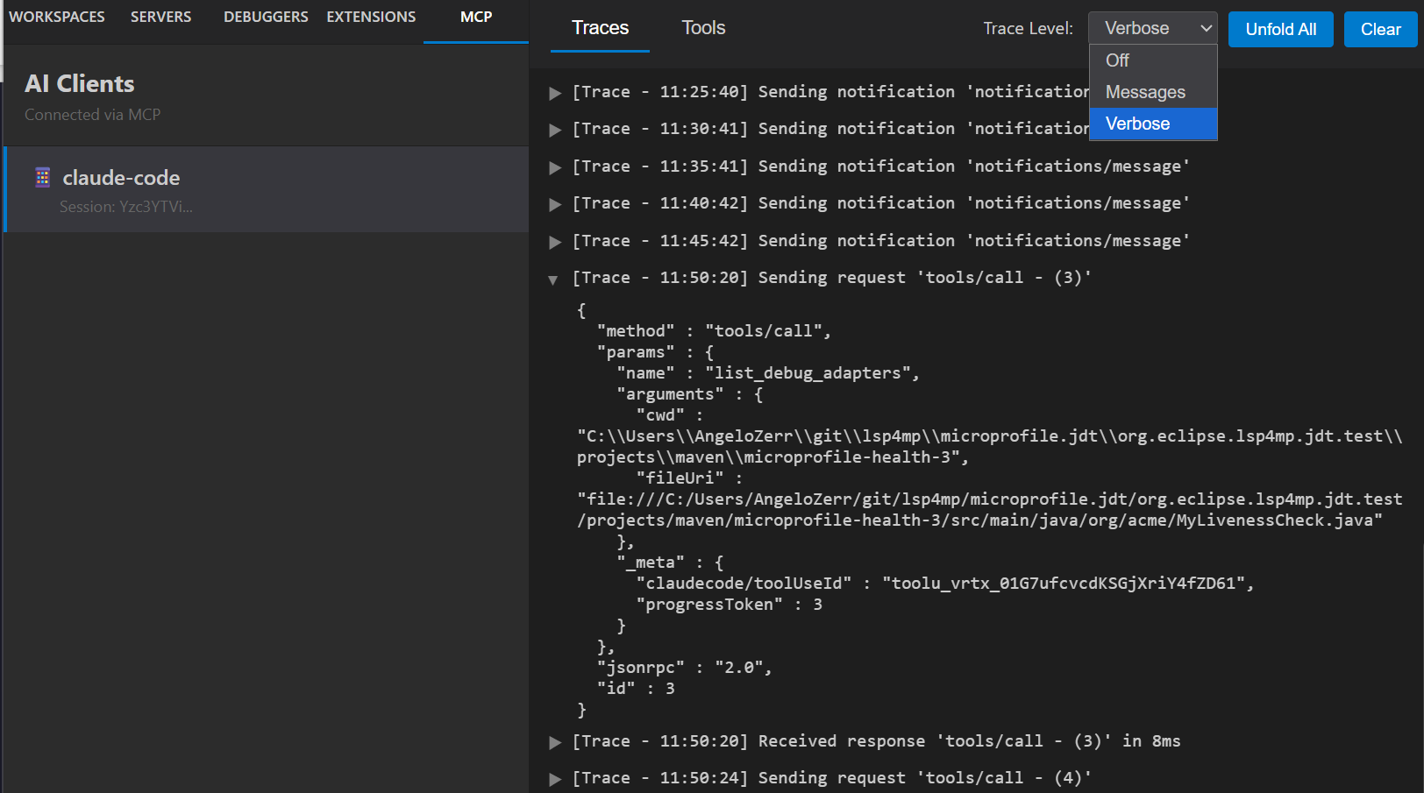
Admin: MCP Traces
Connected clients, live protocol traces, tool calls & results

Slide 18
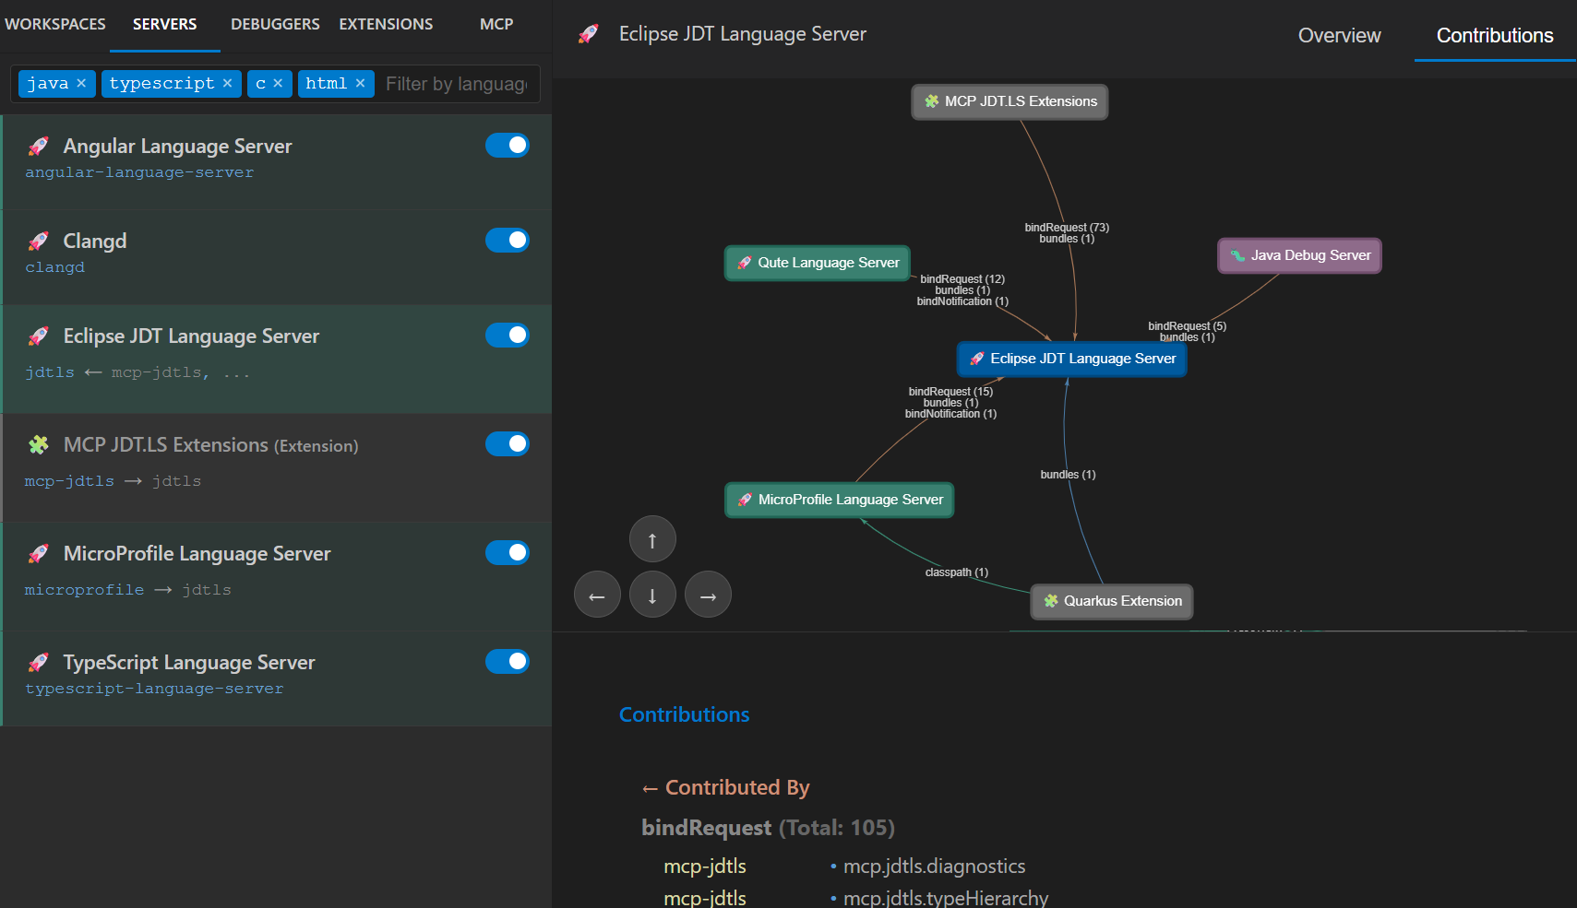
Admin: Server Contributions
Visualize bind relationships between LSP and DAP servers (vis.js)

Slide 19
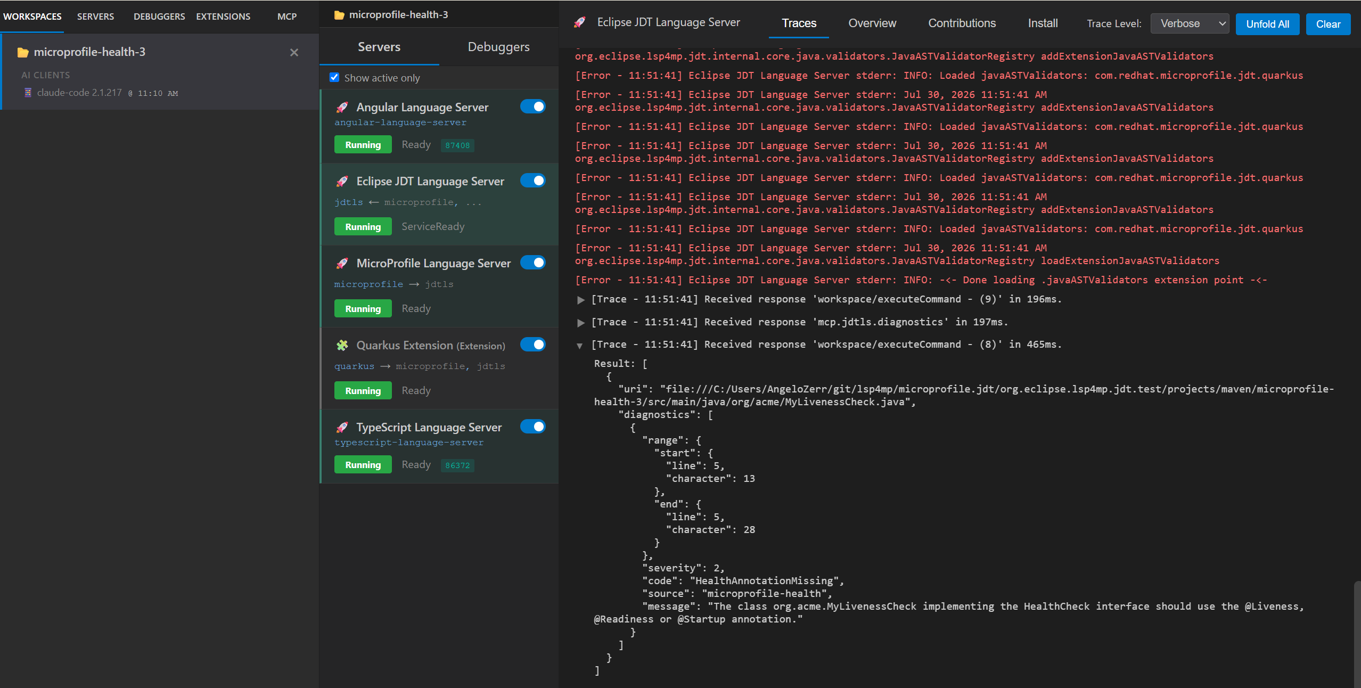
Admin: Workspace / Servers
Monitor opened projects, server status, traces, contribution diagrams

Slide 20
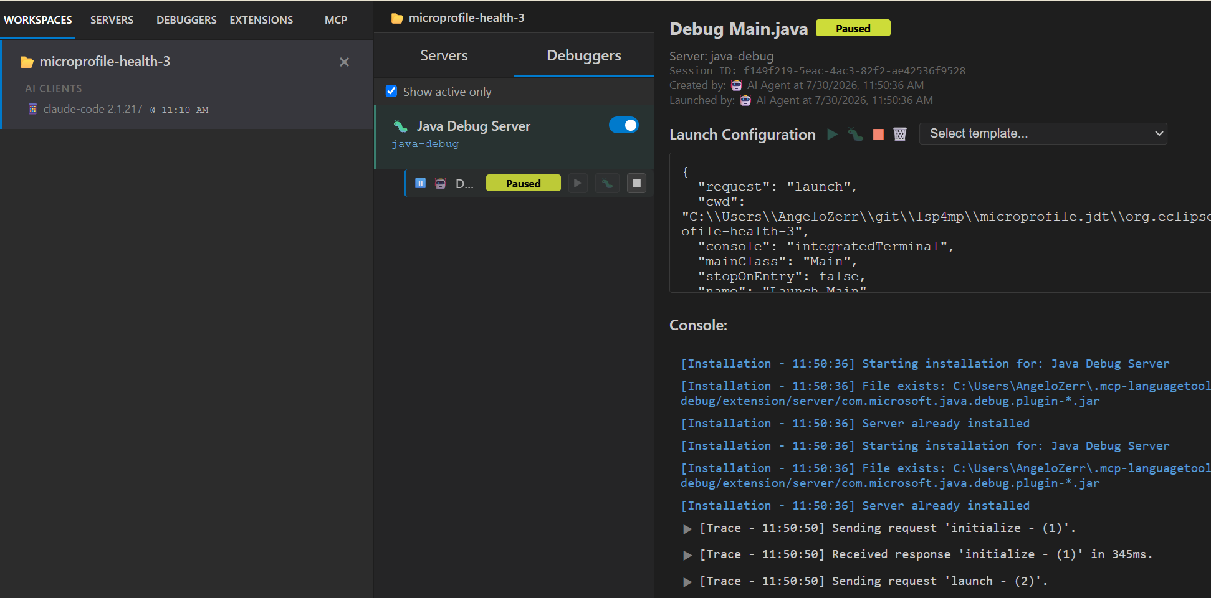
Admin: Workspace / Debuggers
Per-workspace debug adapter instances — sessions, traces

Slide 21
File Watcher: Keeping Language Servers in Sync
When an AI agent creates files, language servers must know about them
The Problem
The Solution: 3 Mechanisms
▸ AI agent creates Java file on disk
▸ JDT.LS doesn't know about it → ClassNotFoundException
▸ Root cause: workspace/didChangeWatchedFiles was not implemented
▸ File Watcher — automatic, local workspaces (Java NIO)
▸ refresh_workspace — explicit, like F5 in Eclipse IDE
▸ notify_file_changes — programmatic, works with remote too
How it works
File System
→ events →
WorkspaceFileWatcher
→ LSP →
Language Servers
*.java, pom.xml...
batch 500ms + glob filter
didChangeWatchedFiles
Static patterns (server.json) + dynamic (registerCapability) Event queuing when server stopped → replay on restart Configurable excludes (fileWatchers.excludePatterns)
JDT.LS: also needs project.refreshLocal() via mcp-jdtls → refresh_workspace calls both LSP + server-specific refresh No auto-refresh on restart — explicit action by agent or admin

Slide 22
Roadmap
Scaling to large Java projects and beyond
Known challenge: large project import
Roadmap
▸ Tested on Quarkus repo (huge codebase):
▸ 1. File scanning: each importer scans all files → very slow on large repos
▸ 2. Gradle conflict: build.gradle takes over pom.xml → Maven modules imported as Gradle
▸ 3. M2E import: ran 2h+, never completed → JDT.LS never becomes ready
▸ Fix JDT.LS import (scan, Gradle conflict)
▸ Maven artifact caching strategy started → Quarkus repo: 2h+ → 48 min
▸ Partial / incremental M2E import
▸ Connect to running JDT.LS in IDE → reuse already-imported workspace
▸ More language extensions

Slide 23
Getting Started
1. Clone, build, and start MCP Language Tools
git clone https://github.com/angelozerr/mcp-languagetools cd mcp-languagetools ./mvnw clean install -DskipTests ./mvnw quarkus:dev -f dev/pom.xml
2. Configure your MCP client (Claude Code, Bob...)
{ "mcpServers": { "mcp-languagetools": { "url": "http://localhost:7654/mcp" } } }
3. Ask your AI assistant to work on Java code!

Slide 24
Thank You!
MCP Language Tools
▸ github.com/angelozerr/mcp-languagetools
Admin Console: localhost:7654/admin
Questions?

