Slide 1





















The basic computational tools for data science
Angelo Ziletti, PhD
Principal Data Scientist, Bayer AG

Slide 2
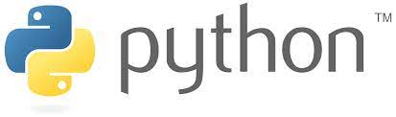
A data scientist minimal toolkit
Programming languages:
Python is by far now the top programming language for data science
R was popular, mostly for statisticians (but now much less)
Storing and sharing code: git
Machine learning algorithms (except deep learning): scikit-learn
Working with arrays: NumPy
Statistical functions: SciPy
Working with Tables: Pandas
Plotting: matplotlib, seaborn
Deep learning frameworks
Cloud computing

Slide 3

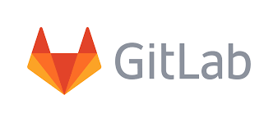
Git: a repository system for code
Control System: Git is a content tracker. Git can be used to store content
it is mostly used to store code due to the other features it provides
Version Control System:
The code which is stored in Git keeps changing as more code is added.
Also, many developers can add code in parallel.
Version Control System helps in handling this by maintaining a history of what changes have happened. Also, Git provides features like branches and merges, which I will be covering later.
Distributed Version Control System:
Git has a remote repository which is stored in a server and a local repository which is stored in the computer of each developer.
Most popular git:
Github: github.com
Gitlab: gitlab.com
From An introduction to Git: what it is, and how to use it (freecodecamp.org)

Slide 4
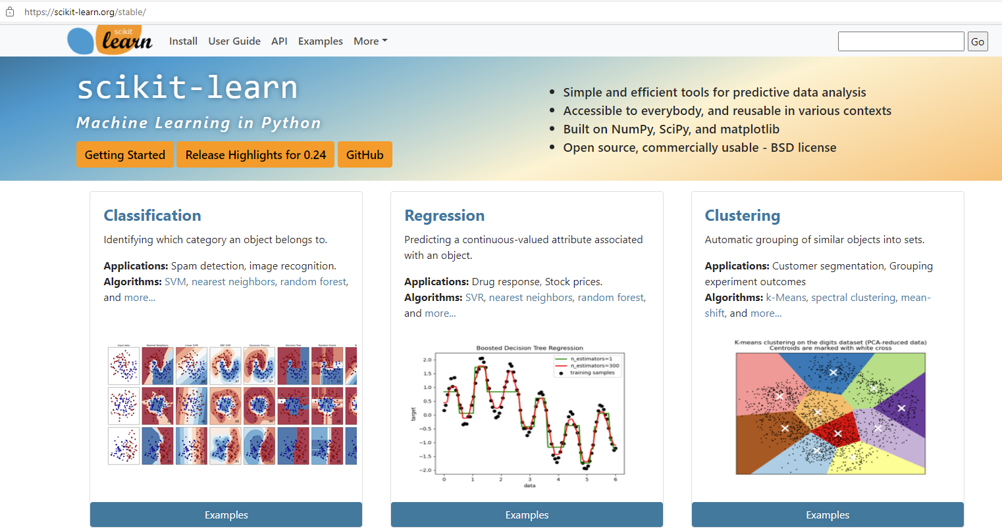
Scikit-learn: a library for nearly all machine learning methods
Scikit-learn is a free software machine learning library for Python
features various classification, regression and clustering algorithms including support vector machines, random forests, gradient boosting, k-means and DBSCAN,
designed to interoperate with the Python numerical and scientific libraries NumPy and SciPy
Many tutorials available, great documentation

Slide 5
Scikit-learn: Let us explore it together
Getting started: Getting Started — scikit-learn 0.24.2 documentation
Supervised learning: 1. Supervised learning — scikit-learn 0.24.2 documentation
Unsupervised learning: 2. Unsupervised learning — scikit-learn 0.24.2 documentation
Model selection and evaluation: 3. Model selection and evaluation — scikit-learn 0.24.2 documentation

Slide 6
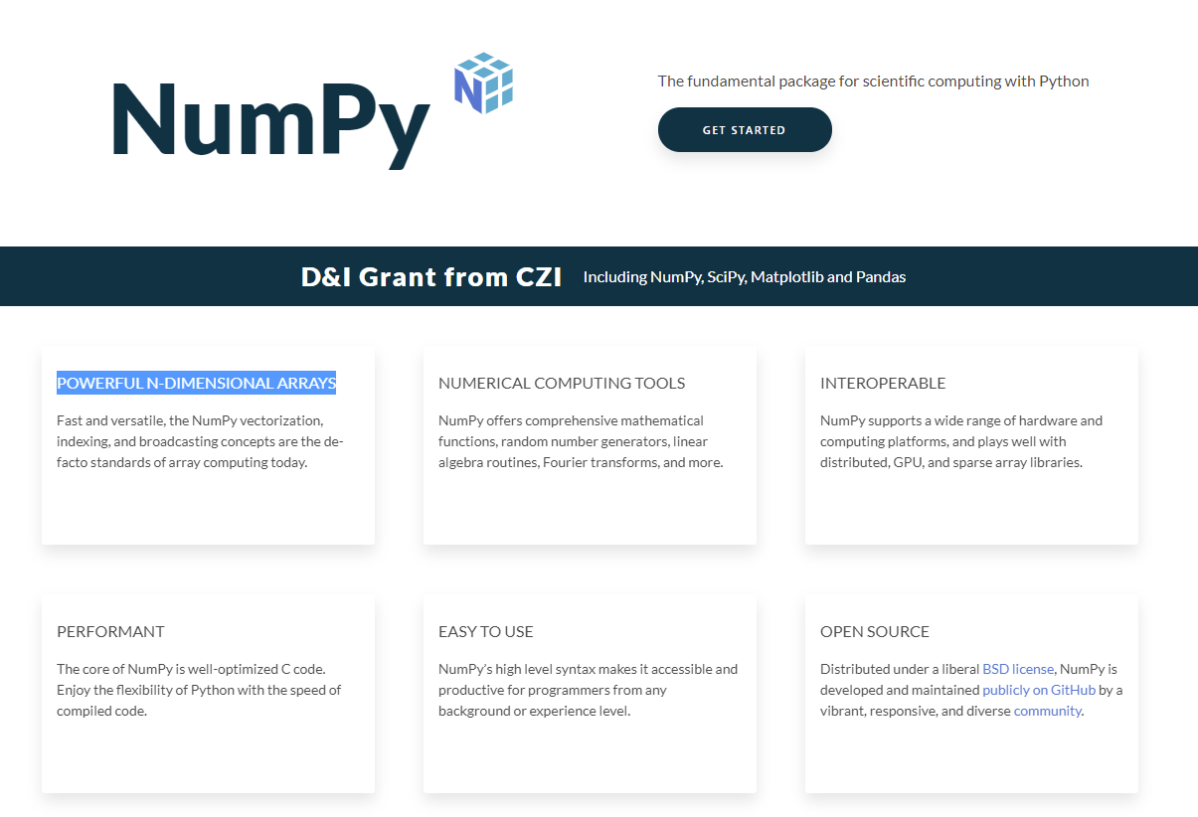
NumPy: working with arrays
NumPy is a library for Python adding support for large, multi-dimensional arrays and matrices, along with a large collection of high-level mathematical functions to operate on these arrays
E.g., fast operations on arrays, including mathematical, logical, shape manipulation, sorting, selecting, I/O, discrete Fourier transforms, basic linear algebra, basic statistical operations.
At the core of the NumPy package, is the ndarray object. This encapsulates n-dimensional arrays of homogeneous data types, with many operations being performed in compiled code for performance

Slide 7
Vectorization & NumPy
Vectorization is at the core of NumPy
Vectorization describes the absence of any explicit looping, indexing, etc., in the code. These things are taking place, of course, just “behind the scenes” in optimized, pre-compiled C code. Vectorized code has many advantages, among which are:
vectorized code is more concise and easier to read
fewer lines of code generally means fewer bugs
the code more closely resembles standard mathematical notation (making it easier, typically, to correctly code mathematical constructs)
vectorization results in more “Pythonic” code. Without vectorization, our code would be littered with inefficient and difficult to read for loops.
When possible, always write vectorized code (avoid for-loop whenever possible)

Slide 8
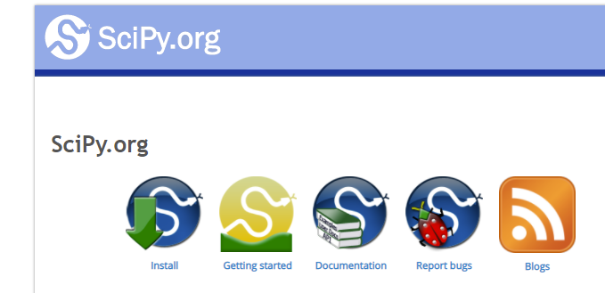
SciPy:
SciPy is a free and open-source Python library used for scientific computing and technical computing
SciPy contains modules for
optimization
linear algebra
integration, interpolation,
special functions
FFT, signal and
image processing,
ODE solvers
and others….
Let us have a look: SciPy User Guide — SciPy v1.7.1 Manual

Slide 9
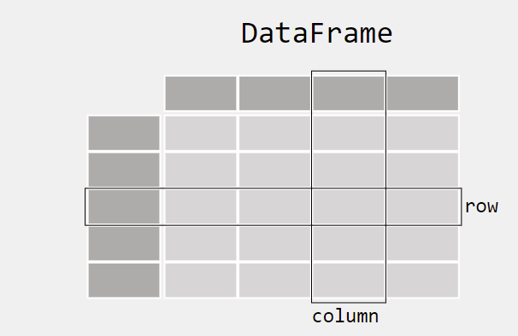
Pandas: working with tables
pandas is a software library written for Python for data manipulation and analysis
it offers data structures and operations for manipulating numerical tables and time series
One of the central objects of the Pandas library is dataframe
Let us explore Pandas together: Getting started — pandas 1.3.2 documentation (pydata.org)

Slide 10
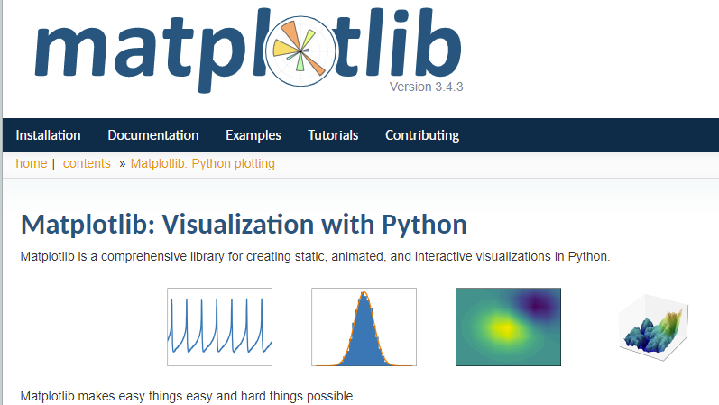
Matplotlib: visualization
Matplotlib is a visualization library for Python
It allows a high-degree of customizability
Lots of materials and tutorials available online
Let us have a look: Usage Guide — Matplotlib 3.4.3 documentation

Slide 11
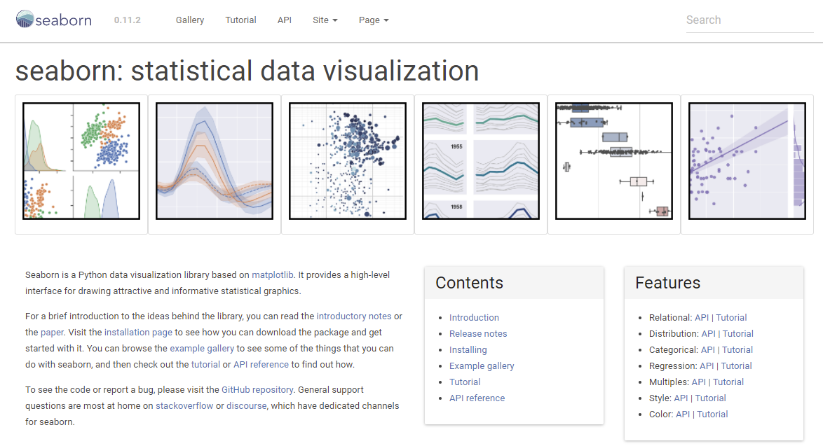
Seaborn: making nice and insightful plots easily
Seaborn is a Python data visualization library based on matplotlib
It provides a high-level interface for drawing attractive and informative statistical graphics
Let us explore seaborn together: An introduction to seaborn — seaborn 0.11.2 documentation (pydata.org)

Slide 12
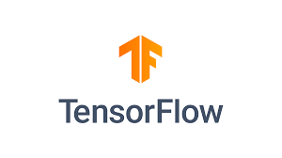

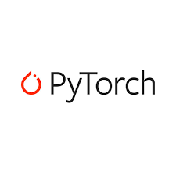

Deep Learning
Some of the top deep learning frameworks:
TensorFlow
Keras
PyTorch
Gluon
Essentially all real projects with deep learning computations will need a GPUs
Deep learning frameworks optimized for GPU usage
GPUs are usually orders of magnitude faster than CPUs for deep learning
Choice depends on model availability, documentation, personal preference

Slide 13
Cloud computing
Cloud computing is the on-demand availability of computer system resources, especially data storage (cloud storage) and computing power, without direct active management by the user.
Cloud computing relies on sharing of resources to achieve coherence and economies of scale, typically using a "pay-as-you-go" model which can help in reducing capital expenses but may also lead to unexpected operating expenses for unaware users.
Without cloud computing, very likely the data science progress would have not been as fast
Top cloud providers:
Amazon Web Services (AWS)
Microsoft Azure
Google Cloud Platforms
In general, they all provide similar services

