Slide 1
SUPERTEAM KRAKÓW • SOLANA PoC
An AI agent bought
drinks—and Solana
recorded the lifecycle
Supervised web fulfillment: exact quote approval, email 3DS, purchase evidence, and physical delivery.
REAL ORDER
REAL CARD
LOCAL SOLANA
30 AUG 2026
Notes:
Open with the outcome: the system turned a plain-language intent into a physical delivery. The interesting part is not just browser automation—the system kept payment supervised and recorded each authorization boundary on Solana.
[Sources]
- Local demo artifacts under agent/out/
- User-confirmed in-person delivery, 30 Aug 2026

Slide 2
ONE PROTOCOL, MANY ADAPTERS
02
The contract does not care what gets delivered
1
2
3
4
INTENT
›
ON-CHAIN GATE
›
WEB ADAPTER
›
PHYSICAL PROOF
“Bring drinks to
the demo venue.”
Lock funds. Approve
spec + exact quote.
Search, checkout,
card, email 3DS.
Order status +
human receipt.
Food today. Local merch tomorrow. The program only sees approved hashes, amounts, and lifecycle events.
SUPERVISED FULFILLMENT • KRAKÓW • 30 AUG 2026
Notes:
Walk left to right. The Solana program is stable while the off-chain adapter changes. In this demo, the adapter was Glovo. The same contract can govern food, local print, handmade goods, or a manual fulfillment path.
[Sources]
- Repository architecture and agent adapter configuration
- agent/out/chain-job.json

Slide 3
BUILDER ARCHITECTURE
03
Three planes, one verifiable fulfillment lifecycle
CONTROL PLANE
EXECUTION PLANE
EVIDENCE PLANE
Solana + Anchor
Local agent
Proof artifacts
—
Campaign + vault PDAs
↔
—
Adapter policy runner
↔
—
Quote + order ID
—
SPL-token escrow
—
Persistent browser
—
Screenshots + status
—
Quote/spec hashes
—
Human checkpoints
—
Payment audit
—
Lifecycle transactions
—
AgentMail 3DS input
—
Delivery/photo hash
Boundary rule: card secrets, OTPs, browser cookies, addresses, and raw email bodies stay off-chain.
SUPERVISED FULFILLMENT • KRAKÓW • 30 AUG 2026
Notes:
This is the implementation split. The Anchor program is the control plane; it owns escrow and approved state. The local agent is the execution plane; it holds browser state and touches merchant systems. JSON evidence and hashes bridge the two. Sensitive data never crosses into Solana.
[Sources]
- Anchor program and generated IDL in the repository
- agent/src adapter runner and browser modules
- agent/out/chain-job.json

Slide 4
SAFETY MODEL
04
Payment stayed human-controlled
01
02
03
CHECKLIST
QUOTE APPROVAL
PAY + 3DS
Venue, basket, note, cap
25.24 PLN, exact string
One attempt, email challenge
DEFAULT: PAY OFF
NO PAN / OTP ON-CHAIN
NO SILENT RETRY
CAP ENFORCED
ONE ATTEMPT
SUPERVISED FULFILLMENT • KRAKÓW • 30 AUG 2026
Notes:
Stress that autonomy is bounded. By default, the agent stops before payment. The human approved the exact quote. The card attempt was unique. Secrets stayed off-chain and out of the model transcript.
[Sources]
- agent/out/quote.json
- agent/out/payment-attempt.json
- agent/out/three-ds-audit.json

Slide 5
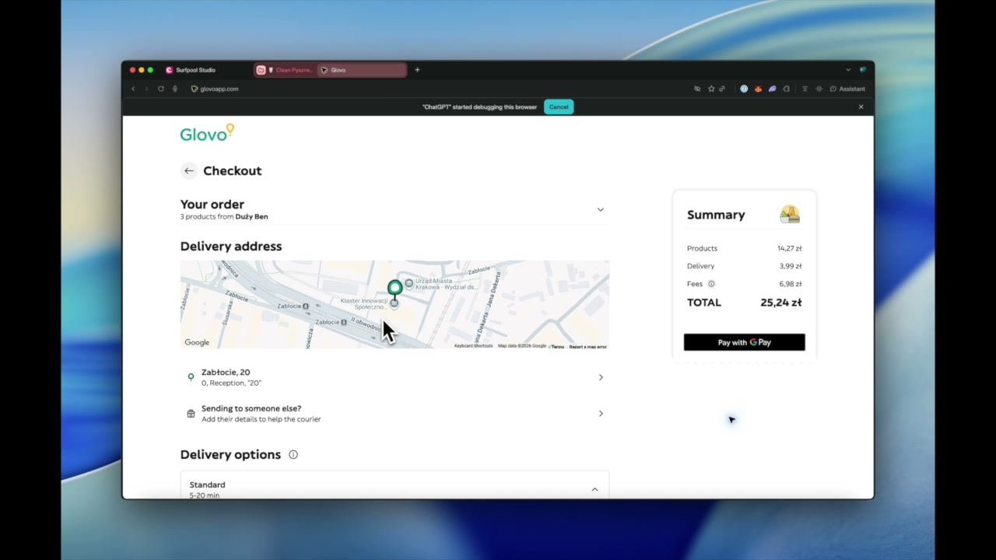
VIDEO
05
Live demo: intent → checkout → 3DS → delivery
▶
PLAY 1:44 DEMO
CLICK PLAY • LOCAL VIDEO COMPANION FILE
Notes:
Click the play button to open the edited 1:44 demo clip from the presentation-assets folder. During playback, narrate only the checkpoints: basket under cap, exact approval, card attempt, email 3DS, order confirmation, and delivery.
[Sources]
- presentation-assets/Poland Agent got hands.m4v

Slide 6
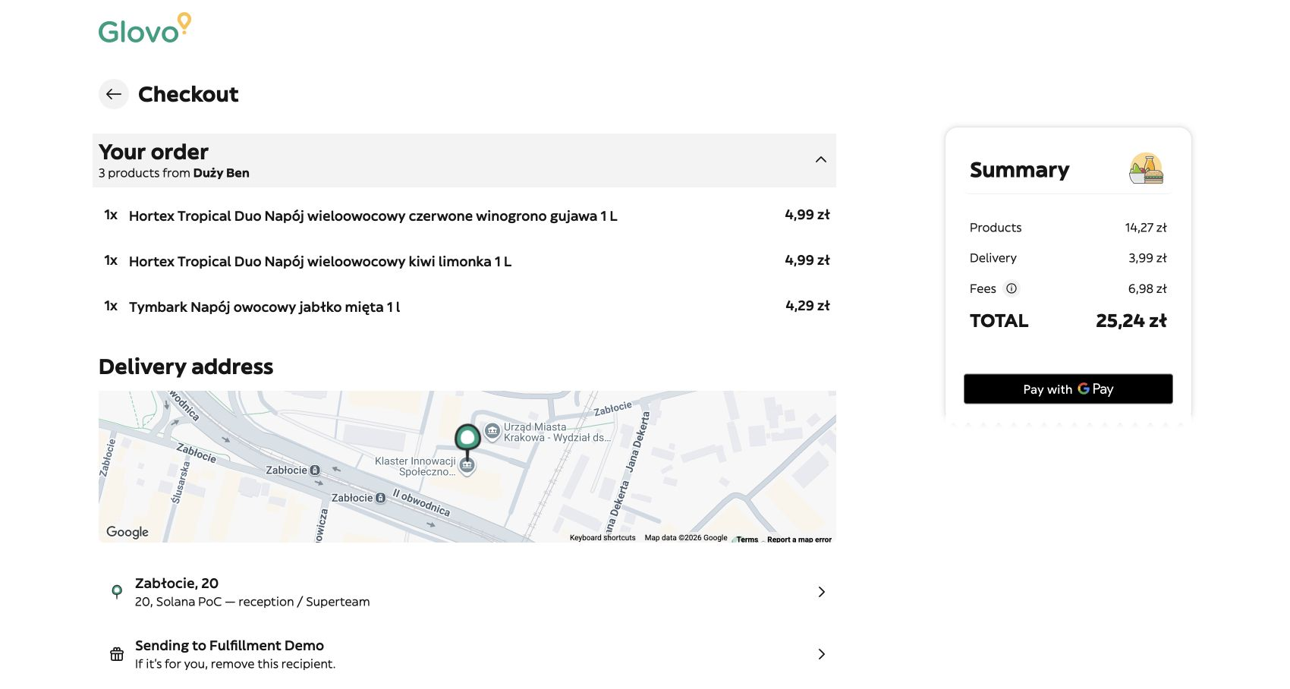
CHECKOUT EVIDENCE
06
The agent built a real basket under a hard cap
3 × 1 L
juices selected
for the classroom
25.24 PLN
approved landed quote
26.00 PLN
maximum allowed
SUPERVISED FULFILLMENT • KRAKÓW • 30 AUG 2026
Notes:
Point out that the amount shown by the merchant—not a forecast—became the approved quote. The order was three one-litre juices from Duży Ben, delivered to the configured Superteam venue.
[Sources]
- agent/out/screenshots/glovo-final-checkout.jpg
- agent/out/quote.json

Slide 7
PAYMENT AUTHENTICATION
07
Email 3DS completed without exposing the OTP
1
2
3
READ
VALIDATE
SUBMIT ONCE
AgentMail detected a fresh
Apata challenge.
Merchant = Glovo
Amount = 25.24 PLN
Six digits entered only
after explicit approval.
The audit records provider, merchant, currency, amount, mode, and completion time—never the code itself.
APATA • EMAIL OTP • SECRET-FREE AUDIT
Notes:
The mailbox was used as a constrained authentication input. The agent classified the sender, checked the amount and merchant, and submitted exactly once. The audit file contains no OTP.
[Sources]
- agent/out/three-ds-audit.json
- agent/out/payment-auth.json

Slide 8
SURFPOOL / SOLANA
08
Authorization boundaries became on-chain events
QUOTE APPROVED
PAYMENT AUTH
PURCHASE
25.24 PLN
Apata 3DS
Order 101758048957
5pedrWb…f6Rv2
YWwoQjV…qevyPE
CjJT67j…7WTbX
Campaign
Spec hash
84FzYjkH…QYzh7N
fa927741…cf0e4
VIEW LOCALLY IN SURFPOOL STUDIO • 127.0.0.1:18488
Notes:
The transaction signatures are real local-Solana transactions. The audience can inspect them in Surfpool Studio. Explain that the on-chain program stores lifecycle evidence and hashes—not personal delivery information or card secrets.
[Sources]
- agent/out/chain-job.json
- Payment auth transaction: YWwoQjVTkbiEWQKEXWEtCDpKmtc1ZrUwGk9Lj547uJm5k8Fj7TJ6Bium1K9RRcy7wWoMiuAv2SSjMXyTbqevyPE
- Purchase transaction: CjJT67jsbsvqUqX3Vbq5yTrBvCqeNbCrqHNfZw8UdebSYhmbfLeCKHQuQq4RrW16EKgGT3AJTnbvzMrkba7WTbX

Slide 9
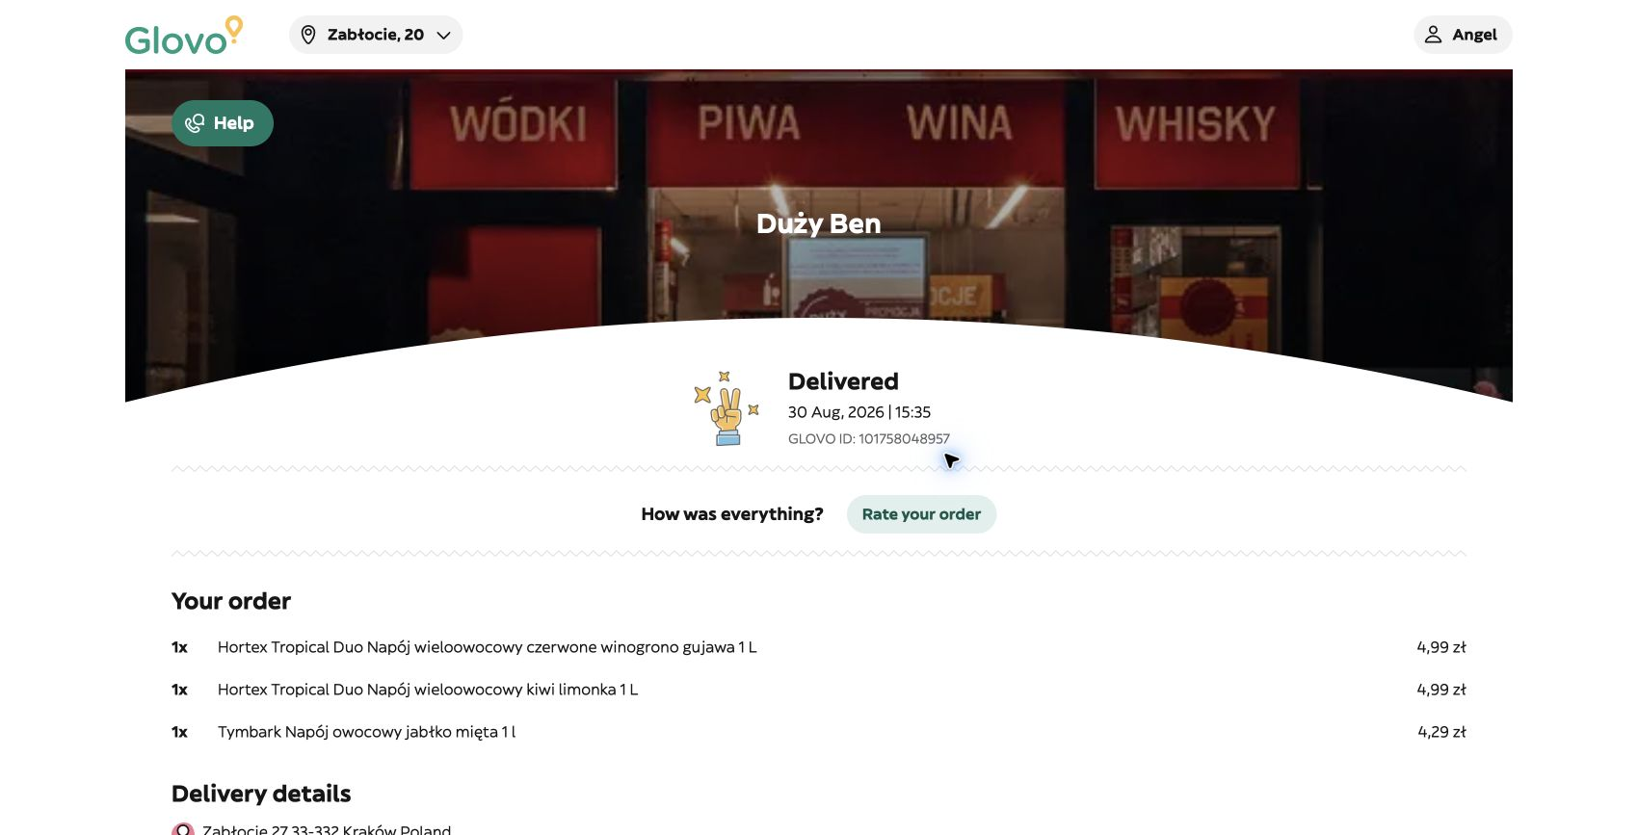
DELIVERY EVIDENCE
09
The physical order arrived
DELIVERED
15:35
30 Aug 2026
Order ID
101758048957
Merchant status +
human receipt confirmed
SUPERVISED FULFILLMENT • KRAKÓW • 30 AUG 2026
Notes:
This run used two sources of delivery evidence: Glovo marked the order Delivered, and the recipient confirmed physical receipt. That matters because merchant status alone can be wrong. A future version should also hash a delivery photo when available.
[Sources]
- agent/out/screenshots/glovo-delivered.jpg
- agent/out/delivery-evidence.json

Slide 10
RECONCILIATION
10
The key result: settlement was blocked
25.24
26.09
+0.85
→
→
approved quote
PLN
final merchant charge
PLN
variance
PLN
SETTLEMENT BLOCKED
The final charge was 0.09 PLN above the hard cap. Human reconciliation is required.
SUPERVISED FULFILLMENT • KRAKÓW • 30 AUG 2026
Notes:
Do not hide this edge case—it is the trust story. Glovo's final charged amount was 26.09 PLN, versus the 25.24 PLN approved quote and 26.00 PLN cap. The delivery succeeded, but settlement remained blocked pending human reconciliation.
[Sources]
- agent/out/amount-reconciliation-exception.json
- Final Glovo order total recorded by the demo operator

Slide 11
THE THESIS
A browser can transact where APIs do not exist.
A protocol decides when it should.
01
RECONCILE
02
PROVE
03
EXPAND
Make mutable merchant totals
an explicit protocol state.
Hash photos or signed human
receipt when available.
Add local print, shops, and
manual fulfillment adapters.
LOCK
→
APPROVE SPEC HASH
→
PROVE DELIVERY
The Solana program stayed unchanged.
Notes:
Close on the protocol, not the delivery app. The value is a reusable authorization and proof layer for physical commerce. Wolt, Glovo, local print, or a human operator can all be adapters without changing the core contract.
[Sources]
- Repository README talk track
- Local demo evidence under agent/out/

