Slide 1

EMOSENSE Multimodal Emotion Recognition Using Deep Learning
ANGEL NAKKALA
700748217

Slide 2
Responsibilities
Implement algorithms for combining information from text, sound, and video.
Develop a simple user interface for input and output.
Integrate the developed Deep learning models into the application.
Document findings for the project report
Prepare a comprehensive project report.

Slide 3
Motivation
The motivation behind our project lies in addressing this gap by introducing a cutting-edge platform that harnesses the power of multimodal emotion recognition. We recognize that a candidate's responses to interview questions are not solely conveyed through the spoken word. The nuances of facial expressions, tone of voice, and other non-verbal signals play a pivotal role in conveying their true emotions and interpersonal skills.

Slide 4
Objective
The aim of this project is to provide candidates seeking for a job a platform that analyses their answers to a set of pre-defined questions, as well as the non-verbal part of a job interview through sound and video processing.

Slide 5
Problem Statement
Traditional job interviews often fall short in capturing the holistic attributes of candidates, relying predominantly on verbal responses and neglecting crucial non-verbal cues.
This project addresses the need for a comprehensive platform that integrates text, sound, and video processing to analyze candidates' responses in job interviews.

Slide 6
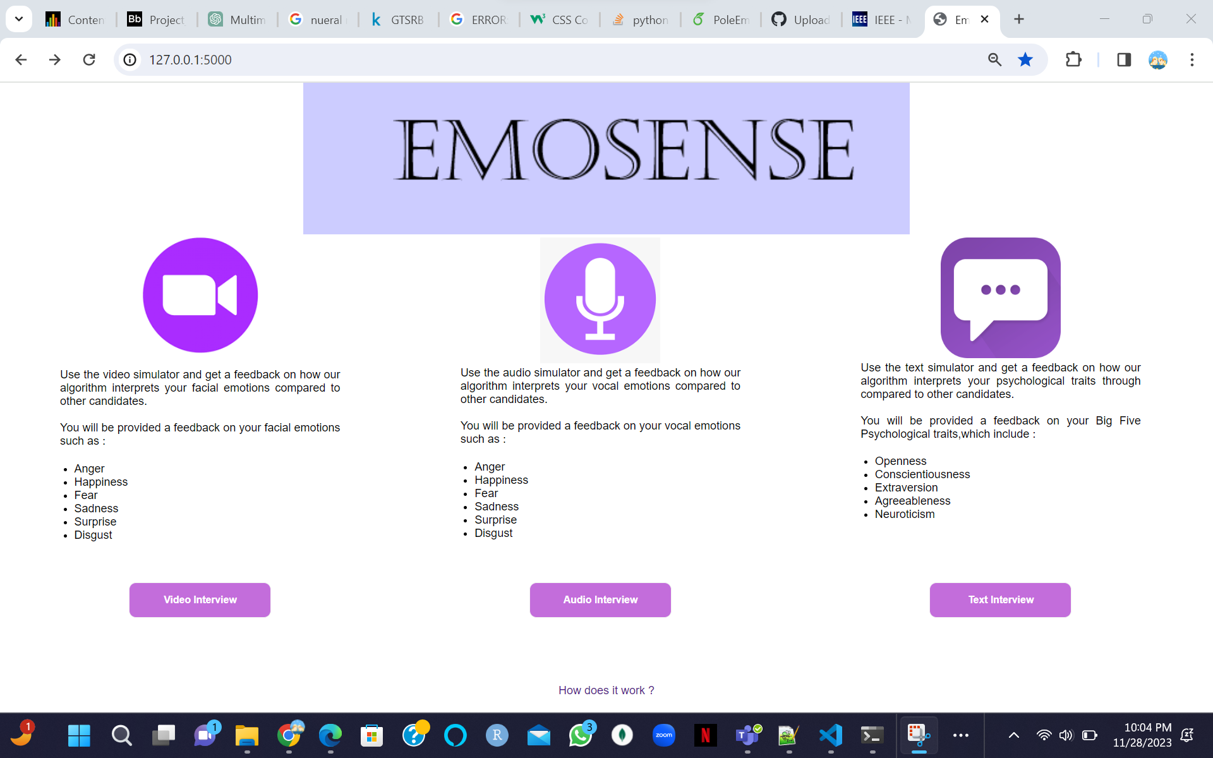
Proposed Solution
Text: Utilize advanced natural language processing techniques to extract sentiment and emotion-related features from the text.
Audio: Implement signal processing techniques to extract acoustic features indicative of different emotional states.
Video: Leverage facial recognition algorithms to extract facial expressions and related features.

Slide 7
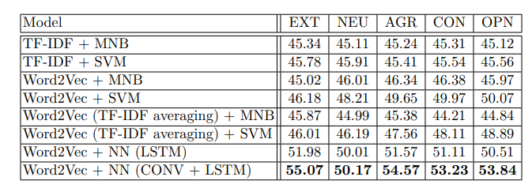
Text Input Results

Slide 8
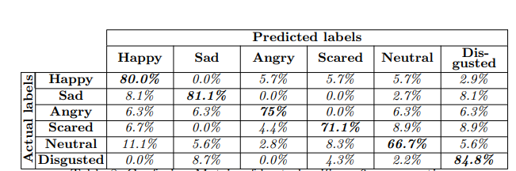
Speech Input Results

Slide 9
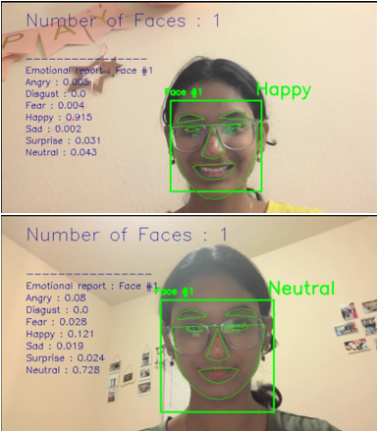
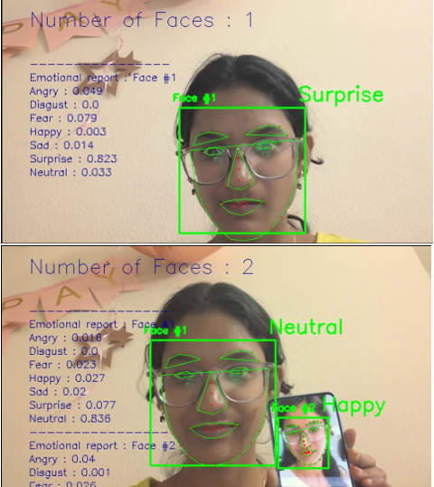
Video Input Results

Slide 10



References
B.Kratzwalda, S.Ilie´, M.Kraus, S.Feuerriegel, H.Prendinger. Deep learning for affective computing: text-based emotion recognition in decision support, Sep. 2018. https://arxiv.org/pdf/1803.06397.pdf
N.Majumder, S.Poria, A.Gelbukh, E.Cambria. Deep Learning-Based Document Modeling for Personality Detection from Text, 2107. http://sentic.net/deep-learning-based-personality-detection.pdf
The Ryerson Audio-Visual Database of Emotional Speech and Song (RAVDESS), https://zenodo.org/record/1188976/?f=3.XAcEs5NKhQK
B.Basharirad, and M.Moradhaseli. Speech emotion recognition methods: A literature review. AIP Conference Proceedings 2017. https://aip.scitation.org/doi/pdf/10.1063/1.5005438
L.Chen, M.Mao, Y.Xue and L.L.Cheng. Speech emotion recognition: Features and classification models. Digit. Signal Process, vol 22 Dec. 2012.
T.Vogt, E.Andre´ and J.Wagner. Automatic Recognition of Emotions from Speech: A Review of the Literature and Recommendations for Practical Realisation. Affect and Emotion in Human-Computer Interaction, 2008.
T.Vogt and E.Andre´. Improving Automatic Emotion Recognition from Speech via Gender Differentiation. Language Resources and Evaluation Conference, 2006.

