Slide 1

EMOSENSE Multimodal Emotion Recognition Using Deep Learning
ANGEL NAKKALA
700748217

Slide 2
Responsibilities
Implement algorithms for combining information from text, sound, and video.
Integrate the developed Deep learning models into the application.
Document findings for the project report
Prepare a comprehensive project report.

Slide 3
Motivation
The motivation behind our project lies in addressing this gap by introducing a cutting-edge platform that harnesses the power of multimodal emotion recognition. Create a system that allows users to interact with technology in a more natural and intuitive way by combining facial expressions, spoken commands, and written text.

Slide 4
Objective
Multimodal Emotion Recognition is a relatively new discipline that aims to include text inputs, as well as sound and video. This field has been rising with the development of social networks that gave researchers access to a vast amount of data. Recent studies have been exploring potential metrics to measure the coherence between emotions from the different channels. We are going to explore several categorical targets depending on the input considered.

Slide 5
Related work
Personality detection from Text:
Some earlier work on automated personality detection from plain text was done by James Pennebaker and Laura King,4who compiled the essay dataset For this, they collected stream-of-consciousness essays written by volunteers in a controlled environment and then asked the authors of the essays to define their own Big Five personality traits. They used Linguistic Inquiry and Word Count (LIWC) features to determine correlation between the essay and personality.

Slide 6
Related work
Speech Emotion Recognition:
Grimm et al. Proposed a multi-dimensional model by utilizing emotion primitives for speech emotion recognition. k-NN Acoustic features such as pitch, energy, speaking rate and spectral characteristics. A multi-dimensional model by utilizing emotion primitives. Three dimension were made by composing of three different value of emotion primitives, which is called valence, activation, and dominance.

Slide 7
Related work
Video Emotion Recognition:
In the Ryerson Model:
A great part of the work was to select the filters (e.g Gabor filters) and the architecture of the filters in order to extract as much information from the image as possible. With the rise of deep learning and greater computation capacities, this work can now be automated

Slide 8
Problem Statement
This project addresses the need for a comprehensive platform that integrates text, sound, and video processing to analyze candidates' responses in job interviews.

Slide 9
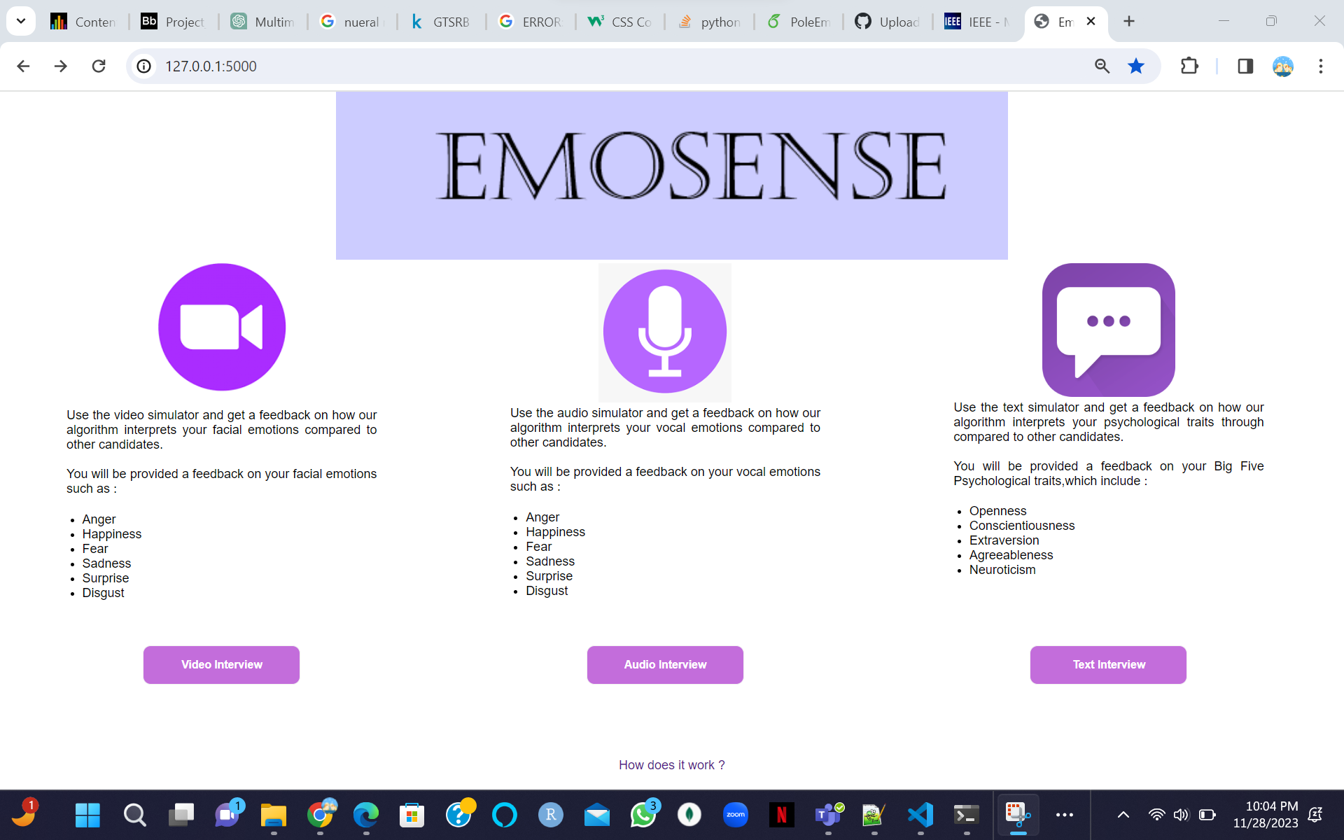
Proposed Solution
Text: Utilize advanced natural language processing techniques to extract sentiment and emotion-related features from the text.
Audio: Implement signal processing techniques to extract acoustic features indicative of different emotional states.
Video: Leverage facial recognition algorithms to extract facial expressions and related features.

Slide 10
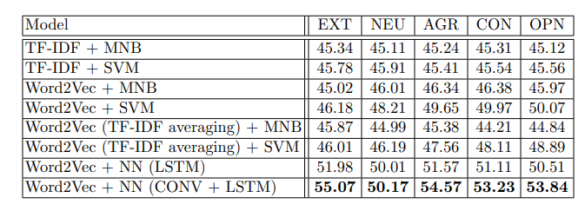
Text Input Results

Slide 11
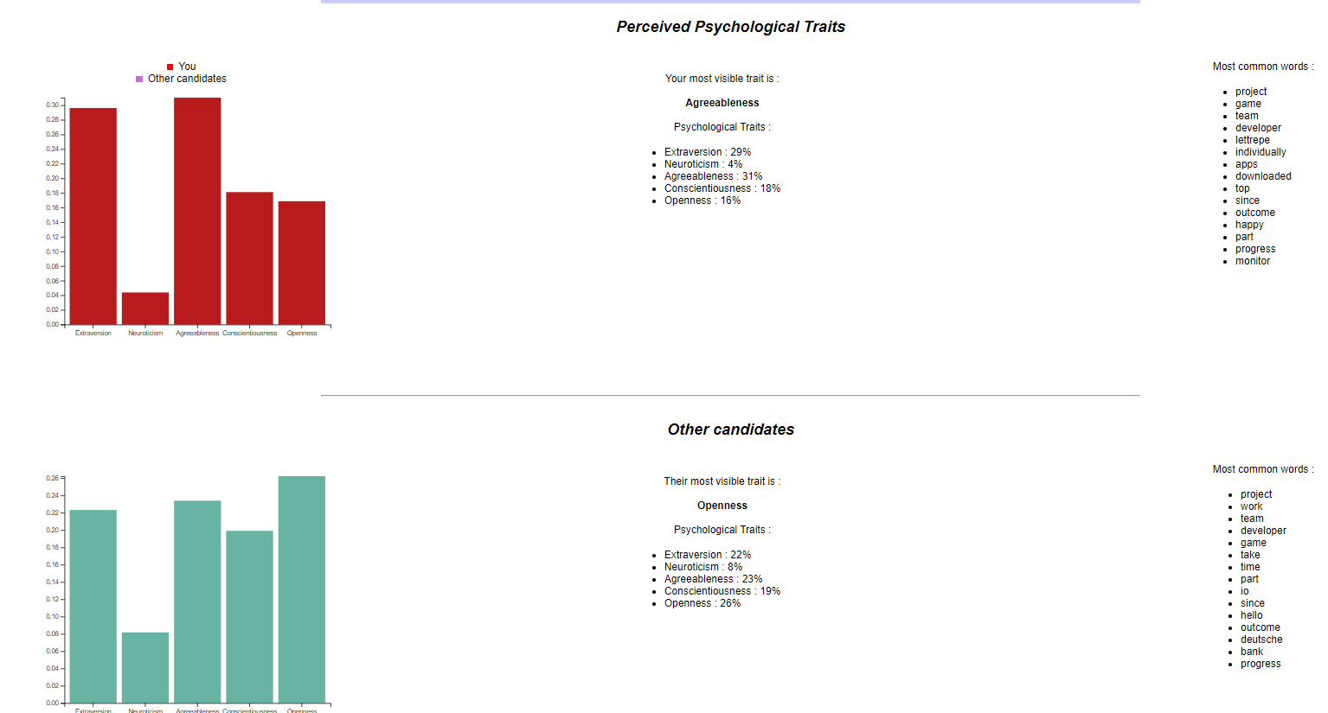

Slide 12
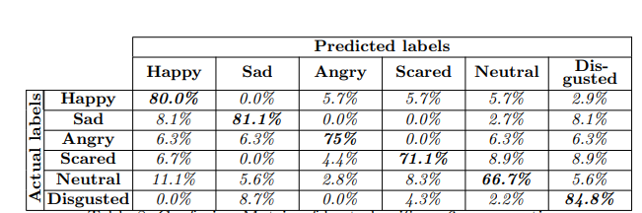
Speech Input Results

Slide 13
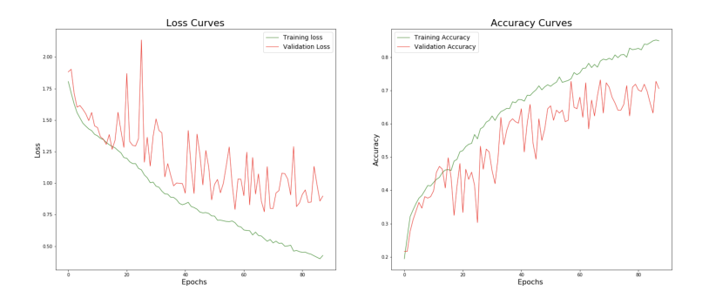

Slide 14
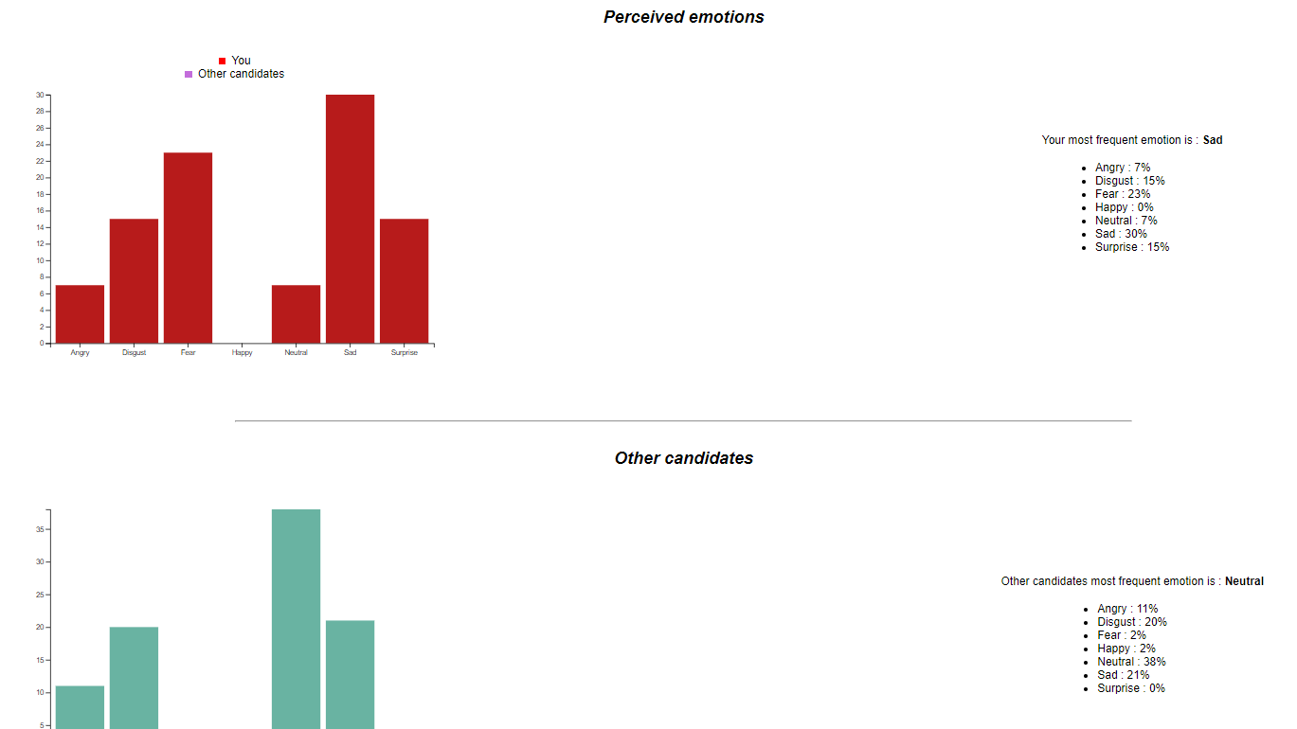

Slide 15
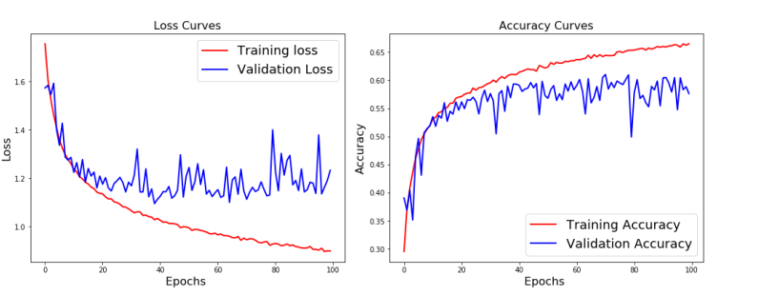
Video Input Results

Slide 16
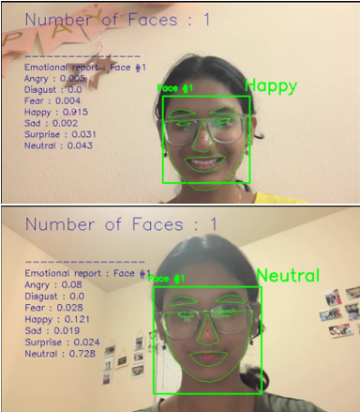
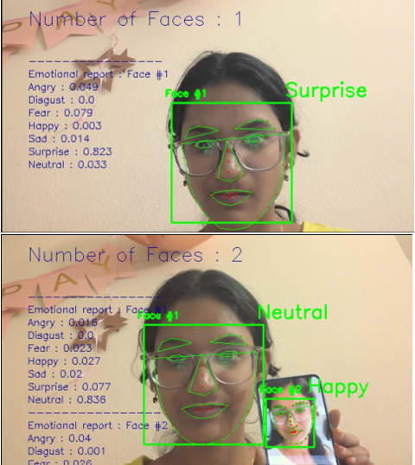
Video Input Results

Slide 17



References
B.Kratzwalda, S.Ilie´, M.Kraus, S.Feuerriegel, H.Prendinger. Deep learning for affective computing: text-based emotion recognition in decision support, Sep. 2018. https://arxiv.org/pdf/1803.06397.pdf
N.Majumder, S.Poria, A.Gelbukh, E.Cambria. Deep Learning-Based Document Modeling for Personality Detection from Text, 2107. http://sentic.net/deep-learning-based-personality-detection.pdf
The Ryerson Audio-Visual Database of Emotional Speech and Song (RAVDESS), https://zenodo.org/record/1188976/?f=3.XAcEs5NKhQK
B.Basharirad, and M.Moradhaseli. Speech emotion recognition methods: A literature review. AIP Conference Proceedings 2017. https://aip.scitation.org/doi/pdf/10.1063/1.5005438
L.Chen, M.Mao, Y.Xue and L.L.Cheng. Speech emotion recognition: Features and classification models. Digit. Signal Process, vol 22 Dec. 2012.
T.Vogt, E.Andre´ and J.Wagner. Automatic Recognition of Emotions from Speech: A Review of the Literature and Recommendations for Practical Realisation. Affect and Emotion in Human-Computer Interaction, 2008.
T.Vogt and E.Andre´. Improving Automatic Emotion Recognition from Speech via Gender Differentiation. Language Resources and Evaluation Conference, 2006.

