Slide 1
BellaBeats Consumer Insights
January 2021
Angel Garcia

Slide 2
Goals for this presentation
To Note:
Sample size of 33 users
940 Logs
To share an overview of data, to understand how users use BellaBeats | Examine trends to identify which steps must be taken to improve | Discuss any and all questions to help your business grow

Slide 3
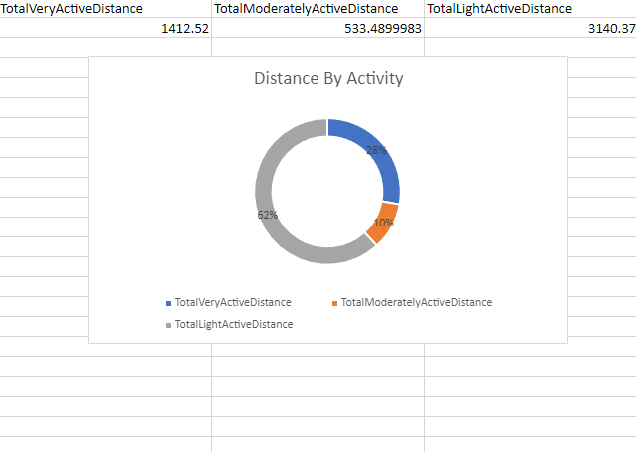
LightActive BellaBeat users travel longer distances
Distance = Miles
To note:
Data does not accommodate for how many users under each category
This may lead us to believe, there are more LightActive users than others

Slide 4


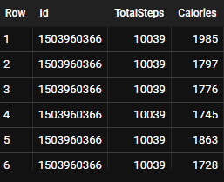



Same steps different calories
(users may have been running thus why burned more calories)

Slide 5
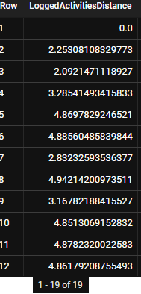
LoggingActivity Usage
940 Logs
Only 18
manual logs recorded
(excluding log#1 recorded as 0)
Rate of 0.019% usage
Users do not like manually logging their activities

Slide 6
Acting on insights
Low usage of LoggedActivities
Tweak
Improve
Remove

Slide 7
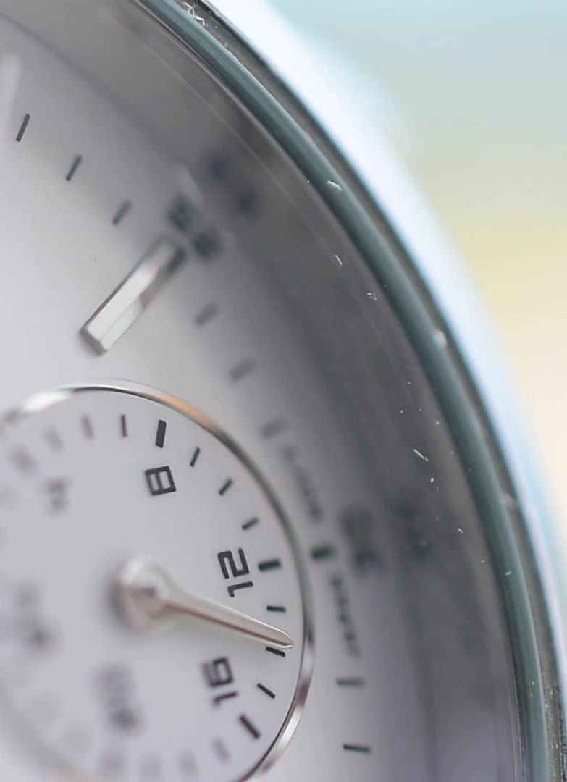
Outliers
Users may have removed their watches
Health concerns not taken to measurements
Devices need to recharge
Hand movements sometimes accounted as steps

Slide 8
Summary
More people may be LightActive than VeryActive
LightActive travel more miles than VeryActive/ModActive
Step/Calorie tracking may not be accurate
BellaBeat tracker may have to be modified to be more accurate/cleaner
Logging activities may have to be tweaked, low usage

