Slide 1
Apparition of Comets
Angela Cheng
GSFC-6930 Spring Intern

Slide 2
Using JPL Horizons to find approaching comets

Slide 3
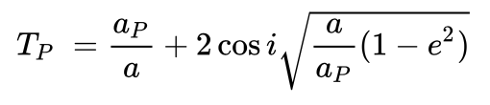
Comet Classification: Tisserand's parameter
a : semimajor axis
e : orbital eccentricity
i : orbital inclination
a_{p} : larger body semimajor axis
Three main categories:
Jupiter-family comet: T_{J} > 2, and orbital period P < 200 years
Halley-type comet: T_{J} < 2, and orbital period P < 200 years
Long period comet: P > 200 years, high eccentricity, usually parabolic orbit

Slide 4
Workflow
JPL Horizons email interface
Save as .txt files and parse
4 scripts for different output formats

Slide 5
Data Output Formats
Fully automated excel table of comet names, close approach dates and distances, comet period, semi-major axis, eccentricity, and inclination
2D plot of orbits projected onto the ecliptic plane
Plot of all closest approach distances and dates of a comet class
Plot of distances and dates of close approaches of all comets in a class
Notes:
All Python scripts

Slide 6
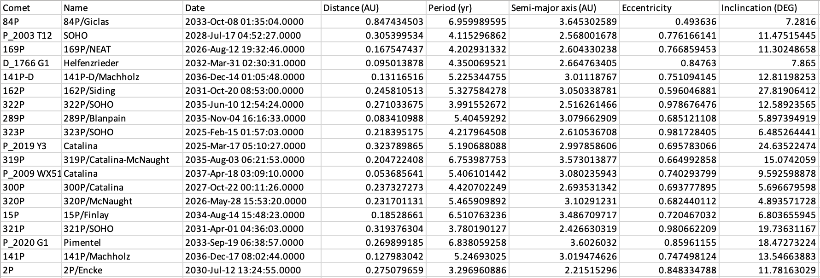
Automated Excel Table

Slide 7
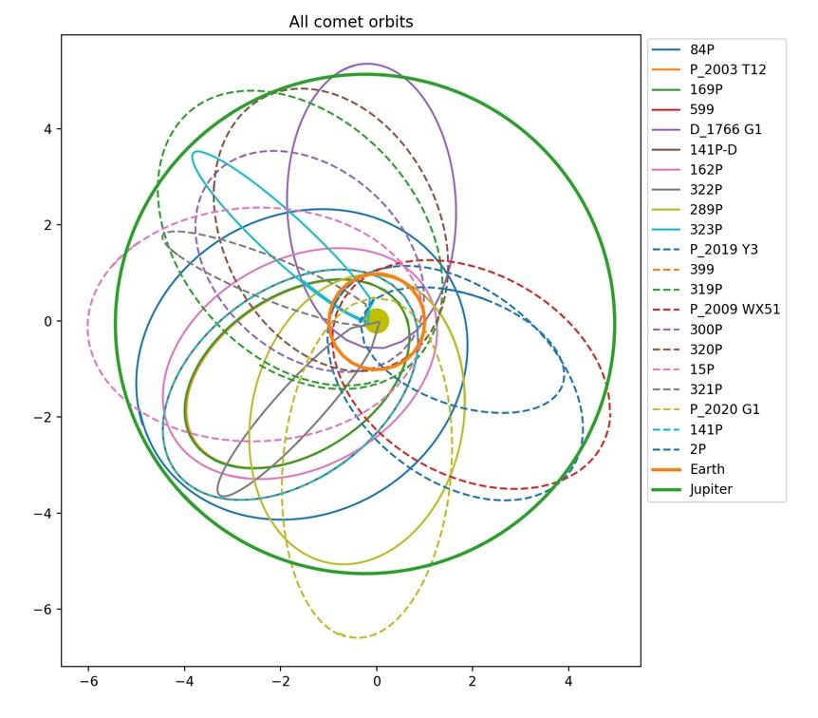
2D orbital plot

Slide 8
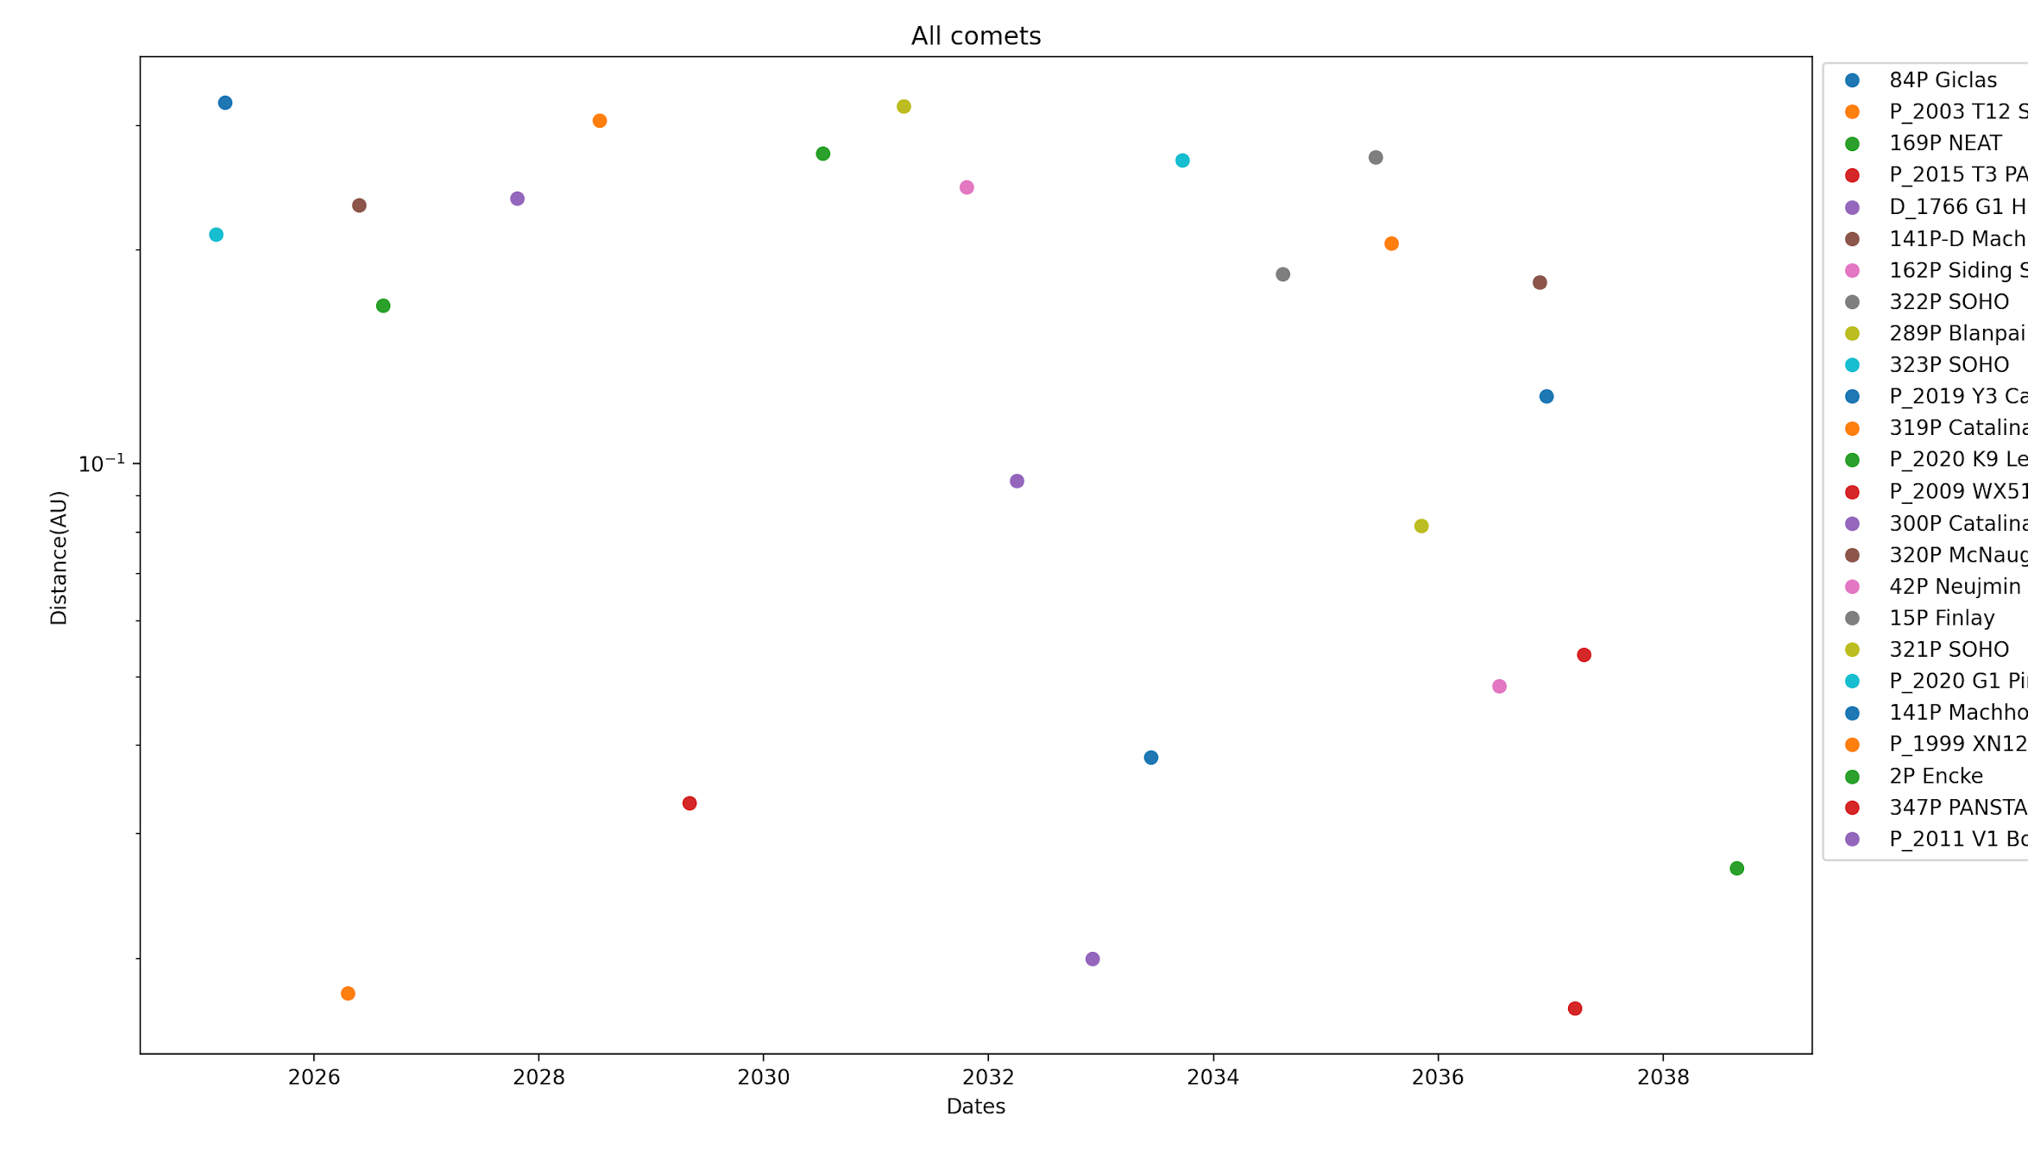
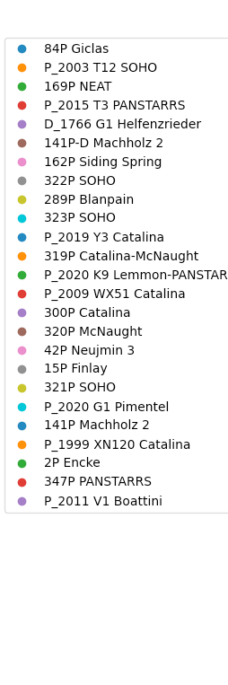
Closest approach distances

Slide 9
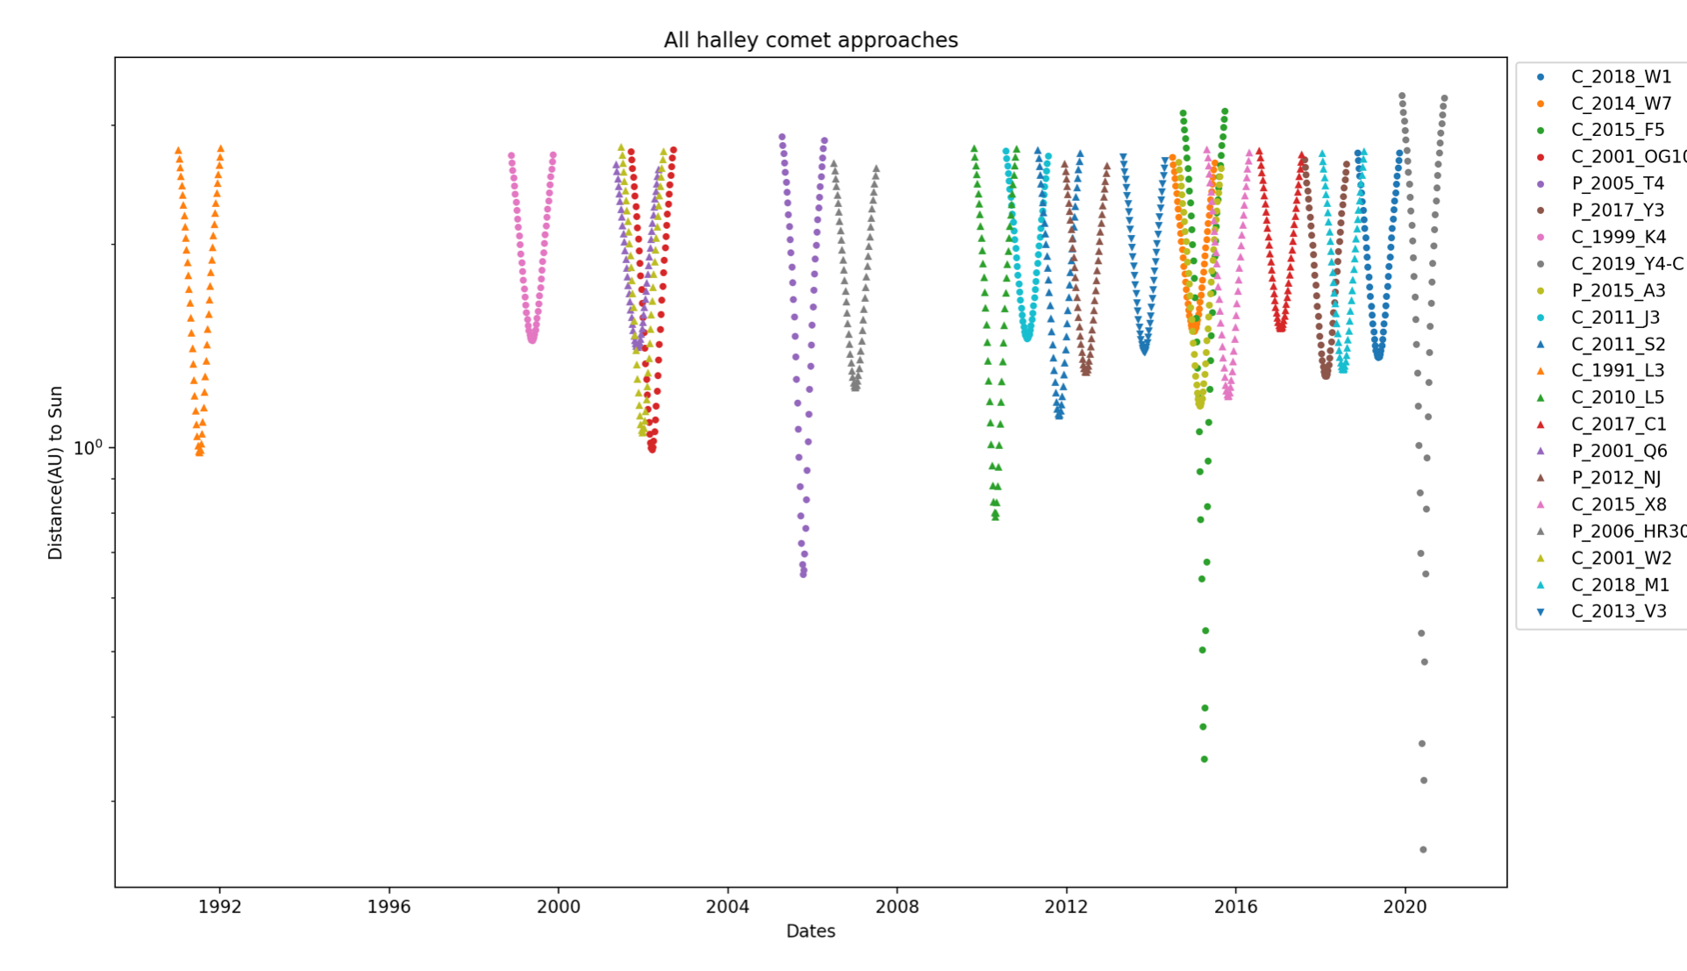
Distances and dates of comet close approaches

Slide 10
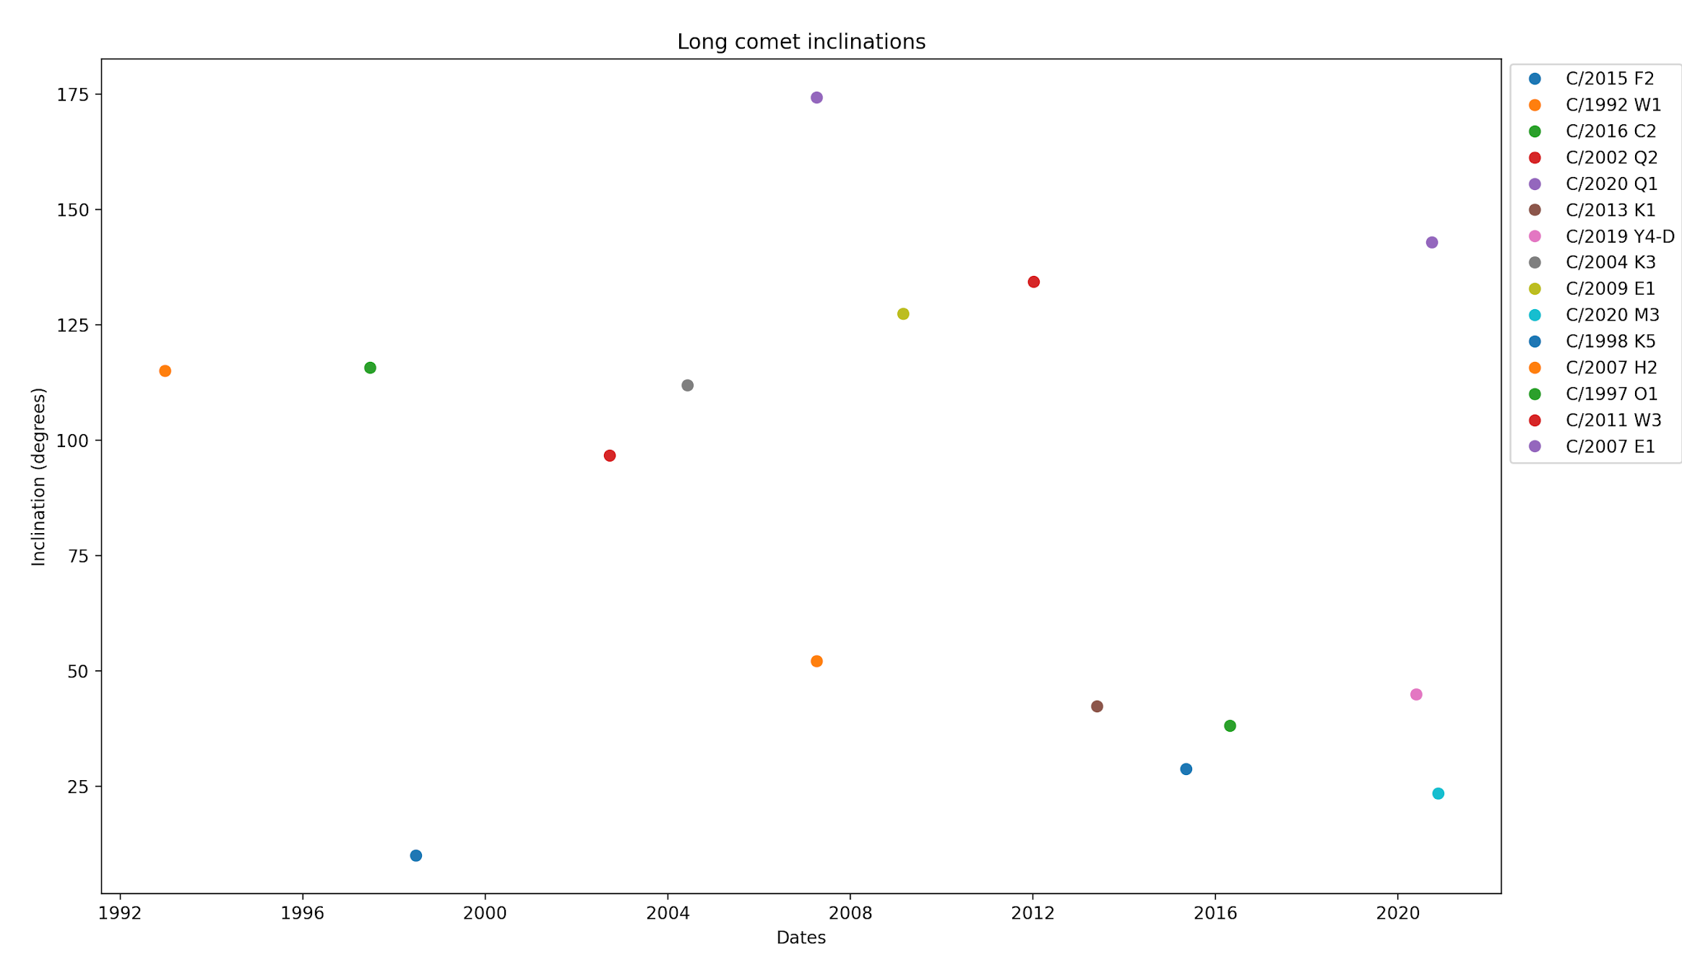
Inclination plot

Slide 11
Using Spherical Harmonics to Model H₂O and CO₂ Distribution on Coma of Comet 67P

Slide 12
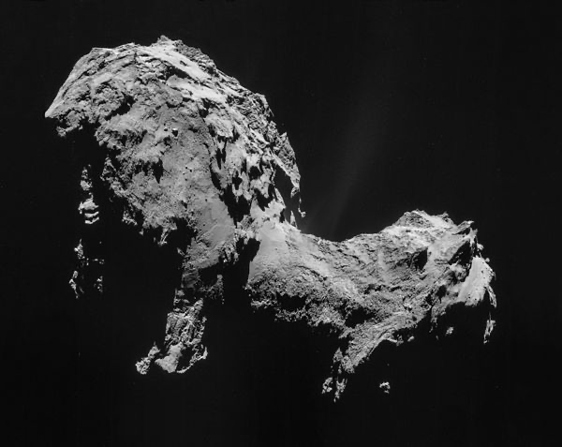
The Rosetta Mission
Rosetta spacecraft
Built by ESA
Reached comet in August 2014
67P/Churyumov–Gerasimenko
ROSINA (Rosetta Orbiter Spectrometer for Ion and Neutral Analysis) collected data on neutral molecules and ions

Slide 13
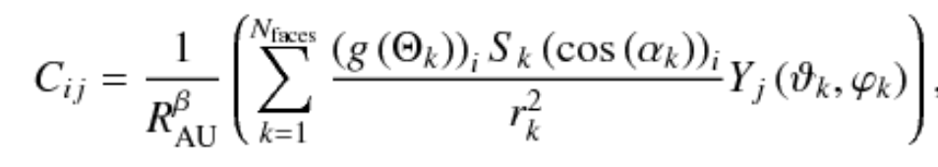

Potential activity formula
R_{AU} : distance from Sun to comet
N_{faces} : total number of triangles meshing the nucleus
S_{k} : surface area of kth triangle
Y_{j} : real spherical harmonics up to order 4
r_{k} : distance from spacecraft to triangle
a_{night} : 0.1, constant
Referenced paper by Fougere, 2016
Needed a simplified mesh model to do calculations
Solution: use jigsawpy conda environment

Slide 14
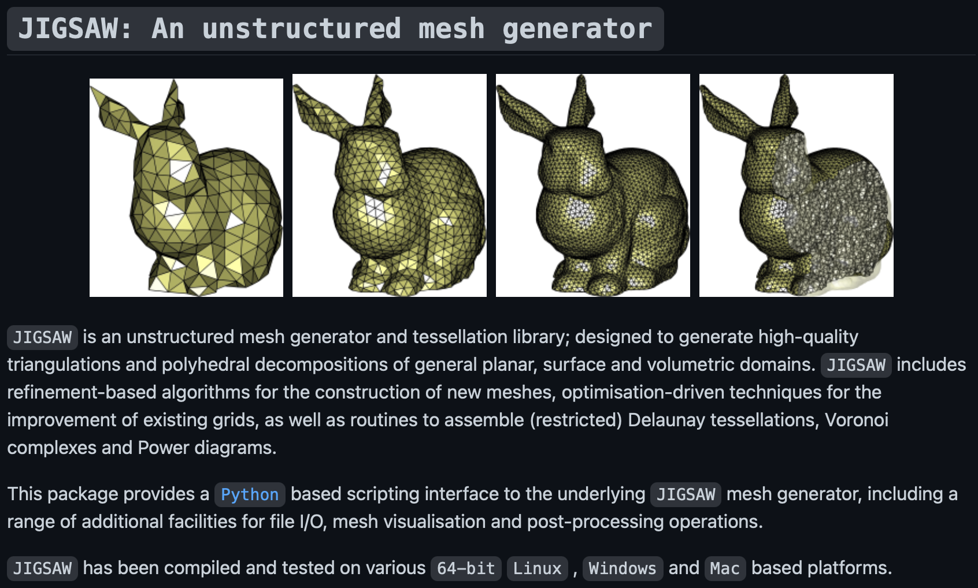
JIGSAW on Github: https://github.com/dengwirda/jigsaw-python

Slide 15
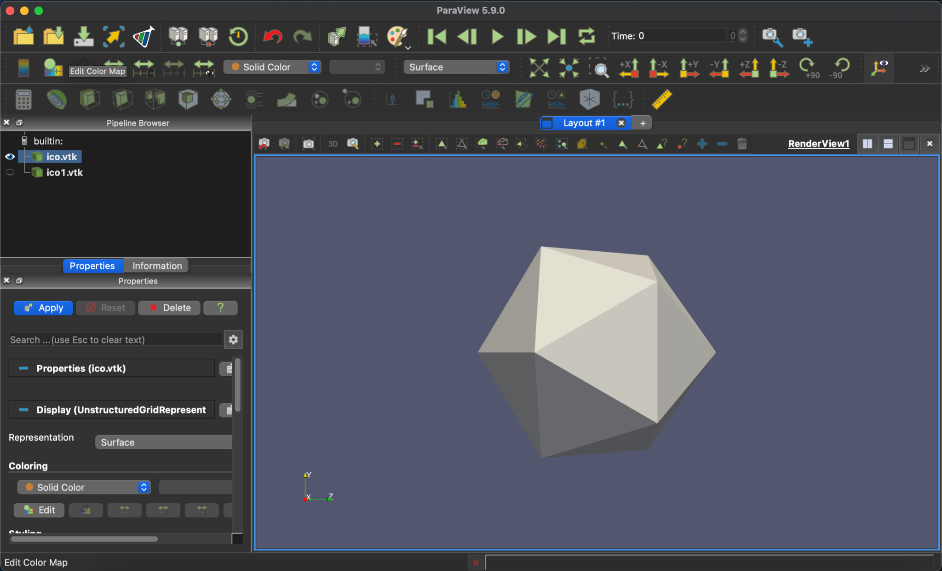
20-faced icosahedral mesh

Slide 16
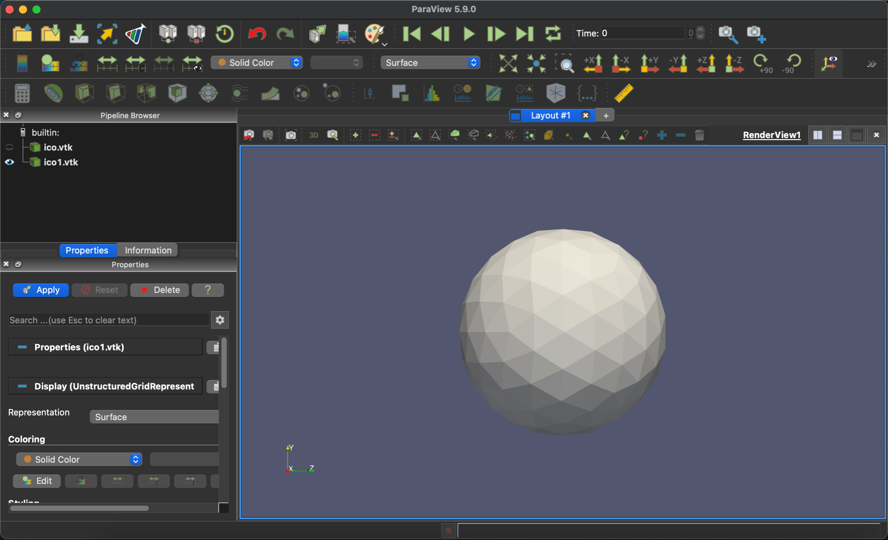
320-faced icosahedral mesh

Slide 17
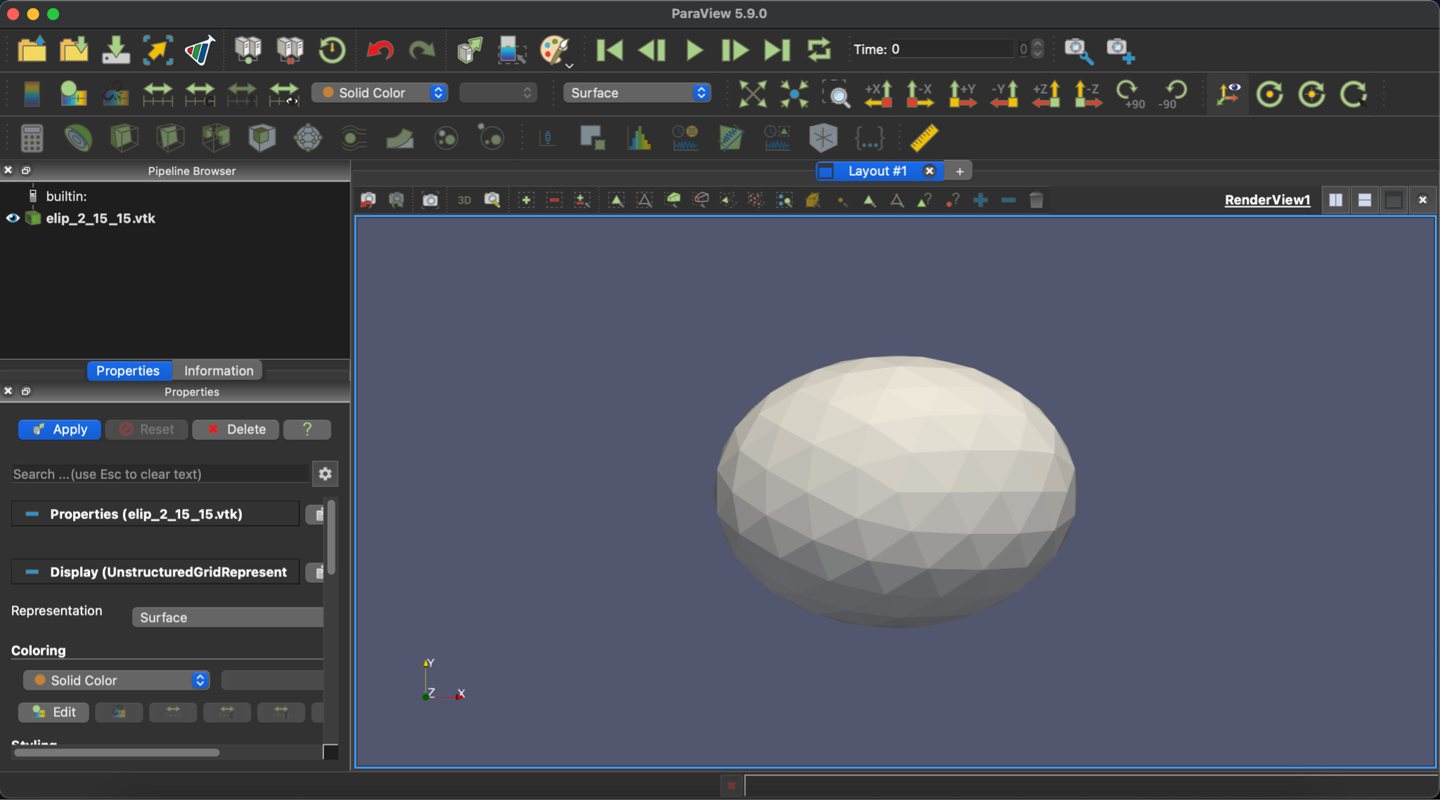
320-faced ellipsoid mesh (2, 1.5, 1.5)

Slide 18
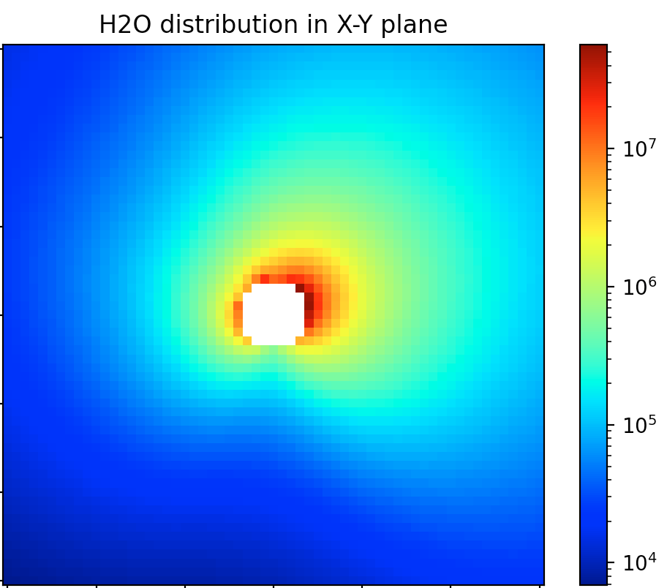
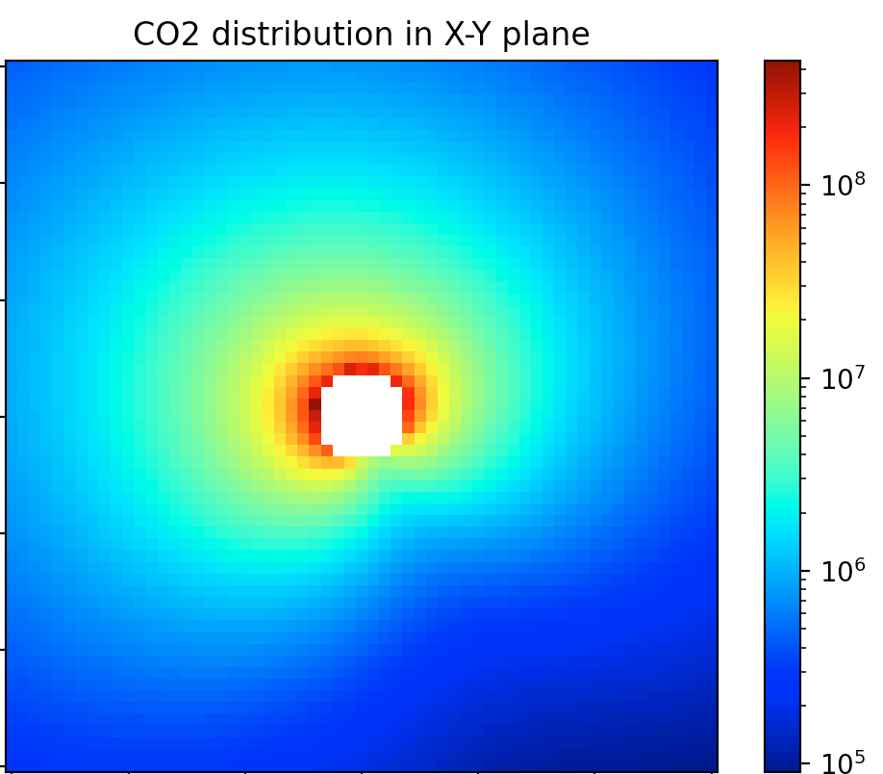
Potential activity map with icosahedral mesh
Sun at infinity on x axis
Map shows a 30 km x 30 km cross section

Slide 19


Potential activity map with icosahedral mesh
Sun at infinity on x axis
Map shows a 30 km x 30 km cross section

Slide 20
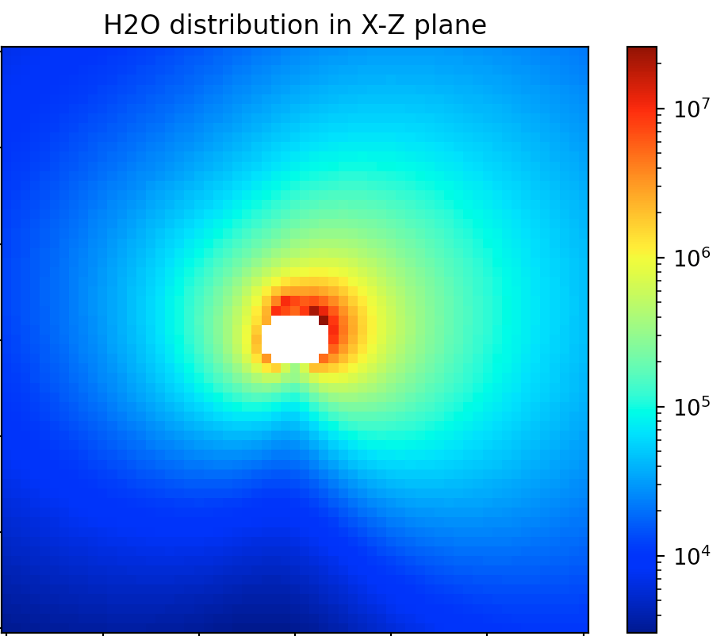
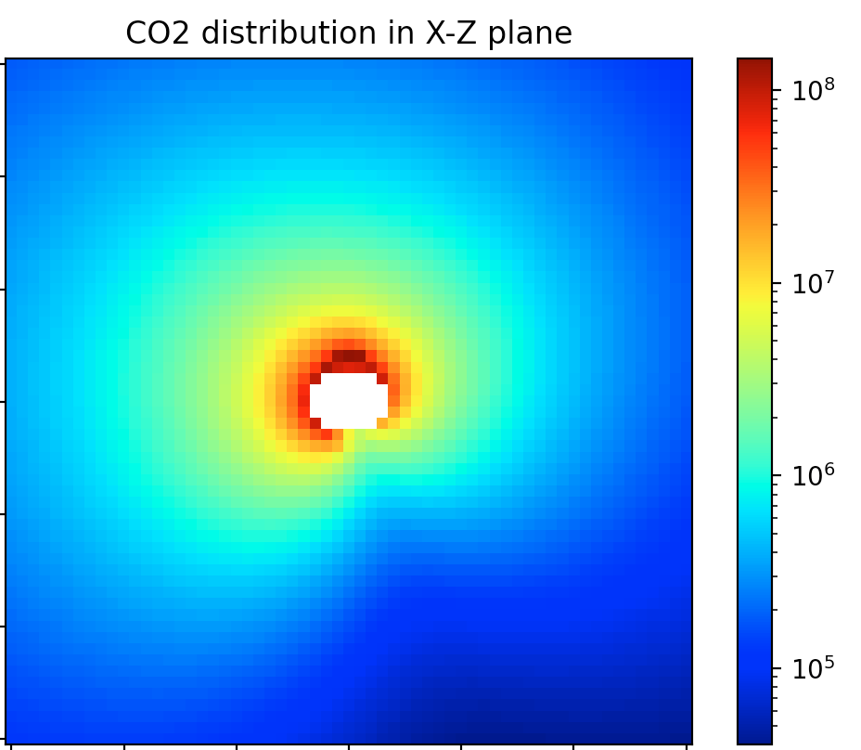
Potential activity map with ellipsoid mesh
Sun at infinity on x axis
Map shows a 30 km x 30 km cross section
Ellipsoid radii are (2, 1.5, 1.5)

Slide 21
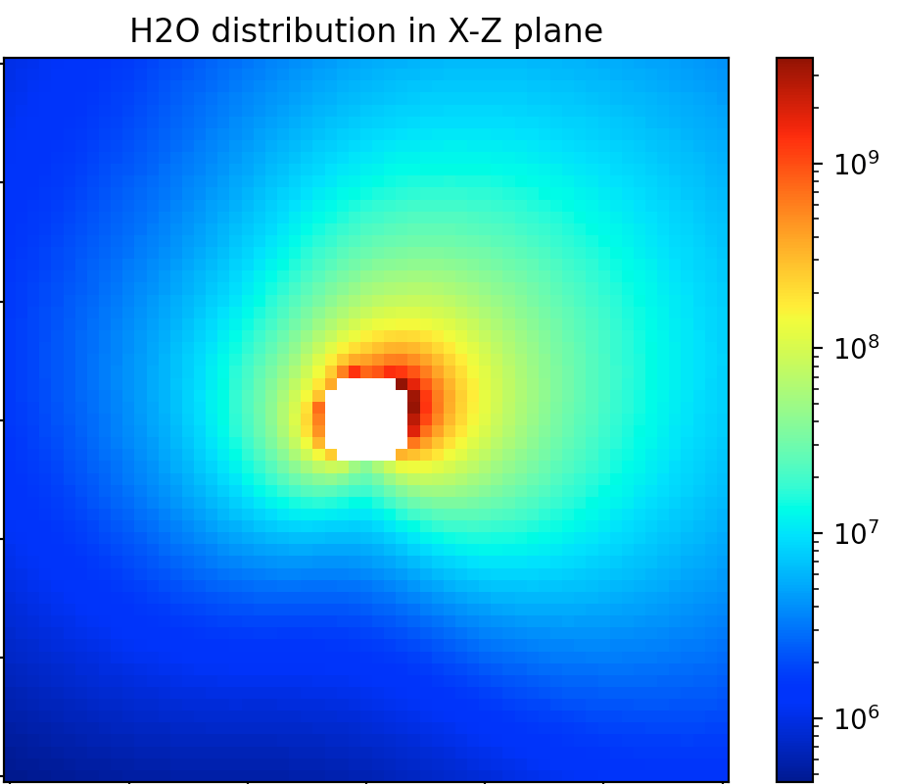
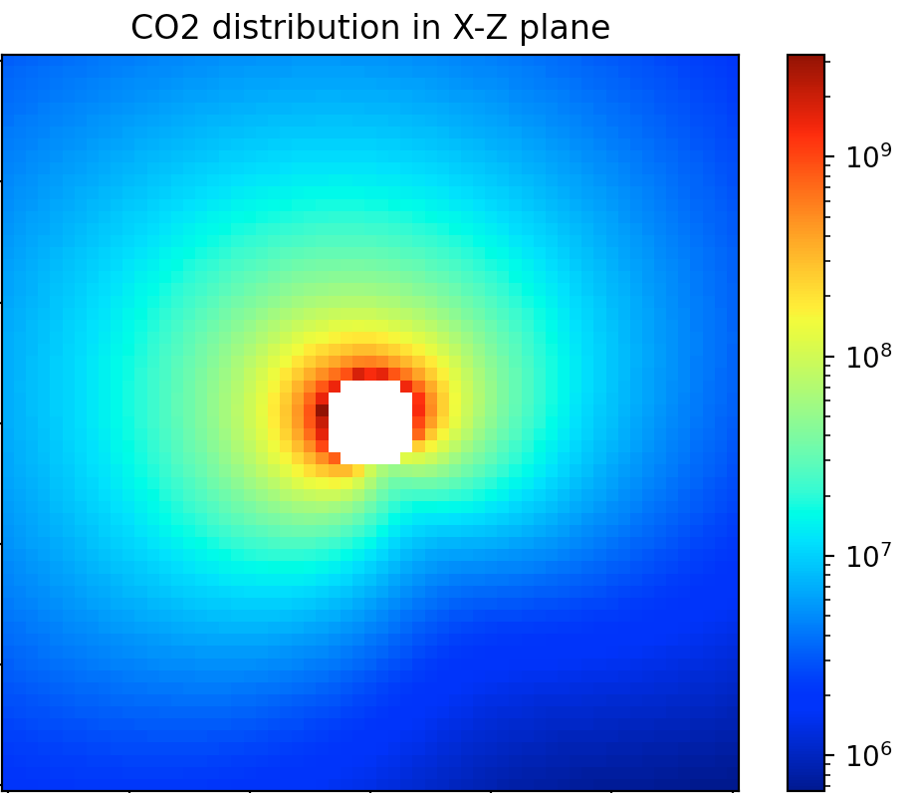
Potential activity map with alternative heliospheric distance
Sun’s rays from infinity on x axis
Map shows a 30 km x 30 km cross section
Ellipsoid radii are (2, 1.5, 1.5)

Slide 22
Future work
Apply three-dimensional direct simulation Monte-Carlo modeling on potential activity matrix to obtain density and particle speed data like the paper
Use more sophisticated mesh, closer to real nucleus geometry
Compare maps of sun from different angles
Use python script for sending automated emails
Apply to comet mission planning

Slide 23
Acknowledgements
Conor Nixon, mentor
Darren Engwirda, creator of JIGSAW mesh generator
Nicholas Fougere, first author of 67P modeling paper
Brittany Griffiths, project support specialist at code 693
Sarah Alspaw, intern coordinator

Slide 24

Questions?

