Slide 2
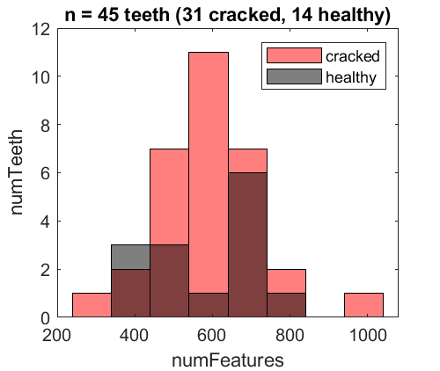
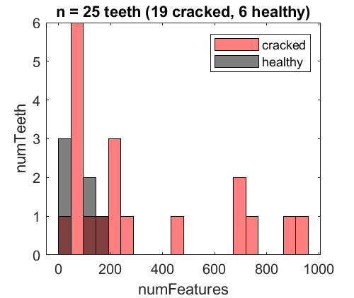
a
MicroCT
b
Hr-CBCT

Slide 3
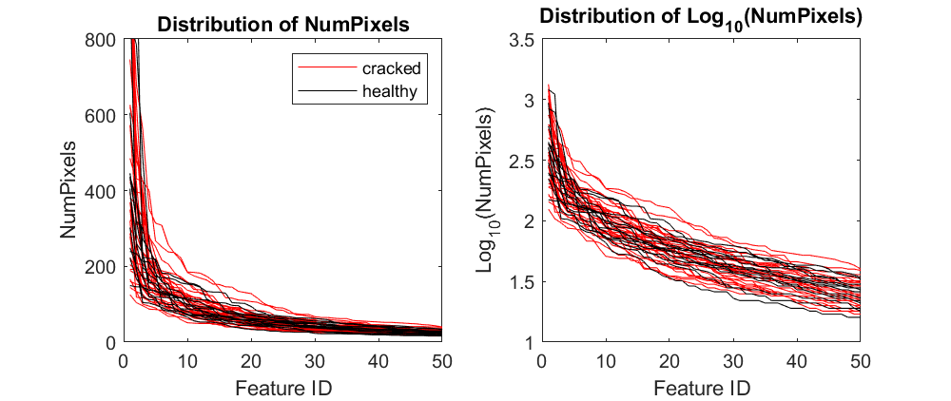
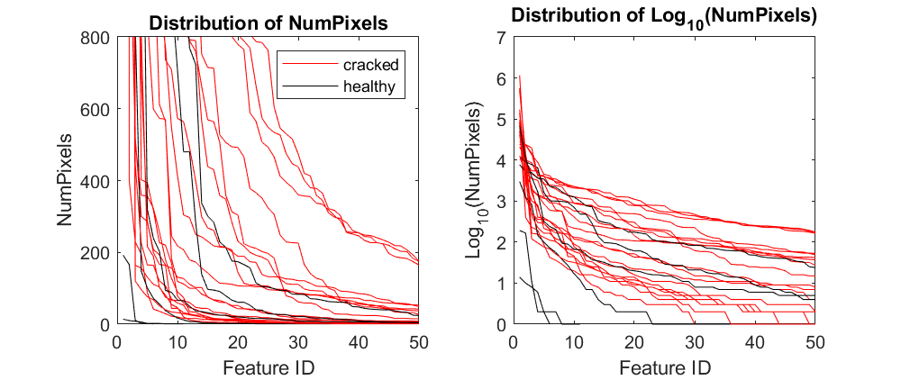
a
MicroCT
b
Hr-CBCT
Distribution of NumVoxels
Distribution of NumVoxels
NumVoxels
NumVoxels
Distribution of Log₁₀(NumVoxels)
Distribution of Log₁₀(NumVoxels)
Distribution of log10(NumVoxels)
Log₁₀(NumVoxels)
Log₁₀(NumVoxels)

Slide 4
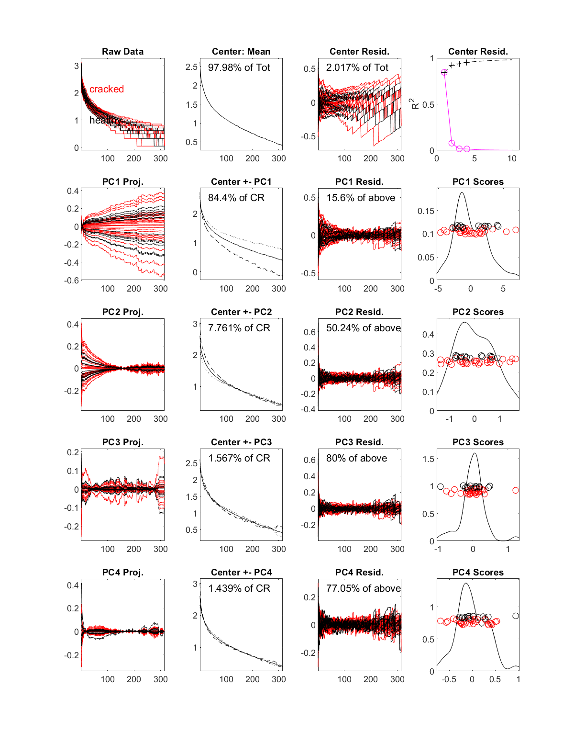
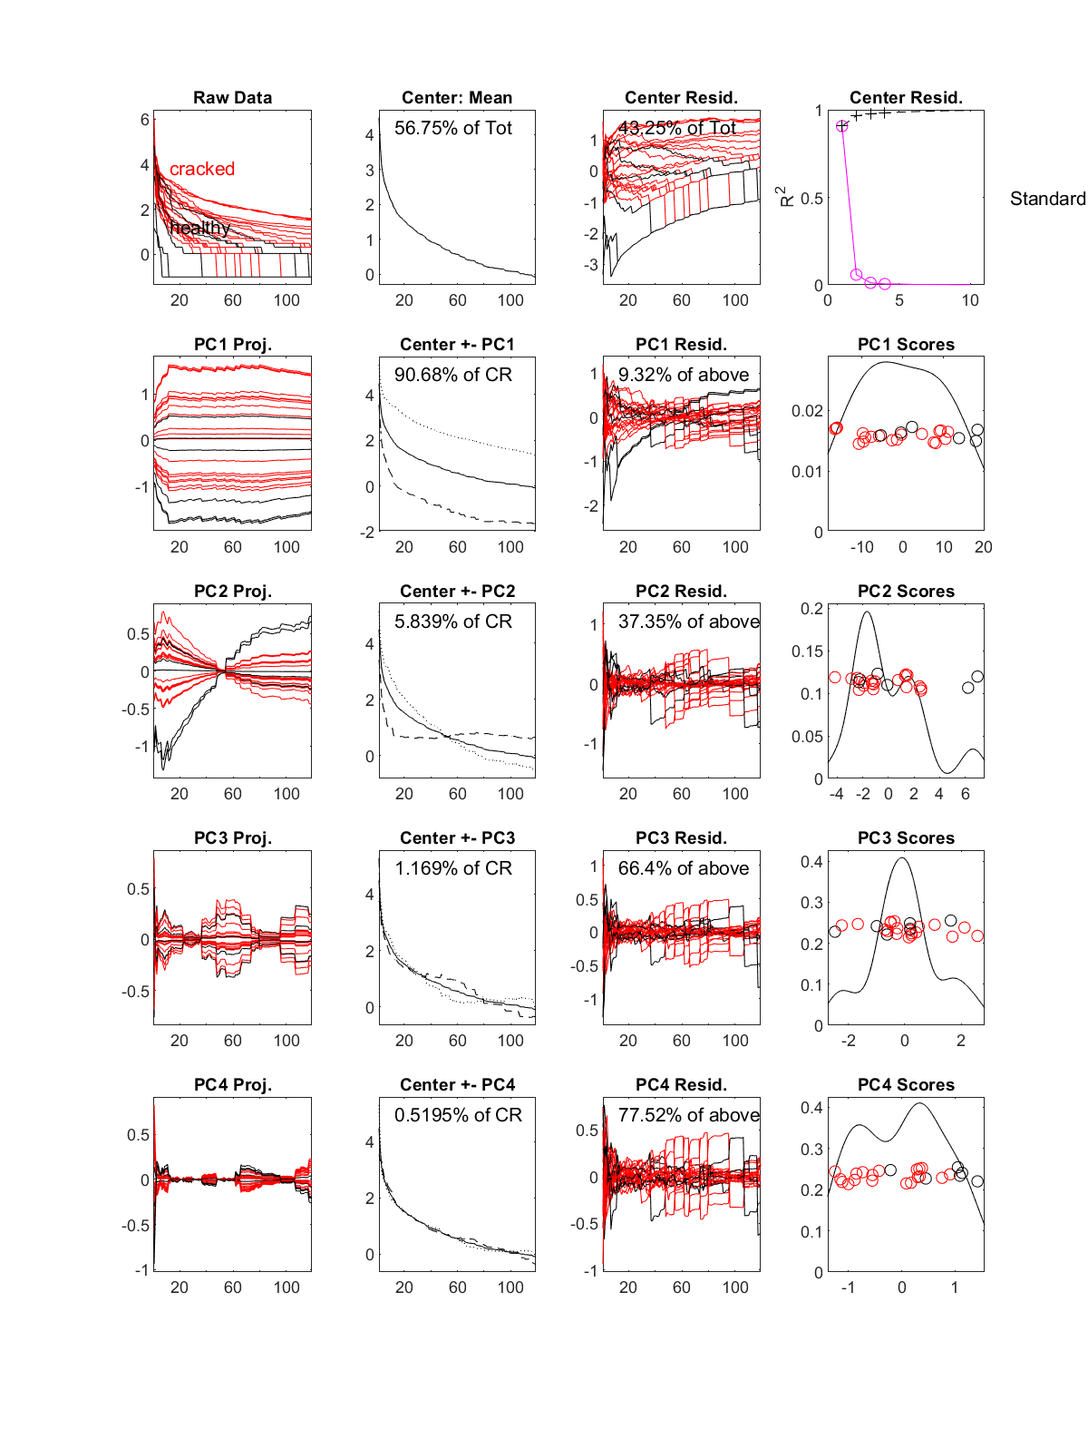
a
MicroCT
b
Hr-CBCT
Log₁₀(data)
Log₁₀(data)

Slide 5
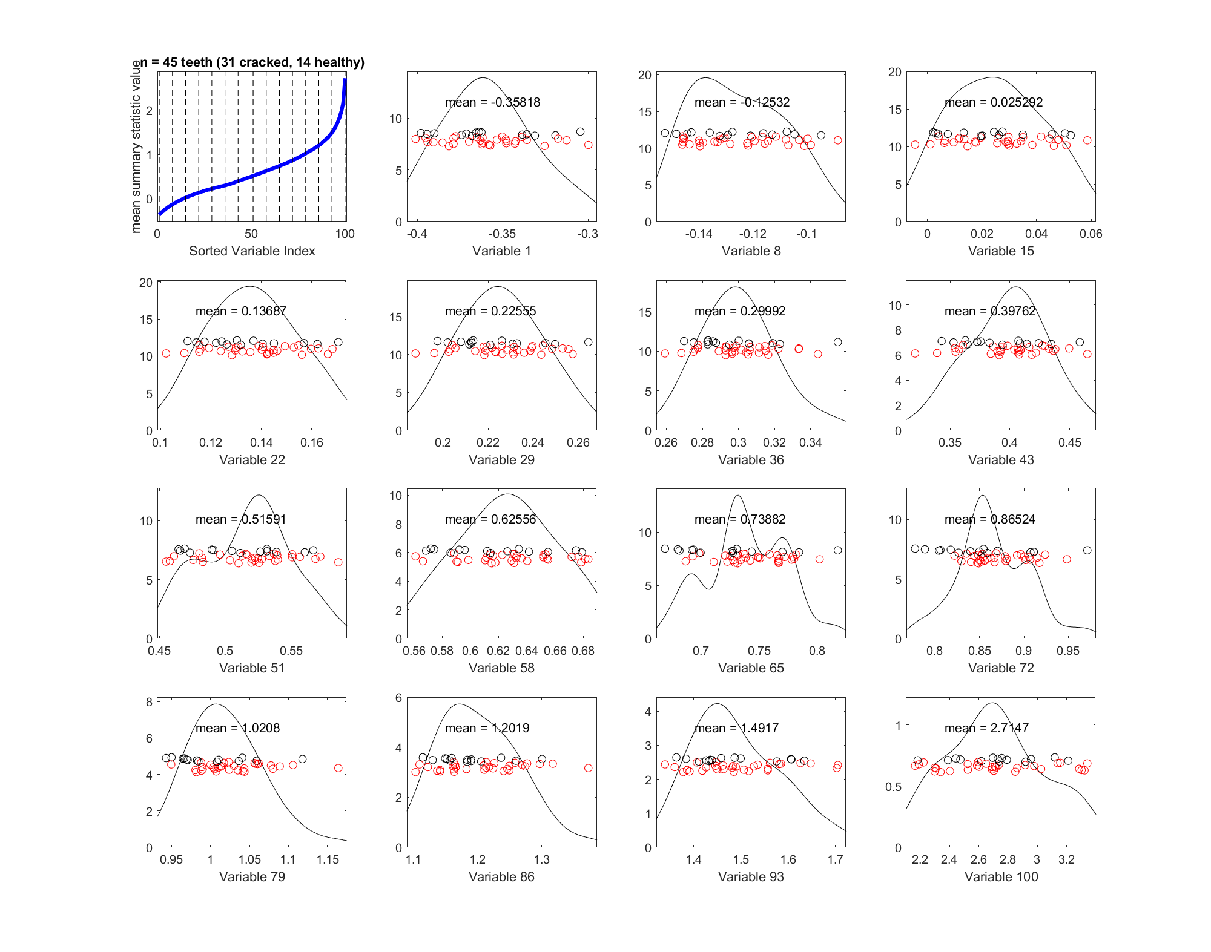
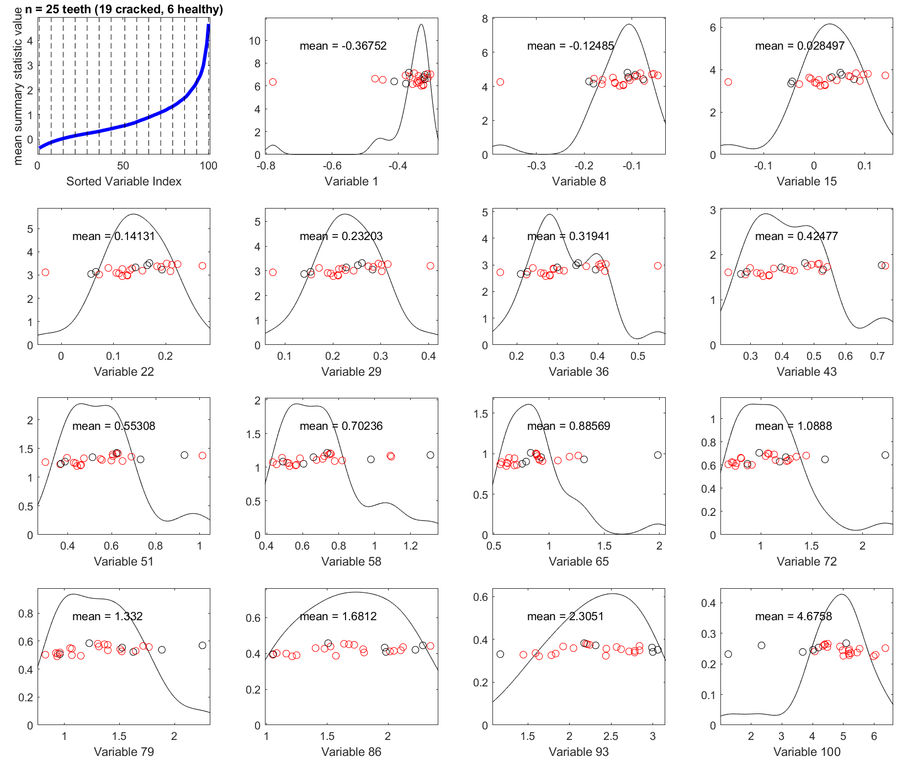
a
MicroCT
b
Hr-CBCT

