Slide 1
Cracked vs. healthy teeth classification via functional data analysis
Client: Beatriz Paniagua, Jared Vicory
Consultant: Angel Huang
Professor: Dr. Steve Marron
2020/12/11

Slide 2
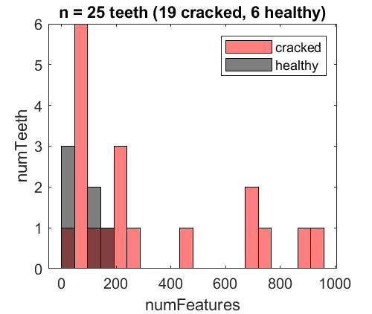
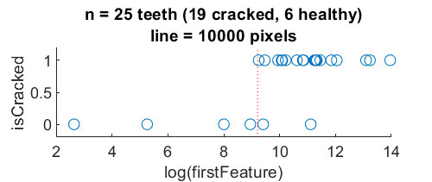


Dataset
N = 25 teeth (19 cracked + 6 healthy)
Each tooth has different number of features (i.e. pixel clusters)
Min number of features is 6, max is 948, median is 119.
Left: Cracked teeth have broader spread of (and overlapping) number of features than healthy teeth
Right: The value of the first feature (#pixel in the biggest cluster) can separate the two classes reasonably well by drawing a line at 10000 pixel. All cracked teeth have their first feature greater than 10000, whereas only 2/6 healthy teeth have their first feature greater than 10000.
Next, I will look into if any distribution features can separate out the two classes better.

Slide 3
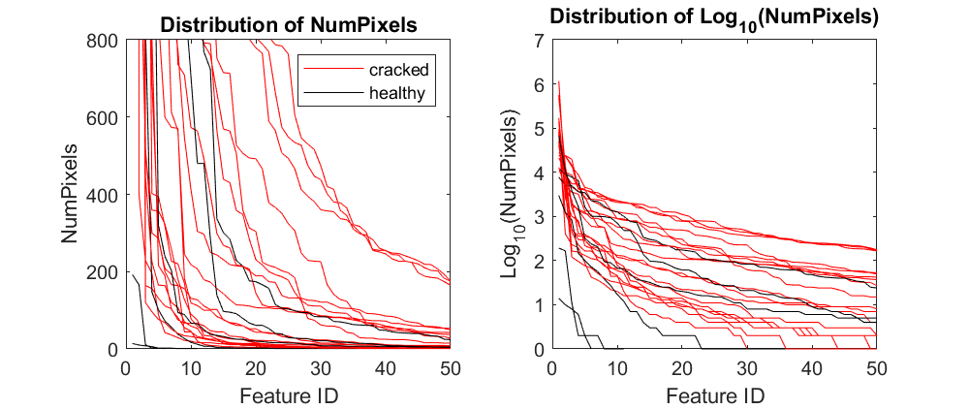
1_rawTrace
Still, the top 3 healthy teeth with high pixel count overlap with the distribution of cracked teeth
Log scale seems more sensible, but doesn’t differentiate the two teeth types perfectly either

Slide 4
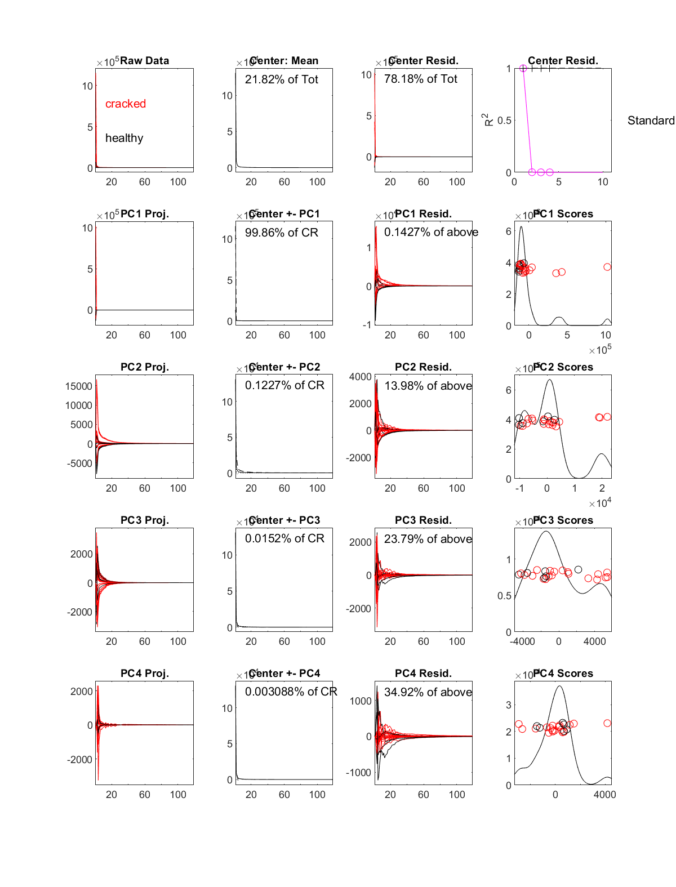
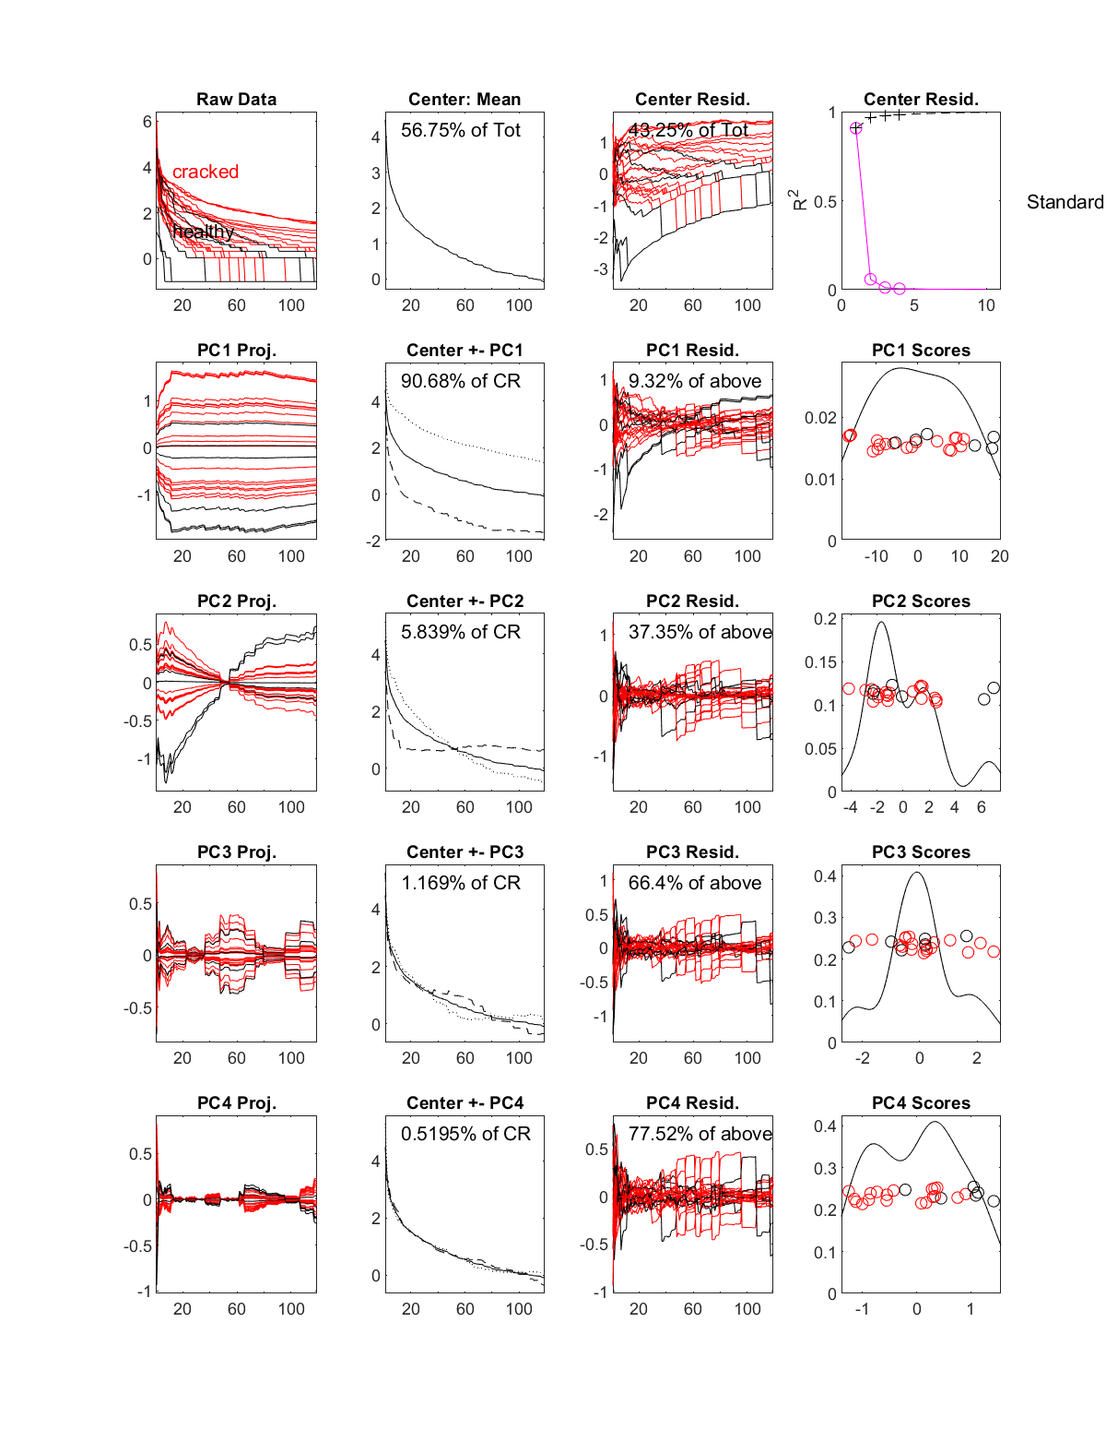
Original data
Log10(data)
2_curvdatPlot
-- pick median number of features =119 (add zeros for samples with fewer features)
-- log scale seems more informative
-- PC1, PC4 for log(data) seems to separate out some of the healthy teeth, but not perfect, especially given the small sample size.
-- also tried minFeature and maxFeature, not as good

Slide 5
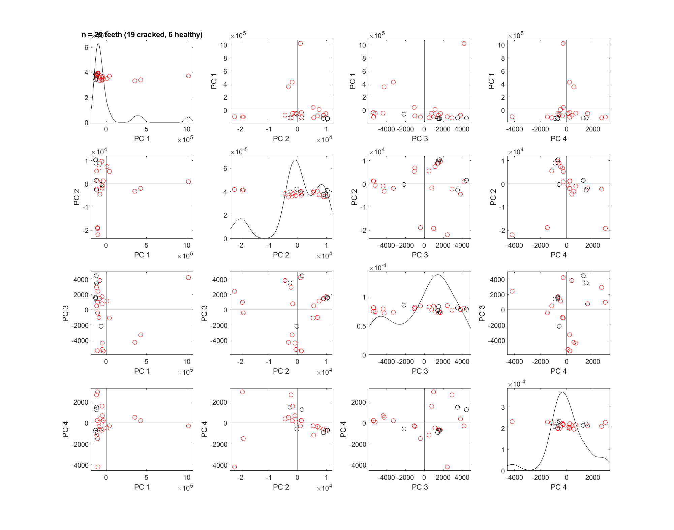
4_PCAScatPlot
rawData
Truncated each sample to the minimum number of features = 119
-- 4 PCs don’t seem to separate the 2 classes

Slide 6
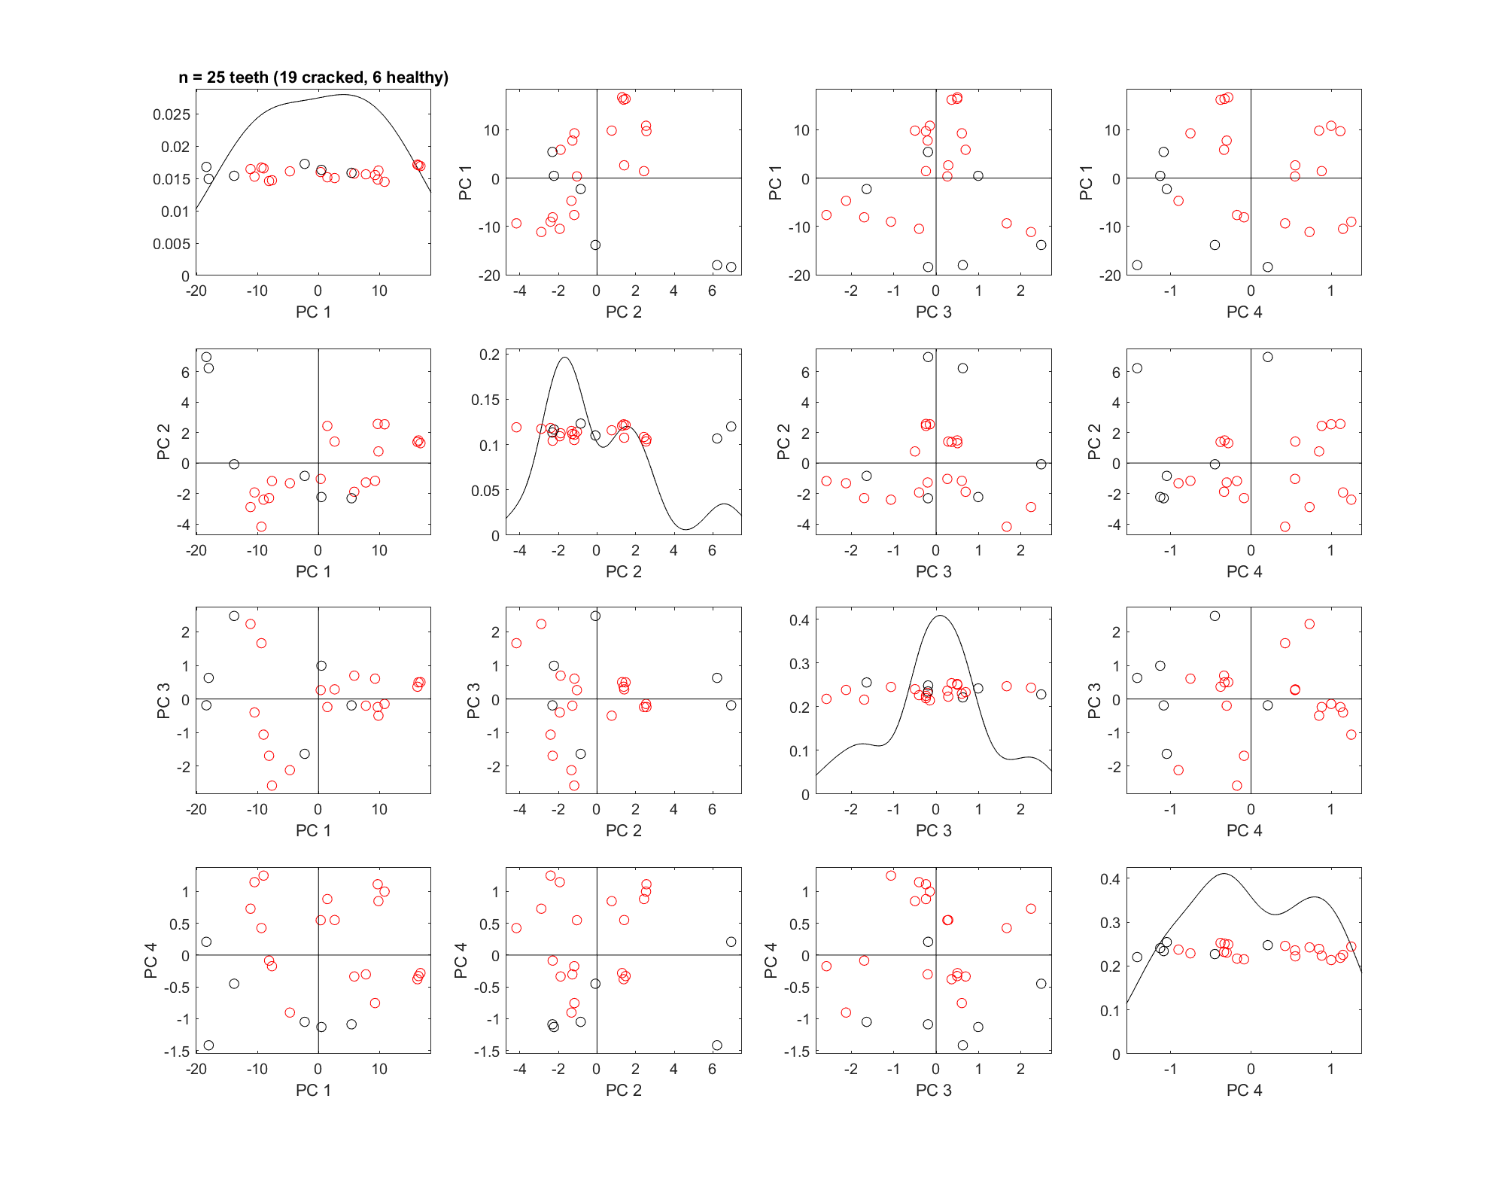
4_PCAScatPlot
log10(numPixel)
number of features = 119
-- PC4 interacting with other PCs seem to separate healthy teeth reasonably well

Slide 7
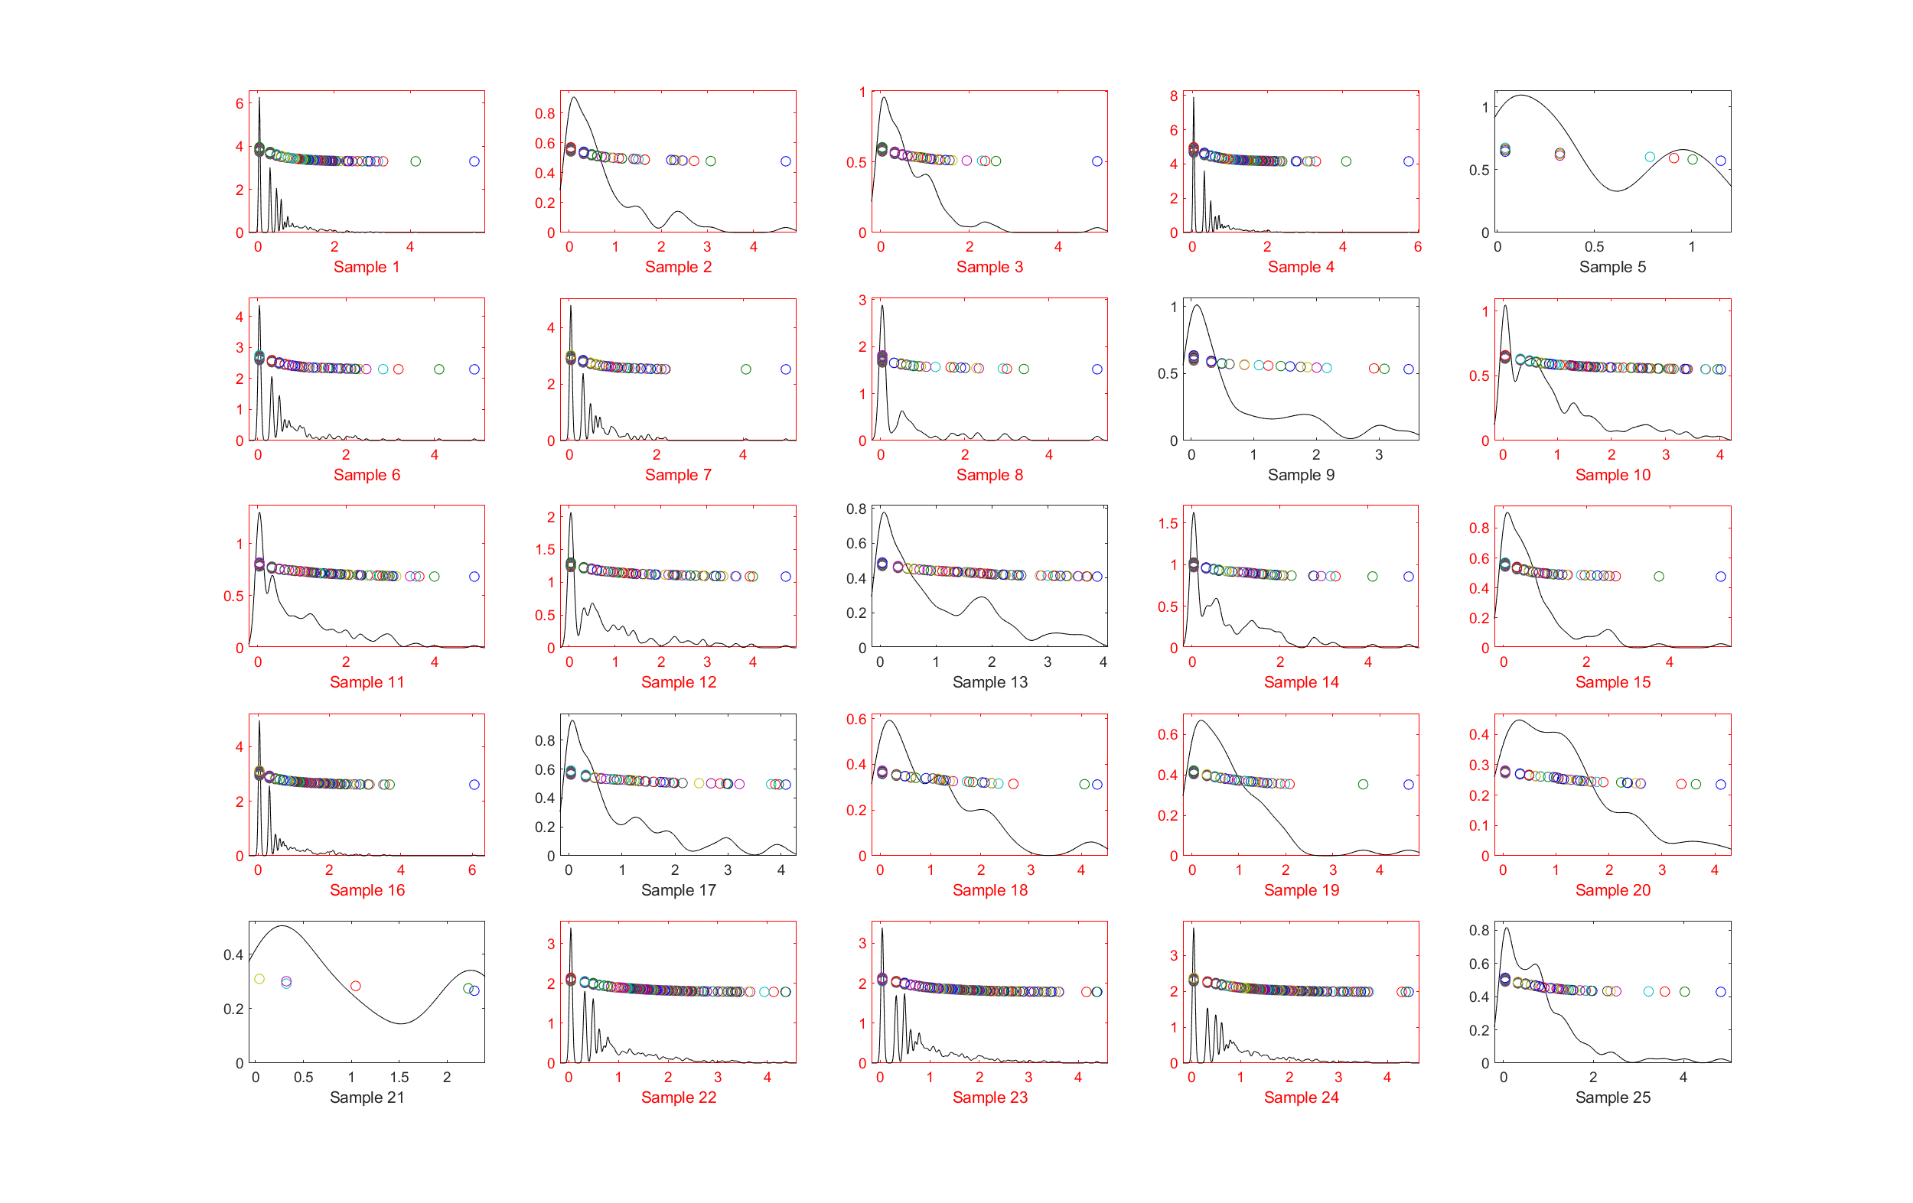
5_projPlot
log10(numPixel) projection (distribution) plot
-- go to next slide to zoom in
Red: cracked
Black: healthy

Slide 8
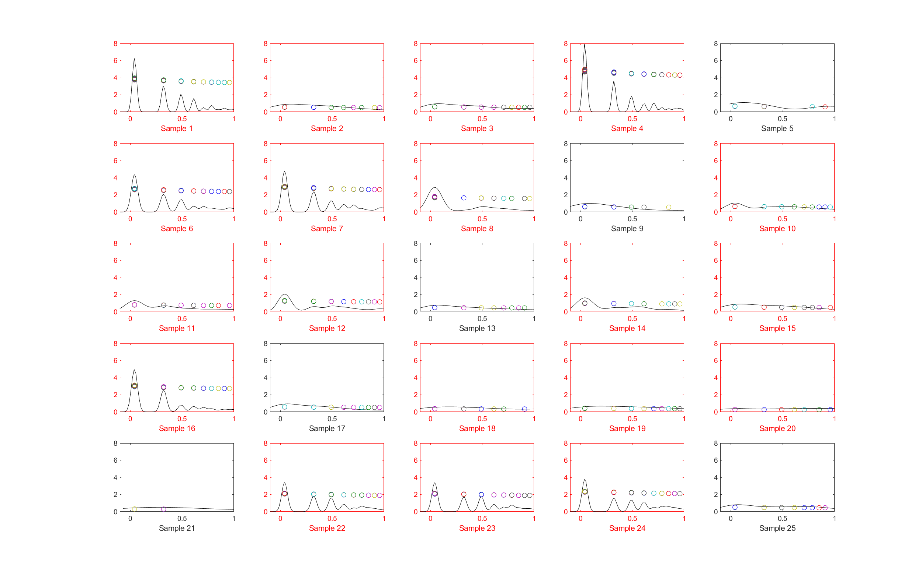
5_projPlot
log10(numPixel) projection (distribution) plot
Zoom in x to [0,1], clamp y to [0,8] to see pattern of larger pixel clusters
Red: cracked
Black: healthy
-- all of the healthy teeth have low peak amplitudes, but some of the crack teeth also have low peak amplitudes

Slide 9
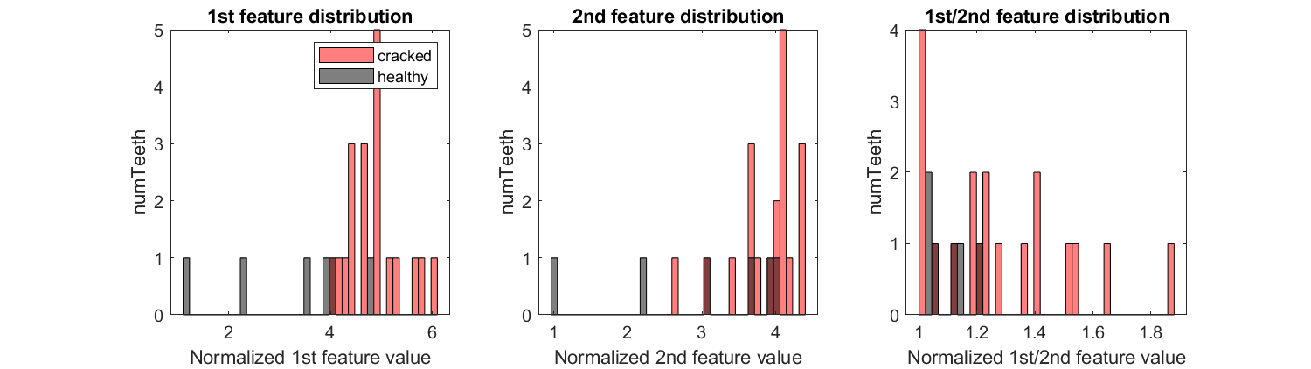
Exploratory plot:
Normalized by number of features in each sample
1st feature distribution (2 samples overlaps) – similar message as slide 2 right plot
2nd feature distribution (more overlapping)
ratio of 1st /2nd peak distribution (worse)

Slide 10
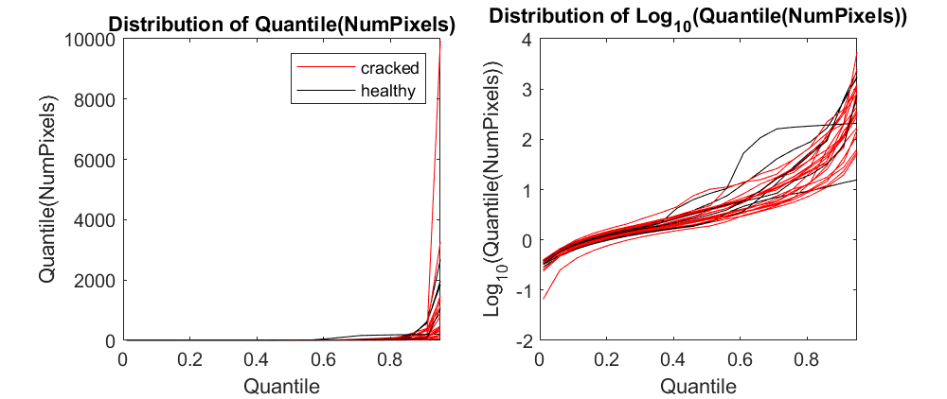
From now on, use quantile to represent each curve
21_rawTrace
Still overlapping distributions
numQuantiles=100

Slide 11
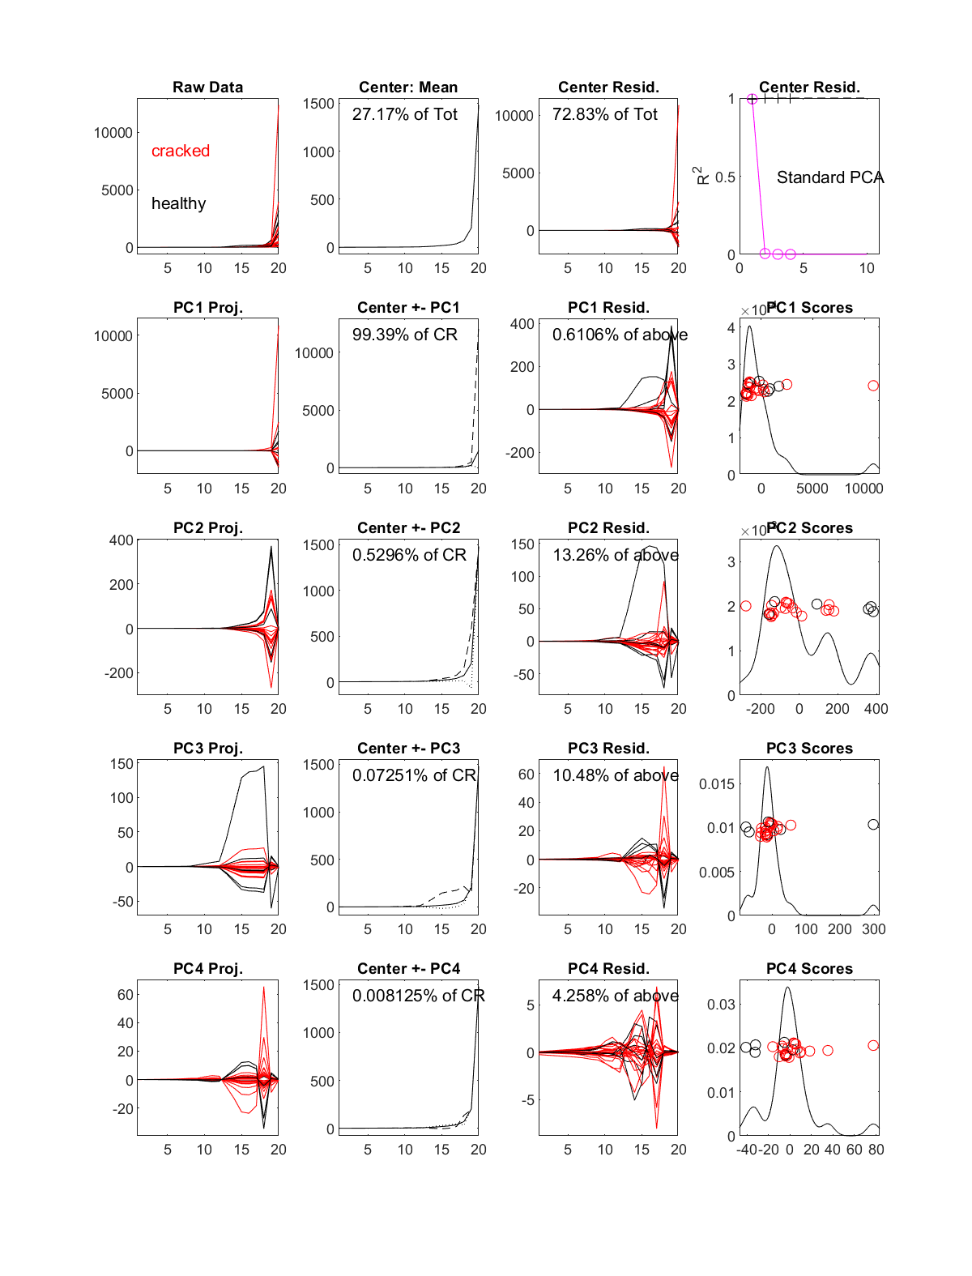
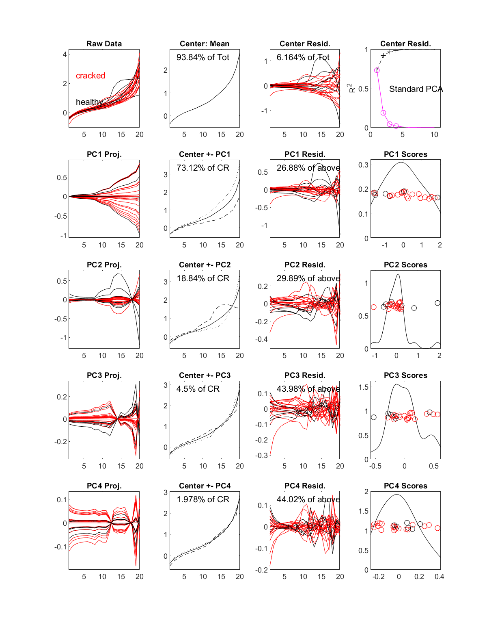
Original quantile
Log10(quantile)
22_curvdatPlot
Use quantiles as features,
number of features = 100
4PC dimentions
-- hard to distinguish two classes

Slide 12
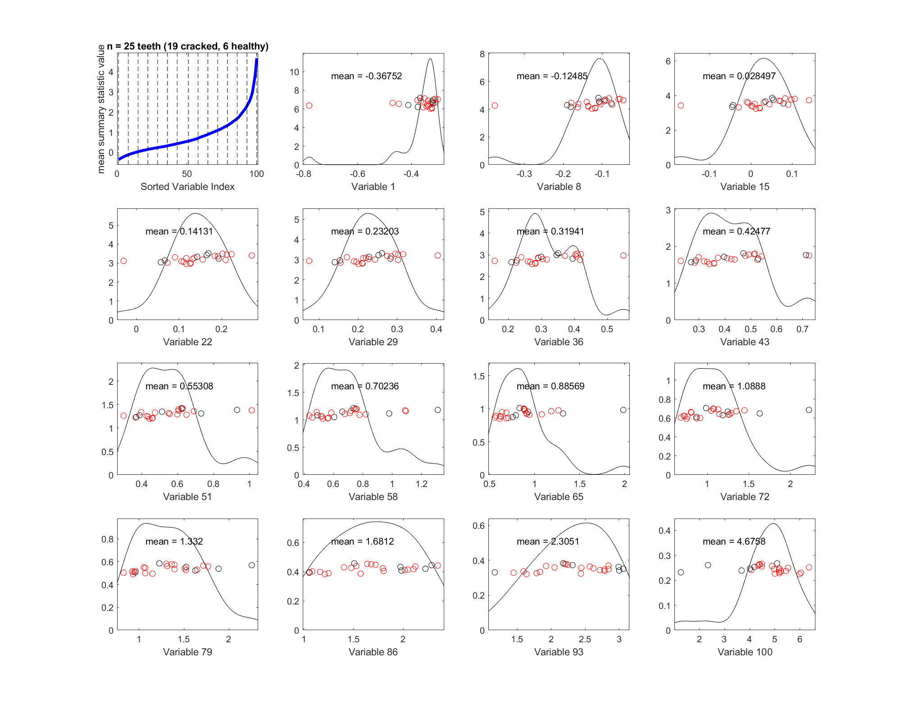
23_margDistPlot
Marginal distribution plot on log10(quantile)
Use quantiles as features,
number of features = 100
Summary statistics of mean
-- variable 100 seems to separate out most of the healthy samples
Max, std, min all look similar to this plot

Slide 13
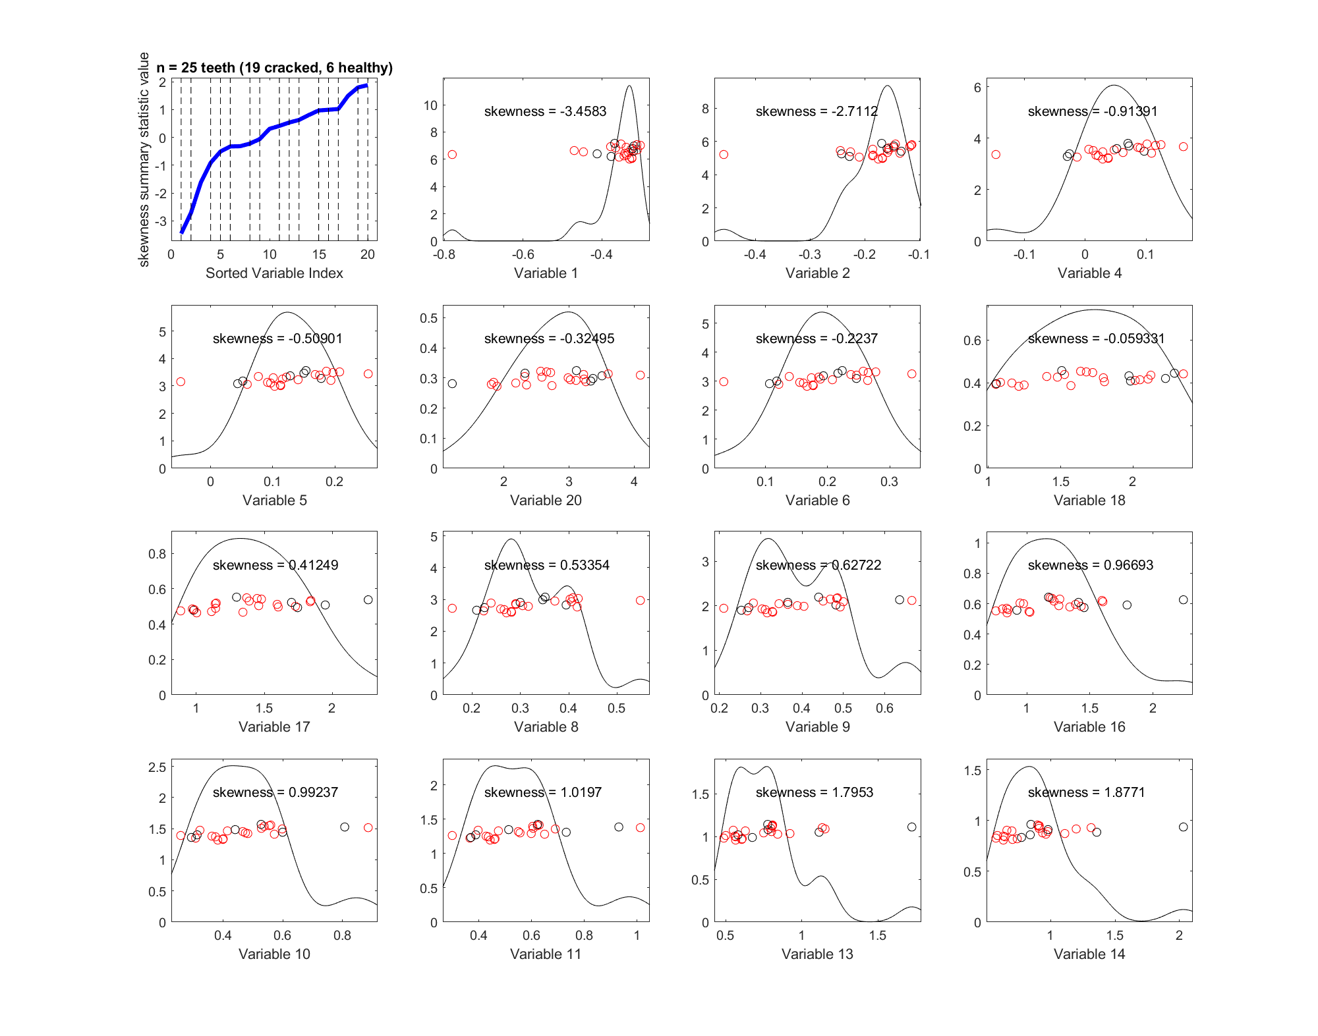
23_margDistPlot
Marginal distribution plot on log10(quantile)
Use quantiles as features,
number of features = 100
Summary statistics of skewness
-- hard to separate 2 classes

Slide 14
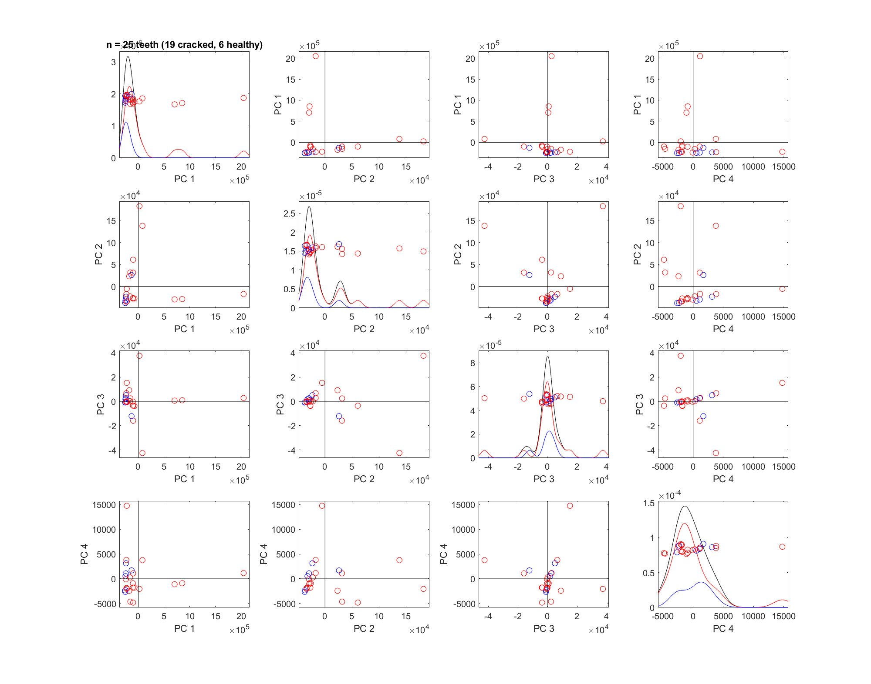
24_PCAScatPlot
quantile
Use quantiles as features,
number of features = 100
-- use isubpopkde=1 to show curve for each class
-- red (cracked) and blue (healthy) distribution peak overlap

Slide 15
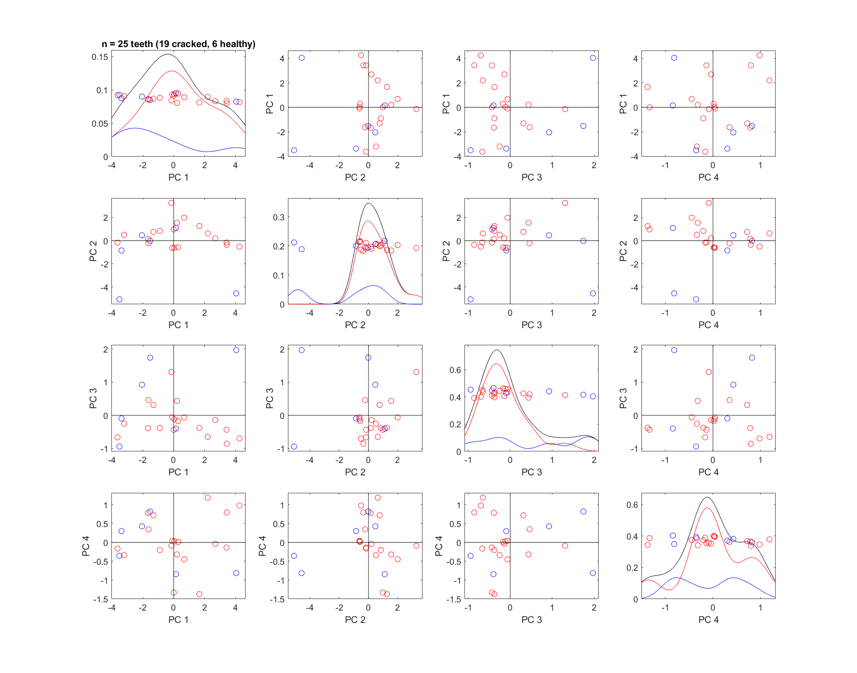
24_PCAScatPlot
log10(quantile)
Use quantiles as features,
number of features = 100
-- use isubpopkde=1 to show curve for each class
-- red (cracked) and blue (healthy) distributions still have some overlapping

Slide 16
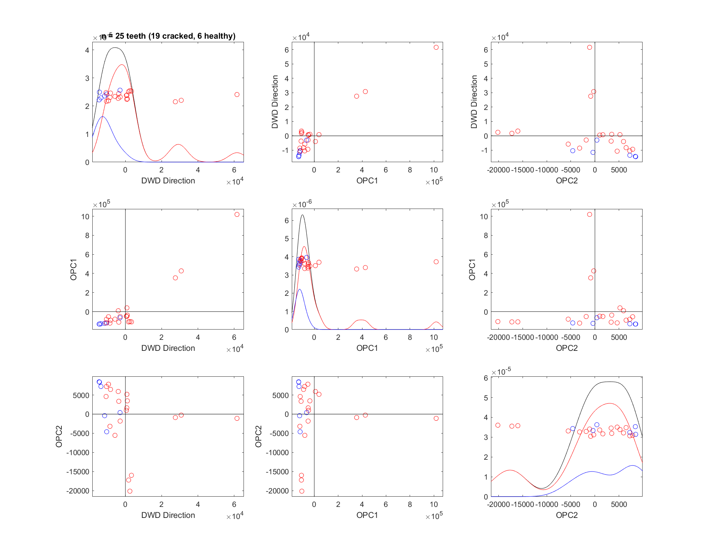
31_DWD_PCAScatPlot
number of features = 119
PCA plot with DWD direction
Some combinations (DWD-PC1 ~ DWD-PC2/3/4) seem to separate the classes a little?

Slide 17
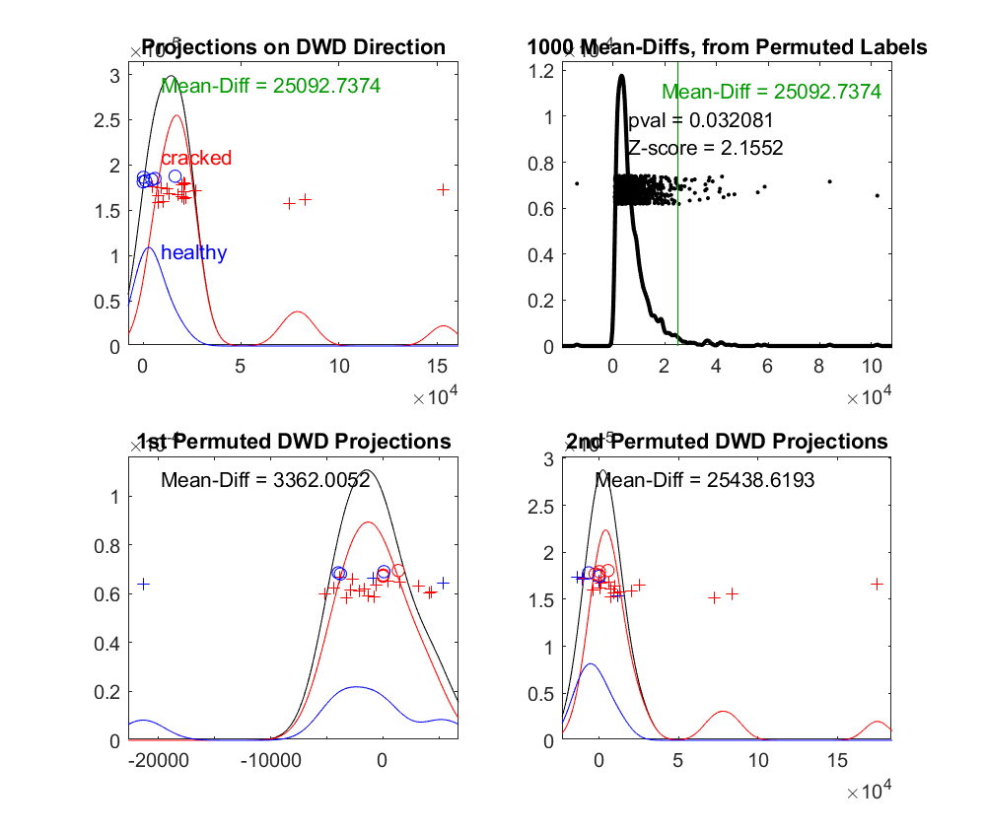
32_DiProPerm
number of features = 119
DiProPerm test show significant difference (p=0.0267) between 2 classes! Yay!
(run again p value will change but still <0.05)

Slide 18
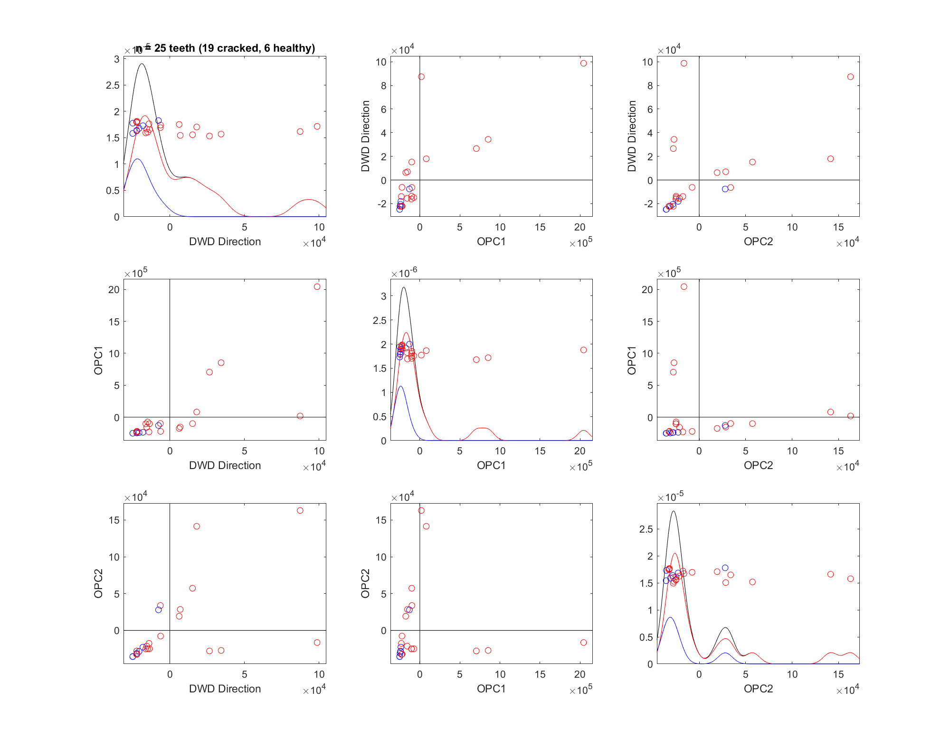
33_DWD_PCAScatPlot
number of features = 100 quantiles
PCA plot with DWD direction
Some combinations (DWD-PC1 ~ DWD-PC2) seem to separate the classes a little?

Slide 19
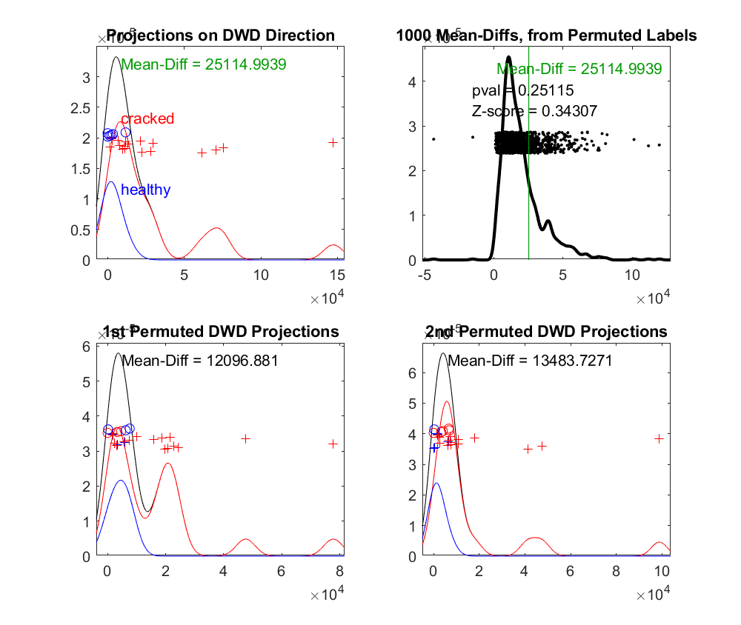
34_DiProPerm
number of features = 100 quantiles
DiProPerm test doesn’t show significant difference (p=0.25) between 2 classes using quantile.

